Slide 1



Adventure Awaits :
“A Voyage Through Cultures”

Slide 2
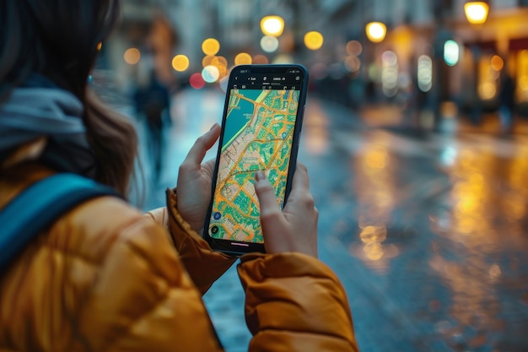

The Problem
Tourists often face several problems while planning a trip.
‣ Firstly, budgeting and cost management can be difficult as travel prices, accommodation, and food expenses may vary greatly.
‣ Secondly, lack of proper information about destinations, transport routes, or safety measures can create confusion.
‣ Thirdly, difficulty in getting travel documents such as visas or permits often delays plans.
‣ Fourthly, unreliable online bookings or fraudulent websites may lead to financial loss.
‣ Fifthly, health and safety concerns such as vaccination requirements or political instability can affect travel decisions.
‣ Lastly, time management and itinerary planning become challenging when trying to balance sightseeing, relaxation, and travel schedules effectively.

Slide 3

THE SOLUTION
Vigilant Voyager
The process begins when a traveler feels confused about planning their trip. To solve this, the system or tool starts by taking the traveler’s preferences, such as the type of travel experience they want. These preferences may include travel companions, distance range, budget, time, and interests

Slide 4

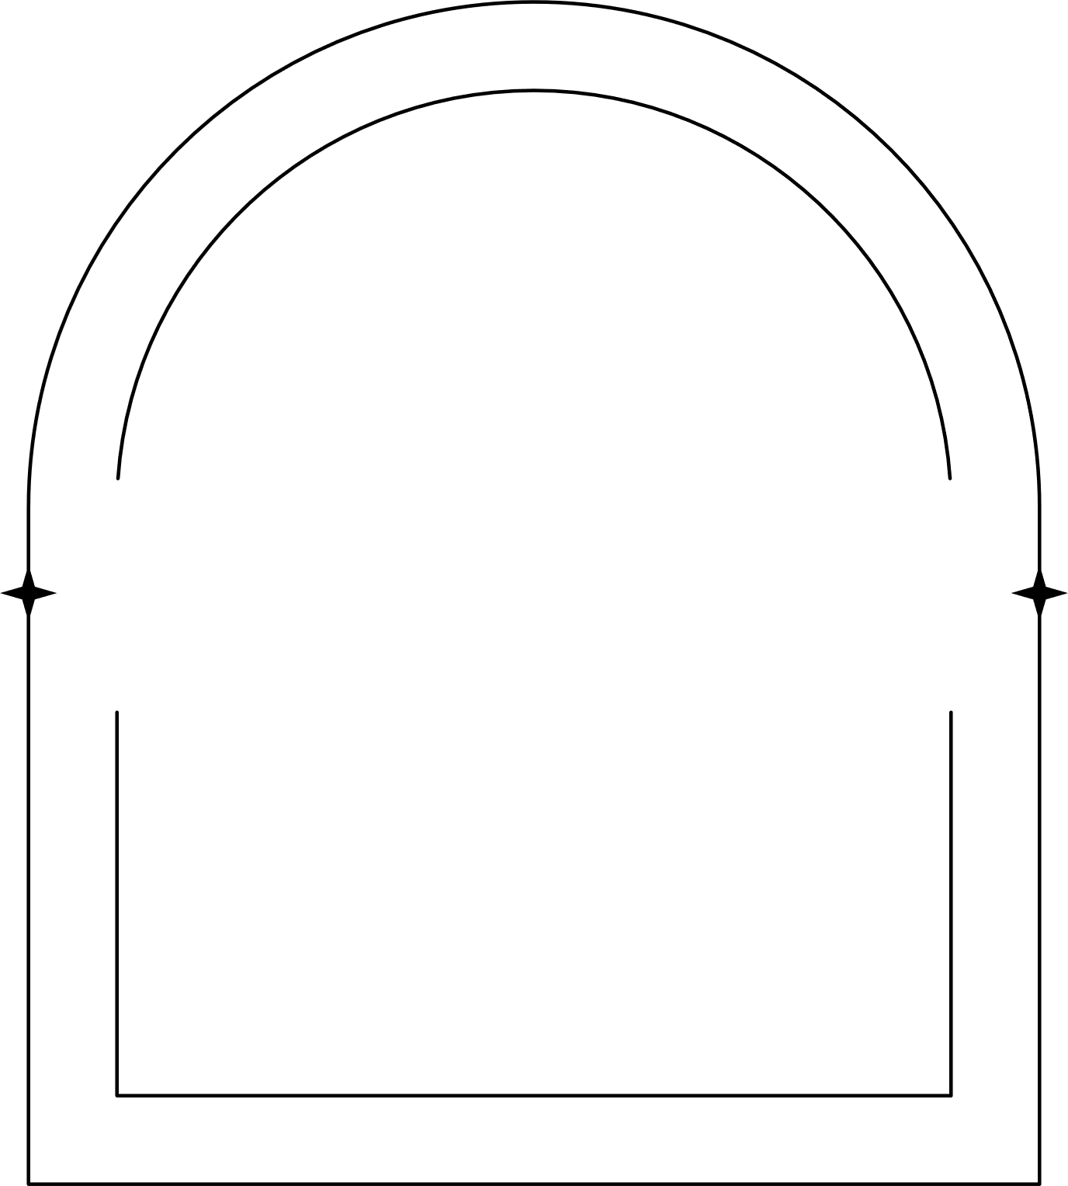
Feasibility and Viability
‣
Tourists struggle to decide which sources are trustworthy.
‣
There’s too much information online — hundreds of blogs, videos, and reviews.
‣
Many travellers know they want a break but don’t know where to go that fits their time, budget, and interests.
‣
2
It’s hard to estimate the total trip cost before travelling
‣Curate verified destination data from official tourism APIs or reliable databases.
‣Use AI-based filters to summarize top-rated destinations and attractions.
‣ Provide short, trustworthy descriptions instead of long blog-style texts. Include user reviews and ratings from verified travellers
3
4
‣Real-time distance and travel time
‣Map view showing stay options near chosen destinations.

Slide 5

Work Flow
Confused in planning
Taking preferences
Travel companion,distance range….etc
Categorize and shortlist according to preferences
Output of best places with respect to their preferences

Slide 6
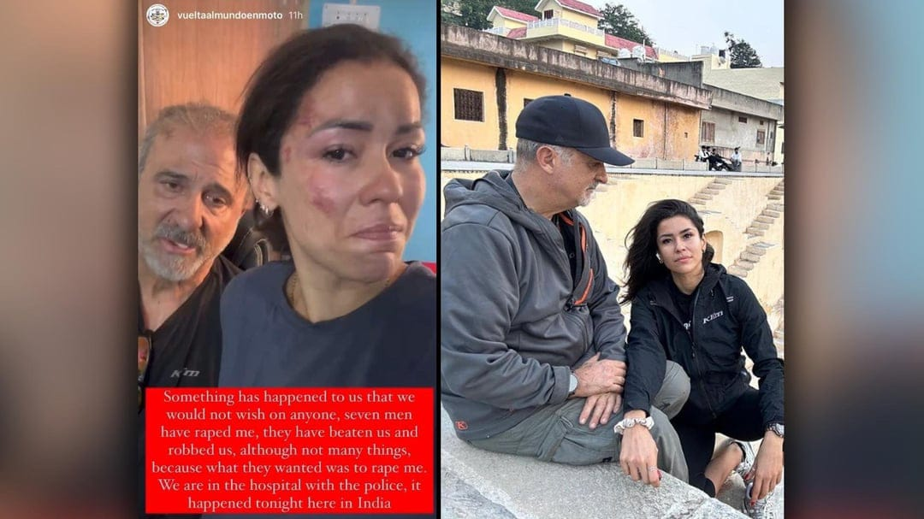
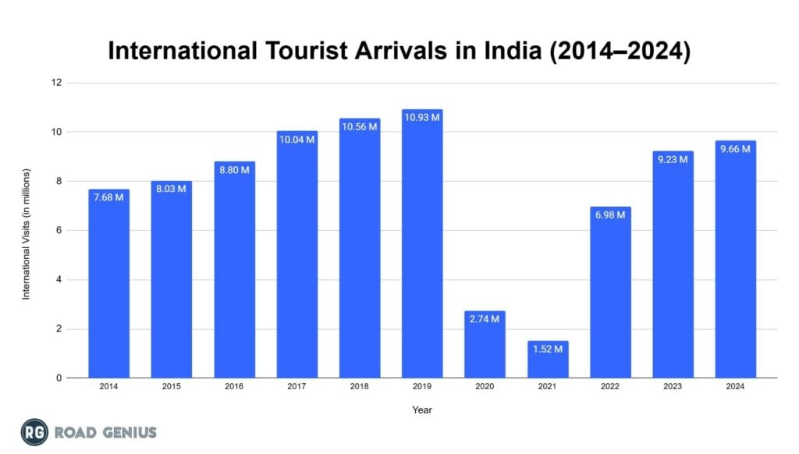
Future Implementation
• India sees around 10 million tourists yearly.
• A 2023 survey showed up 40% tourists have safety concerns
• Tourists in India face:
• Scams
• Overcharging
• Harassment
• Poor safety measures
• Cultural misunderstandings
The app may suggest safer routes, hotels, or activities depending on the traveler’s profile (solo, family, female, etc.).
‣Real-time safety
‣Updates Location
‣Safe zone alerts
‣Emergency contact integration
‣24/7 virtual travel assistant

Slide 7
TECHNICAL APPROACH
Architecture Overview
Single page application(SPA)
Hosting can be deployed on static hosting(GitHub pages)
1
Frontend stack
HTML 5 : Structure and Semantic Markup
CSS 3 : Styling , Animation , Responsive Design
Vanilla JavaScript : Client-side Logic & Interactivity
2
3
Data Storage
Browser local storage: persist user session data locally
Static JavaScript Dataset: hard coded dataset of places
4
External APIs Used
OpenStreetMap
Ipapi.co
Google maps embed API

Slide 8
Let your memories live beyond the moment.
Thank You
Very Much

