Slide 1
ESSENTIAL LECTURE 01
Introduction to
Desktop Publishing
and Visual Communication
Clear publications begin with a clear message—not with the software.
ITT06105 • Ordinary Diploma in Information Technology • 2026/2027

Slide 2
ITT06105 / DESKTOP PUBLISHING
START HERE
What should you be able to do?
By the end of this lecture, focus on these four practical outcomes.
01 Explain DTP
02 Read a visual message
Describe desktop publishing in your own words and name everyday products made with it.
Identify the audience, the main message and the intended action.
03 Apply basic principles
04 Improve a weak notice
Explain hierarchy, contrast, alignment, proximity and repetition.
Identify specific problems and suggest a clearer layout using paper sketches.
DESKTOP PUBLISHING • LECTURE 01 • 2026/2027
02

Slide 3
ITT06105 / DESKTOP PUBLISHING
FOUNDATIONS
Desktop publishing is already around us
Look at the information people see every day—not only at books and magazines.
Event poster
College notice
Brochure
Announces an activity
Gives instructions
Explains a service
Lesson hand-out
Newsletter
Digital graphic
Supports learning
Shares updates
Communicates on screen
DESKTOP PUBLISHING • LECTURE 01 • 2026/2027
03

Slide 4
ITT06105 / DESKTOP PUBLISHING
FOUNDATIONS
What is desktop publishing?
Desktop publishing (DTP) is the process of using computer software to arrange text, images and other visual elements into a finished publication for print or digital sharing.
Example: a department notice needs accurate words, visible event details, organised spacing and a shareable final file.
DESKTOP PUBLISHING • LECTURE 01 • 2026/2027
04

Slide 5
ITT06105 / DESKTOP PUBLISHING
FOUNDATIONS
DTP is more than typing
Word processors can also make attractive pages, but publishing puts deliberate page communication at the centre.
Typing and editing
Desktop publishing
The main task is to enter words, correct mistakes and form readable paragraphs. A letter or ordinary report may need little visual arrangement.
The task includes choosing information, arranging it into a reading order, combining suitable graphics and checking how the finished page will print or display.
Both may use the same computer. The difference is the communication and layout decisions being made.
DESKTOP PUBLISHING • LECTURE 01 • 2026/2027
05

Slide 6
ITT06105 / DESKTOP PUBLISHING
FOUNDATIONS
How desktop publishing became accessible
The tools changed, but the need to communicate clearly remained.
1
2
3
Before personal DTP
1980s onward
Print and screen
Many pages were prepared using specialist typesetting and manual production methods.
Personal computers, page-layout programs and printers brought publishing to smaller organisations.
Digital photography, PDF files and online sharing expanded where publications are used.
DESKTOP PUBLISHING • LECTURE 01 • 2026/2027
06

Slide 7
ITT06105 / DESKTOP PUBLISHING
FOUNDATIONS
Why does DTP matter to organisations?
Inform people
Build consistency
Prepare usable output
Colleges and community groups prepare notices, schedules and learning materials that readers can scan quickly.
Repeated headings, logos and layouts help different publications look like they belong to one organisation.
A publication must remain legible when printed or opened on another device. Saving the right file is part of the work.
DESKTOP PUBLISHING • LECTURE 01 • 2026/2027
07

Slide 8
ITT06105 / DESKTOP PUBLISHING
FOUNDATIONS
What is visual communication?
Visual communication means conveying a message through the appearance and arrangement of text, pictures, symbols, shapes, colours and space.
A reader should be able to recognise what matters first, find the supporting details and understand what to do next.
DESKTOP PUBLISHING • LECTURE 01 • 2026/2027
08

Slide 9
ITT06105 / DESKTOP PUBLISHING
FOUNDATIONS
Correct information can still be poorly communicated
A weak notice might…
A stronger notice…
Use tiny pale writing for the venue, arrange details in random positions and place a decorative picture over essential information.
Makes the event name immediately visible, groups its date and venue, uses readable contrast and removes elements that distract from the message.
Good design supports accurate content; decoration cannot replace accuracy.
DESKTOP PUBLISHING • LECTURE 01 • 2026/2027
09

Slide 10
ITT06105 / DESKTOP PUBLISHING
FOUNDATIONS
Start with three questions
Before opening any design application, decide what the publication needs to accomplish.
1
2
3
WHO is the audience?
WHAT must they know?
WHAT should they do?
Students, residents, parents, customers or another specific group?
The event, service, topic or instruction that must be understood.
Attend, read further, make contact, apply or follow a procedure.
DESKTOP PUBLISHING • LECTURE 01 • 2026/2027
10

Slide 11
ITT06105 / DESKTOP PUBLISHING
FOUNDATIONS
Five qualities of a clear publication
1
Clarity
The central message is easy to understand.
2
Accuracy
Names, dates, contact details and instructions are correct.
3
Readability
Words are legible, with suitable size and contrast.
4
Suitability
Language and visual style match the intended audience.
5
Consistency
Similar elements look related throughout the page.
DESKTOP PUBLISHING • LECTURE 01 • 2026/2027
11

Slide 12
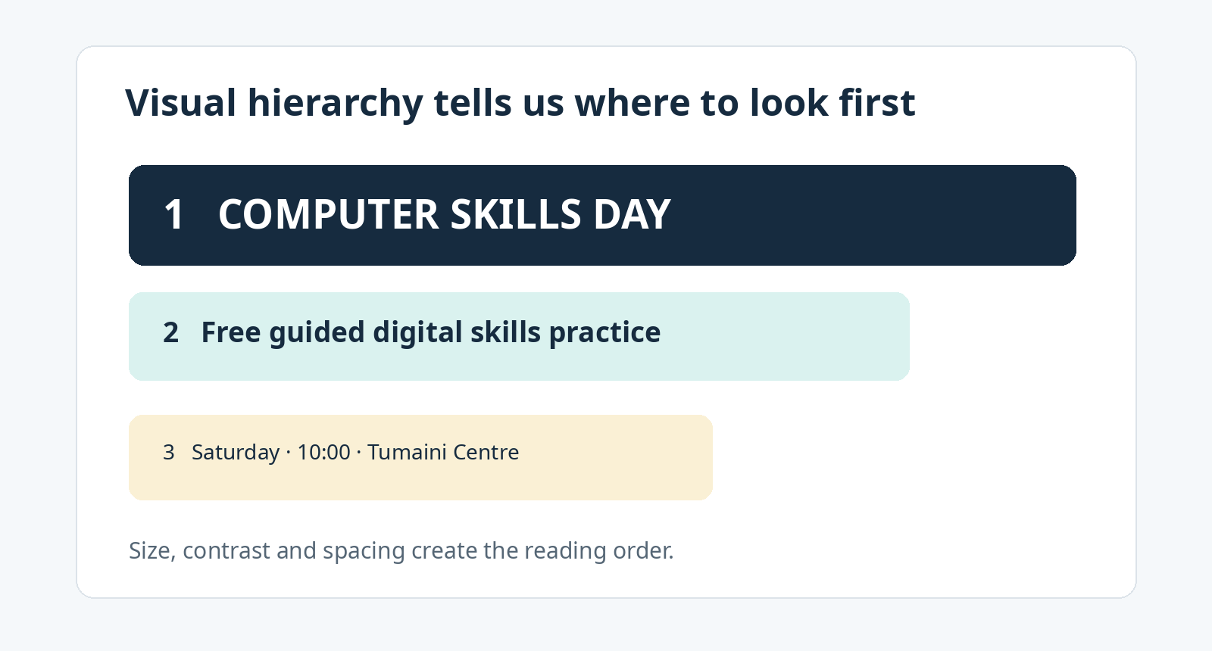
ITT06105 / DESKTOP PUBLISHING
FOUNDATIONS
Visual hierarchy: guide the reader’s eyes
Size, contrast and spacing establish a deliberate reading order.
DESKTOP PUBLISHING • LECTURE 01 • 2026/2027
12

Slide 13
ITT06105 / DESKTOP PUBLISHING
FOUNDATIONS
Hierarchy is more than “make it bigger”
What the reader notices first
What comes next
A large event name or lesson title identifies the subject immediately. The headline should be meaningful, not just decorative.
A short explanation gives context. Date, place, instructions and contact details are then grouped so they can be located quickly.
A good reading order depends on the reader’s needs—not every detail should be equally prominent.
DESKTOP PUBLISHING • LECTURE 01 • 2026/2027
13

Slide 14
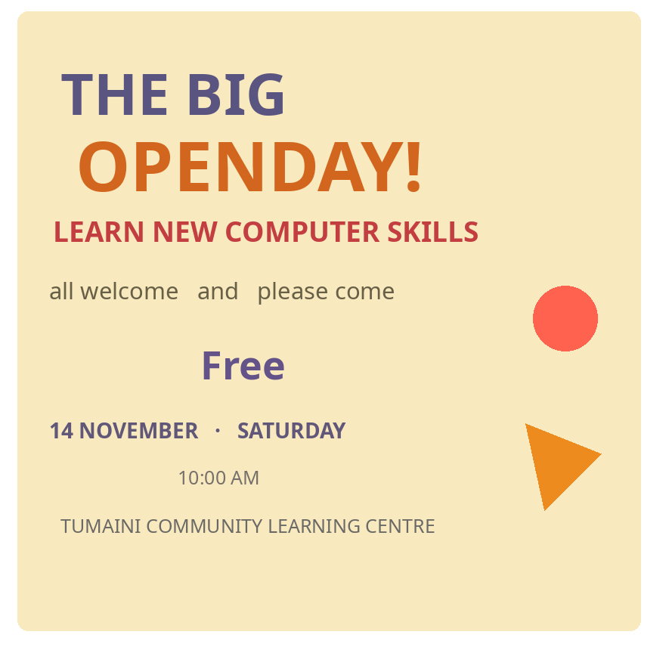
ITT06105 / DESKTOP PUBLISHING
FOUNDATIONS
Study this crowded event notice
The information exists, but many elements compete for attention.
Look for:
• competing type sizes and colours
• inconsistent left edges
• event details scattered apart
• decoration that distracts
DESKTOP PUBLISHING • LECTURE 01 • 2026/2027
14

Slide 15
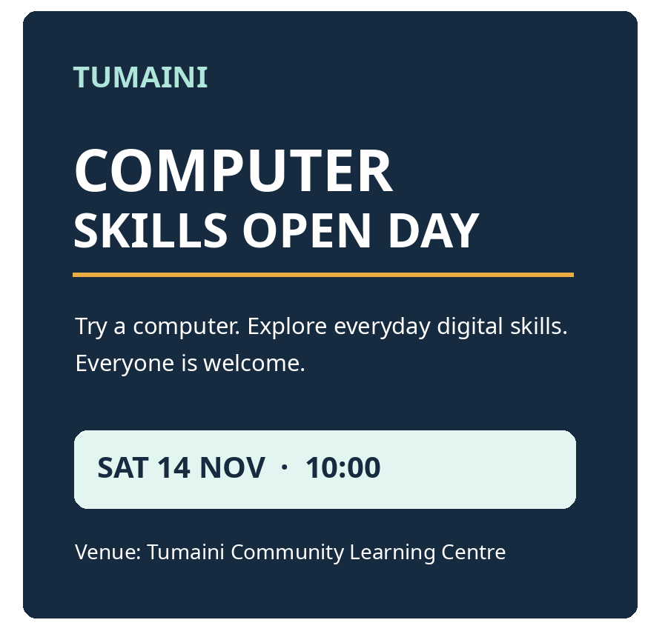
ITT06105 / DESKTOP PUBLISHING
FOUNDATIONS
A clearer version of the same message
Grouping and contrast direct the reader from the headline to the event details.
What improved?
The event title forms a clear headline. Supporting text is easy to scan. The date and time appear together. Alignment and open space make the page calmer.
DESKTOP PUBLISHING • LECTURE 01 • 2026/2027
15

Slide 16
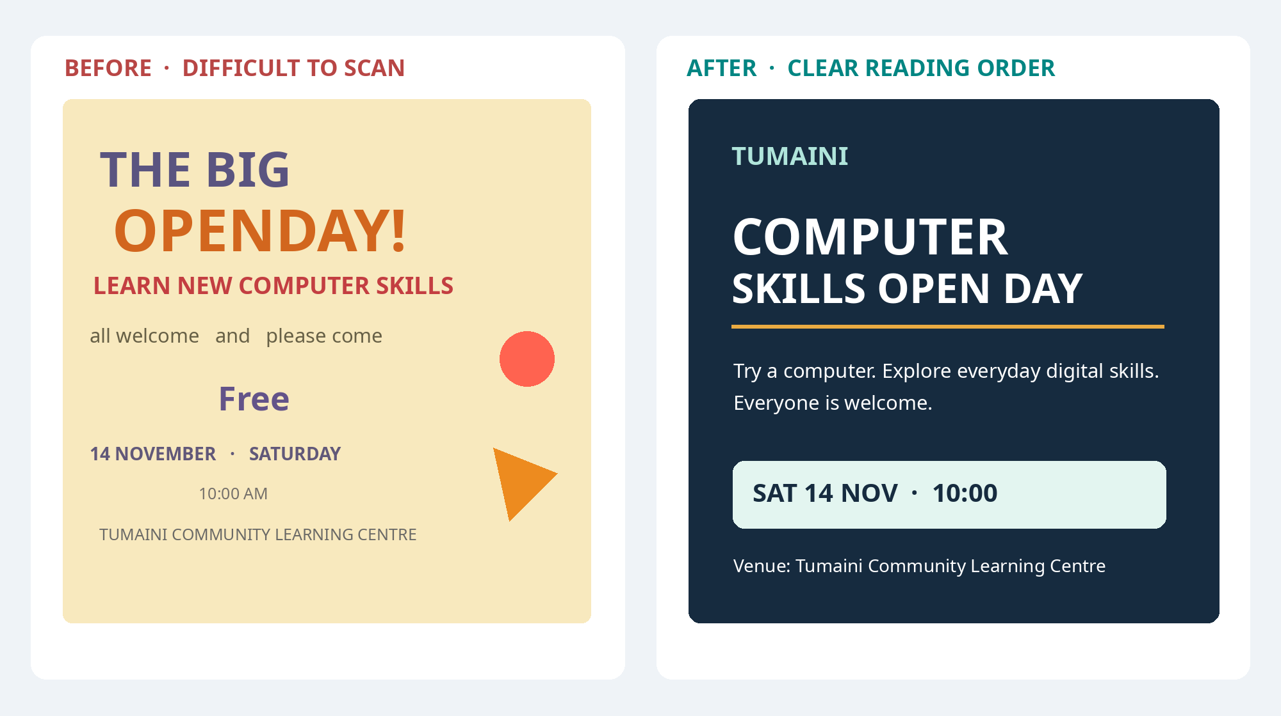
ITT06105 / DESKTOP PUBLISHING
FOUNDATIONS
Compare the two designs—not just their appearance
The stronger notice gives the reader a more predictable path through the information.
DESKTOP PUBLISHING • LECTURE 01 • 2026/2027
16

Slide 17
ITT06105 / DESKTOP PUBLISHING
FOUNDATIONS
Four principles that organise a page
These terms give us practical reasons for improving a design.
Contrast
Alignment
Differentiate important information from supporting details.
Use consistent edges and lines to establish order.
Proximity
Repetition
Put related information together, and separate unrelated groups.
Reuse visual features so headings and sections feel consistent.
DESKTOP PUBLISHING • LECTURE 01 • 2026/2027
17

Slide 18
ITT06105 / DESKTOP PUBLISHING
FOUNDATIONS
Contrast helps important information stand out
FAINT HEADING
CLEAR HEADING
Contrast can come from colour, size, weight or shape. Use it to express priority, not to make every object compete.
DESKTOP PUBLISHING • LECTURE 01 • 2026/2027
18

Slide 19
ITT06105 / DESKTOP PUBLISHING
FOUNDATIONS
Alignment creates a reliable structure
WITHOUT ALIGNMENT
WITH ALIGNMENT
Event title
Event title
When it happens
When it happens
Where to go
Where to go
Consistent left edges help the eye scan. They also make a publication look more deliberate.
DESKTOP PUBLISHING • LECTURE 01 • 2026/2027
19

Slide 20
ITT06105 / DESKTOP PUBLISHING
FOUNDATIONS
Proximity reveals which details belong together
A confusing arrangement
A clearer arrangement
The time appears near the fee, while the venue is isolated beneath unrelated contact text. Readers must work out what belongs to the event.
Place date, time and venue inside one event-details block. Give registration and contact details their own neighbouring block.
Spacing communicates relationships even before the reader understands every word.
DESKTOP PUBLISHING • LECTURE 01 • 2026/2027
20

Slide 21
ITT06105 / DESKTOP PUBLISHING
FOUNDATIONS
Repetition makes a document feel consistent
Section heading
Information box
Page identity
Use the same typeface, size and colour each time a new section begins.
Repeat a similar border, fill or spacing style when the same kind of information appears.
A repeated header or logo can show that several pages belong to the same publication.
Repetition brings unity. Contrast still helps distinguish the most important item.
DESKTOP PUBLISHING • LECTURE 01 • 2026/2027
21

Slide 22
ITT06105 / DESKTOP PUBLISHING
FOUNDATIONS
Whitespace is useful space—not wasted space
CROWDED LAYOUT
CLEAR LAYOUT
The empty areas separate groups and make the important parts easier to notice.
DESKTOP PUBLISHING • LECTURE 01 • 2026/2027
22

Slide 23
ITT06105 / DESKTOP PUBLISHING
FOUNDATIONS
Gestalt: how we perceive groups and patterns
Gestalt principles describe common ways in which people see visual elements as belonging together or standing apart.
Proximity
Similarity
Figure and ground
Nearby elements are often read as one group.
Items with matching shapes or colours appear related.
A clear contrast separates the main subject from its background.
DESKTOP PUBLISHING • LECTURE 01 • 2026/2027
23

Slide 24
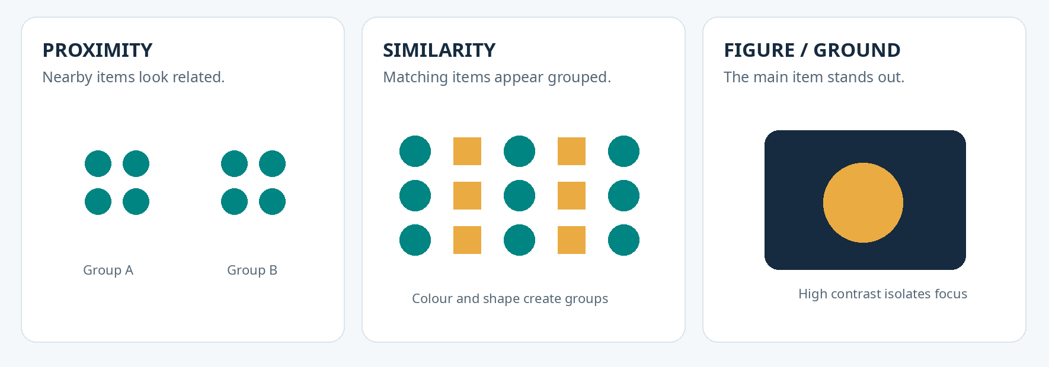
ITT06105 / DESKTOP PUBLISHING
FOUNDATIONS
Three Gestalt ideas in a picture
Notice how distance, repeated shapes and contrast affect what seems connected.
DESKTOP PUBLISHING • LECTURE 01 • 2026/2027
24

Slide 25
ITT06105 / DESKTOP PUBLISHING
FOUNDATIONS
Design is a reasoned decision, not personal taste
“The date is hard to find.”
Move it into the event-details group and give it readable contrast.
“The page feels disorganised.”
Use consistent alignment and spacing for headings and paragraphs.
“Everything is shouting.”
Reduce competing emphasis and establish one clear headline.
DESKTOP PUBLISHING • LECTURE 01 • 2026/2027
25

Slide 26
ITT06105 / DESKTOP PUBLISHING
FOUNDATIONS
Choose software that matches the publishing task
Photoshop
Illustrator
InDesign
Suited to editing photographs and raster image compositions. A common task is cropping or correcting a photo for a notice.
Suited to vector artwork that can be resized, such as icons and logos.
Suited to arranging text and graphics into pages, brochures and booklets.
Also consider available computers, licences, skills, file compatibility and output requirements.
DESKTOP PUBLISHING • LECTURE 01 • 2026/2027
26

Slide 27
ITT06105 / DESKTOP PUBLISHING
FOUNDATIONS
Which tool would you choose?
1
2
3
Edit a photograph
Create a small icon
Build a booklet
A raster editor helps crop or retouch the image before it is placed in a publication.
A vector editor keeps simple shapes clear at different display sizes.
A page-layout tool helps maintain columns, image placement and styles.
DESKTOP PUBLISHING • LECTURE 01 • 2026/2027
27

Slide 28
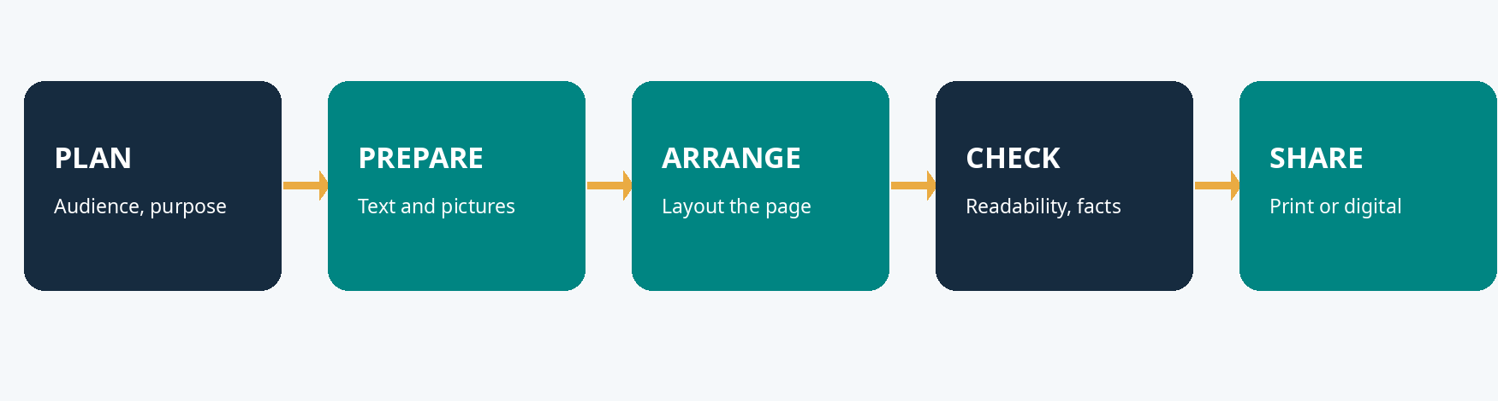
ITT06105 / DESKTOP PUBLISHING
FOUNDATIONS
A simple desktop publishing workflow
Prepare the message, build the page and check the result before anyone else reads it.
The process is not always perfectly linear. A failed check may send the designer back to correct content or layout.
DESKTOP PUBLISHING • LECTURE 01 • 2026/2027
28

Slide 29
ITT06105 / DESKTOP PUBLISHING
FOUNDATIONS
Check these five things before sharing
1
Audience
Would the intended readers understand the words?
2
Accuracy
Are the names, times, dates and contacts correct?
3
Hierarchy
Can readers spot the main message in seconds?
4
Readability
Is the text large enough and sufficiently contrasted?
5
Output
Does the file display or print as expected?
DESKTOP PUBLISHING • LECTURE 01 • 2026/2027
29

Slide 30
ITT06105 / DESKTOP PUBLISHING
YOUR ACTIVITY
Practical: diagnose the original notice
Use the printed activity sheet. No specialist software is required.
Explain, do not just label.
Identify the intended audience, message and action. Then describe three difficulties and link each one to a design principle.
Useful words: hierarchy • alignment • proximity • contrast
DESKTOP PUBLISHING • LECTURE 01 • 2026/2027
30

Slide 31
ITT06105 / DESKTOP PUBLISHING
YOUR ACTIVITY
Sketch a clearer version and explain your choices
1
2
3
Plan
Rearrange
Justify
Write down the headline and essential date, time and venue.
Sketch blocks with a clear reading order and enough whitespace.
Describe at least two changes and how they help readers.
DESKTOP PUBLISHING • LECTURE 01 • 2026/2027
31

Slide 32
ITT06105 / DESKTOP PUBLISHING
REVISE
Three quick self-check questions
1 Why is desktop publishing more than ordinary typing?
Explain in terms of page arrangement and communication.
2 How do alignment and proximity help a reader?
Use one simple event-notice example.
3 What should a reader see first on an event poster?
Explain why that order serves the intended audience.
DESKTOP PUBLISHING • LECTURE 01 • 2026/2027
32

Slide 33
ITT06105 / DESKTOP PUBLISHING
CLOSING
What to remember
Desktop publishing prepares a message for print or digital reading. Good visual communication starts with the audience and purpose, then uses hierarchy, contrast, alignment, proximity, repetition and spacing to make information easier to understand.
NEXT: Core Lecture 2 — Text, Images and Colour
For independent study: full L01 notes and selected Gestalt examples from full L05.
DESKTOP PUBLISHING • LECTURE 01 • 2026/2027
33

