Slide 1
ESSENTIAL LECTURE 02
Working with Text,
Images and Colour
Make graphics clear, text readable and colour purposeful.
ITT06105 • Ordinary Diploma in Information Technology • 2026/2027

Slide 2
ITT06105 / DESKTOP PUBLISHING
START HERE
What you should be able to do
These are the essential skills for this classroom session.
01 Recognise image types
02 Make text readable
Explain why photographs and logos may need different graphic formats.
Choose clear type, spacing and a sensible heading-to-body hierarchy.
03 Use colour deliberately
04 Improve a notice
Choose a small palette with readable contrast and appropriate emphasis.
Identify weaknesses and sketch a clearer version for readers.
DESKTOP PUBLISHING • LECTURE 02 • 2026/2027
02

Slide 3
ITT06105 / DESKTOP PUBLISHING
START HERE
What makes a publication easy to read?
Graphic selection
Text arrangement
A photograph explains what happened or what a place looks like. A logo identifies an organisation. Each graphic should support the message.
Headings, body text and labels should make information easy to scan. Size, spacing and alignment tell readers where to look first.
Colour works with both: it can attract attention, organise sections and reinforce meaning.
DESKTOP PUBLISHING • LECTURE 02 • 2026/2027
03

Slide 4
ITT06105 / DESKTOP PUBLISHING
FOUNDATIONS
Three decisions before you design
IMAGE
TEXT
COLOUR
Which picture, drawing or symbol helps the reader understand the message?
What is the headline? Which details must remain easy to find?
Which colours improve contrast and support the intended mood?
A good design makes these three decisions work together—not compete for attention.
DESKTOP PUBLISHING • LECTURE 02 • 2026/2027
04

Slide 5
ITT06105 / DESKTOP PUBLISHING
KEY CONCEPT
What is a raster image?
A raster image is made of many small picture elements called pixels. Each pixel stores colour information; together the pixels form a photograph or digital picture.
Examples: phone photographs, scanned pages and most screenshots.
Raster images are particularly useful for detailed textures, shadows and natural colour changes.
DESKTOP PUBLISHING • LECTURE 02 • 2026/2027
05

Slide 6

ITT06105 / DESKTOP PUBLISHING
IMAGE BASICS
Pixels form a picture
A raster image looks continuous at normal size, but it is built from coloured squares.
When you enlarge too far
Individual pixels can become visible. Software may smooth the blocks, but smoothing cannot recover detail that was never captured.
This is called pixelation.
DESKTOP PUBLISHING • LECTURE 02 • 2026/2027
06

Slide 7

ITT06105 / DESKTOP PUBLISHING
IMAGE BASICS
Why image size matters
More original detail
Enlarged low-resolution version
A large printed photograph needs enough pixels for its intended physical size.
DESKTOP PUBLISHING • LECTURE 02 • 2026/2027
07

Slide 8
ITT06105 / DESKTOP PUBLISHING
KEY CONCEPT
What is a vector graphic?
A vector graphic is made from points, lines, curves and shapes described mathematically. These shapes can be scaled without the blocky edges associated with enlarged raster images.
Examples: logos, simple icons, diagrams and illustrations.
A vector file may also contain an embedded raster photograph, so check its actual content.
DESKTOP PUBLISHING • LECTURE 02 • 2026/2027
08

Slide 9
ITT06105 / DESKTOP PUBLISHING
IMAGE BASICS
Vectors use paths and shapes
Changing a vector shape means changing its geometry, rather than colouring individual pixels.
Why scaling is different
The software redraws each path at the new size. The icon can be displayed on a small badge or a large sign while retaining smooth edges.
Editable objects
DESKTOP PUBLISHING • LECTURE 02 • 2026/2027
09

Slide 10
ITT06105 / DESKTOP PUBLISHING
COMPARE
Raster versus vector at a glance
RASTER
VECTOR
Best for
Photographs and detailed images
Icons, logos and simple artwork
Built from
Pixels
Paths, points and shapes
Enlargement
Can show pixelation
Usually stays crisp
Typical formats
JPEG, PNG
SVG, AI
DESKTOP PUBLISHING • LECTURE 02 • 2026/2027
10

Slide 11


ITT06105 / DESKTOP PUBLISHING
COMPARE
Choose the right graphic for the job
The same publication often includes both raster and vector content.
Workshop photograph or illustration
Organisation identity
Use detailed raster images for scenes; retain editable vectors for simple symbols and logos.
DESKTOP PUBLISHING • LECTURE 02 • 2026/2027
11

Slide 12
ITT06105 / DESKTOP PUBLISHING
FILE FORMATS
Four file formats you will meet often
JPEG / JPG
PNG
SVG
Usually suited to photographs. Small files are possible, but saving with lossy compression can discard image detail.
Useful for sharp graphics and transparency. PNG uses lossless compression for its stored pixels.
An editable, scalable vector format suited to simple drawings and logos. It can contain embedded raster images.
A PDF is a document container: it may hold text, raster images and vector shapes.
DESKTOP PUBLISHING • LECTURE 02 • 2026/2027
12

Slide 13
ITT06105 / DESKTOP PUBLISHING
FILE FORMATS
JPEG and PNG are not interchangeable
Choose JPEG when …
Choose PNG when …
You are sharing a photograph that has many colours and gradual transitions. Adjust the quality setting and check whether the result still looks acceptable.
You need transparent backgrounds, clear edges or text-like artwork. A PNG is still raster-based even when its edges look sharp.
Do not repeatedly save a working photograph as a low-quality JPEG; keep an original or editable source.
DESKTOP PUBLISHING • LECTURE 02 • 2026/2027
13

Slide 14
ITT06105 / DESKTOP PUBLISHING
FILE FORMATS
What about SVG and PDF?
SVG: an artwork format
PDF: a publication format
SVG stores shapes and paths. Use it for a scalable icon or logo when the receiving software supports it. Keep the original design editable.
PDF is commonly used for sharing completed layouts and print proofs. A PDF can contain several kinds of content; the extension does not guarantee high quality.
Always inspect the final exported file: filenames do not prove that the content is correct.
DESKTOP PUBLISHING • LECTURE 02 • 2026/2027
14

Slide 15
ITT06105 / DESKTOP PUBLISHING
APPLY
Quick format decisions
A school-event photograph
JPEG is a sensible starting choice.
A logo with no background
SVG, or a PNG when a raster file is required.
A finished two-page hand-out
PDF for reliable sharing and printing.
DESKTOP PUBLISHING • LECTURE 02 • 2026/2027
15

Slide 16
ITT06105 / DESKTOP PUBLISHING
IMAGE BASICS
Pixel dimensions are not file size
Pixel dimensions
File size
A 1,200 × 800 pixel image contains 960,000 pixels. These values describe its image dimensions, not the size of the saved file on a drive.
File size depends on dimensions, format, compression settings and other data. Two 1,200 × 800 pictures can occupy very different amounts of storage.
A smaller file is useful only if it still meets the publication’s quality needs.
DESKTOP PUBLISHING • LECTURE 02 • 2026/2027
16

Slide 17
ITT06105 / DESKTOP PUBLISHING
IMAGE BASICS
Cropping and resizing are different
Cropping changes what is visible
Resizing changes dimensions
Cropping removes content near the edges to improve composition or fit a different shape. An unneeded background can disappear.
Resizing changes the pixel dimensions or intended physical size. It does not necessarily remove content, but enlarging may reduce apparent quality.
Before editing an important image, save a working copy and preserve the original.
DESKTOP PUBLISHING • LECTURE 02 • 2026/2027
17

Slide 18
ITT06105 / DESKTOP PUBLISHING
KEY CONCEPT
What is typography?
Typography is the selection and arrangement of written characters so that information is readable, organised and appropriate for its audience.
Typography includes typeface choice, size, weight, alignment, spacing and line length.
Good typography is not only decorative: it helps the reader find and understand information.
DESKTOP PUBLISHING • LECTURE 02 • 2026/2027
18

Slide 19
ITT06105 / DESKTOP PUBLISHING
TYPOGRAPHY
Typeface, font and style
Typeface
Font and style
A typeface is a family of letter designs, such as Arial or Georgia. A serif design has small finishing strokes; a sans-serif design does not.
A font is a particular implementation or variation of a typeface, such as a bold or italic style. In everyday software, the words are often used loosely.
For beginner publications, one readable type family with clear sizes and weights is often enough.
DESKTOP PUBLISHING • LECTURE 02 • 2026/2027
19

Slide 20
ITT06105 / DESKTOP PUBLISHING
TYPOGRAPHY
Serif and sans-serif: compare
Aa Gg Rr
Aa Gg Rr
SERIF TYPE
SANS-SERIF TYPE
Example: Georgia. The letter ends have small finishing strokes.
Example: Arial. The letterforms have simpler endings.
Neither family is automatically better. Choose a typeface that suits the reader and the setting.
DESKTOP PUBLISHING • LECTURE 02 • 2026/2027
20

Slide 21
ITT06105 / DESKTOP PUBLISHING
TYPOGRAPHY
Create a clear text hierarchy
Readers should be able to find the most important detail first.
DIGITAL SKILLS
How hierarchy works
Open training day
The title attracts attention. The second line explains the event. The paragraph gives context. The smaller line provides details.
Learn to use a computer, write documents and organise files.
Saturday • 10:00 • Main Hall
DESKTOP PUBLISHING • LECTURE 02 • 2026/2027
21

Slide 22
ITT06105 / DESKTOP PUBLISHING
TYPOGRAPHY
Make body text comfortable to read
SIZE
SPACING
ALIGNMENT
Use sufficiently large body text for the intended medium. Small text may be difficult to read on a classroom screen or printed notice.
Leave clear space between lines and separate different kinds of information. Crowded text slows down reading.
Keep related text aligned consistently. For ordinary paragraphs, left alignment is often easier to follow than centring every line.
Readability depends on size, spacing, contrast, line length and the viewing conditions.
DESKTOP PUBLISHING • LECTURE 02 • 2026/2027
22

Slide 23
ITT06105 / DESKTOP PUBLISHING
TYPOGRAPHY
A few consistent styles beat many fonts
Too many styles
A restrained system
Several unrelated typefaces, colours and sizes create competition. Readers spend effort decoding the page rather than understanding the message.
Use one type family, perhaps two when necessary. Give headings a clear size or weight difference, then keep body text consistent.
Bold text should identify important information—not every sentence.
DESKTOP PUBLISHING • LECTURE 02 • 2026/2027
23

Slide 24
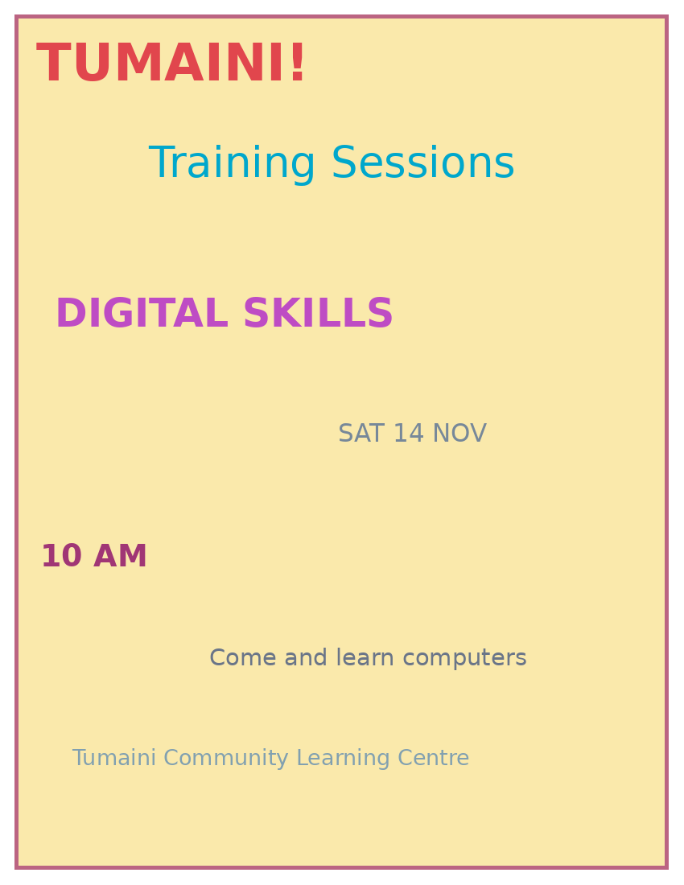
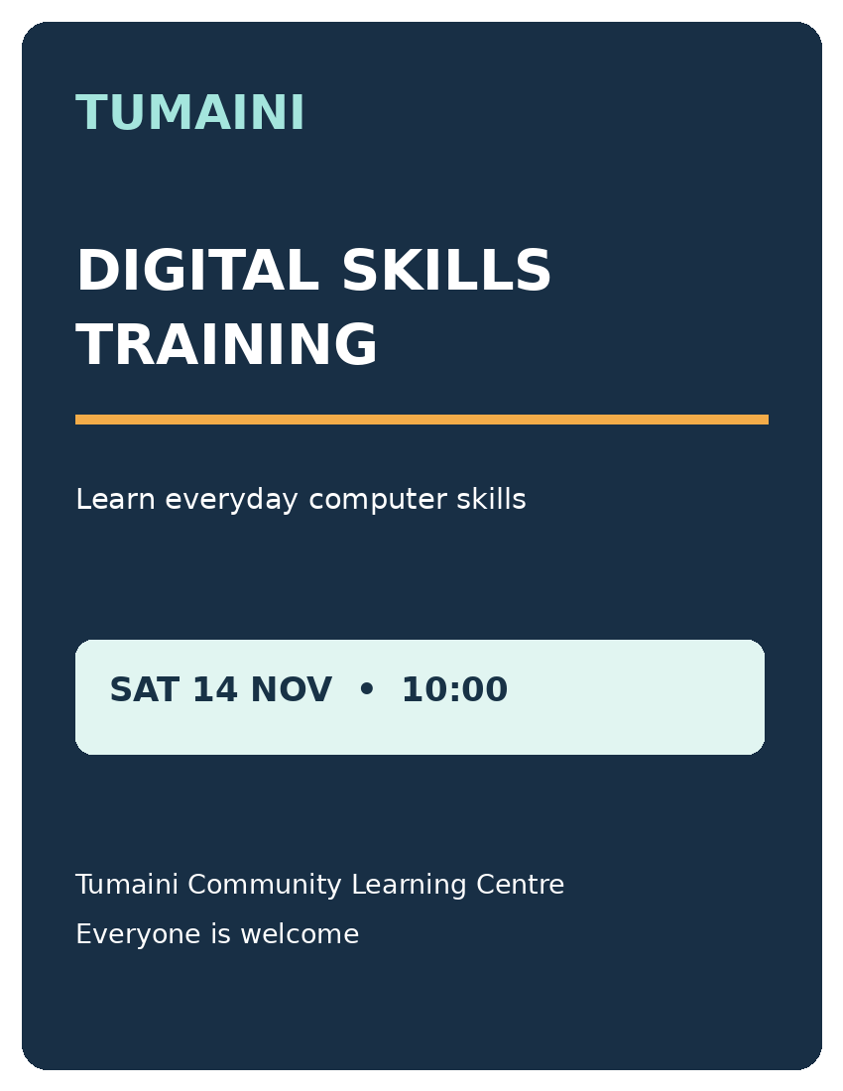
ITT06105 / DESKTOP PUBLISHING
TYPOGRAPHY
Typography can guide or confuse
UNCLEAR
CLEARER
DESKTOP PUBLISHING • LECTURE 02 • 2026/2027
24

Slide 25
ITT06105 / DESKTOP PUBLISHING
TYPOGRAPHY
Why the improved notice reads better
HEADLINE
GROUPING
CONSISTENCY
The event name is visibly larger than supporting text. Readers recognise the main message first.
Date and time appear together. Information with the same purpose occupies the same area.
The notice uses a limited set of type styles, clear alignment and enough empty space.
Typography and layout principles from Lecture 1 work together here.
DESKTOP PUBLISHING • LECTURE 02 • 2026/2027
25

Slide 26
ITT06105 / DESKTOP PUBLISHING
KEY CONCEPT
What does colour do in DTP?
Colour is a visual tool that can attract attention, separate sections, improve recognition and create a particular mood. Its purpose should support the message.
Example: one accent colour can draw attention to the date of an event while darker text keeps the details readable.
A colourful page is not necessarily a clear page; readability comes first.
DESKTOP PUBLISHING • LECTURE 02 • 2026/2027
26

Slide 27
ITT06105 / DESKTOP PUBLISHING
COLOUR
Three useful colour properties
HUE
SATURATION
LIGHTNESS
The colour family we recognise, such as red, yellow, green or blue.
How vivid or muted a colour appears. Highly saturated colours stand out but can be tiring if overused.
How light or dark a colour appears. Differences in lightness often help make text easier to read.
You do not need advanced colour mathematics to choose a practical classroom palette.
DESKTOP PUBLISHING • LECTURE 02 • 2026/2027
27

Slide 28
ITT06105 / DESKTOP PUBLISHING
COLOUR
RGB and CMYK describe different uses
RGB — light on screens
CMYK — printing inks
Red, green and blue light are combined by digital displays. RGB is a common colour mode for photographs and digital graphics.
Cyan, magenta, yellow and black inks are used in many printing processes. Colours may shift between screen and paper depending on devices and settings.
For beginner work, choose suitable export settings and inspect proofs instead of memorising colour profiles.
DESKTOP PUBLISHING • LECTURE 02 • 2026/2027
28

Slide 29
ITT06105 / DESKTOP PUBLISHING
COLOUR
Build a small, usable palette
Dark navy
Teal
Pale mint
Warm orange
Main text
Headings / accent
Background
Small highlight
A reliable starting rule
Choose one dark colour for most text, one light background, and one or two accents. Repeat those choices consistently rather than introducing a new colour for every line.
DESKTOP PUBLISHING • LECTURE 02 • 2026/2027
29

Slide 30
ITT06105 / DESKTOP PUBLISHING
COLOUR
Check contrast before decoration
LOW CONTRAST
HIGH CONTRAST
Important information should not disappear into the background.
Dark and light colours can create a clear reading difference.
Colour contrast must be checked for body text as well as headlines.
DESKTOP PUBLISHING • LECTURE 02 • 2026/2027
30

Slide 31
ITT06105 / DESKTOP PUBLISHING
COLOUR
Do not communicate with colour alone
Weak instruction
More accessible instruction
“Students in red must submit today.” A reader may not distinguish the colours, or may be viewing a black-and-white printout.
“Submit today” with a visible label or icon and adequate contrast. Colour may reinforce the priority, but the words carry the message.
Also check whether your notice still makes sense when photocopied in greyscale.
DESKTOP PUBLISHING • LECTURE 02 • 2026/2027
31

Slide 32
ITT06105 / DESKTOP PUBLISHING
APPLY
Bring text, graphics and colour together
IMAGE
TEXT
COLOUR
Use one relevant picture or symbol. Choose a suitable file format and avoid stretching a small image far beyond its size.
Use a strong heading and a short supporting explanation. Group date, location and action details logically.
Use restrained colours, consistent highlights and clear text/background contrast.
The reader should recognise the purpose and locate the key information in a few seconds.
DESKTOP PUBLISHING • LECTURE 02 • 2026/2027
32

Slide 33
ITT06105 / DESKTOP PUBLISHING
ACTIVITY
Design review: what is going wrong?
Ask these questions
1. Can you find the main message quickly?
2. Are the date and time easy to locate?
3. Which colours or type styles make reading harder?
4. What should be grouped together?
DESKTOP PUBLISHING • LECTURE 02 • 2026/2027
33

Slide 34
ITT06105 / DESKTOP PUBLISHING
ACTIVITY
A clearer version of the same notice
Notice the changes
A clear headline starts the reading order. The message is shorter. Date and time sit together. The limited palette gives the notice a consistent appearance.
DESKTOP PUBLISHING • LECTURE 02 • 2026/2027
34

Slide 35
ITT06105 / DESKTOP PUBLISHING
PRACTICAL
Your practical: redesign a notice
Read
Identify the audience, message and action.
01
Plan
Sketch a heading, supporting line and details.
02
Choose
Select one or two type styles and a limited palette.
03
Explain
Give three reasons why your version is clearer.
04
DESKTOP PUBLISHING • LECTURE 02 • 2026/2027
35

Slide 36
ITT06105 / DESKTOP PUBLISHING
PRACTICAL
Self-check before submitting your sketch
Content
Design
Can a reader identify the title, date, time and organisation without searching? Is any essential information missing?
Is the heading clearly larger than the body? Are alignments consistent? Is contrast sufficient? Have you avoided too many fonts or colours?
You may complete this first design on paper; software is not required for the essential activity.
DESKTOP PUBLISHING • LECTURE 02 • 2026/2027
36

Slide 37
ITT06105 / DESKTOP PUBLISHING
REVISION
Essential terms to remember
Raster
Pixels; photographs
Vector
Paths; scalable icons
Typography
Readable arrangement of text
Contrast
Difference that improves visibility
JPEG
Common lossy photo format
PNG
Lossless raster with transparency
SVG
Scalable vector graphic
Hierarchy
Order of importance on a page
DESKTOP PUBLISHING • LECTURE 02 • 2026/2027
37

Slide 38
ITT06105 / DESKTOP PUBLISHING
REVISION
Check your understanding
1. Explain how raster and vector graphics differ.
2. Why is JPEG often suitable for photographs, but SVG useful for logos?
3. Name three typography decisions that improve readability.
4. Give two ways colour can help a reader understand a notice.
5. Why should colour not be the only way to communicate urgency?
DESKTOP PUBLISHING • LECTURE 02 • 2026/2027
38

Slide 39
ITT06105 / DESKTOP PUBLISHING
LOOK AHEAD
Next: planning a publication
A good publication begins with a plan.
In Lecture 3, you will turn a brief into a short content outline and a simple page sketch. Bring your redesigned notice: it is an early example of how layout decisions follow the needs of a reader.
DESKTOP PUBLISHING • LECTURE 02 • 2026/2027
39

