Slide 1
ESSENTIAL LECTURE 03
Planning and
Organising a Publication
From a clear purpose and audience to a simple, readable page.
ITT06105 • Ordinary Diploma in Information Technology • 2026/2027

Slide 2
ITT06105 / DESKTOP PUBLISHING
START HERE
By the end of this lecture...
You should be able to plan an A4 hand-out before opening a design application.
01 Define purpose and audience
02 Choose the key content
Explain why the publication is needed and identify who will read it.
Select a main message, supporting points and one clear reader action.
03 Sketch a basic layout
04 Explain your choices
Draw a thumbnail showing the heading, image, content, margin and footer.
Describe how hierarchy, alignment and spacing help the reader.
DESKTOP PUBLISHING • LECTURE 03 • 2026/2027
02

Slide 3
ITT06105 / DESKTOP PUBLISHING
LOOK BACK
How Lecture 3 connects to your previous learning
Good layouts depend on the visual communication principles you already know.
Lecture 1: Visual communication
Lecture 2: Text and graphics
Lecture 3: Planning
A strong publication makes the main message easy to notice. Contrast, alignment and proximity help organise the page.
Readable type, suitable images and restrained colour help the audience understand the message.
Now decide the message and reading order before choosing the fonts, colours and software.
Planning is the bridge between an idea and a finished document.
DESKTOP PUBLISHING • LECTURE 03 • 2026/2027
03

Slide 4
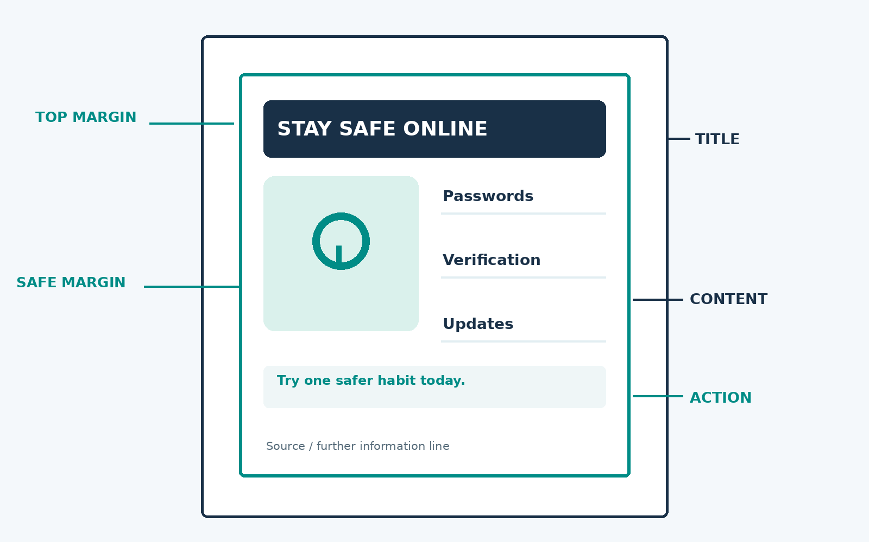
ITT06105 / DESKTOP PUBLISHING
PROJECT
Our running project: a one-page learning hand-out
This fictional brief will continue through Photoshop, Illustrator and InDesign exercises.
Tumaini Community Learning Centre
Create an A4 hand-out titled “Stay Safe Online” for first-year students. It should explain basic online safety habits in plain language and suggest one action readers can take today.
The organisation and assignment details are fictional classroom examples.
DESKTOP PUBLISHING • LECTURE 03 • 2026/2027
04

Slide 5
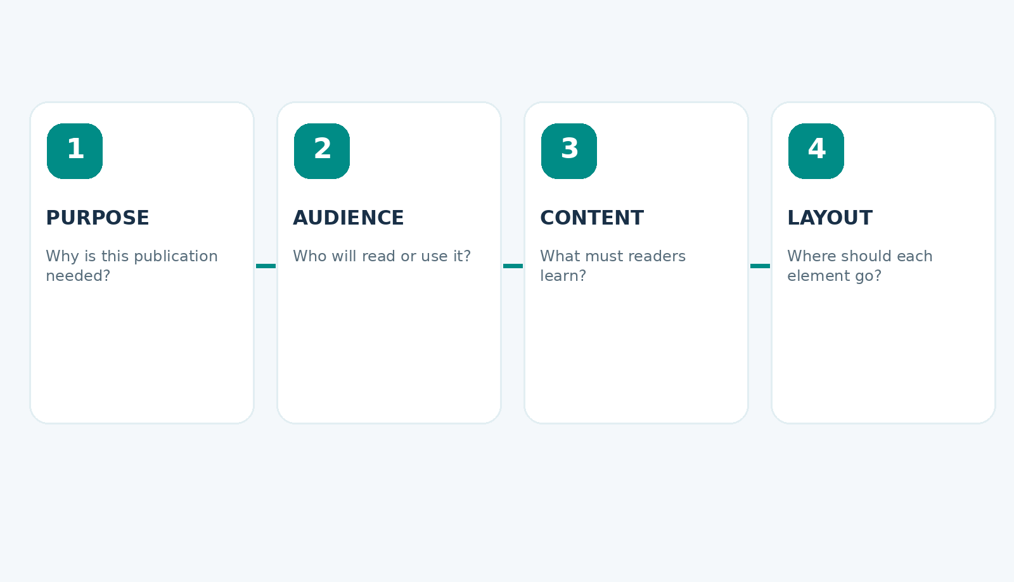
ITT06105 / DESKTOP PUBLISHING
CORE WORKFLOW
Plan first. Design second. Produce last.
A publication is easier to revise when its purpose and content are settled early.
Start with the reader’s need—not with decorative fonts or software effects.
DESKTOP PUBLISHING • LECTURE 03 • 2026/2027
05

Slide 6
ITT06105 / DESKTOP PUBLISHING
PURPOSE
The purpose is what the publication must achieve
Purpose describes the intended result of communication, not simply the document format.
Weak statement
Better statement
“We are making an A4 hand-out.” This identifies a format, but it does not explain what readers should learn or do.
“We want first-year students to recognise three online safety habits and apply at least one today.” This gives the design a clear goal.
A useful purpose can often be written as: “After reading, the audience should be able to…”
DESKTOP PUBLISHING • LECTURE 03 • 2026/2027
06

Slide 7
ITT06105 / DESKTOP PUBLISHING
AUDIENCE
The audience shapes every design decision
A suitable publication considers readers’ knowledge, language, context and available devices.
What do they already know?
Where will they read it?
Avoid unexplained technical words when readers are beginners.
A printed A4 sheet needs readable text at normal viewing distance.
What matters to them?
What action can they take?
Lead with practical benefits and familiar examples.
Use a short, realistic instruction rather than vague advice.
DESKTOP PUBLISHING • LECTURE 03 • 2026/2027
07

Slide 8
ITT06105 / DESKTOP PUBLISHING
COMPARE
One topic, two different audiences
The same subject needs different explanations for different readers.
First-year diploma students
Experienced IT technicians
Headline: “5 simple ways to protect your accounts.” Explain strong passwords, verification and suspicious links with short examples.
Headline: “Account security checklist.” Technical detail and policies may be appropriate because readers already know basic terms.
Our assignment is aimed at the first group, so plain language is more important than jargon.
DESKTOP PUBLISHING • LECTURE 03 • 2026/2027
08

Slide 9
ITT06105 / DESKTOP PUBLISHING
SCOPE
Scope prevents a one-page document becoming overcrowded
Scope sets boundaries on what the publication will and will not include.
Inside the scope
Outside the scope
A concise title, three to five safety tips, one helpful graphic and one clear action to try.
A full cybersecurity syllabus, complicated technical diagrams or long explanations of every threat.
Short publications become stronger when unnecessary content is deliberately removed.
DESKTOP PUBLISHING • LECTURE 03 • 2026/2027
09

Slide 10
ITT06105 / DESKTOP PUBLISHING
DOCUMENT BRIEF
A design brief records decisions before layout begins
A brief is a short description of what must be made, for whom and for what purpose.
A practical five-point brief
Why write it?
1. Product: one-page A4 hand-out.
2. Audience: new college students.
3. Purpose: encourage safer online habits.
4. Main message: small steps reduce risk.
5. Delivery: print and digital PDF.
A brief helps the designer avoid wasting time on unsuitable details. It also gives the client or tutor a simple basis for feedback before the final artwork is made.
DESKTOP PUBLISHING • LECTURE 03 • 2026/2027
10

Slide 11
ITT06105 / DESKTOP PUBLISHING
CHECKLIST
Five questions to ask before you design
These questions make the brief practical rather than bureaucratic.
WHO?
Who needs this information?
WHY?
What should change after reading?
WHAT?
Which message and facts are essential?
WHERE?
Will it be printed, shared on screen or both?
HOW?
What makes the information easy to find?
DESKTOP PUBLISHING • LECTURE 03 • 2026/2027
11

Slide 12
ITT06105 / DESKTOP PUBLISHING
CONTENT
Good content is selected, not collected indiscriminately
Include only details that support the purpose and the audience’s immediate needs.
Must know
Helpful if space allows
Leave for extended reading
A clear title; the main safety recommendation; the most useful examples; a simple reader action.
A small icon or illustration; a short reminder; one trustworthy source line.
Long background histories, technical definitions and unrelated warnings.
A one-page hand-out is not a shortened textbook chapter: it should prioritise action.
DESKTOP PUBLISHING • LECTURE 03 • 2026/2027
12

Slide 13
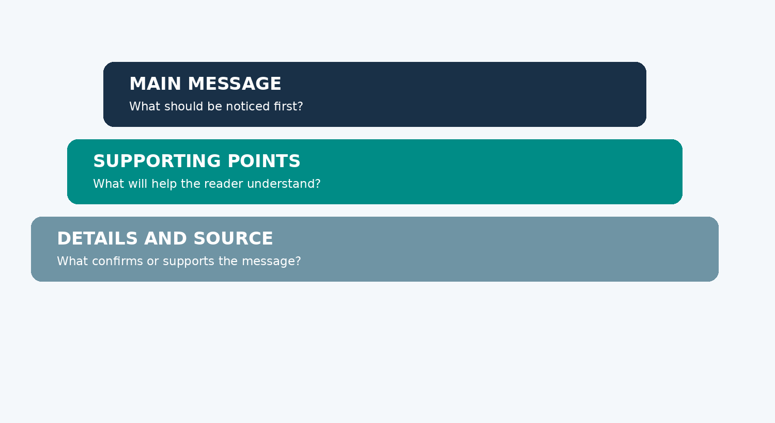
ITT06105 / DESKTOP PUBLISHING
HIERARCHY
Content hierarchy decides what readers encounter first
A hierarchy separates the main message from supporting explanations and optional detail.
Use heading size, position, spacing and contrast to communicate levels of importance.
DESKTOP PUBLISHING • LECTURE 03 • 2026/2027
13

Slide 14
ITT06105 / DESKTOP PUBLISHING
OUTLINE
A content outline is the skeleton of your page
Arrange messages in a logical reading order before deciding colours or exact positions.
1 Headline
Stay Safe Online
2 Short introduction
Your accounts and data deserve simple protection.
3 Three habits
Use strong passwords; turn on verification; check links.
4 Action
Choose one habit and practise it today.
5 Source line
Provide a credible source or course reference.
DESKTOP PUBLISHING • LECTURE 03 • 2026/2027
14

Slide 15
ITT06105 / DESKTOP PUBLISHING
CONTENT MAP
A content map links each message to a place on the page
It helps prevent an attractive design from losing important information.
TOP
Main heading and introductory sentence
MIDDLE LEFT
Simple icon or illustration
MIDDLE RIGHT
Three to five short safety habits
BOTTOM
Action line, source and contact if needed
The map records the location and purpose of each element—not finished artwork.
DESKTOP PUBLISHING • LECTURE 03 • 2026/2027
15

Slide 16
ITT06105 / DESKTOP PUBLISHING
BRAINSTORM
A mind map can help you gather ideas quickly
Begin with a topic in the middle, then add possible points around it. Edit afterwards.
STRONG PASSWORDS
TWO-STEP CHECKS
STAY SAFE ONLINE
CHECK LINKS
UPDATE DEVICES
A mind map is a tool for generating ideas; it is not the final page layout.
DESKTOP PUBLISHING • LECTURE 03 • 2026/2027
16

Slide 17
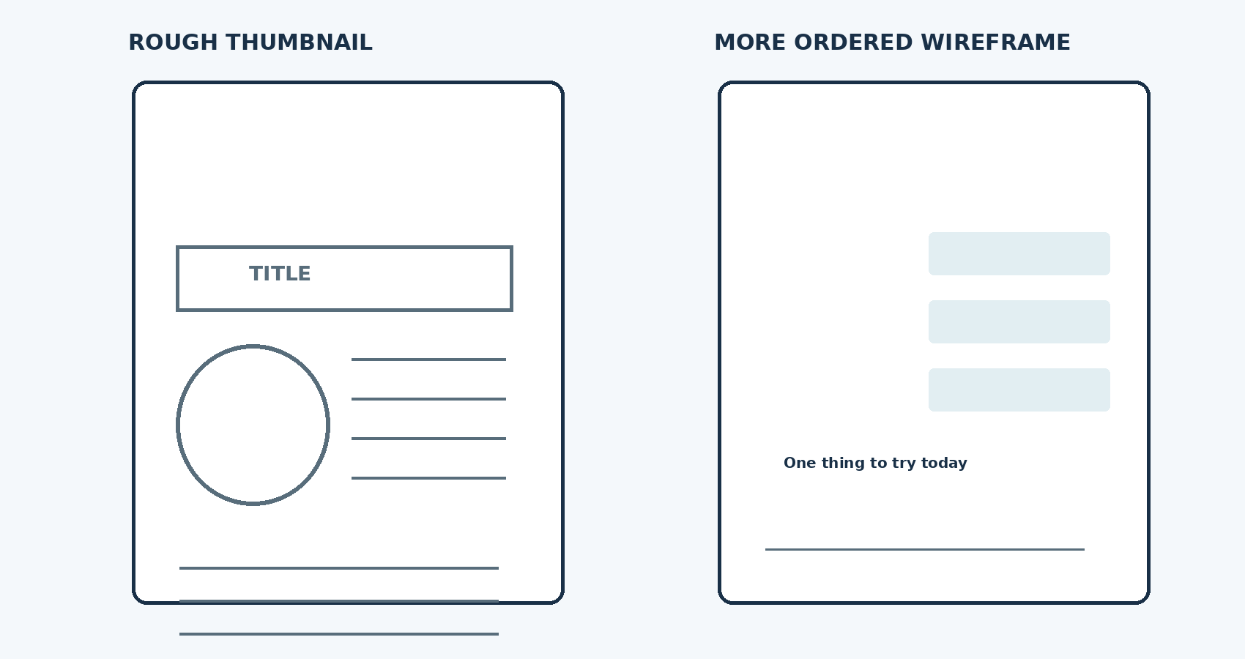
ITT06105 / DESKTOP PUBLISHING
SKETCH
A thumbnail sketch is a very small page plan
A quick sketch lets you test positions and balance without committing to the final design.
Boxes and lines are enough. Attractive drawing is not required at this stage.
DESKTOP PUBLISHING • LECTURE 03 • 2026/2027
17

Slide 18
ITT06105 / DESKTOP PUBLISHING
WIREFRAME
A wireframe shows the structure more clearly
It represents the approximate size and placement of text, graphics and white space.
Thumbnail sketch
Wireframe
A rough early idea, often drawn quickly by hand. Several thumbnails can be compared before choosing a direction.
A more deliberate structure with areas reserved for the title, content, illustrations and footer. Exact colours are not yet necessary.
Both are planning tools; neither is the finished publication.
DESKTOP PUBLISHING • LECTURE 03 • 2026/2027
18

Slide 19
ITT06105 / DESKTOP PUBLISHING
PAGE DESIGN
A basic A4 layout needs clear zones
Decide where the heading, image, core content and action line will fit.
A clean reading path is usually more valuable than complex visual effects.
DESKTOP PUBLISHING • LECTURE 03 • 2026/2027
19

Slide 20
ITT06105 / DESKTOP PUBLISHING
MARGINS
Margins keep important content away from the edge
A margin is the space between the edge of a page and the main content area.
Why margins matter
Simple starting rule
Margins help text breathe and reduce the risk of cropping or crowding. Consistent edges also make different parts of the page feel connected.
For an A4 classroom hand-out, begin with approximately 15–20 mm of space around the main content, then adjust for the page and printer.
A margin is a design choice, not the same thing as bleed for commercial printing.
DESKTOP PUBLISHING • LECTURE 03 • 2026/2027
20

Slide 21
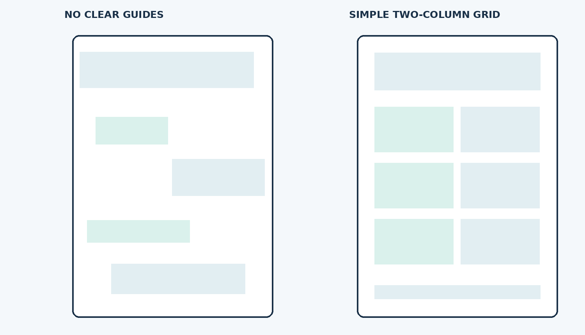
ITT06105 / DESKTOP PUBLISHING
GRID
A grid makes alignment easier
A grid is an underlying arrangement of columns and spaces that helps organise the page.
For a beginner hand-out, a simple single-column or two-column grid is enough.
DESKTOP PUBLISHING • LECTURE 03 • 2026/2027
21

Slide 22
ITT06105 / DESKTOP PUBLISHING
DESIGN PRINCIPLES
Use alignment and proximity to improve the sketch
Good planning already applies the visual communication skills from Lecture 1.
Alignment
Proximity
Place related items along shared vertical or horizontal lines. Random positions make a page feel unstable and harder to scan.
Keep headings near the text they introduce. Separate unrelated sections so readers can recognise groups quickly.
The best grid is one that improves reading, not one that adds unnecessary complexity.
DESKTOP PUBLISHING • LECTURE 03 • 2026/2027
22

Slide 23
ITT06105 / DESKTOP PUBLISHING
SPACING
Whitespace is part of the design
Blank space gives important ideas room to stand out and helps readers see where one section ends.
Crowded page
Clear page
Every space is filled with text, unrelated icons or decoration. Readers have few visual clues about what matters most.
The title, key points and action have breathing room. Related items form visible groups, and the page feels easier to scan.
Leaving space empty is not wasting space when it improves understanding.
DESKTOP PUBLISHING • LECTURE 03 • 2026/2027
23

Slide 24
ITT06105 / DESKTOP PUBLISHING
EDITORIAL CHOICE
Ask whether every element earns its place
A planning check can save more time than a late redesign.
Heading
Image
Can the reader identify the topic immediately?
Does it explain something or merely decorate the page?
Body text
Action line
Is the essential message concise and correctly grouped?
Does the reader know what to do next?
DESKTOP PUBLISHING • LECTURE 03 • 2026/2027
24

Slide 25
ITT06105 / DESKTOP PUBLISHING
DELIVERY
Plan for the format in which the page will be used
Publication format influences page size, image clarity and how the audience reads.
Printed A4 hand-out
Digital PDF
Keep the page within reliable print margins; use readable type and artwork that remains clear when printed.
Check page readability on a small screen, preserve text and ensure any links are functional.
Our project will first use A4 as the master page and may later be exported as a PDF.
DESKTOP PUBLISHING • LECTURE 03 • 2026/2027
25

Slide 26
ITT06105 / DESKTOP PUBLISHING
REVIEW
Feedback is more useful before final production
Show the brief and rough layout to someone who resembles the intended reader.
Ask specific questions
Make one thoughtful revision
“What did you read first?” “Which advice was difficult?” “What action would you take?” These questions reveal problems you can fix.
If readers miss the key action, make it easier to find. If a term is unfamiliar, rewrite it rather than adding a longer paragraph.
Feedback is evidence about the design—not a vote on a favourite colour.
DESKTOP PUBLISHING • LECTURE 03 • 2026/2027
26

Slide 27
ITT06105 / DESKTOP PUBLISHING
WORKFLOW
The minimum planning sequence for this course
You can complete this process with pencil and paper before using any software.
1. Write
2. Select
Purpose and audience
Main message and essential facts
3. Arrange
4. Check
A4 thumbnail with margins and zones
Reading order and one reader action
DESKTOP PUBLISHING • LECTURE 03 • 2026/2027
27

Slide 28
ITT06105 / DESKTOP PUBLISHING
YOUR TURN
Class activity: write a five-line publication brief
Use the fictional Tumaini hand-out assignment described earlier.
Complete these five lines
1. The publication I will create is …
2. My intended readers are …
3. After reading, they should …
4. Three essential points to include are …
5. The document will be delivered as …
DESKTOP PUBLISHING • LECTURE 03 • 2026/2027
28

Slide 29
ITT06105 / DESKTOP PUBLISHING
YOUR TURN
Class activity: sketch the page in five minutes
Keep the drawing simple. Show the information, not artistic talent.
Label the heading, image/icon, three tips, action line and source.
DESKTOP PUBLISHING • LECTURE 03 • 2026/2027
29

Slide 30
ITT06105 / DESKTOP PUBLISHING
REVIEW
Before submitting: five quality checks
Use these questions to test the first draft of your one-page hand-out.
1
Is the audience clear?
2
Is one main message unmistakable?
3
Does every key fact have a place?
4
Are margins, alignment and spacing consistent?
5
Is there one realistic action for the reader?
DESKTOP PUBLISHING • LECTURE 03 • 2026/2027
30

Slide 31
ITT06105 / DESKTOP PUBLISHING
EXAMPLE
Example of a clear planning decision
Notice how the five lines support each other rather than describing different projects.
Tumaini — Stay Safe Online
Format: A4, one-page educational hand-out.
Audience: first-year diploma students who are new to online safety.
Purpose: help readers identify simple account-protection habits.
Content: strong passwords, two-step verification, suspicious links.
Action: choose one security setting to improve today.
DESKTOP PUBLISHING • LECTURE 03 • 2026/2027
31

Slide 32
ITT06105 / DESKTOP PUBLISHING
COMMON ERRORS
Four planning mistakes to avoid
Most beginner layout problems start before the software is opened.
Too much content
No clear audience
Trying to fit every fact on a single A4 page.
Using technical language that beginners may not understand.
Decoration first
Skipping the sketch
Choosing colours and fonts before deciding what matters.
Building directly in software and repeatedly moving elements.
DESKTOP PUBLISHING • LECTURE 03 • 2026/2027
32

Slide 33
ITT06105 / DESKTOP PUBLISHING
PRACTICE
Tutorial and practical follow-up
These tasks develop the same skills without adding new theory to memorise.
Tutorial (paper)
Practical (paper or computer)
Discuss the purpose and audience in pairs. Compare two thumbnail sketches and explain which is easier to understand.
Create your own A4 wireframe and content outline. Add labels for the title, graphic, key points, action and source.
Submit a brief and an annotated sketch; a polished digital publication is not yet required.
DESKTOP PUBLISHING • LECTURE 03 • 2026/2027
33

Slide 34
ITT06105 / DESKTOP PUBLISHING
KEY TAKEAWAYS
Five ideas to remember
These are the concepts you should recognise and explain without notes.
Purpose
Audience
Brief
The change the document should produce.
The people for whom the message is intended.
A short record of design requirements.
Hierarchy
Wireframe
The order in which content receives attention.
A plan showing where page elements belong.
DESKTOP PUBLISHING • LECTURE 03 • 2026/2027
34

Slide 35
ITT06105 / DESKTOP PUBLISHING
REVISION
Check your understanding before CAT 1
Use the review questions to strengthen your understanding of the first three lectures.
Review questions
1. What distinguishes a document purpose from its format?
2. Give two reasons why the target audience affects layout decisions.
3. Explain how hierarchy and margins improve an A4 hand-out.
4. List the five elements of a useful design brief.
5. Sketch and label a simple one-page publication.
Review the essential concepts of visual communication, graphics and planning.
DESKTOP PUBLISHING • LECTURE 03 • 2026/2027
35

