Slide 1
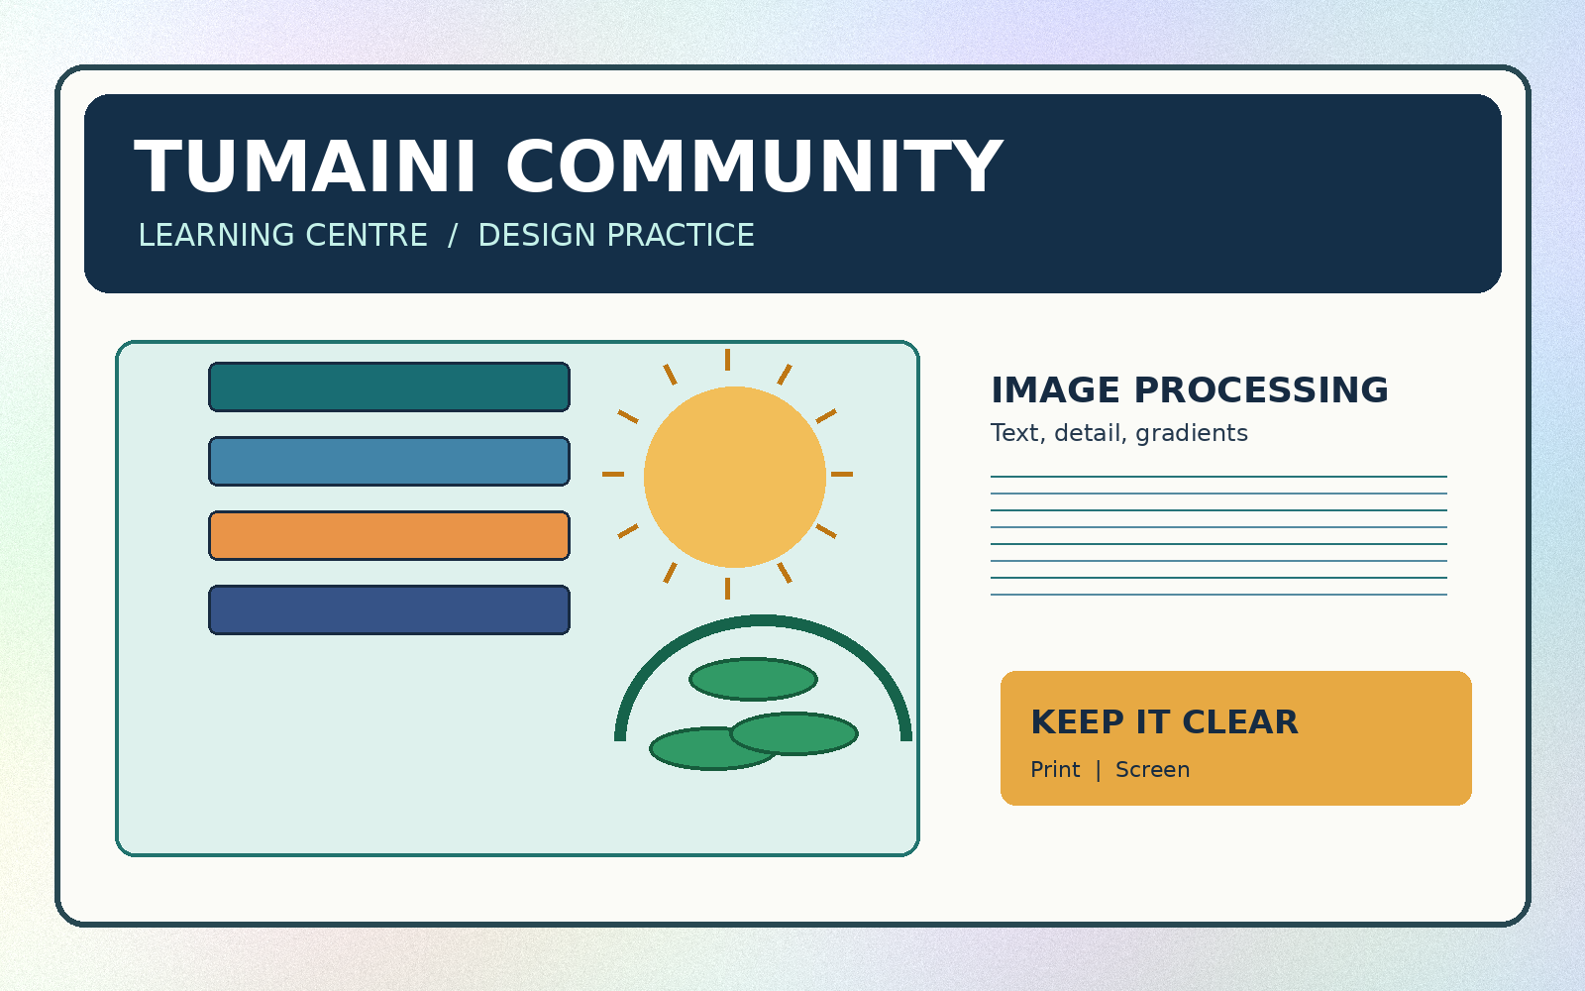
ESSENTIAL LECTURE 04
Photoshop Essentials
Prepare images for a clear and readable publication
Open • Crop • Resize • Save • Export
ITT06105 • Ordinary Diploma in Information Technology • 2026/2027

Slide 2
ITT06105 / DESKTOP PUBLISHING
START HERE
Four skills you will use today
After the lecture, you should be able to carry out a small image-editing task independently.
01 ORGANISE
02 EDIT
03 CORRECT
Keep an untouched original and store each working file in a clearly labelled folder.
Open an existing image, choose a crop and resize it without stretching.
Make a small brightness or contrast change only when the image needs it.
04 DELIVER • Save an editable Photoshop file and export a suitable JPEG or PNG.
DESKTOP PUBLISHING • PHOTOSHOP ESSENTIALS • 2026/2027
02

Slide 3
ITT06105 / DESKTOP PUBLISHING
CONNECTION
Remember the A4 hand-out plan
Lecture 3 explained who the readers are and what the publication should communicate.
OUR RUNNING PROJECT
The message is already planned.
Tumaini Community Learning Centre
Now prepare an image to fit that message.
The one-page “Stay Safe Online” hand-out needs one appropriately prepared image to support the information, not to distract from it.
Next lecture: combine it with text and shapes.
DESKTOP PUBLISHING • PHOTOSHOP ESSENTIALS • 2026/2027
03

Slide 4
ITT06105 / DESKTOP PUBLISHING
CONTEXT
What is Photoshop used for?
In desktop publishing, image editing supports the quality and clarity of the final publication.
Photographs
Illustrations
Working images
Improve composition, crop unnecessary surroundings and make modest corrections to light or contrast.
Prepare raster illustrations to use in a poster, brochure or educational hand-out.
Export an appropriately sized copy while retaining the editable project and untouched source.
Photoshop mainly works with raster (pixel-based) images; it is not a replacement for every publishing application.
DESKTOP PUBLISHING • PHOTOSHOP ESSENTIALS • 2026/2027
04

Slide 5
ITT06105 / DESKTOP PUBLISHING
CONTEXT
One workflow, different applications
The programs overlap, but each has a typical strength in a publishing project.
PHOTOSHOP
ILLUSTRATOR
INDESIGN
Prepare photographs, edit raster images and create pixel-based compositions.
Draw scalable vector artwork such as an icon, logo or simple diagram.
Arrange text, image frames and graphics into the finished page layout.
In this lecture we use Photoshop for a small image task. Later lessons introduce the other applications at a basic level.
DESKTOP PUBLISHING • PHOTOSHOP ESSENTIALS • 2026/2027
05

Slide 6
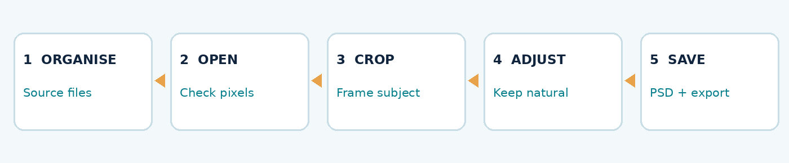
ITT06105 / DESKTOP PUBLISHING
WORKFLOW
Five small steps—not fifty commands
Follow one repeatable route each time you prepare an image.
Think in sequence
Organise your files first, then inspect the image, crop only what is necessary, make modest adjustments and save both working and final output files.
A successful edit is usable, reproducible and easy to find.
DESKTOP PUBLISHING • PHOTOSHOP ESSENTIALS • 2026/2027
06

Slide 7
ITT06105 / DESKTOP PUBLISHING
PREPARATION
Create a project folder before editing
One good habit can prevent much of the confusion beginners experience.
Tumaini_Handout
What each folder holds
01_Originals
02_Working_Files
03_Exports
Originals contain unchanged source images. Working_Files contains editable Photoshop projects. Exports contains JPEG or PNG files intended for the hand-out.
Never perform all of your changes on the only copy of the original image.
DESKTOP PUBLISHING • PHOTOSHOP ESSENTIALS • 2026/2027
07

Slide 8
ITT06105 / DESKTOP PUBLISHING
PREPARATION
Use names that tell you what is inside
A clear filename matters when a practical project is submitted, revised or shared.
SOURCE IMAGE
WORKING PROJECT
FINAL EXPORT
Tumaini_Original_1600x1000.png
This filename identifies the starting artwork.
tumaini_image_edit.psd
This is the editable Photoshop project.
tumaini_image_web.jpg
This is the copy prepared for placing or sharing.
DESKTOP PUBLISHING • PHOTOSHOP ESSENTIALS • 2026/2027
08

Slide 9
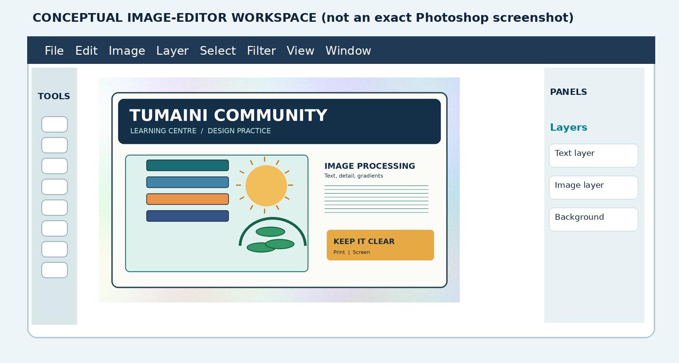
ITT06105 / DESKTOP PUBLISHING
WORKSPACE
Recognising the Photoshop workspace
Menus, tools, panels and the image canvas each have different roles.
Read the labels
The Menu Bar contains commands, the Tools panel gives editing tools, the canvas displays the document, and panels show settings and image structure. The arrangement may vary by version.
Diagram is conceptual; not an exact Photoshop screenshot.
DESKTOP PUBLISHING • PHOTOSHOP ESSENTIALS • 2026/2027
09

Slide 10
ITT06105 / DESKTOP PUBLISHING
WORKSPACE
Four areas to locate before you begin
Finding these areas is more useful than memorising every button.
MENU BAR
TOOLS PANEL
DOCUMENT CANVAS
File, Edit and Image contain commands for opening, adjusting and saving documents.
The Crop Tool changes image framing. Other tools are used for moving, selecting and editing.
The canvas is the actual image or document area. The surrounding workspace is not part of the exported image.
Also locate the Layers panel: it shows the document components and becomes more important in Lecture 5.
DESKTOP PUBLISHING • PHOTOSHOP ESSENTIALS • 2026/2027
10

Slide 11
ITT06105 / DESKTOP PUBLISHING
WORKSPACE
File > Open or File > New?
These commands solve different problems.
File > Open
File > New
Choose Open when the image already exists. For this lecture, open the supplied Tumaini illustration or practice photograph and inspect its properties.
Choose New when you need a blank document, such as a new 1200 × 800 pixel graphic. Before starting, decide on width, height, units and intended use.
For the first practical, start with File > Open; do not complicate the task with a blank composition.
DESKTOP PUBLISHING • PHOTOSHOP ESSENTIALS • 2026/2027
11

Slide 12
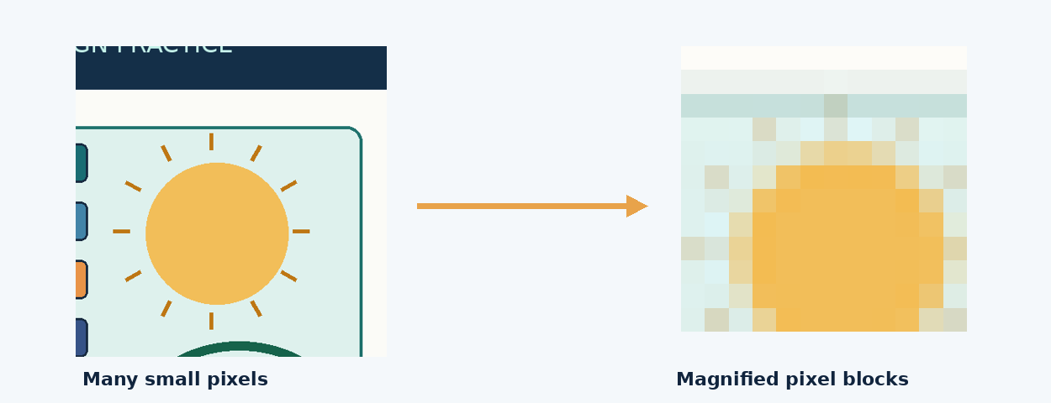
ITT06105 / DESKTOP PUBLISHING
PIXELS
Raster images are made of pixels
Image detail is limited by the quality and dimensions of the source.
A pixel is a picture element
Pixels are tiny units that store colour values. Together, they form a raster image. Excessive enlargement can make blocks or softness visible because the missing original detail cannot simply be recovered.
DESKTOP PUBLISHING • PHOTOSHOP ESSENTIALS • 2026/2027
12

Slide 13
ITT06105 / DESKTOP PUBLISHING
PIXELS
Read width × height correctly
An image described as 1600 × 1000 pixels has two dimensions, not one overall size.
Worked example: 1600 × 1000 px
Why it matters
Width: 1600 pixels
Height: 1000 pixels
Total: 1600 × 1000 = 1,600,000 pixels
A pixel count describes the digital image, not its printed size.
A small image may look fine on a phone but become soft when enlarged in print. Check the intended placement size before choosing or resizing a file.
DESKTOP PUBLISHING • PHOTOSHOP ESSENTIALS • 2026/2027
13

Slide 14
ITT06105 / DESKTOP PUBLISHING
PIXELS
Image dimensions and print resolution
Pixels and pixels per inch (PPI) answer different questions.
Pixel dimensions
Effective PPI
The numbers of pixels across and down the raster image. For example, 2400 pixels wide means the file contains 2400 columns of pixels.
How many image pixels are allocated per printed inch. At 300 effective PPI, an image 2400 pixels wide covers 2400 ÷ 300 = 8 inches.
Changing a PPI label without resampling does not add new pixels.
DESKTOP PUBLISHING • PHOTOSHOP ESSENTIALS • 2026/2027
14

Slide 15
ITT06105 / DESKTOP PUBLISHING
CROPPING
Cropping changes what is visible
Cropping is about composition: keep the part of the image the reader needs.
WHY CROP?
BE CAREFUL
AFTER CROPPING
Remove distracting surroundings, place the main subject more clearly and fit a chosen layout shape.
Do not remove an essential face, sign, instructional detail or visual clue by accident.
Check the new framing at the size readers are likely to see in the final publication.
DESKTOP PUBLISHING • PHOTOSHOP ESSENTIALS • 2026/2027
15

Slide 16
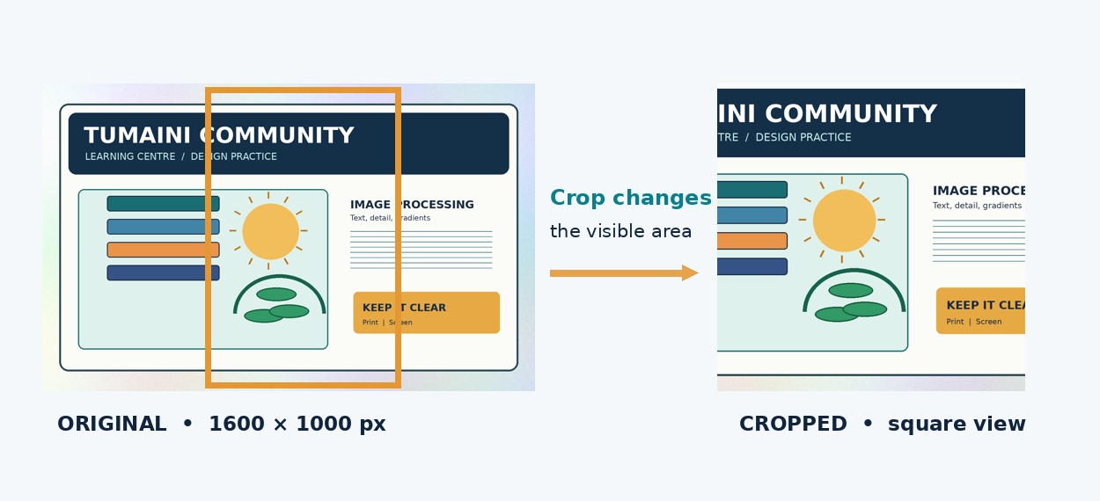
ITT06105 / DESKTOP PUBLISHING
CROPPING
Before and after: change the frame
A crop is not the same as simply shrinking the image.
See the difference
Cropping changes the visible scene. A square crop may help a design, but it can also remove important context. Always judge whether the image still communicates the intended idea.
DESKTOP PUBLISHING • PHOTOSHOP ESSENTIALS • 2026/2027
16

Slide 17
ITT06105 / DESKTOP PUBLISHING
CROPPING
A simple Crop Tool procedure
Follow the same sequence even if the exact buttons differ between Photoshop versions.
Do this
Check before confirming
1. Open the supplied image.
2. Select the Crop Tool (commonly C).
3. Choose a suitable ratio or drag the handles.
4. Move the boundary and inspect what remains.
5. Confirm the crop and save a working copy.
Is the main subject visible?
Is any important text cut off?
Does the framing fit the hand-out?
If “Delete Cropped Pixels” is available, consider leaving it off to preserve flexibility.
DESKTOP PUBLISHING • PHOTOSHOP ESSENTIALS • 2026/2027
17

Slide 18
ITT06105 / DESKTOP PUBLISHING
CROPPING
Aspect ratio describes shape—not pixel count
Different images can have the same aspect ratio but very different amounts of detail.
1 : 1 • SQUARE
4 : 5 • PORTRAIT
16 : 9 • WIDE
800 × 800 px or 200 × 200 px. Often useful for a small icon or square image block.
800 × 1000 px or 400 × 500 px. May suit a tall, narrow illustration.
1600 × 900 px or 800 × 450 px. Often used for landscape-shaped screen graphics.
DESKTOP PUBLISHING • PHOTOSHOP ESSENTIALS • 2026/2027
18

Slide 19
ITT06105 / DESKTOP PUBLISHING
CROPPING
Do not crop away the reason for the image
A technically neat crop is not useful if it destroys essential information.
Poor crop
Better crop
A poster image shows a person pointing to a safety sign. Cropping away the sign leaves the gesture without a clear meaning.
Keep the relevant subject and sign within the frame. Use spacing and alignment in the hand-out to make the most important information visible.
The reader’s need—not the decorative appearance—determines whether a crop is successful.
DESKTOP PUBLISHING • PHOTOSHOP ESSENTIALS • 2026/2027
19

Slide 20
ITT06105 / DESKTOP PUBLISHING
RESIZING
Resizing changes pixel dimensions
Resizing is different from cropping: it changes how many pixels the image uses.
Correct proportional resize
Prevent stretching
Original: 1600 × 1000 px
New width: 800 px
Scale factor: 800 ÷ 1600 = 0.5
New height: 1000 × 0.5 = 500 px
With width–height proportions linked, an object retains its natural shape. Changing width without adjusting height can distort faces, letters and symbols.
1600 × 1000 px resized to 800 × 500 px retains shape but has one quarter as many pixels.
DESKTOP PUBLISHING • PHOTOSHOP ESSENTIALS • 2026/2027
20

Slide 21
ITT06105 / DESKTOP PUBLISHING
RESIZING
Do not confuse Image Size with Canvas Size
One changes the image dimensions; the other changes the surrounding document area.
Image Size
Canvas Size
Used to inspect or change an image’s pixel dimensions. If resampling is enabled, Photoshop can add or remove pixels.
Changes the area around existing content. For example, adding a border without scaling the original photograph is a canvas-size task.
For the basic practical: inspect Image Size; you do not need to master Canvas Size today.
DESKTOP PUBLISHING • PHOTOSHOP ESSENTIALS • 2026/2027
21

Slide 22
ITT06105 / DESKTOP PUBLISHING
RESIZING
What does “Resample” mean?
The number of pixels changes only when the software is told to recalculate the image.
Resample ON
Resample OFF
Changing the pixel width or height alters the number of pixels. Reducing dimensions is common for smaller digital images. Enlarging does not recover genuine lost detail.
If you change only the resolution value, the underlying pixel dimensions remain fixed. A different calculated print size is not the same as a new, sharper image.
DESKTOP PUBLISHING • PHOTOSHOP ESSENTIALS • 2026/2027
22

Slide 23
ITT06105 / DESKTOP PUBLISHING
RESIZING
Worked example: printing width
This simple calculation connects pixels to an approximate printed dimension.
2400 pixels ÷ 300 pixels per inch = 8 inches
A 2400-pixel-wide image covers about 8 inches when placed at 300 effective PPI.
Effective PPI is a planning guide; source detail, paper, printer and viewing distance still matter.
DESKTOP PUBLISHING • PHOTOSHOP ESSENTIALS • 2026/2027
23

Slide 24
ITT06105 / DESKTOP PUBLISHING
CORRECTION
Make small changes to brightness and contrast
The goal is to make an image clear, not to create unnatural colour.
BRIGHTNESS
CONTRAST
COMPARE
Changes the overall lightness of the image. Too much can wash out light areas and remove detail.
Changes the difference between light and dark regions. Too much may hide information in shadows.
Look at the original and the edited image together. Keep the correction only if readability improves.
DESKTOP PUBLISHING • PHOTOSHOP ESSENTIALS • 2026/2027
24

Slide 25
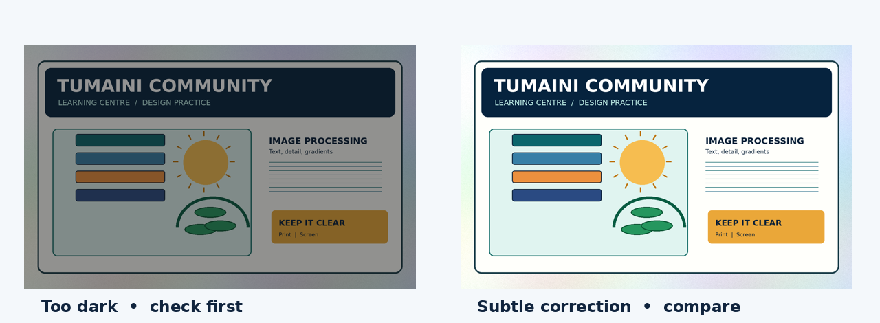
ITT06105 / DESKTOP PUBLISHING
CORRECTION
A modest correction is usually enough
Compare the source against the edited image before deciding.
Avoid heavy changes
If the image is dim, a modest correction may help. If it was already clear, leave it alone. An attractive-looking edit is not automatically better for communicating factual information.
DESKTOP PUBLISHING • PHOTOSHOP ESSENTIALS • 2026/2027
25

Slide 26
ITT06105 / DESKTOP PUBLISHING
CORRECTION
A beginner-friendly adjustment procedure
Advanced non-destructive adjustment layers will be introduced in Lecture 5.
Try this in Photoshop
Common warning signs
1. Duplicate or save a working copy.
2. Open Image > Adjustments > Brightness/Contrast.
3. Move the controls only a little.
4. Compare with the untouched source.
5. Undo the edit if details disappear.
White areas lose their texture, dark areas become solid black, skin or objects look unnatural, or coloured text becomes difficult to read. Make a smaller change or return to the source.
DESKTOP PUBLISHING • PHOTOSHOP ESSENTIALS • 2026/2027
26

Slide 27
ITT06105 / DESKTOP PUBLISHING
FILES
Save the project before exporting
A Photoshop working file and an exported image serve different purposes.
Editable working file (.PSD)
Exported file (.JPG or .PNG)
Keeps the working document for future changes. If the project contains layers or editing information, a PSD can preserve them. Save under 02_Working_Files.
Intended for placing in a document, sharing or viewing. It may not retain the original editing structure. Save under 03_Exports.
Exporting is not a substitute for keeping an editable working project.
DESKTOP PUBLISHING • PHOTOSHOP ESSENTIALS • 2026/2027
27

Slide 28
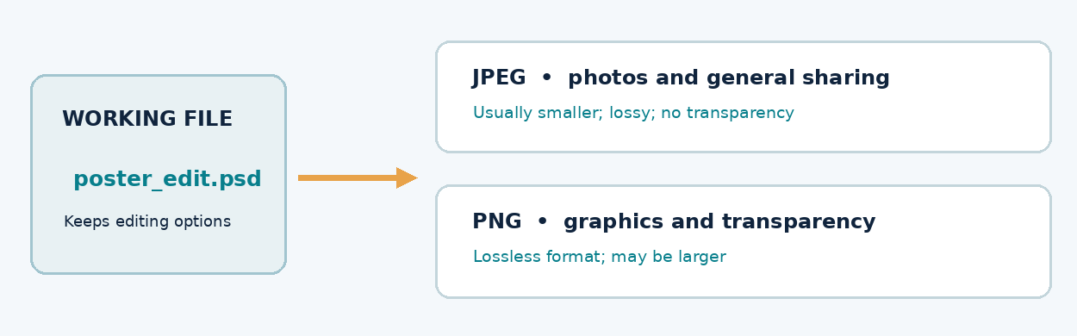
ITT06105 / DESKTOP PUBLISHING
FILES
One project, two useful outputs
Preserve editability and prepare a sharing copy.
Choose the right purpose
PSD is the editable source for Photoshop work. JPEG is a common output for photographs and often produces smaller files. PNG can preserve transparency and sharp-edged graphic areas.
DESKTOP PUBLISHING • PHOTOSHOP ESSENTIALS • 2026/2027
28

Slide 29
ITT06105 / DESKTOP PUBLISHING
FILES
JPEG or PNG? Choose for a reason
A file format should suit the image and how it will be used.
JPEG
PNG
Often suitable for photographs and sharing. It uses lossy compression, and it does not support transparent image areas. Avoid repeatedly saving over the only image.
Useful for graphics, text-heavy images or transparent objects. It uses lossless compression. Some PNG files may be larger than comparable JPEG images.
Do not assume one format is always best. Test the image in the intended publication.
DESKTOP PUBLISHING • PHOTOSHOP ESSENTIALS • 2026/2027
29

Slide 30
ITT06105 / DESKTOP PUBLISHING
FILES
Where does each file belong?
Simple file organisation helps you recover, revise and submit your work.
01_Originals
02_Working_Files
03_Exports
Tumaini_Original_1600x1000.png
Unchanged source.
tumaini_image_edit.psd
Editable Photoshop work.
tumaini_image_web.jpg
Copy prepared for use.
Reopen the exported file before handing it in. Confirm the dimensions and appearance.
DESKTOP PUBLISHING • PHOTOSHOP ESSENTIALS • 2026/2027
30

Slide 31
ITT06105 / DESKTOP PUBLISHING
GUIDED PRACTICE
Step 1 — open and inspect the source
Start with a supplied image to reduce unnecessary setup problems.
Follow the first actions
Make the three folders. Copy the original. Use File > Open. Check that the image is 1600 × 1000 pixels. Locate the Crop Tool and the Layers panel.
Begin with a source that opens correctly before attempting any editing.
DESKTOP PUBLISHING • PHOTOSHOP ESSENTIALS • 2026/2027
31

Slide 32
ITT06105 / DESKTOP PUBLISHING
GUIDED PRACTICE
Step 2 — choose and apply a crop
Your crop should help the reader see the subject clearly.
Do and check
Select the Crop Tool. Try a crop that keeps the main illustration. Check the edges carefully. Confirm only when the remaining image still conveys the intended message.
DESKTOP PUBLISHING • PHOTOSHOP ESSENTIALS • 2026/2027
32

Slide 33
ITT06105 / DESKTOP PUBLISHING
GUIDED PRACTICE
Step 3 — resize without stretching
The example exercise uses an 800-pixel-wide export.
FROM
TO
1600 × 1000 px
→
800 × 500 px
Keep the proportions linked. If the width is halved, the height must also be halved.
DESKTOP PUBLISHING • PHOTOSHOP ESSENTIALS • 2026/2027
33

Slide 34
ITT06105 / DESKTOP PUBLISHING
GUIDED PRACTICE
Step 4 — save and export separately
A small practical is complete only when its output can be reopened.
Save a working project
Export a sharing copy
Use File > Save As or the available equivalent, and save a .PSD under 02_Working_Files. Keep the name descriptive.
Use Export As, Save a Copy or the equivalent command to create a JPEG or PNG in 03_Exports. Reopen the file and check its size, crop and clarity.
Different Photoshop releases may label export commands differently.
DESKTOP PUBLISHING • PHOTOSHOP ESSENTIALS • 2026/2027
34

Slide 35
ITT06105 / DESKTOP PUBLISHING
TROUBLESHOOTING
Five mistakes beginners should avoid
Identify the likely cause before trying to fix the file.
STRETCHED IMAGE
LOST ORIGINAL
BLURRY OUTPUT
Width changed without a matching height. Reopen Image Size and lock proportions.
Only one file was edited repeatedly. Retrieve the source and create separate working/export folders.
Image enlarged beyond its detail. Use a stronger source or display/print it smaller.
Also check for over-adjustment and for forgetting to export a final JPEG/PNG.
DESKTOP PUBLISHING • PHOTOSHOP ESSENTIALS • 2026/2027
35

Slide 36
ITT06105 / DESKTOP PUBLISHING
PRACTICE
Your short independent task
Prepare one image for the A4 “Stay Safe Online” hand-out.
Student checklist
Evidence to submit
□ Original preserved
□ Image opened and inspected
□ Useful crop selected
□ Dimensions changed proportionally
□ Correction checked if used
□ PSD saved and JPEG/PNG exported
One editable project; one exported image; a short completion record and two or three sentences explaining your crop and file format choice.
DESKTOP PUBLISHING • PHOTOSHOP ESSENTIALS • 2026/2027
36

Slide 37
ITT06105 / DESKTOP PUBLISHING
REVIEW
Check your understanding before the next lecture
Answer these without opening the software.
QUESTION 1
QUESTION 2
QUESTION 3
Explain the difference between cropping and resizing. Give one practical example of each.
A 1600 × 1000 image is reduced to 800 pixels wide. What is its proportional new height?
Why should a student submit both a PSD project and a JPEG or PNG export?
DESKTOP PUBLISHING • PHOTOSHOP ESSENTIALS • 2026/2027
37

Slide 38
ITT06105 / DESKTOP PUBLISHING
TAKEAWAY
What you should remember
Keep the image-editing process simple and purposeful.
Organise → Open → Crop → Resize → Check → Save → Export
An image is successful when it supports the publication, remains clear and can be edited again when needed.
NEXT: Use layers, shapes and text to produce a simple graphic composition.
DESKTOP PUBLISHING • PHOTOSHOP ESSENTIALS • 2026/2027
38

