Slide 1

ESSENTIAL LECTURE 05
Basic Image Editing
and Graphic Composition
Combine images, shapes and text into a readable event notice
Layers • Hierarchy • Layout • Export
ITT06105 • Ordinary Diploma in Information Technology • 2026/2027

Slide 2
ITT06105 / DESKTOP PUBLISHING
START HERE
What you will be able to do
This lesson uses a prepared illustration to build one clear digital event notice.
01 ORGANISE
02 DESIGN
03 DELIVER
Recognise the role of layers, name them clearly and arrange objects in the correct order.
Combine one image, a few shapes and editable text using clear spacing and hierarchy.
Save an editable Photoshop project and export a final image that can be checked and shared.
The goal is a readable publication—not a display of every Photoshop effect.
DESKTOP PUBLISHING • GRAPHIC COMPOSITION • 2026/2027
02

Slide 3

ITT06105 / DESKTOP PUBLISHING
CONNECTION
You already have the first ingredient
Lecture 4 taught how to prepare an image. Now use it in a small composition.
One running project
Tumaini Community Learning Centre needs a simple digital announcement for its fictional “Stay Safe Online” session. Keep the main title, image and event details easy to find.
DESKTOP PUBLISHING • GRAPHIC COMPOSITION • 2026/2027
03

Slide 4
ITT06105 / DESKTOP PUBLISHING
CONCEPT
What is a graphic composition?
Every element should help the reader understand one message.
Definition
Example
A graphic composition is a planned arrangement of text, images, shapes and empty space within a defined area. It communicates more effectively when the elements have clear relationships.
An event notice combines an illustration, a prominent session title, a short explanation and a visible date/time. Random decorations that interrupt this sequence do not improve communication.
A composition is effective when readers know where to look first, second and third.
DESKTOP PUBLISHING • GRAPHIC COMPOSITION • 2026/2027
04

Slide 5
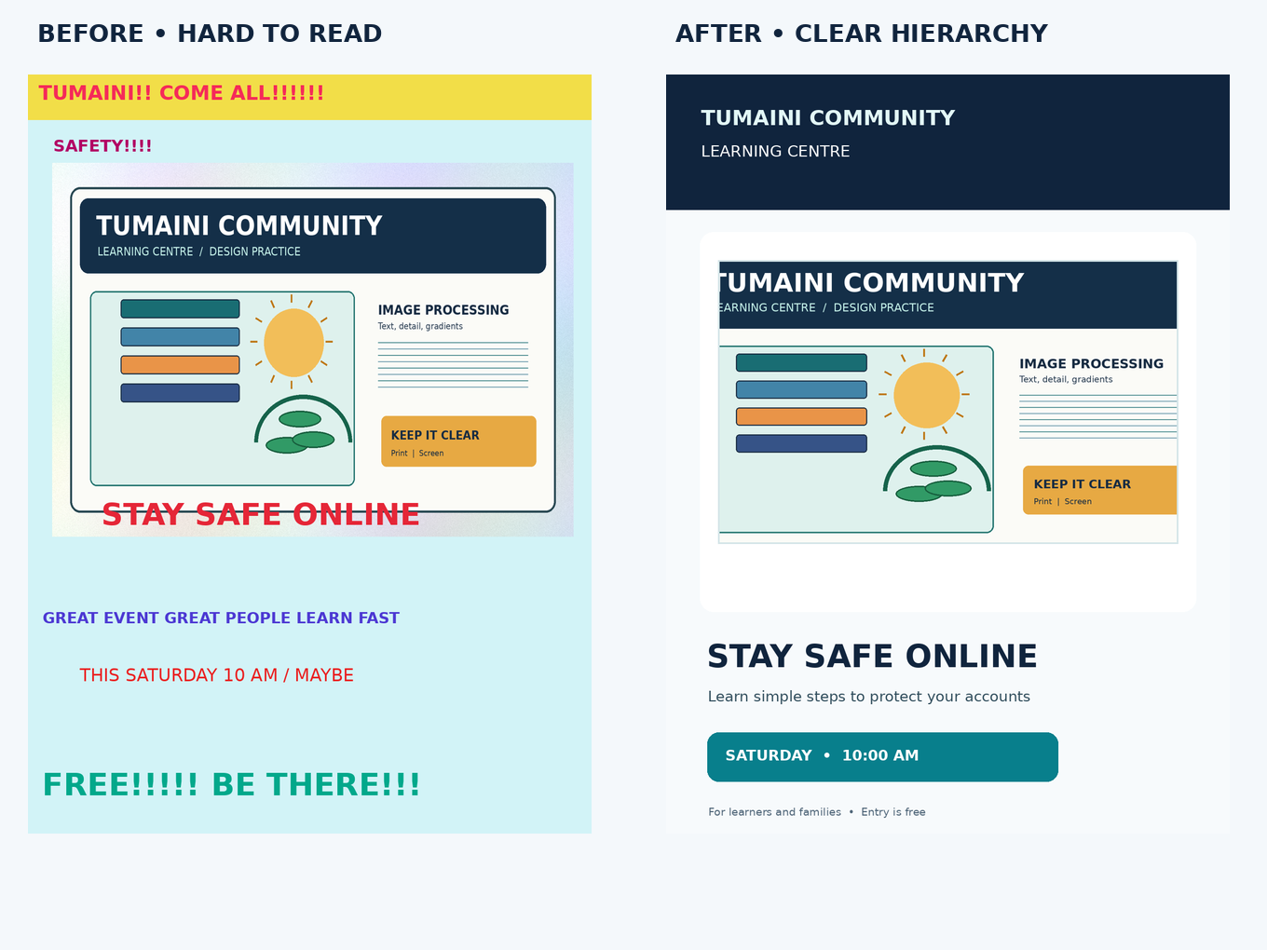
ITT06105 / DESKTOP PUBLISHING
COMPARE
Why some notices are difficult to read
Look for poor hierarchy, crowding, alignment and colour choices.
Which works better?
A design can contain the correct facts but still communicate badly. The clearer notice uses a stronger title, calmer colours, consistent margins and a distinct place for the date and time.
Students should justify their judgement using design principles.
DESKTOP PUBLISHING • GRAPHIC COMPOSITION • 2026/2027
05

Slide 6
ITT06105 / DESKTOP PUBLISHING
LAYERS
A layer is an editable part of the page
Layers make a complex graphic easier to revise without rebuilding everything.
BACKGROUND
IMAGE
TEXT + SHAPES
The base colour or image behind the design. Often kept at the bottom of the stack.
A placed illustration or photograph that can be resized and repositioned separately.
Headlines, descriptions and coloured banners that remain independent of the image.
DESKTOP PUBLISHING • GRAPHIC COMPOSITION • 2026/2027
06

Slide 7
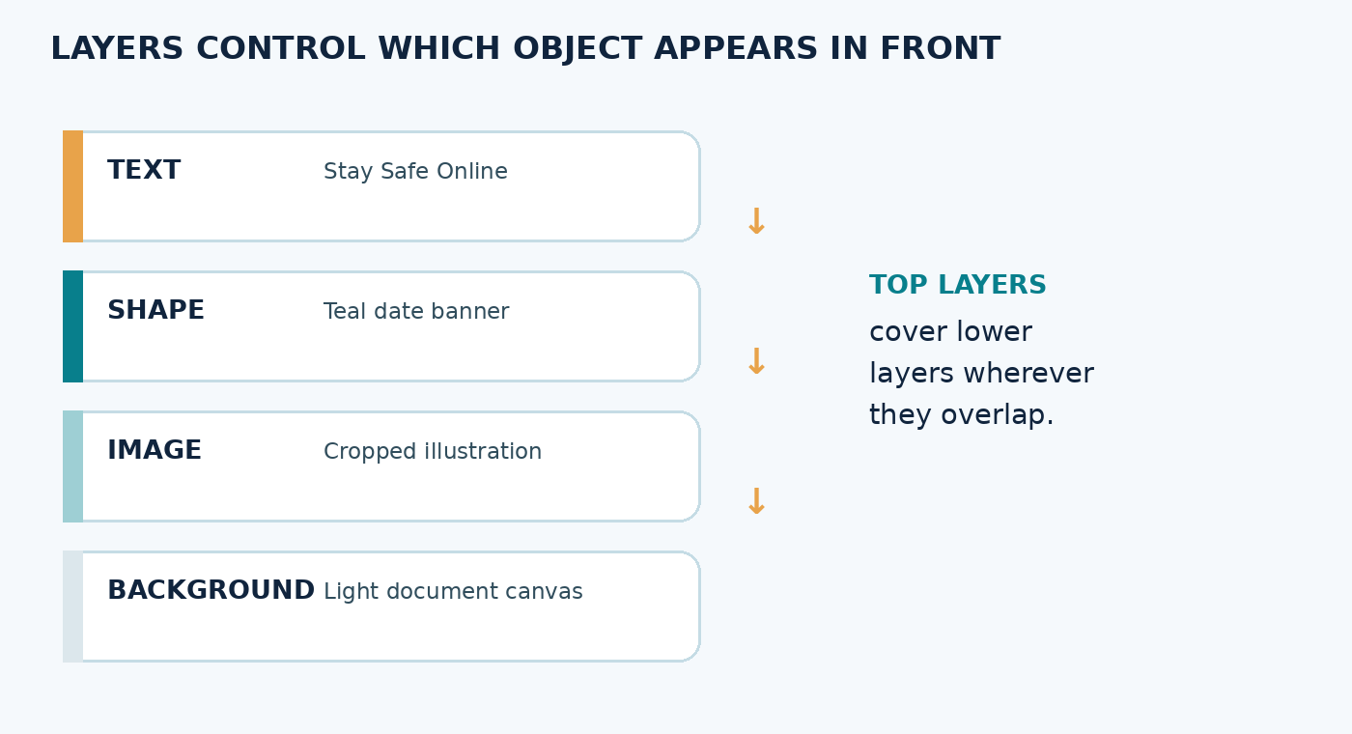
ITT06105 / DESKTOP PUBLISHING
LAYERS
The order of layers changes what you see
The highest visible layer generally appears in front where objects overlap.
Think of stacked sheets
If your title disappears behind a photograph, inspect the Layers panel. Move the title layer above the image layer rather than redrawing the heading.
The top item is visually in front where it overlaps lower items.
DESKTOP PUBLISHING • GRAPHIC COMPOSITION • 2026/2027
07

Slide 8
ITT06105 / DESKTOP PUBLISHING
LAYERS
Why keep separate layers?
One decision can be changed without disturbing unrelated elements.
MOVE
REPLACE
REVISE
Change the position of the event title while leaving the photograph exactly where it is.
Swap a background picture without retyping the event details.
Correct an incorrect date on its own text layer, then produce an updated export.
DESKTOP PUBLISHING • GRAPHIC COMPOSITION • 2026/2027
08

Slide 9
ITT06105 / DESKTOP PUBLISHING
LAYERS
Use meaningful layer names
Clear names make an editable file useful after the lesson.
Hard to work with
Easier to understand
Layer 1
Layer 1 copy 2
Rectangle 5
Text copy 3
Layer 8
Background
Cropped photo
Date banner
Main heading
Event details
Rename layers as the composition grows; do not wait until the end.
DESKTOP PUBLISHING • GRAPHIC COMPOSITION • 2026/2027
09

Slide 10
ITT06105 / DESKTOP PUBLISHING
WORKSPACE
Find the Layers panel in Photoshop
It usually lists each visible component and provides common layer controls.
EYE ICON
ORDER
LOCK + NAME
Temporarily show or hide a layer to identify what it contains.
Drag layers to change front-to-back order when they overlap.
Protect a background from accidental movement and rename important layers.
DESKTOP PUBLISHING • GRAPHIC COMPOSITION • 2026/2027
10

Slide 11
ITT06105 / DESKTOP PUBLISHING
PREPARATION
Make one simple document
The example dimensions support digital teaching—not every type of print job.
Start a portrait canvas
Why choose dimensions first?
Use File > New and enter approximately 1000 × 1350 pixels. Save the new PSD before you begin arranging objects. In other editors, use an equivalent custom-size document.
The document dimensions describe the working area. Changing them late can disturb object positions. Use a different size if the publication’s real output requires one.
Keep the original source image stored separately, exactly as in Lecture 4.
DESKTOP PUBLISHING • GRAPHIC COMPOSITION • 2026/2027
11

Slide 12
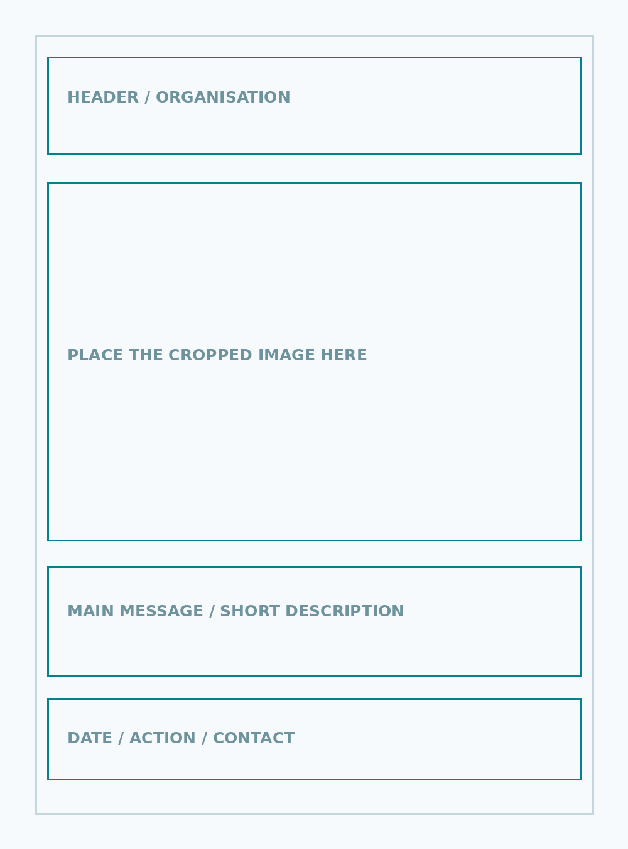
ITT06105 / DESKTOP PUBLISHING
PREPARATION
A layout can start as a simple sketch
You do not need specialised design skills to plan where objects belong.
Four useful regions
Reserve space for the organisation name, a relevant image, the main event title and a date/action line. Use the template as a guide; the final design should be your own editable document.
DESKTOP PUBLISHING • GRAPHIC COMPOSITION • 2026/2027
12

Slide 13
ITT06105 / DESKTOP PUBLISHING
IMAGES
Place the image on its own layer
A separately placed image is easier to move or scale.
Practical sequence
Look for these problems
1. Open the new document.
2. Choose File > Place Embedded (or equivalent).
3. Select the prepared Tumaini image.
4. Resize proportionally and confirm.
5. Name the layer “Photo”.
Do not stretch the picture to fill a frame. Do not cover an important face, icon or word. A picture that already fits naturally may be better than a tightly cropped image.
In different Photoshop versions, commands and toolbar positions may vary.
DESKTOP PUBLISHING • GRAPHIC COMPOSITION • 2026/2027
13

Slide 14
ITT06105 / DESKTOP PUBLISHING
IMAGES
Placing is not the same as flattening
Keep the image and text independent until the project is finished.
PLACE IMAGE
EDIT SOURCE
DO NOT FLATTEN
Add the picture as a separate component, then scale and position it.
Make necessary crop or tonal changes in a working copy when practical.
Avoid merging every layer before you have saved the editable project.
DESKTOP PUBLISHING • GRAPHIC COMPOSITION • 2026/2027
14

Slide 15
ITT06105 / DESKTOP PUBLISHING
TEXT
Use the Type Tool for editable words
A heading should be easy to change if details are corrected.
Headline
Supporting text
Create “STAY SAFE ONLINE” as a separate text layer. Make it visually prominent, use a readable typeface and keep enough clear space around the letters.
Use smaller text for the workshop description and a clear line for date/time. The reader should not need to guess which detail matters most.
Avoid rasterising text: rasterised words are no longer directly editable as characters.
DESKTOP PUBLISHING • GRAPHIC COMPOSITION • 2026/2027
15

Slide 16
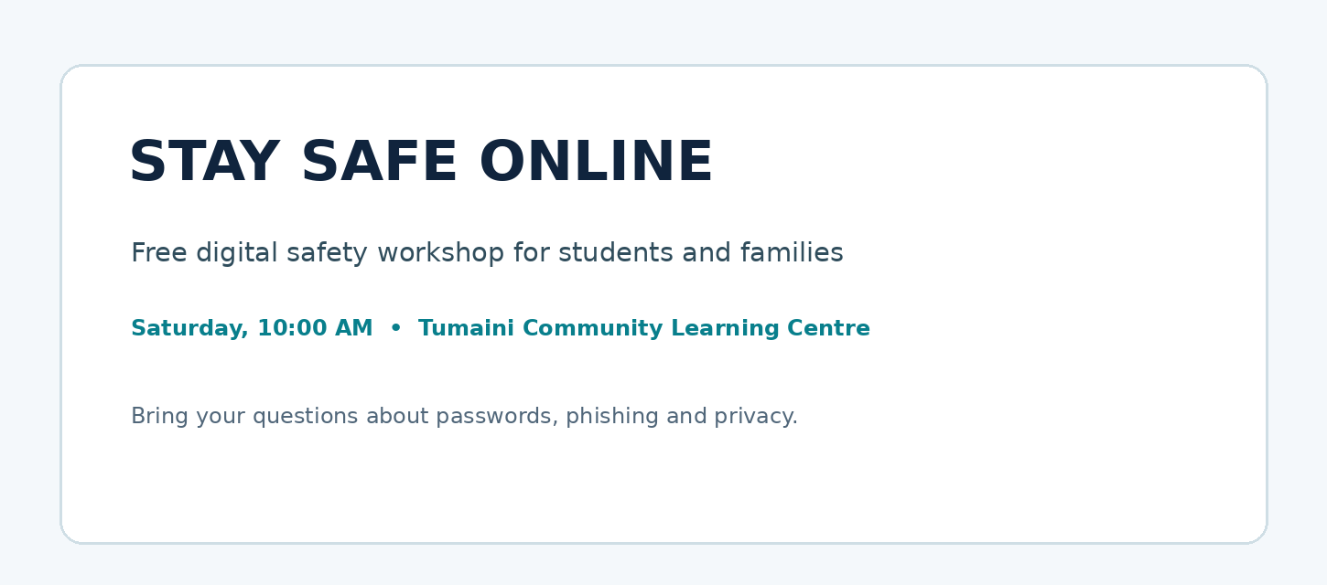
ITT06105 / DESKTOP PUBLISHING
TEXT
Show readers what to read first
Readable hierarchy is created with size, spacing, position and contrast.
Three clear levels
The large heading attracts attention, a medium-sized statement explains the event, and smaller text gives the date and practical information. Keep the type styles consistent.
Use one type family and only a few deliberate size differences.
DESKTOP PUBLISHING • GRAPHIC COMPOSITION • 2026/2027
16

Slide 17
ITT06105 / DESKTOP PUBLISHING
TEXT
A simple hierarchy has a purpose
Each level answers a different question for the reader.
LEVEL 1: WHAT?
LEVEL 2: WHY?
LEVEL 3: WHEN?
STAY SAFE ONLINE
The central topic of the notice; bold and immediately visible.
Learn simple steps to protect your accounts.
A short explanation in smaller readable text.
Saturday • 10:00 AM
Practical detail separated clearly from the description.
DESKTOP PUBLISHING • GRAPHIC COMPOSITION • 2026/2027
17

Slide 18
ITT06105 / DESKTOP PUBLISHING
SHAPES
Shapes are useful when they organise information
A rectangle can be functional rather than decorative.
BANNER
BACKGROUND
ACCENT
Place a coloured rectangle behind the date when it improves legibility.
Use a restrained pale shape to separate the main message from a busy image.
A small line or circle can indicate a section, but should not compete with the title.
DESKTOP PUBLISHING • GRAPHIC COMPOSITION • 2026/2027
18

Slide 19
ITT06105 / DESKTOP PUBLISHING
SHAPES
How to add a banner without creating clutter
A restrained shape should support the text above it.
Basic procedure
Common mistake
Choose a shape tool, draw a rectangle, apply a modest fill colour, move it below the date text in the layer stack and check that the words remain legible.
An oversized or overly bright shape may attract more attention than the event title. Reduce its size, contrast or number of colours until the information is easier to scan.
DESKTOP PUBLISHING • GRAPHIC COMPOSITION • 2026/2027
19

Slide 20
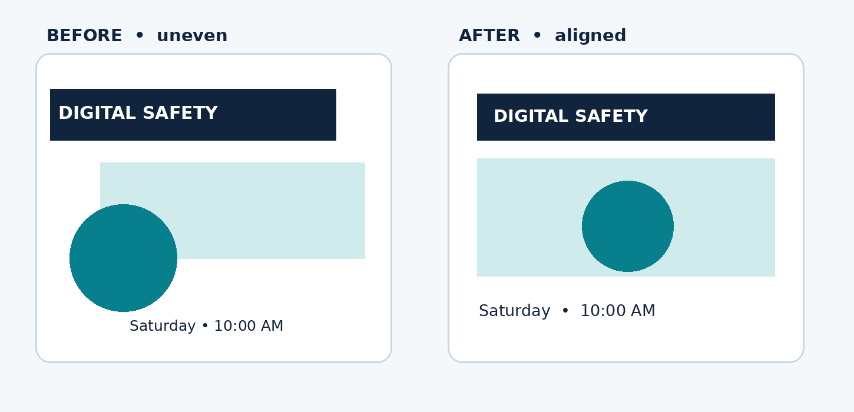
ITT06105 / DESKTOP PUBLISHING
DESIGN RULES
Alignment gives the composition structure
Related elements should share a clear visual edge or centre.
Compare the margins
The right-hand design aligns the heading, image and supporting line. Consistent edges help the eye move from one element to the next without unnecessary searching.
Intentional alignment is more important than perfect symmetry.
DESKTOP PUBLISHING • GRAPHIC COMPOSITION • 2026/2027
20

Slide 21
ITT06105 / DESKTOP PUBLISHING
DESIGN RULES
Spacing can explain relationships
Objects that belong together should appear grouped together.
PROXIMITY
WHITE SPACE
MARGINS
Keep the date and time close enough to be read as one piece of information.
Leave breathing room between the title, image and supporting information.
Keep important text away from the outer edges of the notice.
DESKTOP PUBLISHING • GRAPHIC COMPOSITION • 2026/2027
21

Slide 22
ITT06105 / DESKTOP PUBLISHING
DESIGN RULES
Choose colours that keep words readable
Colour is useful only when the contrast is sufficient.
Reasonable choices
Avoid weak combinations
Dark navy words on white or pale backgrounds often read clearly. A teal banner can work with white text if the contrast is strong enough at the final viewing size.
Pale yellow text on white, bright red words on green or multicoloured decorative backgrounds may make reading difficult. Check the result on a small screen as well as on your computer.
Do not rely on colour alone to communicate a required fact.
DESKTOP PUBLISHING • GRAPHIC COMPOSITION • 2026/2027
22

Slide 23
ITT06105 / DESKTOP PUBLISHING
DESIGN RULES
Before adding a new effect, ask one question
Does it make the message easier to understand?
KEEP
REDUCE
REMOVE
A clear title, readable date, helpful picture and restrained shape.
Too many colours, inconsistent text effects and unrelated icons.
Decorations that overlap text or make the image harder to understand.
DESKTOP PUBLISHING • GRAPHIC COMPOSITION • 2026/2027
23

Slide 24
ITT06105 / DESKTOP PUBLISHING
EDITING
What does non-destructive editing mean?
It means keeping choices reversible rather than damaging your only source.
Simple beginner method
Another method: layer masks
Duplicate the image layer before testing changes. Keep the original beneath it, then hide or delete the copy if you dislike the result. Your source remains available.
A mask hides or reveals parts of a layer without erasing those pixels permanently. Detailed selections are optional for this condensed practical.
You do not need an advanced mask to complete a simple rectangular picture layout.
DESKTOP PUBLISHING • GRAPHIC COMPOSITION • 2026/2027
24

Slide 25
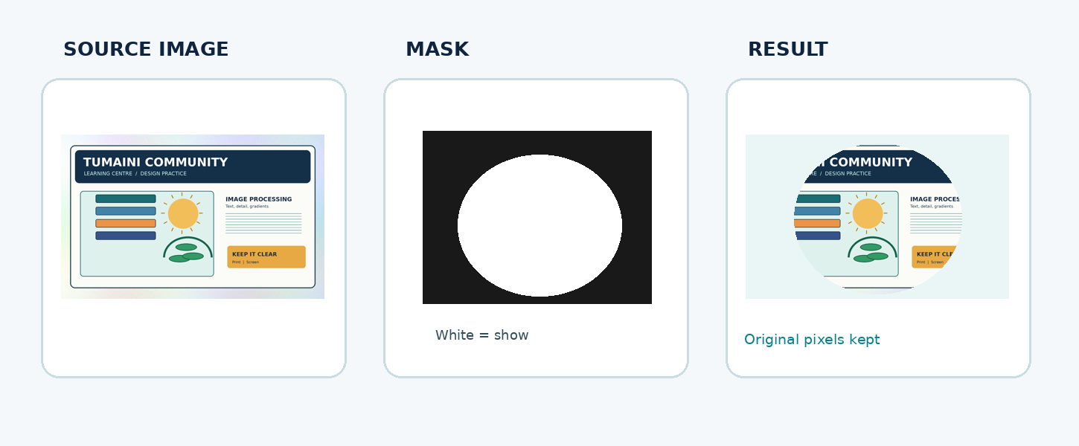
ITT06105 / DESKTOP PUBLISHING
EDITING
A layer mask controls what is visible
For a normal mask: white reveals the image, black hides it.
The pixels remain
A mask changes the visibility of part of a layer rather than permanently deleting that part of the source image. For this course, understand the idea; complex hair or edge selections are extension practice.
DESKTOP PUBLISHING • GRAPHIC COMPOSITION • 2026/2027
25

Slide 26
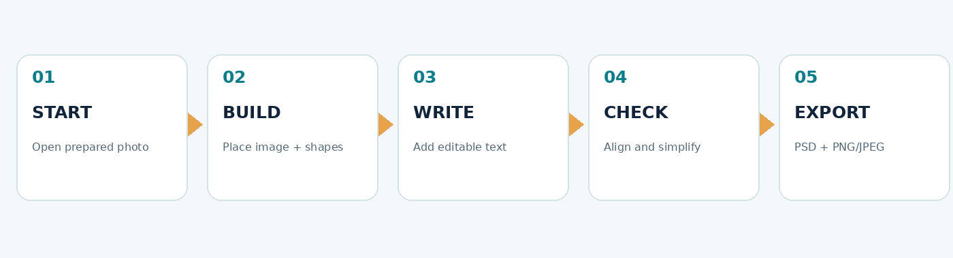
ITT06105 / DESKTOP PUBLISHING
DEMONSTRATION
A five-stage workflow is enough
Use a repeatable routine rather than experimenting with many unrelated commands.
Save the PSD before exporting; then inspect the finished image outside Photoshop.
DESKTOP PUBLISHING • GRAPHIC COMPOSITION • 2026/2027
26

Slide 27
ITT06105 / DESKTOP PUBLISHING
GUIDED PRACTICE
Step 1: start and save a working project
Use the same folder arrangement developed in Lecture 4.
Open a new document
Place the illustration
Create a portrait document of about 1000 × 1350 pixels. Save as 02_Working_Files/tumaini_event_notice.psd. Do not overwrite the original illustration.
Use the supplied cropped Tumaini picture. Scale it proportionally and leave space for a heading and a date banner. Keep it on a named image layer.
DESKTOP PUBLISHING • GRAPHIC COMPOSITION • 2026/2027
27

Slide 28
ITT06105 / DESKTOP PUBLISHING
GUIDED PRACTICE
Step 2: write the message
Use the provided copy rather than inventing detailed event information.
ORGANISATION
MAIN TITLE
SUPPORTING DETAILS
Tumaini Community Learning Centre
Small but clearly visible at the top.
STAY SAFE ONLINE
A prominent heading with strong contrast.
Learn simple steps to protect your accounts
Saturday • 10:00 AM
Keep the two lines readable.
DESKTOP PUBLISHING • GRAPHIC COMPOSITION • 2026/2027
28

Slide 29
ITT06105 / DESKTOP PUBLISHING
GUIDED PRACTICE
Step 3: improve the arrangement
Small changes to spacing and alignment often matter more than special effects.
ALIGN
SEPARATE
CHECK
Use a consistent left or centre line for the main components.
Keep the title, image and date distinct enough to scan.
View the poster at reduced size. If the date is hard to read, improve it.
DESKTOP PUBLISHING • GRAPHIC COMPOSITION • 2026/2027
29

Slide 30
ITT06105 / DESKTOP PUBLISHING
GUIDED PRACTICE
Step 4: make the file easy to revise
Your layers should tell the next person what the document contains.
Suggested layer structure
What to preserve
Headline
Date banner
Photo
Background
Place elements in a sensible order for the design.
Editable text, correctly scaled image and an organised background. Avoid unnecessary rasterising or flattening before saving the PSD.
The exact layer order may differ if objects do not overlap; preserve readability.
DESKTOP PUBLISHING • GRAPHIC COMPOSITION • 2026/2027
30

Slide 31
ITT06105 / DESKTOP PUBLISHING
GUIDED PRACTICE
Step 5: export the finished notice
Keep the editable project separate from the copy intended for sharing.
Editable project
Exported file
Save tumaini_event_notice.psd in Working_Files. Reopen or inspect it and confirm that the main text and image layers can still be edited.
Export tumaini_event_notice.png or .jpg into Exports. Reopen it outside the editor. Check text, colour, event time, picture and cropping.
DESKTOP PUBLISHING • GRAPHIC COMPOSITION • 2026/2027
31

Slide 32
ITT06105 / DESKTOP PUBLISHING
QUALITY REVIEW
A good design still needs a final check
The intended audience sees the exported file, not your Layers panel.
ACCURACY
READABILITY
FILE QUALITY
Is the title correct? Are the date and time clear and consistent with the supplied brief?
Can the heading and date be read on a phone or when the slide is shown smaller?
Does the export open properly? Is the PSD still available for revisions?
DESKTOP PUBLISHING • GRAPHIC COMPOSITION • 2026/2027
32

Slide 33
ITT06105 / DESKTOP PUBLISHING
TROUBLESHOOTING
Solve the common problems first
Most beginner problems have a straightforward cause.
TEXT DISAPPEARS
IMAGE STRETCHES
DATE IS UNREADABLE
Check whether the text layer is hidden or below an opaque image.
Undo the change and resize with proportions constrained.
Increase contrast or type size; reduce clutter and retest at smaller size.
DESKTOP PUBLISHING • GRAPHIC COMPOSITION • 2026/2027
33

Slide 34
ITT06105 / DESKTOP PUBLISHING
STUDENT ACTIVITY
Your short independent practical
Build one clear notice; do not spend the whole session on decorative effects.
Minimum checklist
What to submit
□ Prepared source image used
□ Main heading and supporting text
□ Separate text, image and shape layers
□ Clear hierarchy, contrast and margins
□ Editable PSD file saved
□ PNG/JPEG export reopened and checked
One editable event notice, one exported image and a short written explanation of two design decisions. When software is unavailable, sketch the layered design now and complete the digital file in practical time.
DESKTOP PUBLISHING • GRAPHIC COMPOSITION • 2026/2027
34

Slide 35
ITT06105 / DESKTOP PUBLISHING
REVISION
Can you answer these questions?
Use the notes and diagrams to explain, not just list, the concepts.
QUESTION 1
QUESTION 2
QUESTION 3
How does changing the position of a layer affect overlapping objects?
Explain how hierarchy, alignment and spacing work together in a notice.
What is the difference between a Photoshop PSD and a PNG/JPEG export?
DESKTOP PUBLISHING • GRAPHIC COMPOSITION • 2026/2027
35

Slide 36
ITT06105 / DESKTOP PUBLISHING
TAKEAWAY
Keep the design simple and editable
The message is more important than the number of tools you used.
Image + Shapes + Editable Text + Space
Good composition guides attention, preserves editability and produces a clear final export.
NEXT: Create simple scalable artwork using vector graphics.
DESKTOP PUBLISHING • GRAPHIC COMPOSITION • 2026/2027
36

