Slide 1

ESSENTIAL LECTURE 06
Introduction to
Vector Graphics
Draw, arrange and export one simple educational icon
Shapes • Fill and stroke • Alignment • SVG / PNG
ITT06105 • Ordinary Diploma in IT • 2026/2027

Slide 2
ITT06105 / DESKTOP PUBLISHING
LEARNING OUTCOMES
What you should be able to do
This lecture concentrates on a small number of useful vector-design skills.
EXPLAIN
CREATE
DELIVER
Describe vector graphics and identify when vector artwork is more suitable than a raster image.
Use basic shape tools, fills, strokes and alignment to draw a simple educational icon.
Save an editable source file and export a usable SVG or PNG for a publication.
One well-made, editable icon is better than several unfinished designs.
DESKTOP PUBLISHING • VECTOR GRAPHICS • 2026/2027
02

Slide 3
ITT06105 / DESKTOP PUBLISHING
CONNECTION
From photographs to illustrations
Think back to the images and poster developed in Lectures 4 and 5.
Raster work
Vector work
Photographs are usually raster images made from pixels. Cropping and resizing can change pixel detail, so enlargement needs care.
Simple symbols are easier to make with vector paths. Their outlines can be edited and scaled without depending on a fixed pixel grid.
Different tools solve different publishing problems.
DESKTOP PUBLISHING • VECTOR GRAPHICS • 2026/2027
03

Slide 4
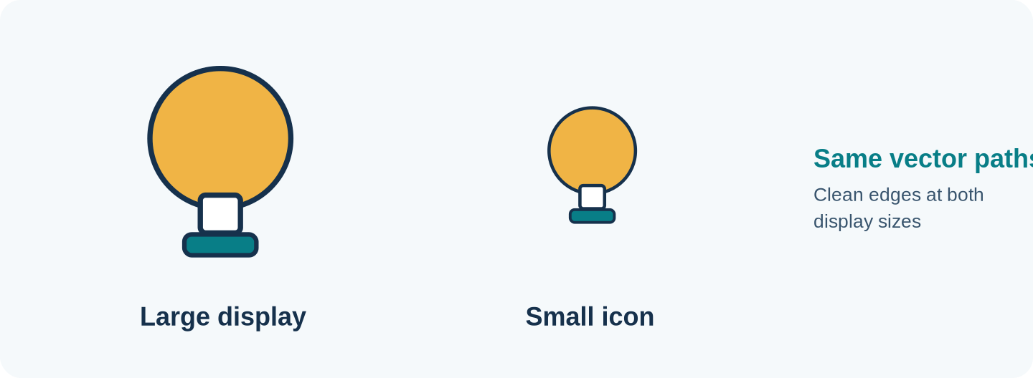
ITT06105 / DESKTOP PUBLISHING
KEY CONCEPT
What is a vector graphic?
A vector graphic is constructed from mathematically described shapes and paths.
Main advantage
Vector shapes can be enlarged or reduced while preserving clean outlines.
Where useful
Icons, logos, diagrams, signs and other illustrations built from simple shapes.
DESKTOP PUBLISHING • VECTOR GRAPHICS • 2026/2027
04

Slide 5
ITT06105 / DESKTOP PUBLISHING
COMPARISON
Vectors and pixels are not the same
Both formats are useful; choose according to the material being produced.
Raster graphic
Vector graphic
Contains a grid of pixels. It suits photographs and detailed textures. Enlarging a small raster picture can expose pixelation.
Contains paths, shapes, fills and strokes. It suits icons and line illustrations that must remain crisp at different sizes.
For a portrait photo, keep the raster image; for a simple icon, consider vector artwork.
DESKTOP PUBLISHING • VECTOR GRAPHICS • 2026/2027
05

Slide 6
ITT06105 / DESKTOP PUBLISHING
WHY IT MATTERS
Why use vector graphics in publishing?
Students will encounter the same symbol on documents of different sizes.
Scale
Edit
Reuse
The same artwork can appear as a small worksheet icon or a large classroom poster without rebuilding its shapes.
Individual objects, colours and outlines can be changed independently.
The symbol can be placed in brochures, hand-outs, slides and online announcements.
DESKTOP PUBLISHING • VECTOR GRAPHICS • 2026/2027
06

Slide 7
ITT06105 / DESKTOP PUBLISHING
SOFTWARE
What do Illustrator and Inkscape do?
Both applications allow objects to be edited as vector artwork.
Adobe Illustrator
Inkscape
A commercial vector-design program used to create and edit logos, diagrams and illustrations. In this lesson we need only its shape, fill, alignment and export tools.
A free vector-editing alternative. Its buttons and menus differ, but the essential ideas of objects, fills, strokes, grouping and export are similar.
Learn the design ideas first; the particular software version may vary.
DESKTOP PUBLISHING • VECTOR GRAPHICS • 2026/2027
07

Slide 8
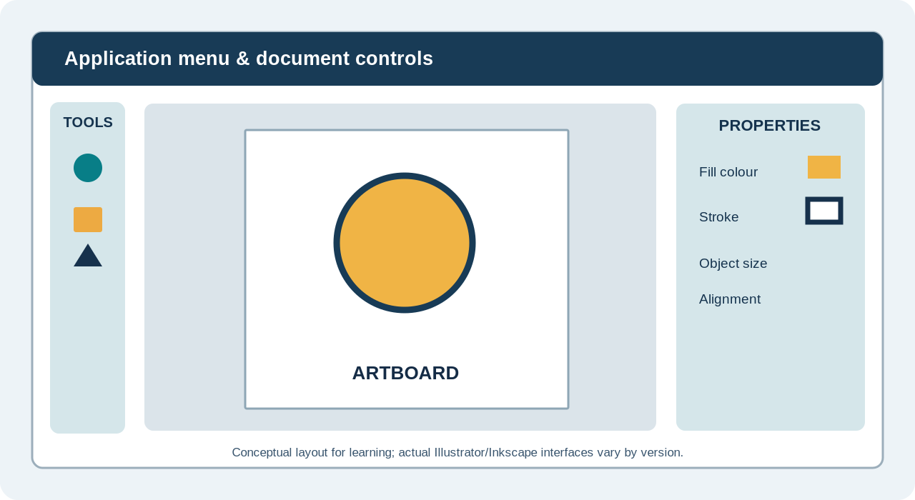
ITT06105 / DESKTOP PUBLISHING
WORKSPACE
Understanding the vector-editing workspace
This is a conceptual diagram, not a screenshot of a specific application version.
Tools & artboard
The shape tools create objects. The artboard is the page or area prepared for export.
Properties
Fill, stroke and object size can usually be changed through toolbars or panels.
DESKTOP PUBLISHING • VECTOR GRAPHICS • 2026/2027
08

Slide 9
ITT06105 / DESKTOP PUBLISHING
DOCUMENT SETUP
What is an artboard?
The artboard defines the intended output area, not the mathematical sharpness of a vector path.
Example setup
Important distinction
For practice, create an 800 × 800 unit square artboard. In Illustrator, choose File > New and enter the dimensions. Set a clear document name.
A vector object is resolution-independent while kept as a vector. When exported as a PNG, it becomes a pixel image with a selected width and height.
Keep the original vector file even after producing PNG copies.
DESKTOP PUBLISHING • VECTOR GRAPHICS • 2026/2027
09

Slide 10
ITT06105 / DESKTOP PUBLISHING
TOOLS
Three basic shape tools
You need very few tools to build the required icon.
Ellipse Tool
Rectangle Tool
Selection Tool
Creates circles and ovals. Hold the appropriate modifier key to constrain proportions if your software supports it.
Creates rectangular elements, such as banners, simple pages and icon bases.
Moves, scales and selects the shapes already drawn. Use it before changing the objects’ positions.
DESKTOP PUBLISHING • VECTOR GRAPHICS • 2026/2027
10

Slide 11
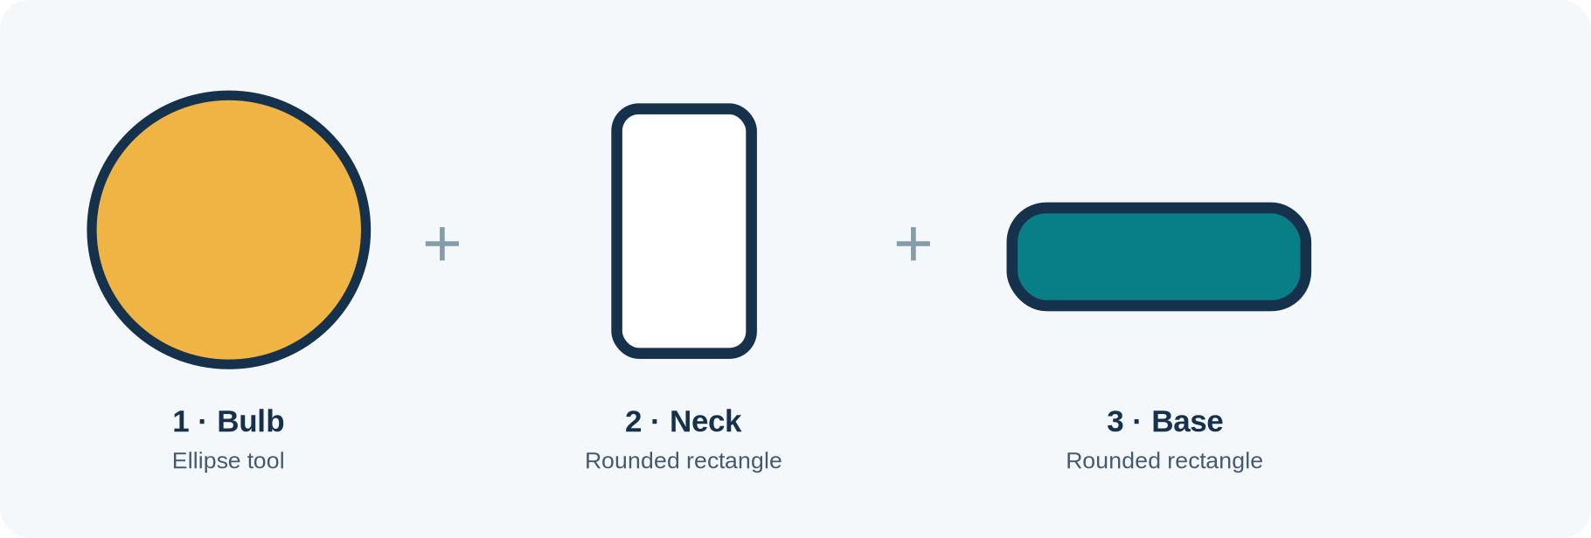
ITT06105 / DESKTOP PUBLISHING
ILLUSTRATION
Our three-shape learning icon
A recognisable symbol can be built without complicated path drawing.
Create each part as a separate object first; then align and group them.
DESKTOP PUBLISHING • VECTOR GRAPHICS • 2026/2027
11

Slide 12
ITT06105 / DESKTOP PUBLISHING
FILL & STROKE
Two properties give shapes their appearance
Fill and stroke are separate controls in a vector editor.
Fill
Stroke
The fill is the interior colour of a shape. In our model icon, a warm gold fill identifies the main bulb. A shape can also be set to no fill.
The stroke is the line along the shape’s boundary. A dark outline can improve the symbol’s definition, especially when used against a pale page.
Use only a small number of colours and keep the outlines consistent.
DESKTOP PUBLISHING • VECTOR GRAPHICS • 2026/2027
12

Slide 13
ITT06105 / DESKTOP PUBLISHING
FILL & STROKE
Fill and stroke: practical decisions
Avoid choosing colours just because they are available.
Use colour with a purpose
Check readability
The bulb can be gold to suggest an idea; the base can be teal to fit the Tumaini project. A limited palette makes the symbol look intentional.
A very thin outline may disappear at small sizes. If the icon looks cluttered, simplify its details rather than adding more colour.
A strong simple icon still works when it is reduced in size.
DESKTOP PUBLISHING • VECTOR GRAPHICS • 2026/2027
13

Slide 14

ITT06105 / DESKTOP PUBLISHING
WORKED EXAMPLE
Construct the lightbulb from three shapes
Start by drawing each object at approximately the correct size.
1 — Bulb
Draw an ellipse at the upper centre of the artboard.
2 and 3 — Neck/base
Draw two rounded rectangles beneath it; position them using the same vertical centre.
DESKTOP PUBLISHING • VECTOR GRAPHICS • 2026/2027
14

Slide 15
ITT06105 / DESKTOP PUBLISHING
OBJECTS
Layer order and shape overlap
The position of objects on top of one another can affect the finished icon.
In front / behind
Our icon
A new shape may cover part of an older one. Use Arrange or the object-order controls to bring an element forward or send it behind.
The narrow neck should meet the ellipse cleanly, and the base should connect beneath it. Small overlaps are acceptable if no unwanted lines remain visible.
Check overlap at normal size rather than only while zoomed in closely.
DESKTOP PUBLISHING • VECTOR GRAPHICS • 2026/2027
15

Slide 16
ITT06105 / DESKTOP PUBLISHING
ALIGNMENT
Align shapes to a shared centre
Good alignment makes a simple icon look deliberate.
Before alignment
After alignment
A bulb, neck and base may be slightly off-centre when drawn with the mouse. The error can make the icon appear unstable.
Select the objects and use horizontal-centre alignment. If your application aligns to the whole selection, check whether the result matches the intended visual centre.
Do not rely only on guesswork; use alignment tools and then inspect visually.
DESKTOP PUBLISHING • VECTOR GRAPHICS • 2026/2027
16

Slide 17
ITT06105 / DESKTOP PUBLISHING
SELECTION
Select, move and resize objects
These are everyday operations in vector design.
Selection
Resizing
Use the Selection Tool to click one shape or select several objects. The bounding box shows which objects are active.
Drag a handle while preserving proportions when needed. If the bulb becomes too narrow or too wide, the icon may lose its intended meaning.
Deselect and examine the full composition after every major adjustment.
DESKTOP PUBLISHING • VECTOR GRAPHICS • 2026/2027
17

Slide 18
ITT06105 / DESKTOP PUBLISHING
GROUPING
Why group related objects?
Grouping makes it easier to move a finished icon without losing its construction.
Before grouping
After grouping
Each part is independent. Moving only the bulb could leave the neck and base behind.
Select all three shapes and choose Group (commonly Ctrl+G). They can now move together while remaining editable when you enter or ungroup the set.
Save a grouped version for reuse, but keep the vector objects editable.
DESKTOP PUBLISHING • VECTOR GRAPHICS • 2026/2027
18

Slide 19
ITT06105 / DESKTOP PUBLISHING
QUALITY
Three tests for a useful icon
Apply these checks before you export the design.
Recognisable
Consistent
Reusable
Can someone identify the idea represented without an explanation? If not, simplify or adjust the proportions.
Are the edges, colours, alignment and shape relationships tidy?
Will the icon remain clear against a white or coloured background and when reduced?
DESKTOP PUBLISHING • VECTOR GRAPHICS • 2026/2027
19

Slide 20
ITT06105 / DESKTOP PUBLISHING
QUALITY
Inspect the icon at more than one size
A design that looks good when large can still fail as a small publication symbol.
Large view
Inspect the overall silhouette and the relative size of each shape.
Small view
Check that the neck and base remain visible and no important detail has become too thin.
DESKTOP PUBLISHING • VECTOR GRAPHICS • 2026/2027
20

Slide 21
ITT06105 / DESKTOP PUBLISHING
FILE FORMATS
The editable source and exported copy have different purposes
Do not submit only a flattened picture if the task asks for editable vector artwork.
Source file
Exported copy
Illustrator normally uses .ai as its native source format. Inkscape uses SVG naturally. The source retains editable vector objects.
SVG retains vector paths for compatible uses. PNG is a raster image and can preserve transparency; its sharpness depends on its exported pixel dimensions.
Submit a source file AND one suitable export.
DESKTOP PUBLISHING • VECTOR GRAPHICS • 2026/2027
21

Slide 22
ITT06105 / DESKTOP PUBLISHING
SVG OR PNG?
When should you use SVG or PNG?
Choose the format based on where the image will be used.
SVG
PNG
Good for simple icons, web graphics and other situations where scalable vector content is supported. Check compatibility with the destination software.
Useful when an application needs a widely supported raster picture or a fixed-size image. Select sufficient pixels for the intended output.
Neither format is automatically best for every printing or publishing workflow.
DESKTOP PUBLISHING • VECTOR GRAPHICS • 2026/2027
22

Slide 23
ITT06105 / DESKTOP PUBLISHING
EXPORT
How to save the Illustrator source
Save early and use a descriptive file name.
Illustrator route
Inkscape route
Choose File > Save As or Save, then save an Illustrator (.ai) document to your project folder. Preserve the shapes as editable objects.
Save the design as SVG. Open the saved file again to confirm that objects can still be selected and recoloured.
Avoid names such as “final2newlatest” that make versions difficult to identify.
DESKTOP PUBLISHING • VECTOR GRAPHICS • 2026/2027
23

Slide 24
ITT06105 / DESKTOP PUBLISHING
EXPORT
How to export the icon
Export only after inspecting the source at normal and small size.
SVG export
PNG export
Choose a suitable SVG save/export route. Reopen the SVG to confirm that all three objects appear and the colours remain correct.
Use the export controls to select the artboard or drawing, then choose the pixel dimensions. Inspect the output against a pale and a dark background.
Exporting a picture does not replace the editable source file.
DESKTOP PUBLISHING • VECTOR GRAPHICS • 2026/2027
24

Slide 25
ITT06105 / DESKTOP PUBLISHING
GUIDED PRACTICE
Practical: build the lightbulb icon
Follow this sequence using Illustrator or Inkscape.
1
Create an 800 × 800 square document and give it a sensible file name.
2
Draw one ellipse and two rounded rectangles using shape tools.
3
Apply a small colour palette and a consistent outline.
4
Centre the objects and adjust their order until the icon reads clearly.
Work at a comfortable zoom, then check the whole icon at normal size.
DESKTOP PUBLISHING • VECTOR GRAPHICS • 2026/2027
25

Slide 26
ITT06105 / DESKTOP PUBLISHING
GUIDED PRACTICE
Practical: finish and submit
Keep the final requirements modest and achievable.
1
Select the three objects and group them after checking their positions.
2
Save the editable vector source (.ai or .svg, depending on the editor).
3
Export a PNG copy and, where appropriate, an SVG copy.
4
Reopen the saved file and verify that the shapes remain editable.
The source and export should represent the same finished icon.
DESKTOP PUBLISHING • VECTOR GRAPHICS • 2026/2027
26

Slide 27
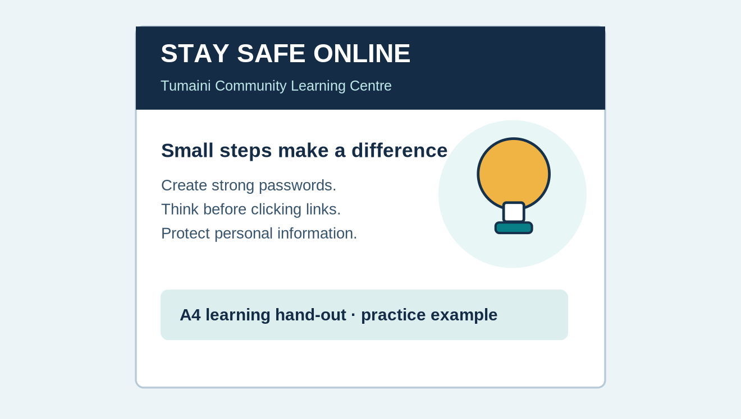
ITT06105 / DESKTOP PUBLISHING
APPLICATION
Place the icon on an educational hand-out
An icon should support a publication rather than compete with its message.
Purpose
A learning symbol helps readers recognise the publication’s educational theme.
Where to use it
Use a small icon beside a heading or in a clear information section, while leaving enough white space.
DESKTOP PUBLISHING • VECTOR GRAPHICS • 2026/2027
27

Slide 28
ITT06105 / DESKTOP PUBLISHING
QUALITY CHECK
Common beginner mistakes
Most of these problems can be corrected without an advanced tool.
What goes wrong
What to do
Shapes are stretched, not centred, poorly overlapped or coloured inconsistently. Sometimes the icon is exported with an unwanted background.
Undo and resize proportionally, align shared centres, inspect overlaps, limit colours and check export settings. Keep an editable version before making large changes.
Always judge the appearance of the complete icon, not just individual shapes.
DESKTOP PUBLISHING • VECTOR GRAPHICS • 2026/2027
28

Slide 29
ITT06105 / DESKTOP PUBLISHING
EDITING
What if the icon needs revision next week?
Good file management saves time after the lesson.
Editable approach
Problematic approach
Open the saved .ai or SVG file, select the component, change the fill or dimensions and export a revised copy.
If only a small PNG remains, changing the individual shapes will be much harder. Enlarging that PNG may introduce pixelation.
Preserve source files with meaningful names in a clearly organised folder.
DESKTOP PUBLISHING • VECTOR GRAPHICS • 2026/2027
29

Slide 30
ITT06105 / DESKTOP PUBLISHING
OPTIONAL EXTENSION
More advanced vector tools can wait
Begin with simple shapes, strokes, alignment and grouping before trying advanced vector tools.
If you finish early
For later study
Try one additional colour version or a monochrome version. Check whether the icon remains recognisable with only one colour.
Anchor points, Pen Tool, Pathfinder and complex shape construction can improve advanced artwork, but they are not required for this core practical.
Complete the essential three-shape exercise first.
DESKTOP PUBLISHING • VECTOR GRAPHICS • 2026/2027
30

Slide 31
ITT06105 / DESKTOP PUBLISHING
APPLICATION
How vector icons help different publications
Think about one symbol used in several places.
A4 hand-out
Digital notice
Poster
A modest icon can support a heading and establish a visual theme without distracting from the text.
A simple symbol can be placed beside a message and scaled to fit different digital layouts.
The same vector artwork can appear larger while retaining its crisp outline.
DESKTOP PUBLISHING • VECTOR GRAPHICS • 2026/2027
31

Slide 32
ITT06105 / DESKTOP PUBLISHING
UNDERSTANDING
Explain your design choices
An important part of design is being able to justify what you have done.
Why these shapes?
Why these colours?
The ellipse suggests the main bulb. The narrower neck and base make the silhouette resemble a lightbulb rather than a plain circle.
Gold draws attention to the bulb while the teal base fits the learning-centre example. Readability remains more important than decoration.
There is no need for an elaborate logo story; explain the practical decisions clearly.
DESKTOP PUBLISHING • VECTOR GRAPHICS • 2026/2027
32

Slide 33
ITT06105 / DESKTOP PUBLISHING
QUICK CHECK
Source versus export: one last comparison
Make sure you can explain these differences without looking at the notes.
Vector source (.ai / SVG)
Raster output (PNG)
Contains selectable paths or objects. Suitable for changing the icon’s colours, proportions and composition.
Contains pixels produced at the chosen export size. Easy to insert into many documents but less flexible for shape-by-shape editing.
A PNG export is a deliverable; the editable vector source is your working design.
DESKTOP PUBLISHING • VECTOR GRAPHICS • 2026/2027
33

Slide 34
ITT06105 / DESKTOP PUBLISHING
SELF-ASSESS
What should be in your submission?
Use these checks before asking for feedback.
Source
Export
Explanation
An editable AI or SVG file with three clearly identifiable components.
A PNG copy that displays cleanly and is not cropped unintentionally.
Two or three sentences explaining the shapes, alignment and intended use of the icon.
DESKTOP PUBLISHING • VECTOR GRAPHICS • 2026/2027
34

Slide 35
ITT06105 / DESKTOP PUBLISHING
REVIEW QUESTIONS
Can you explain these key concepts?
Answer in sentences, not just isolated words.
Question 1
Question 2
Question 3
Explain how vector graphics differ from raster graphics and give an example of each.
What is the difference between fill and stroke? How does alignment improve an icon?
Why should a student keep an editable AI or SVG file after exporting a PNG?
DESKTOP PUBLISHING • VECTOR GRAPHICS • 2026/2027
35

Slide 36
ITT06105 / DESKTOP PUBLISHING
RECAP
A small icon, useful skills
The next step is to use the icon within a page layout.
What you have learned
A vector icon is made from editable shapes. You can create it with simple tools, align and group the pieces, save the source and export an appropriate copy. This is enough for our introductory exercise.
Next: use prepared images and icons in a readable A4 page layout with InDesign.
DESKTOP PUBLISHING • VECTOR GRAPHICS • 2026/2027
36

