Slide 1
ITT06105 • DESKTOP PUBLISHING
INTRODUCTION TO
DOCUMENT LAYOUT
WITH ADOBE INDESIGN
Lecture 07 | Diploma in Information Technology
From Photoshop image + Illustrator icon → A4 educational hand-out
Academic year 2026/2027

Slide 2
ITT06105 / DESKTOP PUBLISHING
LEARNING OUTCOMES
What you will learn
Five practical outcomes for this lecture.
1
Understand
Explain what page-layout software does and recognise InDesign workspace parts.
2
Set up
Create a single A4 portrait page with a consistent content margin.
3
Place
Use text frames and image frames correctly.
4
Organise
Build a simple visual hierarchy using alignment and spacing.
5
Save
Keep an editable INDD and export an initial PDF proof.
DESKTOP PUBLISHING • DOCUMENT LAYOUT • 2026/2027
02

Slide 3
ITT06105 / DESKTOP PUBLISHING
Prepared work from earlier lessons becomes the content for the new page.
One project, three applications
COURSE CONNECTION
PHOTOSHOP
ILLUSTRATOR
INDESIGN
→
→
Prepare and crop a suitable photograph.
Draw a clear, scalable icon.
Arrange image, icon and text on an A4 page.
The three applications are complementary. We do not need to learn every advanced tool in order to create a useful publication.
DESKTOP PUBLISHING • DOCUMENT LAYOUT • 2026/2027
03

Slide 4
ITT06105 / DESKTOP PUBLISHING
KEY CONCEPT
What is document layout?
Think about how the reader experiences the page.
Definition
Document layout is the planned arrangement of text, images, shapes and open space on a page. Its purpose is to make information easy to notice, understand and use.
A well-designed educational hand-out should have a clear title, an illustration, short advice and a footer.
DESKTOP PUBLISHING • DOCUMENT LAYOUT • 2026/2027
04

Slide 5
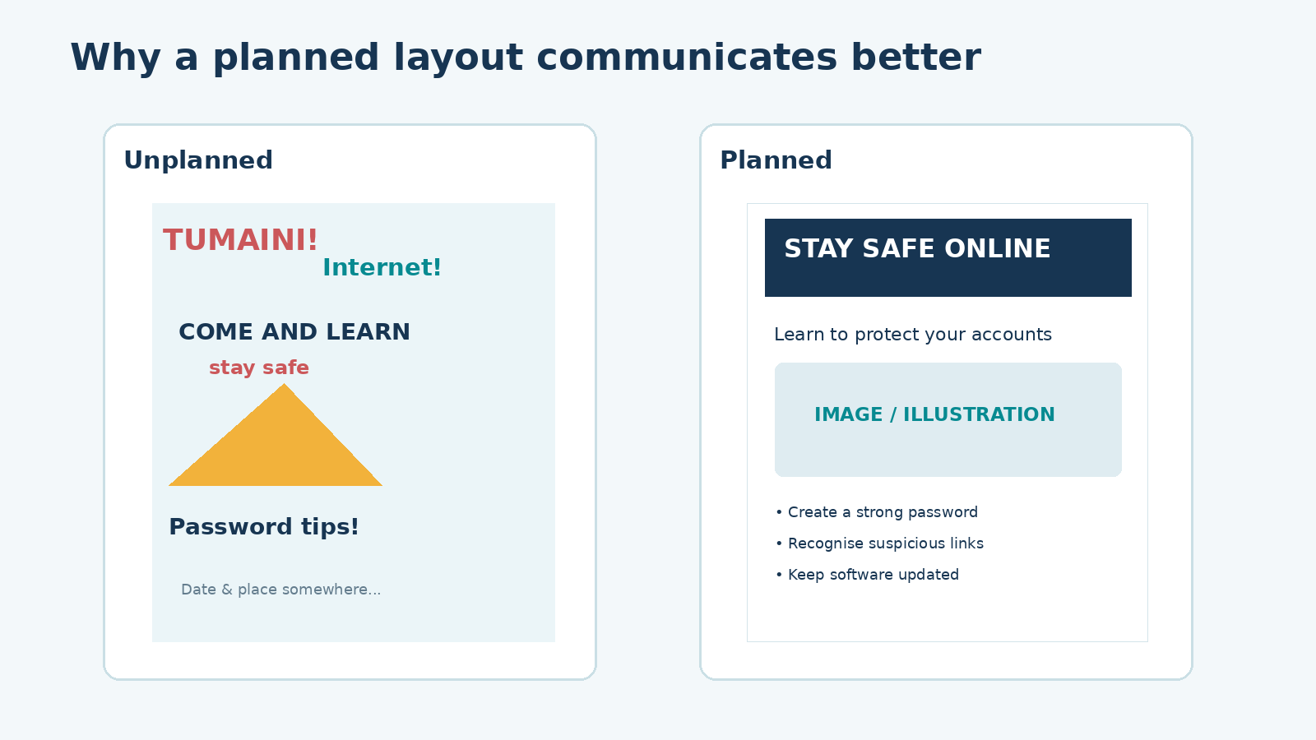
ITT06105 / DESKTOP PUBLISHING
ILLUSTRATION
Good layout makes the message easier to follow
Compare the crowded page with the organised version.
Design for the reader
The planned version creates a clear order. The main message appears first, related information stays together, and spacing helps the reader find the three essential tips.
DESKTOP PUBLISHING • DOCUMENT LAYOUT • 2026/2027
05

Slide 6
ITT06105 / DESKTOP PUBLISHING
SOFTWARE ROLE
Why use Adobe InDesign?
InDesign specialises in organising pages and publications.
InDesign is a page-layout application
It allows a designer to create pages, manage text frames and graphic frames, place prepared images, align elements and export a publication as PDF. Photoshop and Illustrator remain useful for preparing the images and graphics before placing them.
Our goal is a one-page A4 hand-out — not an advanced magazine or multi-page book.
DESKTOP PUBLISHING • DOCUMENT LAYOUT • 2026/2027
06

Slide 7
ITT06105 / DESKTOP PUBLISHING
SOFTWARE COMPARISON
Choose the appropriate application
Three tools, three primary tasks.
Editing an image
Designing a publication
Use Photoshop or a similar editor for cropping, tonal correction and preparing pixel-based photographs. Those edits should happen before the image is placed into the page layout.
Use InDesign to arrange the headline, image, short paragraphs and footer on a page. It manages the composition without permanently changing the original picture.
DESKTOP PUBLISHING • DOCUMENT LAYOUT • 2026/2027
07

Slide 8
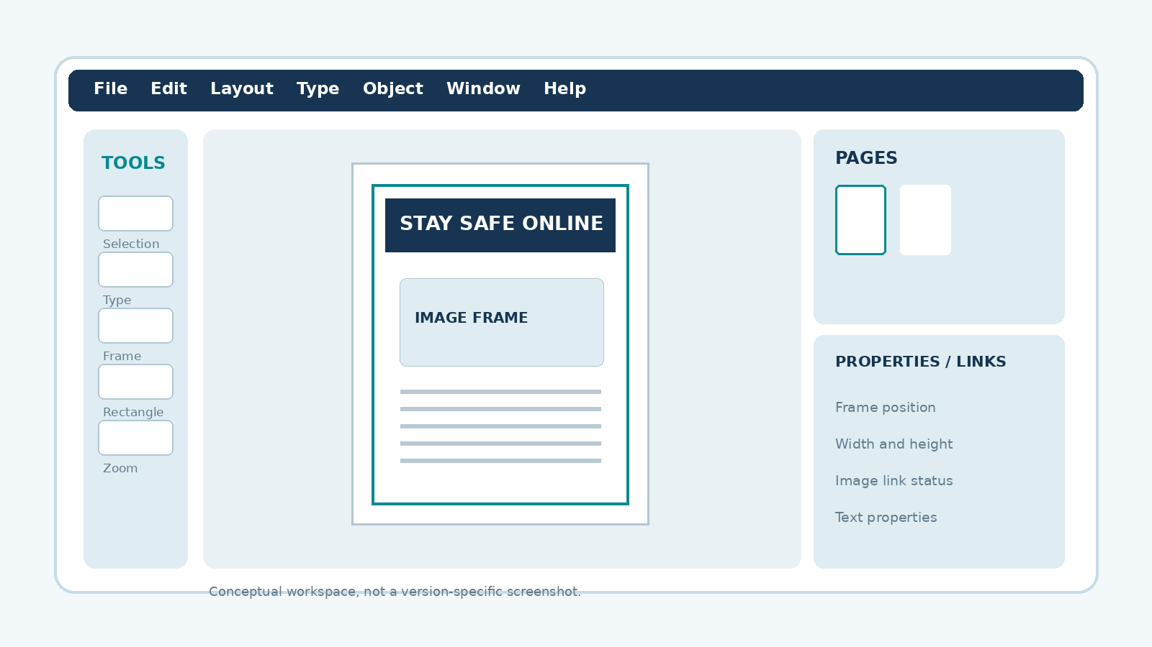
ITT06105 / DESKTOP PUBLISHING
ILLUSTRATION
Recognising the workspace
A conceptual overview — menus and panel locations may differ by version.
What you need today
Locate the Tools panel, document page, pasteboard, Pages panel and Properties or Links panel. Their exact position is less important than knowing what each part is used for.
DESKTOP PUBLISHING • DOCUMENT LAYOUT • 2026/2027
08

Slide 9
ITT06105 / DESKTOP PUBLISHING
EXPLAIN
The page and the pasteboard
These two areas serve different purposes.
Page
Pasteboard
The page is the defined publication area. Text and graphics placed inside it may appear in the exported PDF. For this lesson, the page is one A4 portrait sheet.
The space around the page helps you temporarily store objects while arranging the layout. Objects outside the page are usually not part of the final exported page.
DESKTOP PUBLISHING • DOCUMENT LAYOUT • 2026/2027
09

Slide 10
ITT06105 / DESKTOP PUBLISHING
KEY CONCEPT
The panels support different tasks
Learn the job of each panel, not every menu option.
Essential workspace controls
Tools create or select page objects. Pages helps navigate and organise pages. Properties or Control changes object characteristics, while Links helps locate and update placed images.
Tip: Start by finding the Selection tool, Type tool, Pages panel and the page itself.
DESKTOP PUBLISHING • DOCUMENT LAYOUT • 2026/2027
10

Slide 11
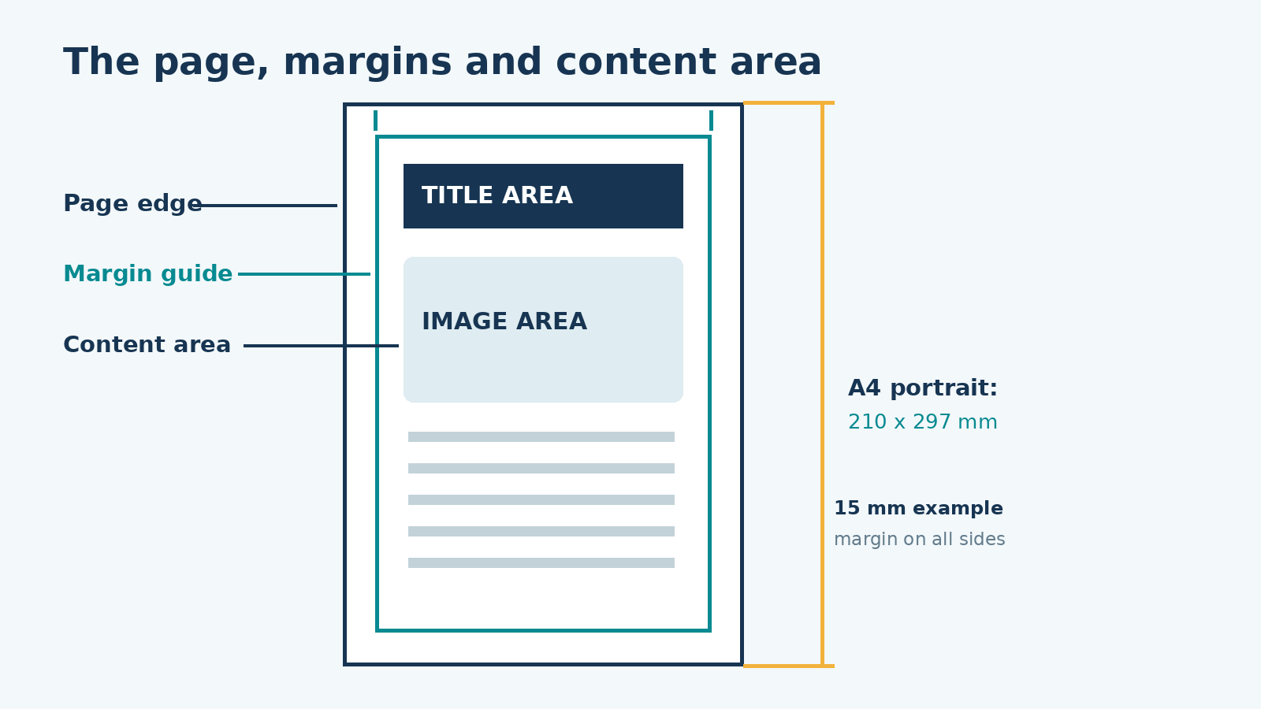
ITT06105 / DESKTOP PUBLISHING
ILLUSTRATION
Page setup: A4 portrait
Our classroom example uses an A4 page and 15 mm margins.
Essential dimensions
An A4 portrait page is 210 mm wide and 297 mm high. Margins provide breathing space between the page edge and the content. They can be adjusted later if a printer gives different requirements.
DESKTOP PUBLISHING • DOCUMENT LAYOUT • 2026/2027
11

Slide 12
ITT06105 / DESKTOP PUBLISHING
STUDENT PRACTICE
Quick calculation: usable page width
A4 page with 15 mm left and right margins.
TRY IT
How much width remains for text and pictures after the two side margins?
Width = 210 − 15 − 15 = 180 mm. Explain why this matters before arranging your frames.
DESKTOP PUBLISHING • DOCUMENT LAYOUT • 2026/2027
12

Slide 13
ITT06105 / DESKTOP PUBLISHING
STUDENT PRACTICE
Quick calculation: usable page height
Use the same 15 mm top and bottom margins.
TRY IT
If the A4 page height is 297 mm, how much vertical space remains inside the margins?
Height = 297 − 15 − 15 = 267 mm. This is the approximate content region for our classroom layout.
DESKTOP PUBLISHING • DOCUMENT LAYOUT • 2026/2027
13

Slide 14
ITT06105 / DESKTOP PUBLISHING
KEY CONCEPT
Margins and guides are not borders
They organise where content should sit.
Margin versus guide
A margin is an intended clear space near a page edge. Guides are reference lines that help align titles, photos and paragraphs. They are usually visible while editing but are not printed as part of the content.
The easiest beginner rule is to keep the important text and graphics inside the margin guides.
DESKTOP PUBLISHING • DOCUMENT LAYOUT • 2026/2027
14

Slide 15
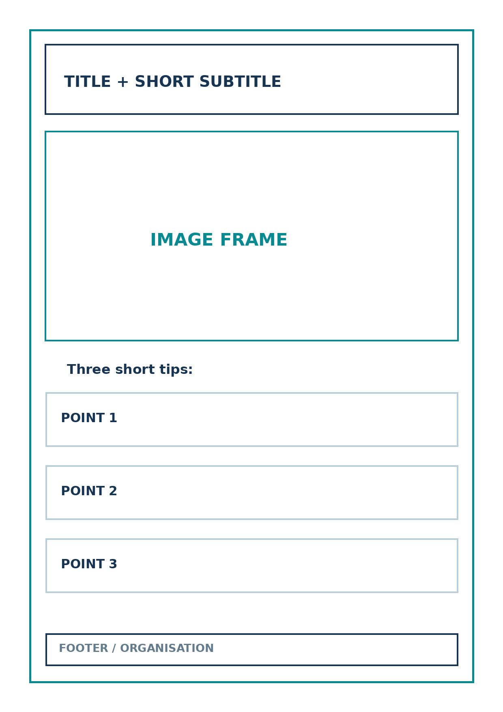
ITT06105 / DESKTOP PUBLISHING
PAGE PLAN
Begin with a wireframe
A simple sketch prevents misplaced content later.
What to sketch
Mark a large title area, a short subtitle, one photograph, three brief tips and a small footer. Decide the order before you start resizing text and images on a computer.
DESKTOP PUBLISHING • DOCUMENT LAYOUT • 2026/2027
15

Slide 16
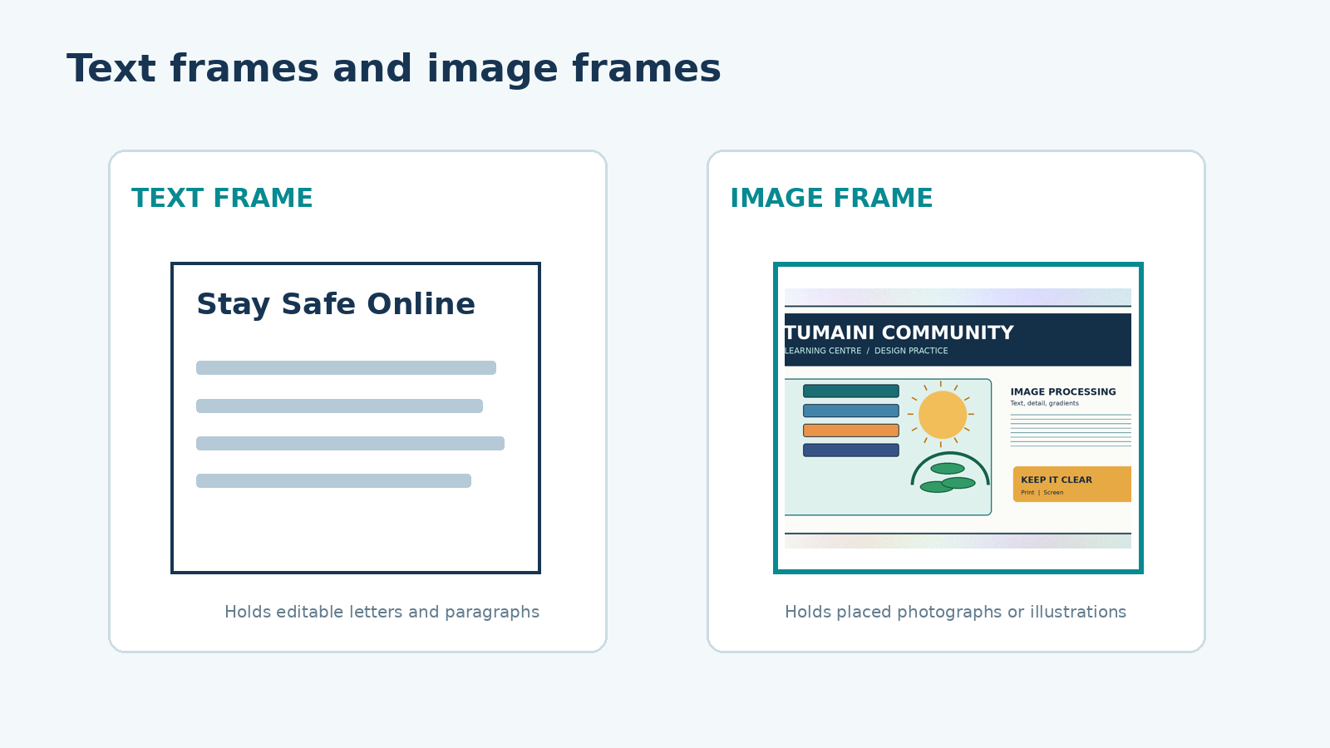
ITT06105 / DESKTOP PUBLISHING
ILLUSTRATION
Text frames and image frames
They contain different kinds of material.
Two essential containers
A text frame holds editable letters and paragraphs. An image frame displays a photograph or illustration that has been placed into the publication. You can move or resize each frame independently.
DESKTOP PUBLISHING • DOCUMENT LAYOUT • 2026/2027
16

Slide 17
ITT06105 / DESKTOP PUBLISHING
KEY CONCEPT
What is a text frame?
The words remain editable within the layout.
Text frame
A text frame is a rectangular or other defined area that contains text. Use a frame for your title, subtitle, body tips or footer. Adjusting frame size changes how the words flow; it does not mean that the words themselves have changed.
Create a headline that can be read immediately, then add short supporting paragraphs.
DESKTOP PUBLISHING • DOCUMENT LAYOUT • 2026/2027
17

Slide 18
ITT06105 / DESKTOP PUBLISHING
KEY CONCEPT
What is an image frame?
Think of the frame as a window onto a picture.
Graphic or image frame
An image frame displays an imported graphic. You can move or crop the visible portion without changing the original image file. The frame and the image inside it can be adjusted separately, so use fitting options carefully.
Place the prepared image from Lecture 5 instead of searching for a new photograph.
DESKTOP PUBLISHING • DOCUMENT LAYOUT • 2026/2027
18

Slide 19
ITT06105 / DESKTOP PUBLISHING
SOFTWARE PROCEDURE
Placing a prepared image
The basic File > Place workflow.
1
Find
Make sure the image is saved inside your project folder.
2
Place
In InDesign, choose File > Place and select the file.
3
Position
Click a prepared frame or drag an appropriately sized frame.
4
Fit
Keep the image in proportion; adjust the crop if required.
DESKTOP PUBLISHING • DOCUMENT LAYOUT • 2026/2027
19

Slide 20
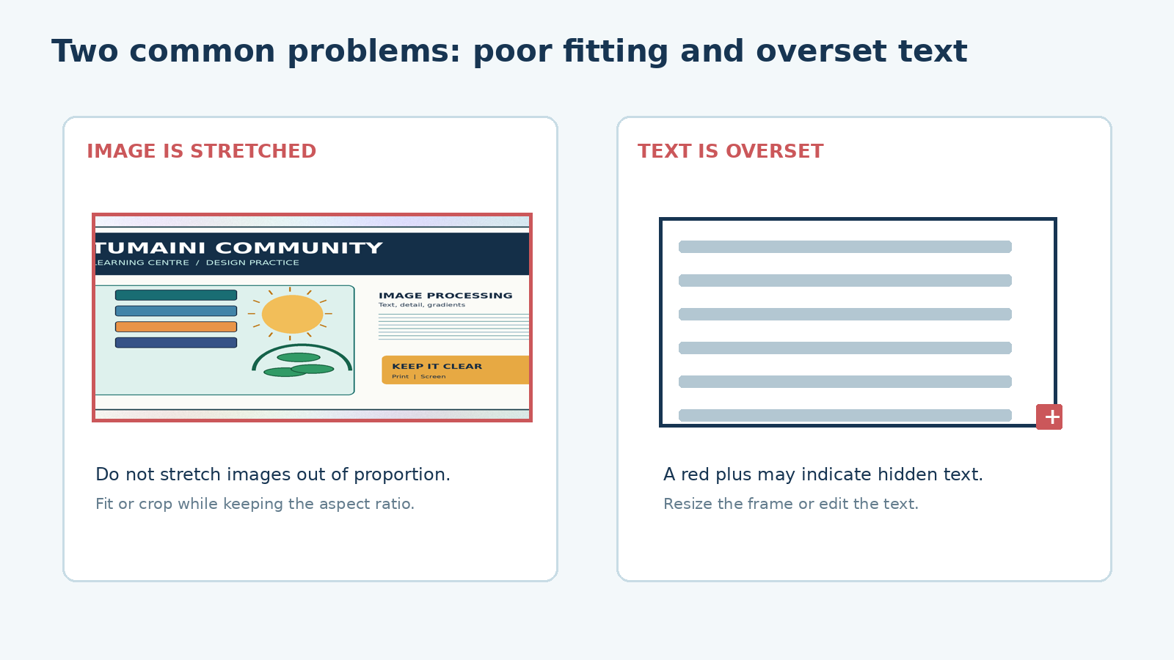
ITT06105 / DESKTOP PUBLISHING
ILLUSTRATION
Avoid stretching the picture
Poor fitting and hidden text are different problems.
A common beginner mistake
Stretching only the width or the height makes people and objects look unnatural. Fit the picture proportionally. If text is hidden, enlarge the text frame or simplify the wording.
DESKTOP PUBLISHING • DOCUMENT LAYOUT • 2026/2027
20

Slide 21
ITT06105 / DESKTOP PUBLISHING
KEY CONCEPT
What is overset text?
Important words should never disappear from the export.
Overset text
Overset text is text that is stored in a frame but does not fit inside the visible area. InDesign may show a small red plus on the text frame. The reader cannot reliably see the hidden material in the exported publication.
Always check that all three safety tips appear completely in the PDF proof.
DESKTOP PUBLISHING • DOCUMENT LAYOUT • 2026/2027
21

Slide 22
ITT06105 / DESKTOP PUBLISHING
EXPLAIN
Build a clear visual hierarchy
Do not use the same size and weight for every line.
What should be noticed first?
What should follow?
The title “Stay Safe Online” must be the most prominent text. It tells readers immediately what the hand-out is about. Use a larger size and a position near the top.
The one-sentence explanation introduces the topic, followed by the main image and three short practical tips. The organisation name belongs in the footer and can be smaller.
DESKTOP PUBLISHING • DOCUMENT LAYOUT • 2026/2027
22

Slide 23
ITT06105 / DESKTOP PUBLISHING
EXPLAIN
Alignment and spacing improve readability
Simple consistency is more useful than decoration.
Alignment
White space
Use the same left edge for related text frames. A title, subtitle and body points that line up feel like parts of the same publication.
Leave enough space around groups of information. Do not fill every area of the page; the empty space helps separate unrelated blocks and makes reading easier.
DESKTOP PUBLISHING • DOCUMENT LAYOUT • 2026/2027
23

Slide 24
ITT06105 / DESKTOP PUBLISHING
ILLUSTRATION
See the planned and unplanned versions
Notice how the clear design uses fewer distractions.
Apply what you already know
This lecture reuses the design principles from Lecture 1: contrast, alignment, proximity and hierarchy. The layout should make the main information easy to locate.
DESKTOP PUBLISHING • DOCUMENT LAYOUT • 2026/2027
24

Slide 25
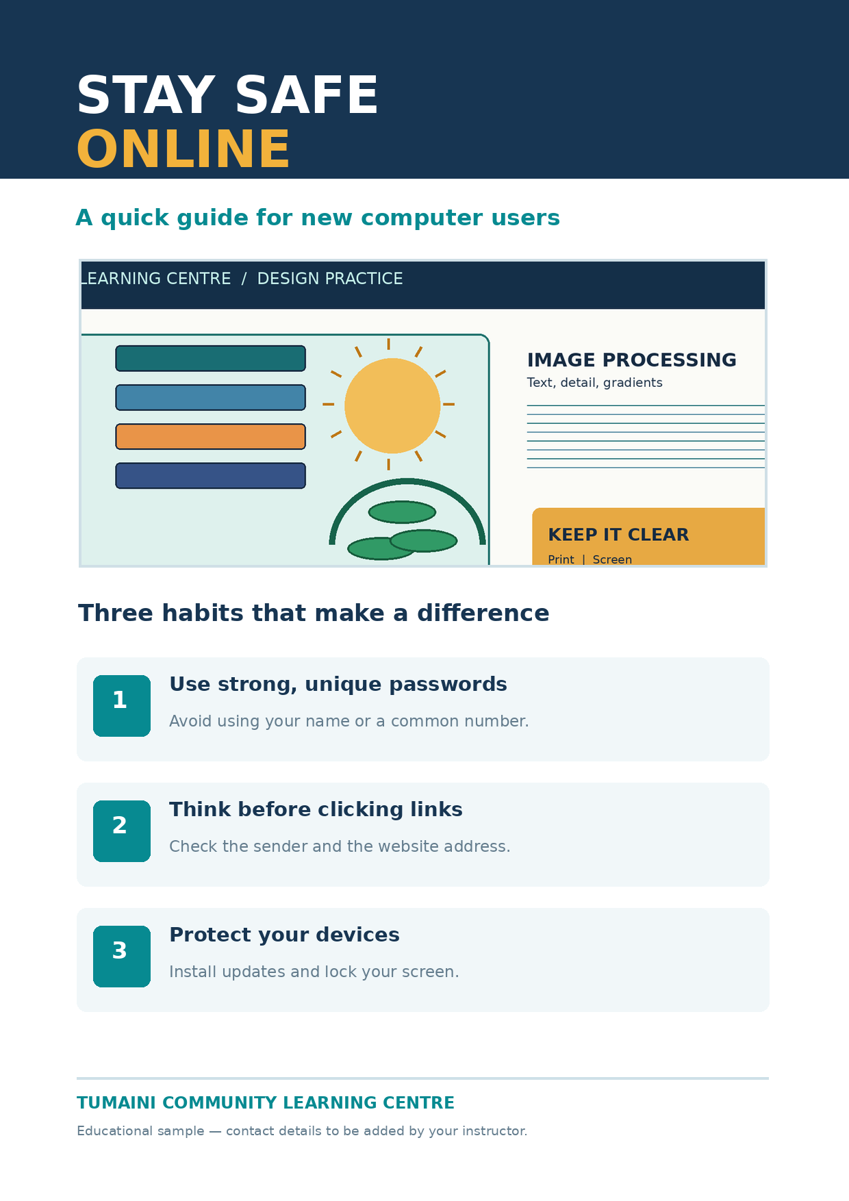
ITT06105 / DESKTOP PUBLISHING
MODEL OUTPUT
Your model hand-out: Stay Safe Online
Use the example as a guide, not as a requirement to copy every detail.
Expected page structure
A title, short subtitle, one main image, three short tips and a footer. You will create the basic skeleton in Lecture 7, then refine and proof the hand-out in Lecture 8.
DESKTOP PUBLISHING • DOCUMENT LAYOUT • 2026/2027
25

Slide 26
ITT06105 / DESKTOP PUBLISHING
GUIDED PRACTICAL
Practical — Stage 1: create the project
Start by keeping the source files organised.
1
Folder
Create a folder named L07_Tumaini_Handout.
2
Assets
Copy the prepared image, lightbulb icon and practice text into it.
3
Document
Open InDesign and create one A4 portrait page.
4
Margins
Set all margins to 15 mm for the classroom exercise.
DESKTOP PUBLISHING • DOCUMENT LAYOUT • 2026/2027
26

Slide 27
ITT06105 / DESKTOP PUBLISHING
GUIDED PRACTICAL
Practical — Stage 2: make the page skeleton
Use only the tools needed for this first draft.
1
Headline
Draw a text frame at the top and type STAY SAFE ONLINE.
2
Image
Create a graphic frame and place the prepared picture.
3
Tips
Add three short safety tips in one or more text frames.
4
Footer
Write TUMAINI COMMUNITY LEARNING CENTRE at the bottom.
DESKTOP PUBLISHING • DOCUMENT LAYOUT • 2026/2027
27

Slide 28
ITT06105 / DESKTOP PUBLISHING
GUIDED PRACTICAL
Practical — Stage 3: refine the basics
A clean first draft matters more than special effects.
1
Check title
Can the headline be read without effort?
2
Check image
Is the image in proportion and suitably placed?
3
Check spacing
Are frames aligned within margins with a little space between them?
4
Check text
Can you see the complete wording of every tip?
DESKTOP PUBLISHING • DOCUMENT LAYOUT • 2026/2027
28

Slide 29
ITT06105 / DESKTOP PUBLISHING
SAVING
Editable working file versus PDF proof
Both are needed for an efficient publishing workflow.
INDD document
The .indd file is the editable source. It preserves layout frames, editable text, images placed into the publication and page settings. You need it when making changes in the next lesson.
A PDF is a document to inspect or share; it does not replace your editable InDesign source file.
DESKTOP PUBLISHING • DOCUMENT LAYOUT • 2026/2027
29

Slide 30
ITT06105 / DESKTOP PUBLISHING
FILE OUTPUT
Practical — Stage 4: save and export
Keep a working document and a proof.
1
Save first
Save Tumaini_Handout_Draft.indd in your project folder.
2
Export
Choose File > Export and select a PDF output.
3
Name
Save Tumaini_Handout_Draft.pdf.
4
Review
Open the PDF and check the page from top to bottom.
DESKTOP PUBLISHING • DOCUMENT LAYOUT • 2026/2027
30

Slide 31
ITT06105 / DESKTOP PUBLISHING
FILE MANAGEMENT
Why placed images can become missing links
The design file may refer to a separate source image.
Image links
InDesign can place graphics as linked assets. The document refers to those image files, which remain stored in your project folder. If the files are renamed or moved, the Links panel may warn that the image is missing or modified.
Keep the source image and INDD file organised in the same project folder and avoid unnecessary renaming.
DESKTOP PUBLISHING • DOCUMENT LAYOUT • 2026/2027
31

Slide 32
ITT06105 / DESKTOP PUBLISHING
TROUBLESHOOTING
Diagnose two avoidable problems
Use this illustration to guide your quality check.
How to correct errors
For a distorted photograph, restore the correct proportions. For hidden text, enlarge or reposition the frame, or shorten the wording. Always export a fresh PDF after making corrections.
DESKTOP PUBLISHING • DOCUMENT LAYOUT • 2026/2027
32

Slide 33
ITT06105 / DESKTOP PUBLISHING
STUDENT PRACTICE
Check your understanding
Look at the first-draft hand-out.
TRY IT
If a heading is outside the page margin and the final tip is hidden, what two corrections should you make?
Move or resize the heading frame inside the margin; fix the overset body text before re-exporting.
DESKTOP PUBLISHING • DOCUMENT LAYOUT • 2026/2027
33

Slide 34
ITT06105 / DESKTOP PUBLISHING
STUDENT PRACTICE
Choose the right file
Suppose you need to change a sentence next week.
TRY IT
Would you reopen the editable .indd document or edit the PDF proof, and why?
Open the .indd document because it preserves editable text and page frames. Then export an updated PDF proof.
DESKTOP PUBLISHING • DOCUMENT LAYOUT • 2026/2027
34

Slide 35
ITT06105 / DESKTOP PUBLISHING
SELF-CHECK
Final draft checklist
Use this before you submit your Lecture 7 activity.
1
Page
A4 portrait, one page, 15 mm classroom margins.
2
Message
Readable title, short introduction and three complete tips.
3
Artwork
Image placed in proportion; optional icon included.
4
Files
Save INDD, open and check the PDF proof.
DESKTOP PUBLISHING • DOCUMENT LAYOUT • 2026/2027
35

Slide 36
ITT06105 / DESKTOP PUBLISHING
PRACTICAL ALTERNATIVE
No InDesign access today?
The concepts can still be practised on paper.
Paper-based route
Sketch an A4 page with a title frame, image frame, three tip blocks and footer. Label margins and explain the reading order. You can later reproduce the sketch in the computer laboratory using the supplied assets.
The paper route supports learning, but a software-produced file is still the intended digital output when access becomes available.
DESKTOP PUBLISHING • DOCUMENT LAYOUT • 2026/2027
36

Slide 37
ITT06105 / DESKTOP PUBLISHING
STUDENT PRACTICE
Short revision exercise
Bring together the main ideas from this lesson.
TRY IT
State one purpose for each: page margins, text frame, graphic frame, PDF proof.
Sample: margins create a clear boundary; text frame holds editable words; graphic frame displays an image; PDF proof allows the result to be checked.
DESKTOP PUBLISHING • DOCUMENT LAYOUT • 2026/2027
37

Slide 38
ITT06105 / DESKTOP PUBLISHING
LECTURE RECAP
Key ideas to remember
A good layout helps readers use the information.
Five essentials
Plan before arranging. Choose A4 portrait and suitable margins. Use text and graphic frames for different content. Keep the page aligned and readable. Save the editable INDD and check the exported PDF.
Your goal today is a well-structured first draft — Lecture 8 will concentrate on refinement and final proofing.
DESKTOP PUBLISHING • DOCUMENT LAYOUT • 2026/2027
38

Slide 39
ITT06105 / DESKTOP PUBLISHING
Keep your draft editable so that you can improve and proofread it.
Next: complete and proof the hand-out
WHAT COMES NEXT
NEXT LESSON
Refine your headings, spacing and images;
fix overflow; inspect the PDF; and prepare
a complete one-page educational hand-out.
Bring your INDD source, placed image, lightbulb icon and first PDF proof.
DESKTOP PUBLISHING • DOCUMENT LAYOUT • 2026/2027
39

