Slide 1
ITT06105 • DESKTOP PUBLISHING
CREATING AND
FINALISING A SIMPLE
PUBLICATION
Lecture 08 | Diploma in Information Technology
Refine a first draft → correct errors → inspect the final PDF
Academic year 2026/2027

Slide 2
ITT06105 / DESKTOP PUBLISHING
LEARNING OUTCOMES
Learning outcomes
Five practical skills to demonstrate at the end of this lecture.
1
Revise
Check that the title, introduction and three safety tips are correct.
2
Refine
Use hierarchy, alignment, spacing and consistent formatting.
3
Correct
Fix overset text, distorted images and missing links.
4
Proof
Export a fresh PDF and inspect the publication as a reader.
5
Submit
Keep the editable source, PDF proof and supporting assets.
DESKTOP PUBLISHING • FINALISING A PUBLICATION • 2026/2027
02

Slide 3
ITT06105 / DESKTOP PUBLISHING
COURSE CONNECTION
Where we are in the publishing process
The first draft was created in Lecture 7.
Lecture 7: create the page | Lecture 8: make it usable
The first draft already has an A4 page, text frames, a placed illustration and the basic reading order. This lecture concentrates on checking and improving that content rather than learning every advanced InDesign feature.
The quality of a final publication depends on what readers can actually see and understand.
DESKTOP PUBLISHING • FINALISING A PUBLICATION • 2026/2027
03

Slide 4
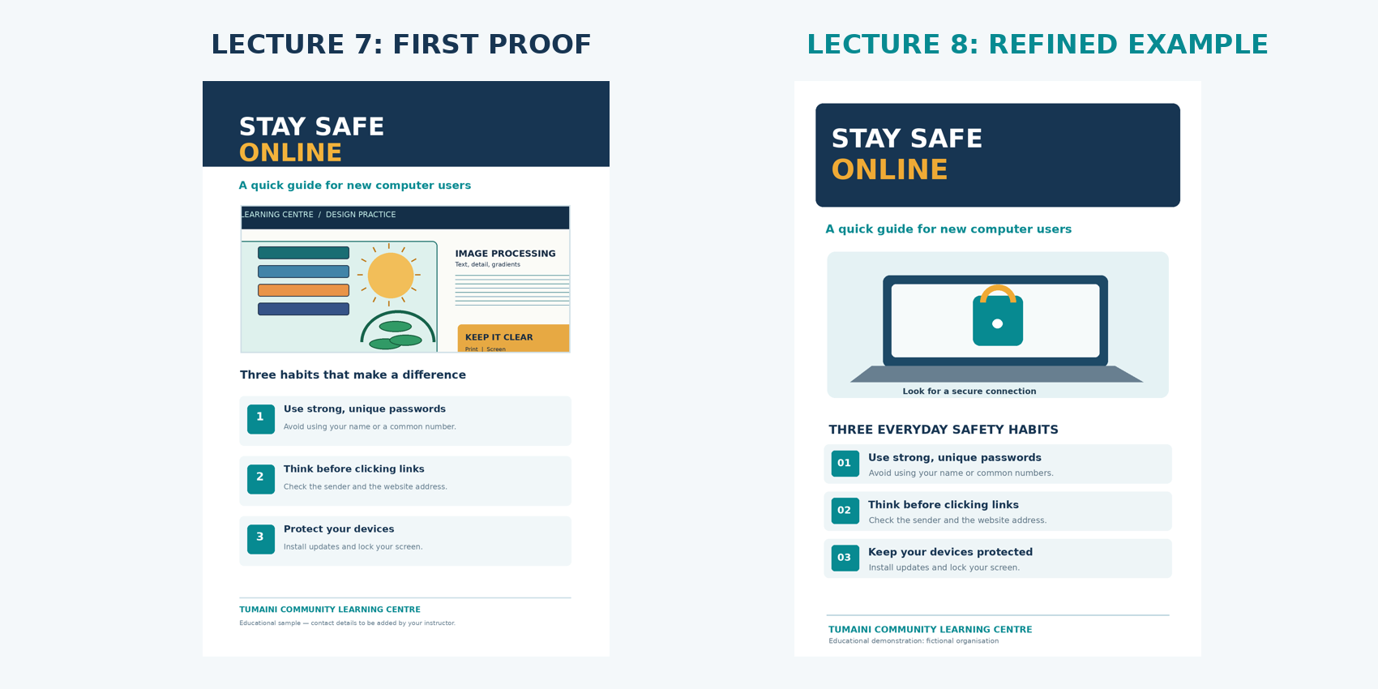
ITT06105 / DESKTOP PUBLISHING
BEFORE / AFTER
From draft to clearer communication
Compare the first proof with an example of refined layout.
What changed?
The revised example strengthens the message, uses a more relevant illustration and groups the tips consistently. The purpose is to make each safety habit easier to find, not merely to decorate the page.
DESKTOP PUBLISHING • FINALISING A PUBLICATION • 2026/2027
04

Slide 5
ITT06105 / DESKTOP PUBLISHING
KEY CONCEPT
What does “finalising” mean?
A publication is not complete merely because it has been saved.
Finalising a publication
Finalising is the process of reviewing content, correcting layout and technical problems, and verifying an exported proof before the document is shared or produced. It includes both communication quality and file accuracy.
Work in the editable document; inspect the PDF; return to the source if corrections are needed.
DESKTOP PUBLISHING • FINALISING A PUBLICATION • 2026/2027
05

Slide 6
ITT06105 / DESKTOP PUBLISHING
EXPLAIN
Editing is different from decorating
Start with useful information, then improve its presentation.
Editing content
Improving design
Check meaning, spelling, accuracy and completeness. Replace vague sentences with specific advice. Ensure all three safety tips can be understood by someone reading alone.
Improve title prominence, text size, spacing, alignment and image placement. A new shape or extra colour is not an improvement unless it helps the message.
DESKTOP PUBLISHING • FINALISING A PUBLICATION • 2026/2027
06

Slide 7
ITT06105 / DESKTOP PUBLISHING
STUDENT PRACTICE
Quick content check
Read the three safety habits on the hand-out.
YOUR TURN
Which is clearer for a new computer user: “Use secure credentials” or “Use strong, unique passwords”? Explain why.
A strong answer considers familiar words, a clear action and relevance to the intended audience.
DESKTOP PUBLISHING • FINALISING A PUBLICATION • 2026/2027
07

Slide 8
ITT06105 / DESKTOP PUBLISHING
KEY DEFINITION
Typographic hierarchy
Readers should know where to begin and what to read next.
Definition
Typographic hierarchy is the use of differences in text size, weight, spacing and placement to indicate relative importance. The title gets attention first; supporting text then guides the reader towards the practical advice.
A clear order for our hand-out is: title → short introduction → main graphic → three tips → organisation footer.
DESKTOP PUBLISHING • FINALISING A PUBLICATION • 2026/2027
08

Slide 9
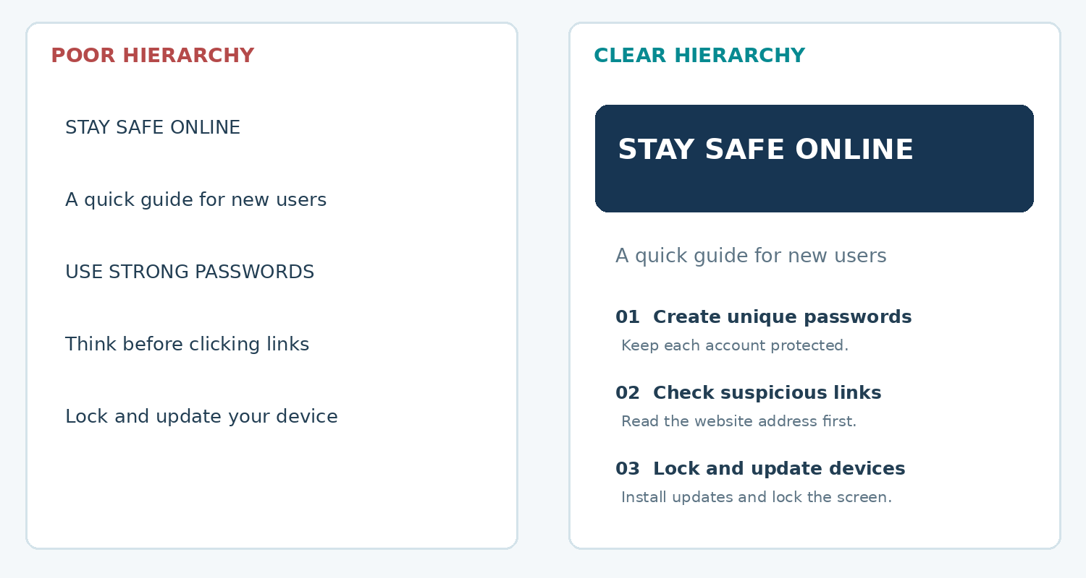
ITT06105 / DESKTOP PUBLISHING
ILLUSTRATION
Compare two text treatments
A large number of fonts is not required for a clear design.
Look at the order
On the right, the title is most prominent, followed by the introduction and grouped tips. Readers can identify the subject quickly, even when viewing the sheet from a distance.
DESKTOP PUBLISHING • FINALISING A PUBLICATION • 2026/2027
09

Slide 10
ITT06105 / DESKTOP PUBLISHING
EXPLAIN
A simple hierarchy works
Use differences purposefully, not randomly.
Headline and introduction
Body tips and footer
Make the title visibly larger and heavier than the body text. The introduction should be short, readable and placed near the headline so that the two pieces feel connected.
Use a consistent size, weight and alignment for the three safety tips. The organisation name can be smaller because it provides attribution rather than the main instruction.
DESKTOP PUBLISHING • FINALISING A PUBLICATION • 2026/2027
10

Slide 11
ITT06105 / DESKTOP PUBLISHING
TYPOGRAPHY
Choosing readable type
Accessibility is more important than novelty.
Keep the type system simple
Use one or two related typefaces, avoid typing long paragraphs in capitals, and choose a body size that remains comfortable on an A4 page. The goal is consistency; the same kind of information should look the same throughout.
If the body text only fits after making it very small, revise the wording or adjust the text frame first.
DESKTOP PUBLISHING • FINALISING A PUBLICATION • 2026/2027
11

Slide 12
ITT06105 / DESKTOP PUBLISHING
STUDENT PRACTICE
What should change first?
A beginner’s hand-out has six decorative fonts and very small advice text.
YOUR TURN
Name two improvements that preserve the message but make the page easier to read.
Think about limiting typefaces, strengthening hierarchy and increasing the body-text legibility.
DESKTOP PUBLISHING • FINALISING A PUBLICATION • 2026/2027
12

Slide 13
ITT06105 / DESKTOP PUBLISHING
DESIGN PRINCIPLE
Alignment
Related items should follow common visual lines.
Definition
Alignment is the positioning of text and graphics so that their edges or centres follow a deliberate relationship. Consistent alignment makes a page appear organised and helps readers group related information.
Try lining up the three advice blocks along the same left edge as the subtitle.
DESKTOP PUBLISHING • FINALISING A PUBLICATION • 2026/2027
13

Slide 14
ITT06105 / DESKTOP PUBLISHING
DESIGN PRINCIPLE
White space
An empty area can improve communication.
Definition
White space is the unoccupied area between elements and around content. It separates groups and prevents the page from feeling overcrowded. It does not have to be white; it can be any unobstructed background.
Leave breathing room around the title, image and tip blocks rather than filling every available area.
DESKTOP PUBLISHING • FINALISING A PUBLICATION • 2026/2027
14

Slide 15
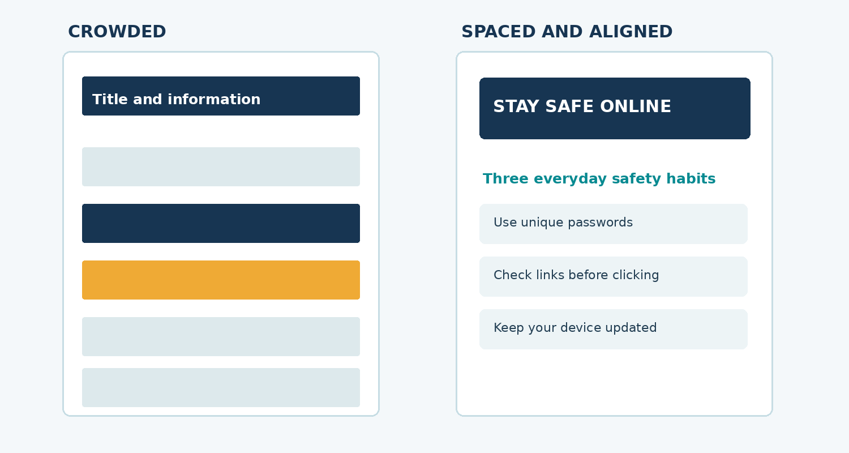
ITT06105 / DESKTOP PUBLISHING
ILLUSTRATION
A crowded page versus an organised page
Contrast, alignment and spacing work together.
Observe the right-hand version
The headline, body sections and margins follow a clear structure. Grouped advice blocks remain distinct without requiring many additional colours or decorations.
DESKTOP PUBLISHING • FINALISING A PUBLICATION • 2026/2027
15

Slide 16
ITT06105 / DESKTOP PUBLISHING
EXPLAIN
Use colours consistently
A few repeated colours are often enough.
Useful palette
Avoid unnecessary decoration
For this teaching example, navy can identify main headings, teal can mark labels or small accents, and amber can highlight one important area. Consistency makes the visual system predictable.
Do not colour every sentence differently, use low-contrast combinations or place busy artwork behind body text. Colour should support the message rather than compete with it.
DESKTOP PUBLISHING • FINALISING A PUBLICATION • 2026/2027
16

Slide 17
ITT06105 / DESKTOP PUBLISHING
TEXT FRAMES
What is overset text?
A common problem when editing short publications.
Definition
Overset text is content stored in a text frame that exceeds the visible frame area. InDesign may display a small red plus sign. The extra words may not appear in the exported PDF, so it must be corrected before submission.
Do not assume all wording is present merely because it exists inside the editing file.
DESKTOP PUBLISHING • FINALISING A PUBLICATION • 2026/2027
17

Slide 18
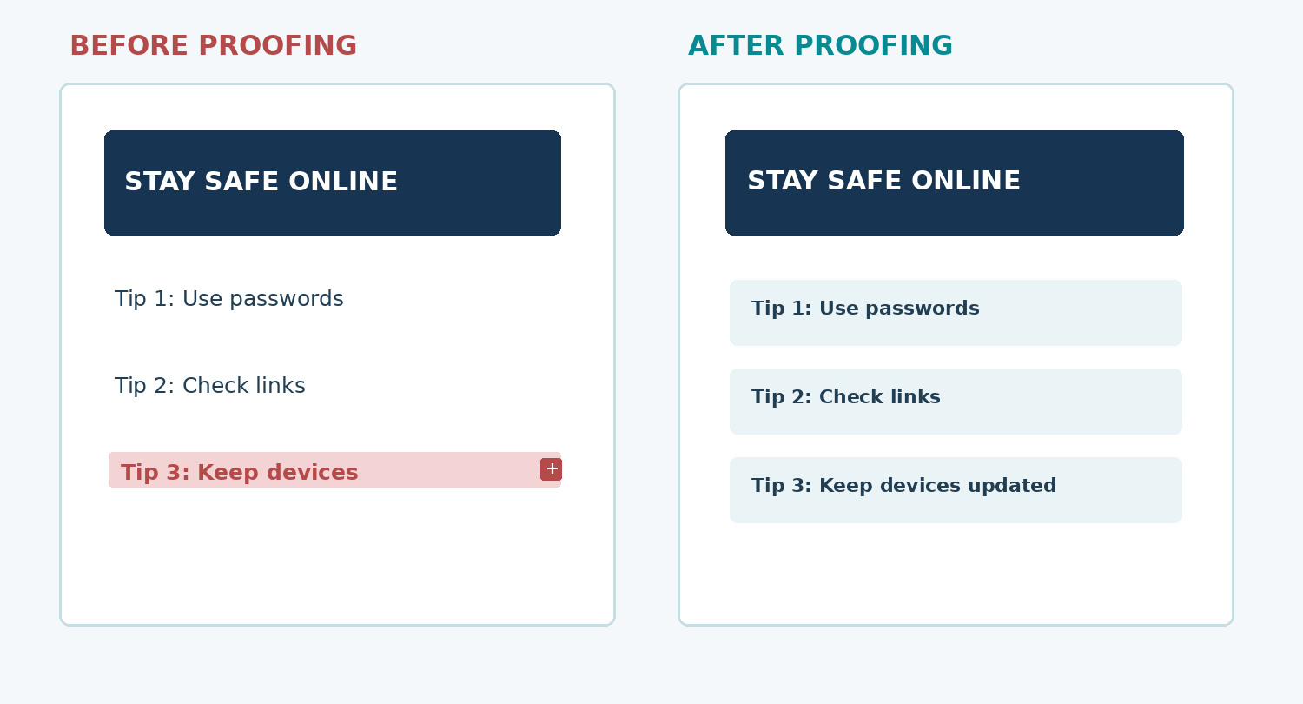
ITT06105 / DESKTOP PUBLISHING
ILLUSTRATION
Fix hidden text before exporting
A red plus sign is a warning, not a decorative symbol.
Correct the frame
Enlarge or reposition the text frame, shorten unnecessary wording or adjust paragraph spacing. Avoid solving the problem by shrinking text until it becomes difficult to read.
DESKTOP PUBLISHING • FINALISING A PUBLICATION • 2026/2027
18

Slide 19
ITT06105 / DESKTOP PUBLISHING
TROUBLESHOOTING
Correcting overset text
A simple diagnostic and correction sequence.
1
Identify
Select the frame with the overset warning.
2
Inspect
Read the text and check which part is hidden.
3
Correct
Enlarge frame, improve text flow or shorten wording.
4
Verify
Check the complete text on the page and exported PDF.
DESKTOP PUBLISHING • FINALISING A PUBLICATION • 2026/2027
19

Slide 20
ITT06105 / DESKTOP PUBLISHING
IMAGE QUALITY
Images should retain their proportions
Do not stretch one dimension independently.
Preserve aspect ratio
When the width and height of an image are changed by different proportions, familiar objects look unnatural. Resize or fit the picture proportionally and crop the visible area within the image frame when necessary.
Our hand-out needs one relevant, clear image; it does not need several competing photographs.
DESKTOP PUBLISHING • FINALISING A PUBLICATION • 2026/2027
20

Slide 21
ITT06105 / DESKTOP PUBLISHING
EXPLAIN
Working with linked assets
Placed graphics may remain separate from the INDD document.
When links are healthy
When links are missing
InDesign locates the source picture or icon. The graphic appears as expected in the layout and in the exported proof. Keep linked resources in a clearly named project folder.
If a source asset is moved or renamed, the Links panel may warn about it. Relink the correct file and verify the content before exporting; do not ignore the warning.
DESKTOP PUBLISHING • FINALISING A PUBLICATION • 2026/2027
21

Slide 22
ITT06105 / DESKTOP PUBLISHING
STUDENT PRACTICE
Diagnose a missing image
A student moved the hand-out image to a new folder.
YOUR TURN
The layout now shows a missing-link warning. What should the student check and do before exporting the final PDF?
Look for the original asset, restore or relink it, then export and inspect the corrected proof.
DESKTOP PUBLISHING • FINALISING A PUBLICATION • 2026/2027
22

Slide 23
ITT06105 / DESKTOP PUBLISHING
KEY DEFINITION
Proofreading and proofing
Review what the reader will actually receive.
Proofing
Proofing is the systematic inspection of a nearly completed publication for content, appearance and technical errors. It includes reading the wording, inspecting layout and ensuring the PDF matches the intended source design.
The editing view is not the final test; open the exported PDF separately and read it from top to bottom.
DESKTOP PUBLISHING • FINALISING A PUBLICATION • 2026/2027
23

Slide 24
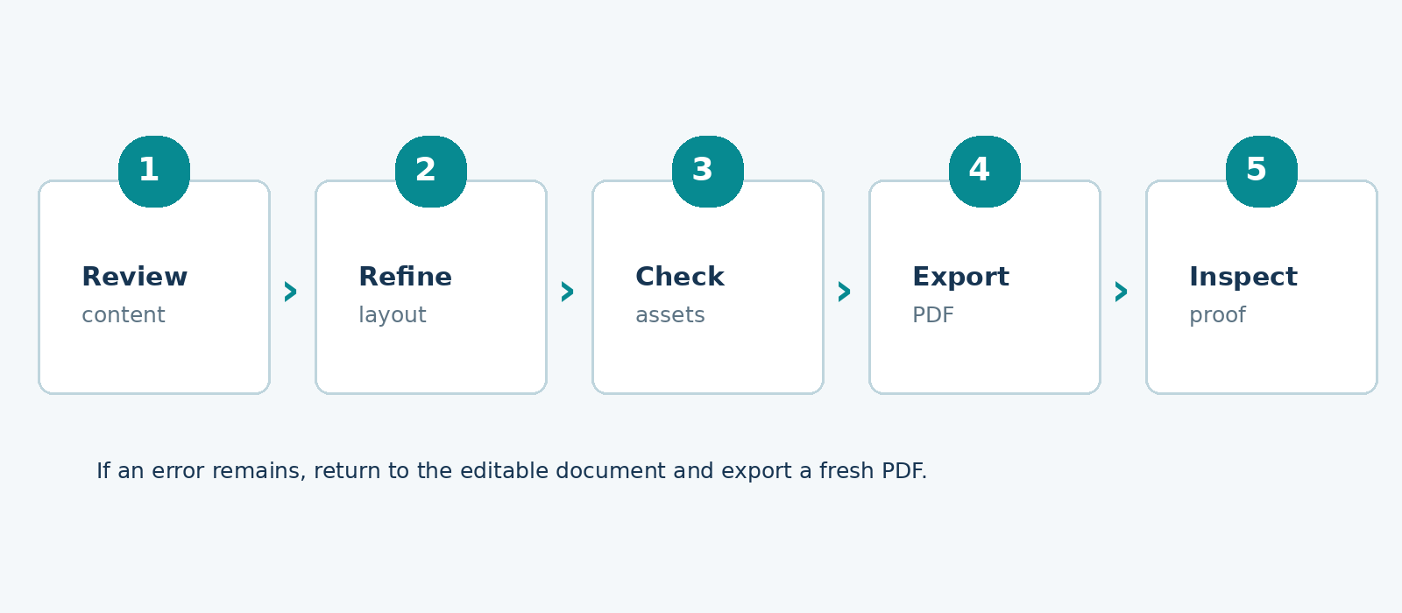
ITT06105 / DESKTOP PUBLISHING
PROCESS
A five-stage finalisation workflow
Use the same sequence for posters, brochures and hand-outs.
Repeat when necessary
Review the words, refine the layout, check graphics and links, export the document, and inspect the proof. If a problem remains, correct the source and export again.
DESKTOP PUBLISHING • FINALISING A PUBLICATION • 2026/2027
24

Slide 25
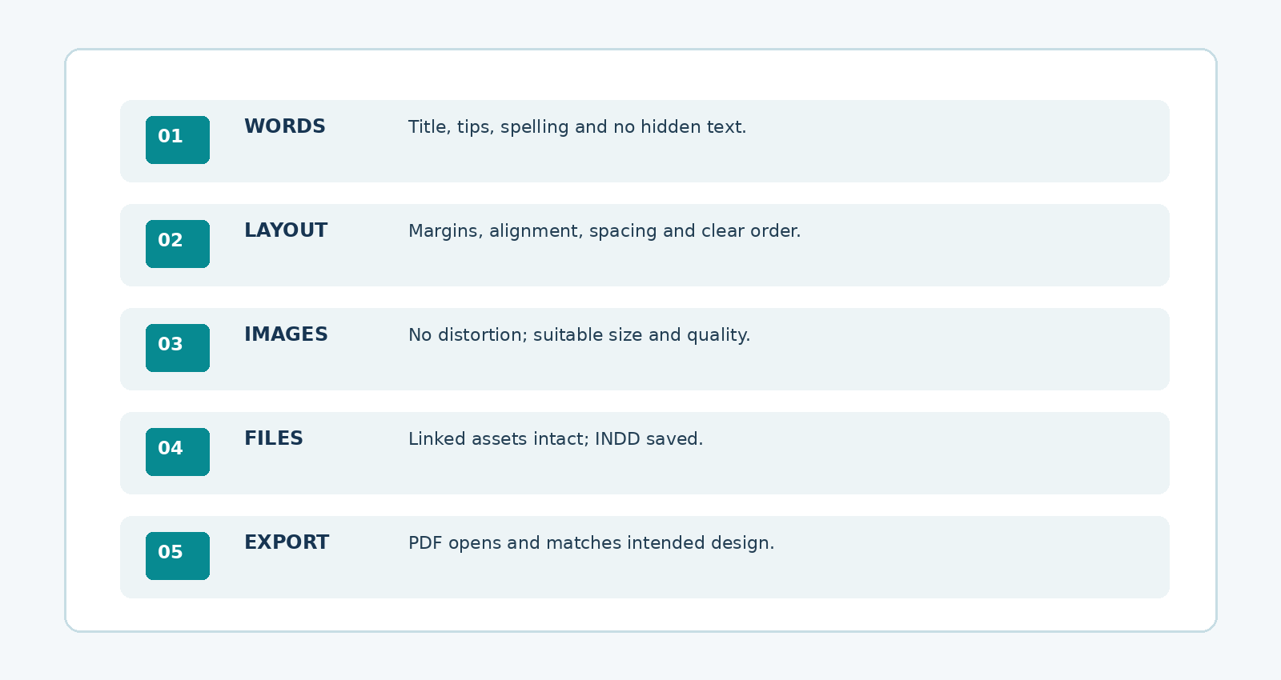
ITT06105 / DESKTOP PUBLISHING
QUALITY CONTROL
The five checks before submission
A brief checklist prevents avoidable errors.
Keep the checklist simple
Check words, layout, images, source files and PDF export. Record the result, and correct issues before marking the work as finished.
DESKTOP PUBLISHING • FINALISING A PUBLICATION • 2026/2027
25

Slide 26
ITT06105 / DESKTOP PUBLISHING
EXPLAIN
Editable source file and exported proof
Both files matter, but for different reasons.
INDD — the working document
PDF — the document to inspect
The .indd file preserves editable text, frames and document structure. Changes to wording, position or images should normally be made here. Retain the source for future corrections.
The PDF shows the publication in a shareable form. Open it independently to check visible text, alignment, page dimensions and image appearance. Export a new PDF after significant corrections.
DESKTOP PUBLISHING • FINALISING A PUBLICATION • 2026/2027
26

Slide 27
ITT06105 / DESKTOP PUBLISHING
GUIDED PRACTICAL
Practical 1: open and assess your draft
Start from the hand-out created in Lecture 7.
1
Open
Locate the L07 project folder and open your INDD source.
2
Read
Review the title, introduction, three tips and footer.
3
Inspect
Look for overset text and missing-image warnings.
4
Record
Write two improvements in the workbook before editing.
DESKTOP PUBLISHING • FINALISING A PUBLICATION • 2026/2027
27

Slide 28
ITT06105 / DESKTOP PUBLISHING
GUIDED PRACTICAL
Practical 2: improve the design
Apply only the changes that improve readability.
1
Format
Use a clear headline and one consistent body text style.
2
Align
Position related frames on common edges.
3
Space
Leave breathing room between image, tips and footer.
4
Correct
Keep images proportional; fix hidden text and links.
DESKTOP PUBLISHING • FINALISING A PUBLICATION • 2026/2027
28

Slide 29
ITT06105 / DESKTOP PUBLISHING
GUIDED PRACTICAL
Practical 3: save and export
Do not lose the editable project.
1
Save source
Save as Tumaini_Handout_Final.indd.
2
Export PDF
Export as Tumaini_Handout_Final.pdf.
3
Open proof
Review the exported PDF outside the editing application.
4
Repeat
If anything is wrong, fix the INDD and export again.
DESKTOP PUBLISHING • FINALISING A PUBLICATION • 2026/2027
29

Slide 30
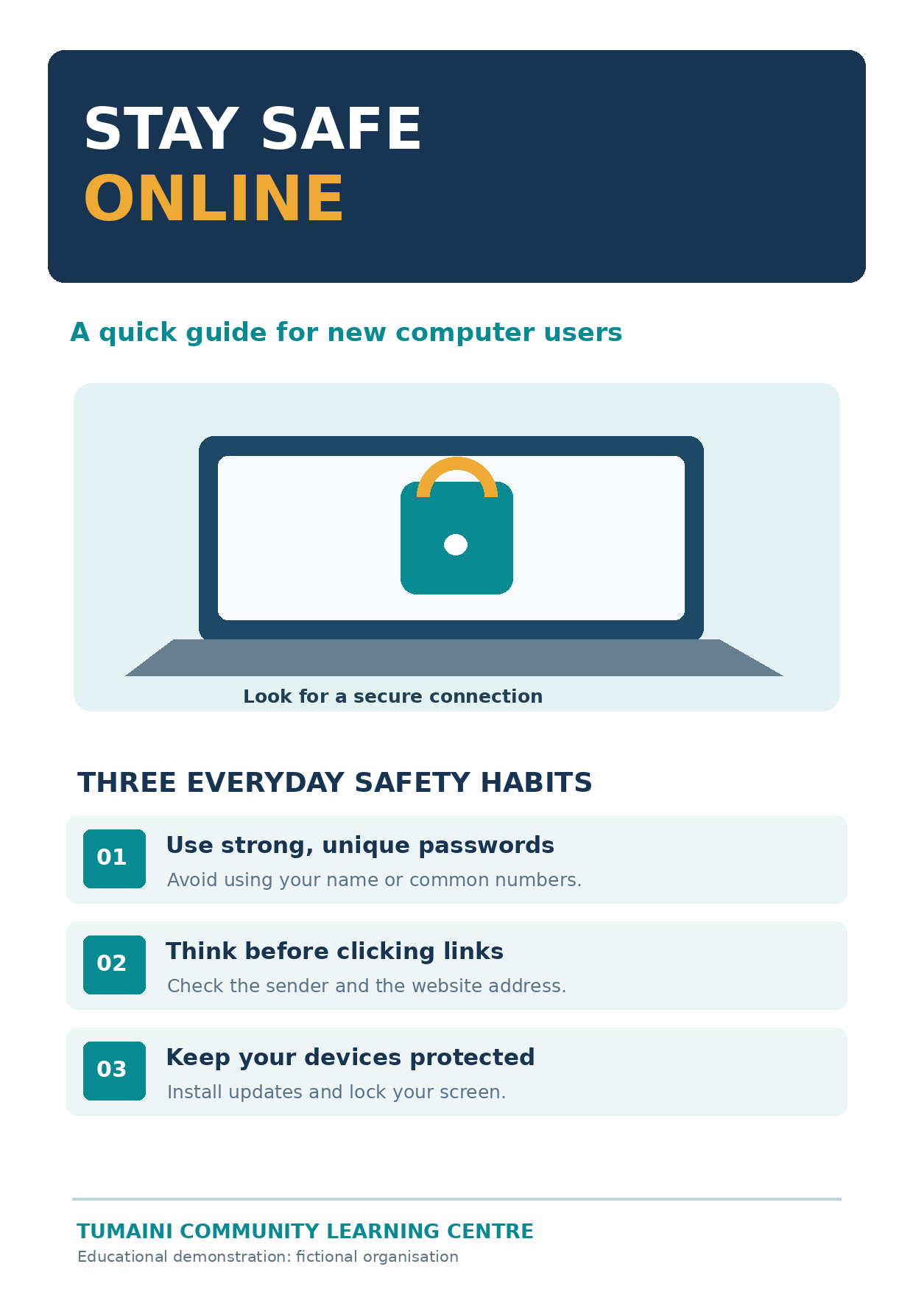
ITT06105 / DESKTOP PUBLISHING
MODEL OUTPUT
Model outcome: a finished educational hand-out
A simple publication can still look professional and communicate clearly.
The quality standard
A readable title, helpful illustration, three complete tips, organised spacing and a consistent footer. This is a model PNG, not a ready-made InDesign project.
DESKTOP PUBLISHING • FINALISING A PUBLICATION • 2026/2027
30

Slide 31
ITT06105 / DESKTOP PUBLISHING
STUDENT PRACTICE
Publication inspection
Imagine you are assessing a classmate’s PDF proof.
YOUR TURN
The title is clear, but Tip 3 is cut off and the picture looks stretched. Which two corrections are essential before submission?
Explain the correction inside the editable document and why a fresh PDF must be checked.
DESKTOP PUBLISHING • FINALISING A PUBLICATION • 2026/2027
31

Slide 32
ITT06105 / DESKTOP PUBLISHING
IMPORTANT DISTINCTION
Classroom PDF versus commercial print
Not every class export is a print-ready production file.
A classroom PDF proof
For this exercise, an exported one-page A4 PDF is used to check the page and share the learning result. Commercial printing may later require confirmed bleed, colour-profile and other prepress settings. Those decisions belong to Lecture 9.
Do not invent commercial printer requirements for this classroom hand-out.
DESKTOP PUBLISHING • FINALISING A PUBLICATION • 2026/2027
32

Slide 33
ITT06105 / DESKTOP PUBLISHING
PRACTICAL ALTERNATIVE
If you have no InDesign access
The concept can still be practised with paper and prepared examples.
Paper-based route
Improve a labelled A4 layout on paper, showing the corrected title, image frame, three tip blocks and footer. Annotate your planned corrections and complete the editable document during an available practical session.
A paper plan is a useful interim activity, but it does not by itself demonstrate digital export skill.
DESKTOP PUBLISHING • FINALISING A PUBLICATION • 2026/2027
33

Slide 34
ITT06105 / DESKTOP PUBLISHING
SUBMISSION CHECKLIST
Final self-check
Complete these checks before handing in your work.
1
Words
All text is correct and visible.
2
Layout
Heading, image and tips are aligned and readable.
3
Assets
No distorted picture or unresolved missing link.
4
Output
INDD and PDF are saved, and the PDF has been opened.
DESKTOP PUBLISHING • FINALISING A PUBLICATION • 2026/2027
34

Slide 35
ITT06105 / DESKTOP PUBLISHING
STUDENT PRACTICE
Short review question
Connect the technical and communication sides of DTP.
YOUR TURN
Why might a hand-out look attractive on the editing screen but still be unsuitable for distribution?
Think about hidden text, spelling, inaccurate wording, image links and unchecked export.
DESKTOP PUBLISHING • FINALISING A PUBLICATION • 2026/2027
35

Slide 36
ITT06105 / DESKTOP PUBLISHING
LECTURE RECAP
Key ideas to remember
Good publishing work is checked, not just created.
The five essentials
Revise the wording. Establish a clear reading order. Keep margins, alignment and spacing consistent. Correct hidden text and image problems. Save the editable project and inspect a freshly exported PDF.
Our next lecture will introduce printing choices, resolution and practical print-quality checks.
DESKTOP PUBLISHING • FINALISING A PUBLICATION • 2026/2027
36

Slide 37
ITT06105 / DESKTOP PUBLISHING
After proofing a PDF, choose appropriate printing settings and check the output.
Next: printing and production quality
NEXT LESSON
COMING NEXT
Printing formats, page settings, resolution, colour and common printing faults.
Keep your final PDF proof: we will use it when discussing print preparation.
DESKTOP PUBLISHING • FINALISING A PUBLICATION • 2026/2027
37

