Slide 1
ITT06105 • DESKTOP PUBLISHING
PRINTING DESKTOP
PUBLISHING
DOCUMENTS
Lecture 09 | Ordinary Diploma in IT
PDF proof → printer settings → test print → quality checks
Academic year 2026/2027

Slide 2
ITT06105 / DESKTOP PUBLISHING
LEARNING OUTCOMES
Learning outcomes
After this lecture, you should be able to explain and demonstrate:
1
Compare
Describe basic inkjet, laser and commercial print options.
2
Prepare
Select suitable A4 paper, size, scaling and print settings.
3
Explain
Describe PDF proof, trim, safe area and bleed.
4
Calculate
Determine image PPI and simple printing costs.
5
Diagnose
Identify common defects and apply safe first checks.
DESKTOP PUBLISHING • PRINTING AND QUALITY • 2026/2027
02

Slide 3
ITT06105 / DESKTOP PUBLISHING
COURSE CONNECTION
Why printing is part of DTP
A design is used by real people, often beyond the screen.
The final output matters
Desktop publishing does not finish when a student saves a file. For printed publications, the physical page must preserve the words, graphics, arrangement and intended quality of the design. Poor settings can make a correct layout unreadable or inaccurately sized.
Our example is the A4 “Stay Safe Online” hand-out completed in Lectures 7 and 8.
DESKTOP PUBLISHING • PRINTING AND QUALITY • 2026/2027
03

Slide 4
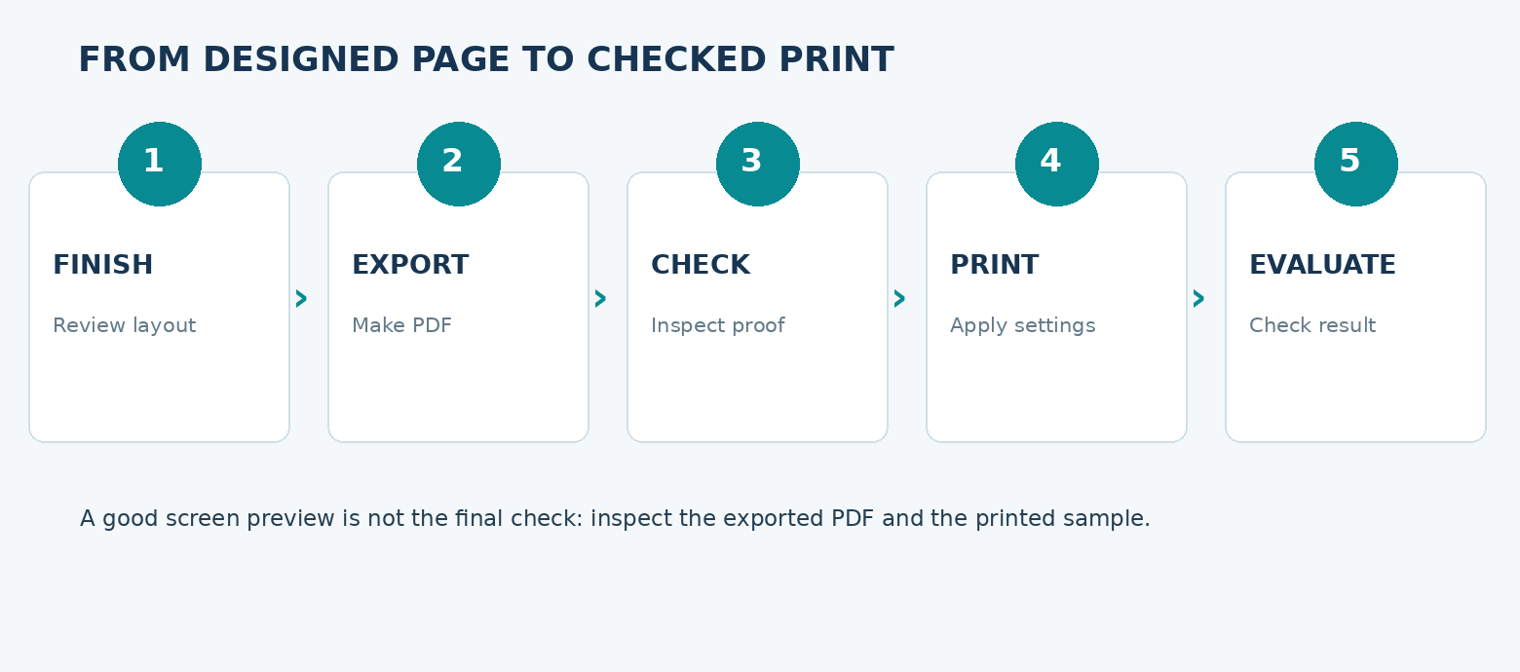
ITT06105 / DESKTOP PUBLISHING
ILLUSTRATION
From designed PDF to printed hand-out
The workflow is short, but each check has a distinct purpose.
Five-stage workflow
Review the editable design; export a fresh PDF; inspect the proof; select printer settings; then examine the first printed copy. If you find an error, correct the source or settings before printing the whole batch.
DESKTOP PUBLISHING • PRINTING AND QUALITY • 2026/2027
04

Slide 5
ITT06105 / DESKTOP PUBLISHING
EXPLAIN
Printed output and digital output
The same publication may be delivered in more than one way.
Digital publication
Printed publication
A PDF shared by phone, email or a learning portal is viewed on a screen. File size, screen legibility and device compatibility matter. Digital viewing does not confirm that colours or margins will print identically.
A physical hand-out requires appropriate paper, actual page dimensions, printer settings and acceptable image detail. Printed colours can differ from screen colours, so one test print is useful.
DESKTOP PUBLISHING • PRINTING AND QUALITY • 2026/2027
05

Slide 6
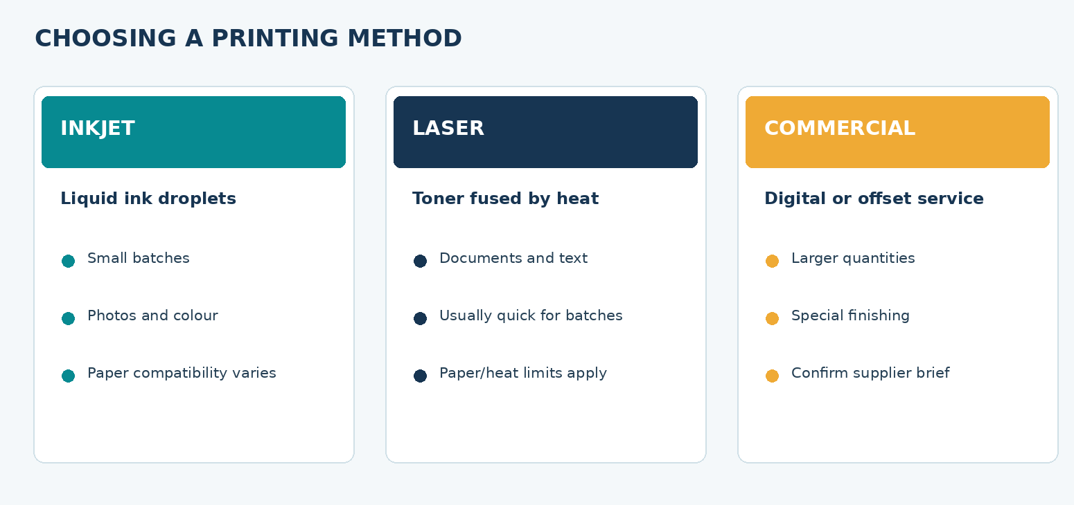
ITT06105 / DESKTOP PUBLISHING
ILLUSTRATION
Which printing method should we choose?
There is no single printer type that is best for all purposes.
Compare needs
Inkjet may suit small colour image tasks; laser often suits repeated office text; commercial printing helps with special paper, larger runs and finishing. Costs, quality and availability vary by device and service.
DESKTOP PUBLISHING • PRINTING AND QUALITY • 2026/2027
06

Slide 7
ITT06105 / DESKTOP PUBLISHING
KEY CONCEPT
Inkjet printing
Many small printers use inkjet technology.
Basic idea
An inkjet printer places droplets of liquid ink onto the paper. It may produce detailed photographic results when suitable ink and paper are used. However, drying, ink consumption and colour quality depend on the device and media.
Example: printing a colourful educational poster in a small office.
DESKTOP PUBLISHING • PRINTING AND QUALITY • 2026/2027
07

Slide 8
ITT06105 / DESKTOP PUBLISHING
KEY CONCEPT
Laser printing
Often used for office text and repeated pages.
Basic idea
A laser printer typically transfers toner to paper and fixes it with heat. It can produce crisp text and efficient document printing, though colour quality and accepted paper types vary between models.
Example: producing a stack of black-and-white class hand-outs.
DESKTOP PUBLISHING • PRINTING AND QUALITY • 2026/2027
08

Slide 9
ITT06105 / DESKTOP PUBLISHING
KEY CONCEPT
Commercial printing services
A print shop may offer more than a standard desktop printer.
Basic idea
Commercial printers can use digital presses or offset processes and offer specialised paper, folding, trimming and binding. Quantity, colour requirements, finishing and production time affect the method selected.
For a large order, ask the provider for page size, bleed, file format and finishing requirements before export.
DESKTOP PUBLISHING • PRINTING AND QUALITY • 2026/2027
09

Slide 10
ITT06105 / DESKTOP PUBLISHING
EXPLAIN
Paper properties
The sheet itself changes the final result.
Size and thickness
Finish and suitability
A4 measures 210 × 297 mm. Paper weight is often expressed in gsm (grams per square metre). Ordinary office paper and heavier brochure stock are not interchangeable for every printer or purpose.
Coated and uncoated surfaces absorb or reflect ink differently. Some printers restrict coated, textured or heavy paper. Always use paper compatible with the specific printer and expected output.
DESKTOP PUBLISHING • PRINTING AND QUALITY • 2026/2027
10

Slide 11
ITT06105 / DESKTOP PUBLISHING
STUDENT PRACTICE
Choose a suitable method
Think about the audience, quantity and resources.
YOUR TURN
Which is more sensible for 20 text-heavy course hand-outs: a local office laser printer or an offset press? Give two reasons.
Mention quantity, setup needs, paper and access; the answer can depend on real costs.
DESKTOP PUBLISHING • PRINTING AND QUALITY • 2026/2027
11

Slide 12
ITT06105 / DESKTOP PUBLISHING
KEY CONCEPT
What is a print-ready document?
A file can look correct on screen but still be unsuitable for a press.
Working definition
A print-ready document is a publication checked and prepared to meet the requirements of its intended printing process. It normally has the correct dimensions, complete text, sound graphics, suitable fonts and an appropriately exported file.
Different print providers have different requirements, so always confirm the actual specification.
DESKTOP PUBLISHING • PRINTING AND QUALITY • 2026/2027
12

Slide 13
ITT06105 / DESKTOP PUBLISHING
EXPLAIN
Editable file versus PDF proof
These two documents have different responsibilities.
Editable source (.indd)
PDF proof
The InDesign file holds the editable layout and may depend on linked images and fonts. Keep it organised so text, positions and graphics can be corrected before final output.
The PDF shows the intended exported page for inspection and sharing. It is convenient for printing, but exporting does not automatically resolve hidden text, blurry images or an unsuitable page setup.
DESKTOP PUBLISHING • PRINTING AND QUALITY • 2026/2027
13

Slide 14
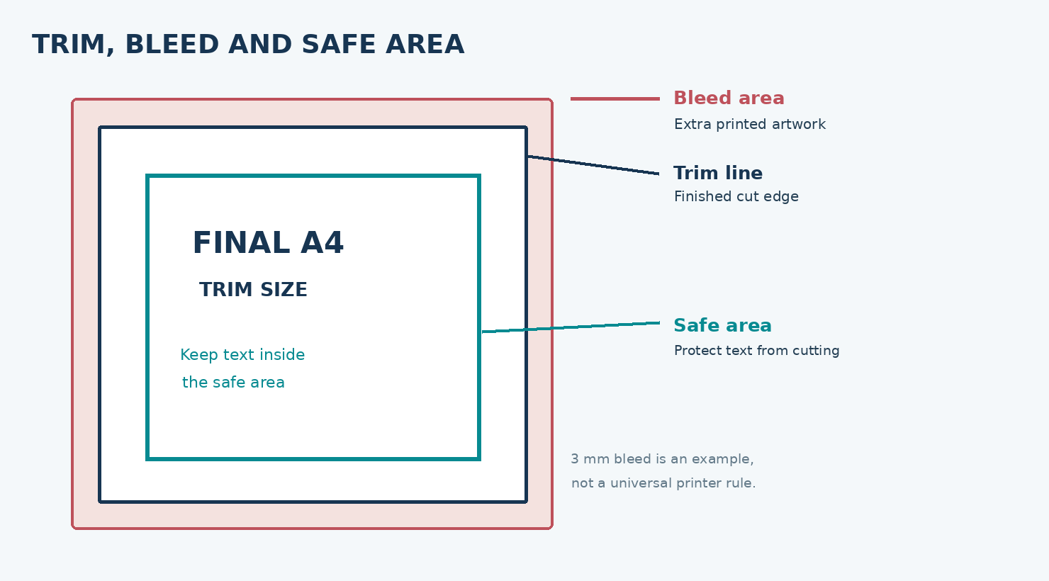
ITT06105 / DESKTOP PUBLISHING
PAGE GEOMETRY
Trim, bleed and safe area
These zones should not be confused with each other.
Remember the difference
Trim is the intended finished edge. Bleed extends background artwork beyond that line. The safe area keeps essential information inside the cut. A 3 mm bleed is just an illustrative value: confirm the provider’s instruction.
DESKTOP PUBLISHING • PRINTING AND QUALITY • 2026/2027
14

Slide 15
ITT06105 / DESKTOP PUBLISHING
KEY CONCEPT
Safe margins on an A4 hand-out
A normal office hand-out may not require a full commercial bleed setup.
Practical classroom choice
For our simple A4 hand-out, keep the title, body text and logo comfortably within the printable area. Margins protect readability and help avoid printer limitations. Background-to-edge printing requires a printer capable of borderless output or later trimming.
The supplied A4 PDF is an instructional example; it is not a certified commercial press file.
DESKTOP PUBLISHING • PRINTING AND QUALITY • 2026/2027
15

Slide 16
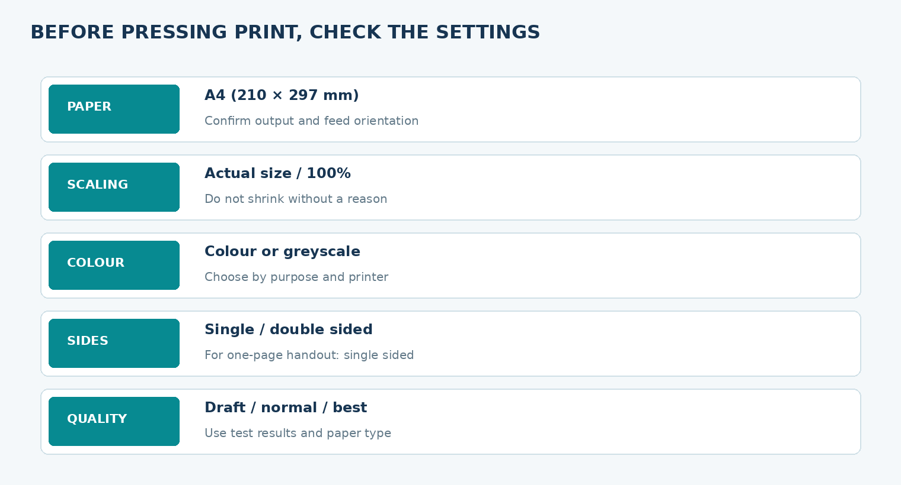
ITT06105 / DESKTOP PUBLISHING
SETTINGS
Printer dialogue: five settings to inspect
Menu names and available choices differ by device.
Checklist
Confirm paper size, actual size/scale, sides, colour or greyscale, and output quality. Check the paper tray and orientation too. Never assume the software has chosen the right values automatically.
DESKTOP PUBLISHING • PRINTING AND QUALITY • 2026/2027
16

Slide 17
ITT06105 / DESKTOP PUBLISHING
EXPLAIN
“Actual size” versus “Fit to page”
A small selection can change the physical dimensions.
Actual size (100%)
Fit to page
Normally prints at the intended scale when page and paper agree. Choose this for our A4 classroom proof unless the printer or document indicates otherwise.
May shrink or scale the image to a printable area. Useful in some situations, but it can alter measurements and reduce the size of text or layout. Inspect the preview before proceeding.
DESKTOP PUBLISHING • PRINTING AND QUALITY • 2026/2027
17

Slide 18
ITT06105 / DESKTOP PUBLISHING
KEY CONCEPT
Orientation, paper and number of copies
Basic settings are as important as advanced options.
Practical rule
Choose A4 portrait for the Tumaini hand-out. Confirm the tray paper matches the PDF size and choose the number of copies needed. A single test copy is usually better than discovering a mistake after producing a large batch.
If a printer does not support edge-to-edge A4, the printable margins may affect output.
DESKTOP PUBLISHING • PRINTING AND QUALITY • 2026/2027
18

Slide 19
ITT06105 / DESKTOP PUBLISHING
KEY CONCEPT
What does duplex mean?
Some documents use both sides of the paper.
Definition
Duplex printing places content on the front and back of the same sheet. It can reduce paper consumption for multipage documents. The long-edge or short-edge flip setting determines page orientation when turning the sheet.
Our one-page hand-out is normally single-sided; duplex is introduced for later publications.
DESKTOP PUBLISHING • PRINTING AND QUALITY • 2026/2027
19

Slide 20
ITT06105 / DESKTOP PUBLISHING
STUDENT PRACTICE
Choose settings for one page
The PDF is already a single-page A4 portrait file.
YOUR TURN
State appropriate settings for paper size, scale, sides, colour and copies when producing ONE proof of the hand-out.
Use A4, actual size, single-sided and one copy; colour depends on the available printer.
DESKTOP PUBLISHING • PRINTING AND QUALITY • 2026/2027
20

Slide 21
ITT06105 / DESKTOP PUBLISHING
KEY FORMULA
What does PPI mean?
Image detail has a relationship with its final printed size.
Effective PPI
Pixels per inch measures the density of image pixels at the size they are printed. The same photograph has lower effective PPI when placed at a larger physical width. This is different from the printer’s dots-per-inch (DPI) specification.
Effective PPI = (pixel width × 25.4) ÷ printed width in millimetres.
DESKTOP PUBLISHING • PRINTING AND QUALITY • 2026/2027
21

Slide 22
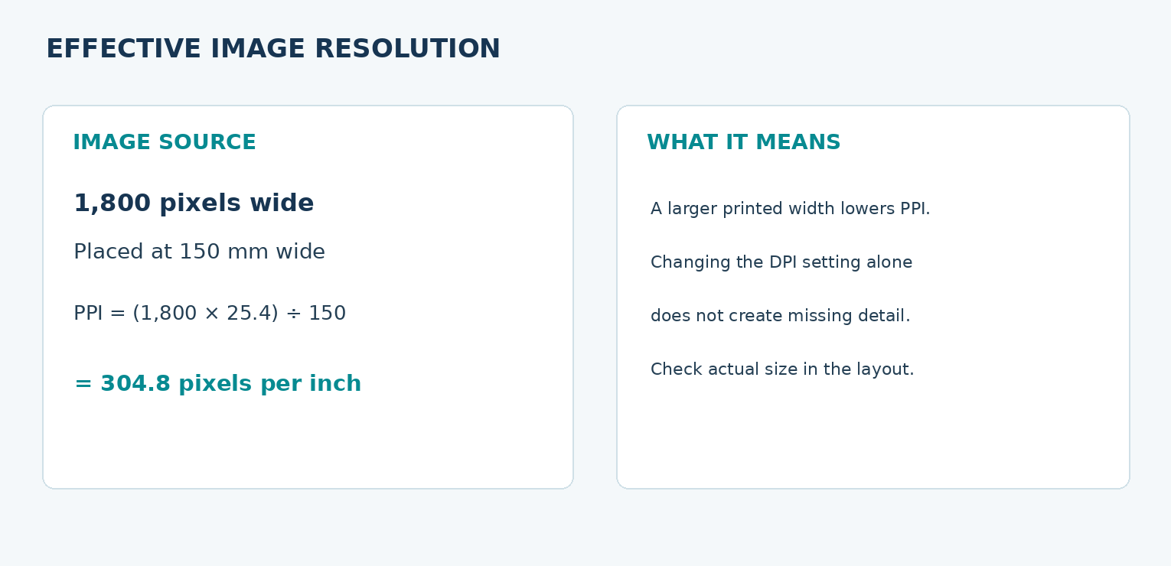
ITT06105 / DESKTOP PUBLISHING
WORKED EXAMPLE
Calculate effective PPI
The image is 1,800 pixels wide and prints at 150 mm.
Worked solution
1,800 × 25.4 ÷ 150 = 304.8 PPI. This value is useful evidence about image detail at the intended size. The appropriate resolution depends on print technology, image type and viewing distance.
DESKTOP PUBLISHING • PRINTING AND QUALITY • 2026/2027
22

Slide 23
ITT06105 / DESKTOP PUBLISHING
EXPLAIN
PPI is not the same as DPI
Two important terms often appear in print settings.
Image PPI
Printer DPI
Describes how the image’s original pixels are distributed at the placed print dimensions. Enlarging an image usually lowers its effective PPI.
Describes the density or addressability of printing marks. Selecting a higher DPI mode in the driver does not magically recreate details absent from the original image.
DESKTOP PUBLISHING • PRINTING AND QUALITY • 2026/2027
23

Slide 24
ITT06105 / DESKTOP PUBLISHING
STUDENT PRACTICE
Your turn: PPI calculation
Show working before deciding whether the image is suitable.
YOUR TURN
A photograph is 1,200 pixels wide and is printed 150 mm wide. Calculate its effective PPI.
Use pixel width × 25.4 ÷ printed width in millimetres.
DESKTOP PUBLISHING • PRINTING AND QUALITY • 2026/2027
24

Slide 25
ITT06105 / DESKTOP PUBLISHING
KEY CONCEPT
What should a good print look like?
A visual quality check considers more than colour alone.
Inspect these properties
Printed body text should be sharp and legible. Images should contain sufficient detail. Content should be correctly placed and not clipped. Colour, streaking, margins and page orientation should be sensible for the specified output.
Compare the printed copy with the PDF proof before printing multiple copies.
DESKTOP PUBLISHING • PRINTING AND QUALITY • 2026/2027
25

Slide 26
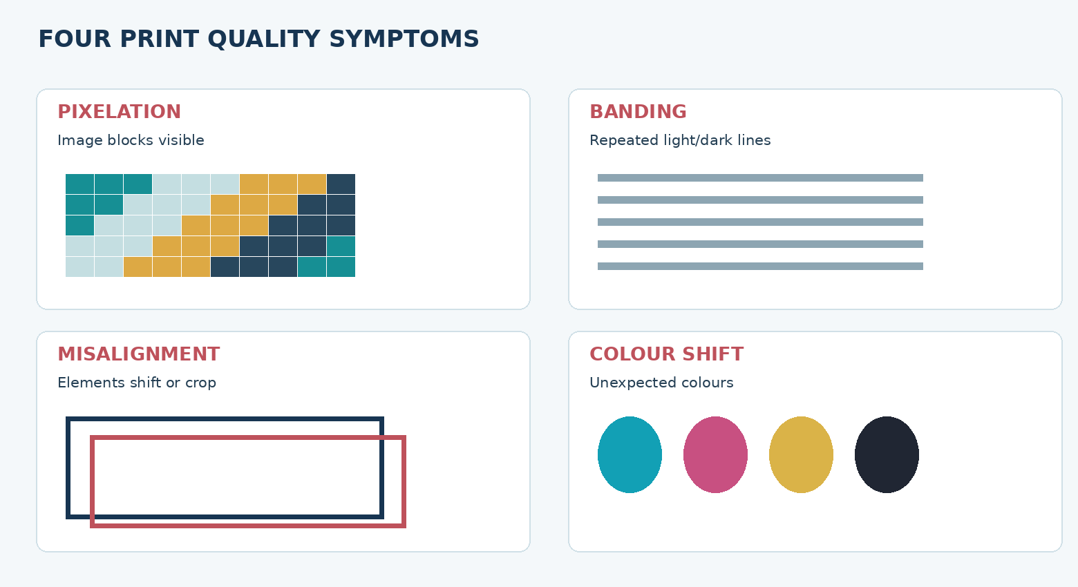
ITT06105 / DESKTOP PUBLISHING
PRINT QUALITY
Recognise common printing defects
A symptom is a starting point for diagnosis, not proof of one cause.
Four typical symptoms
Pixelation, banding, misalignment and colour shift can come from different problems. Compare the PDF with the print and check relevant settings before changing or replacing equipment.
DESKTOP PUBLISHING • PRINTING AND QUALITY • 2026/2027
26

Slide 27
ITT06105 / DESKTOP PUBLISHING
KEY CONCEPT
Pixelation and blur
A photo that looks clear at small size may fail when enlarged.
Possible reasons
Pixelation can occur when too few pixels are spread across a large printed area. Blur can result from low detail, image editing or output conditions. Begin by checking the original photograph and effective PPI at the final page size.
Avoid enlarging a small screenshot or thumbnail to fill a large hand-out.
DESKTOP PUBLISHING • PRINTING AND QUALITY • 2026/2027
27

Slide 28
ITT06105 / DESKTOP PUBLISHING
KEY CONCEPT
Banding and streaks
These marks may not exist in the original PDF.
Possible reasons
Banding consists of unwanted repeated light, dark or coloured lines. Causes may include printhead or toner issues, feed problems, media and maintenance needs. Compare the source with a print test and use the manufacturer’s prescribed checks.
Do not assume all banding can be fixed by changing image contrast.
DESKTOP PUBLISHING • PRINTING AND QUALITY • 2026/2027
28

Slide 29
ITT06105 / DESKTOP PUBLISHING
KEY CONCEPT
Misalignment and unexpected cropping
Paper size and driver settings are common places to investigate.
Possible reasons
If content is shifted, cut off or reduced, compare PDF page size, paper orientation, scaling and available printer margins. If the PDF itself is already incorrect, return to the editable publication instead of repeatedly adjusting the printer.
One-page test prints help distinguish document errors from printer-setting problems.
DESKTOP PUBLISHING • PRINTING AND QUALITY • 2026/2027
29

Slide 30
ITT06105 / DESKTOP PUBLISHING
KEY CONCEPT
Colour differences between screen and print
Screens and paper produce colour in different ways.
Possible reasons
Screen brightness, colour profiles, ink or toner, media type and printer condition can all affect colour appearance. Print may look less vivid than the monitor. For a classroom task, prioritise readable contrast and consistent, intentional use of colour.
For professional accuracy, use the print provider’s colour specifications and proofing process.
DESKTOP PUBLISHING • PRINTING AND QUALITY • 2026/2027
30

Slide 31
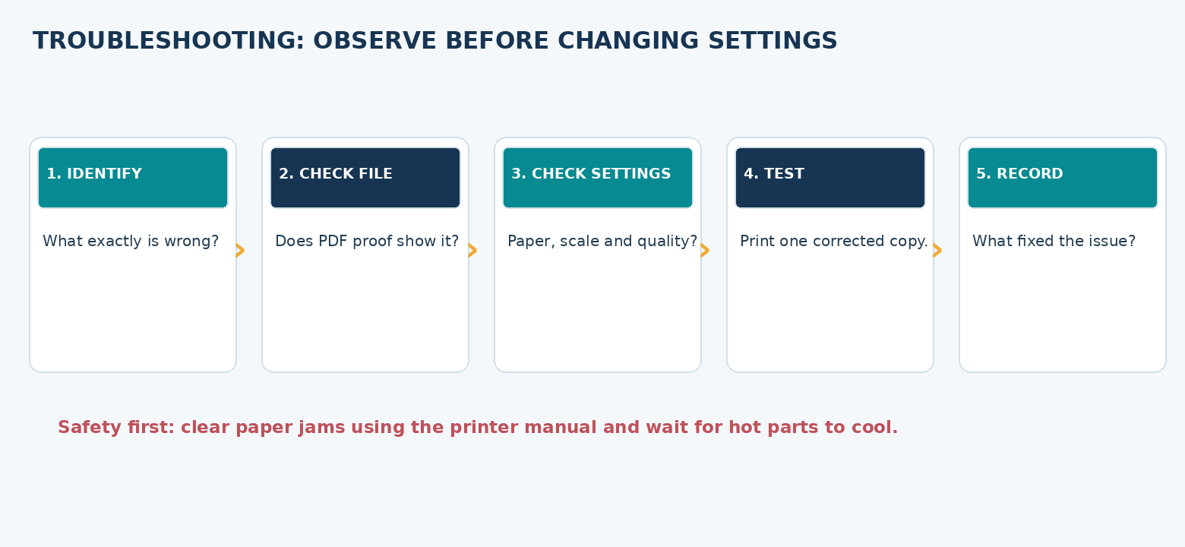
ITT06105 / DESKTOP PUBLISHING
TROUBLESHOOTING
Safe diagnosis is a step-by-step process
Avoid experimenting with the whole printer at once.
Five checks
Name the symptom; inspect the PDF; verify size, media and settings; print one corrected sample; and record what changed. If hardware work is needed, follow the manufacturer’s safety guidance.
DESKTOP PUBLISHING • PRINTING AND QUALITY • 2026/2027
31

Slide 32
ITT06105 / DESKTOP PUBLISHING
SAFETY
Paper jams and printer maintenance
Students should know basic precautions, not internal repair.
Safety first
Power, heat and moving rollers can make printer maintenance hazardous. If a sheet jams, stop the job and follow the printer manual or lab technician’s instructions. Avoid forcing paper through the machine or touching hot internal parts.
When in doubt, report the problem instead of dismantling the equipment.
DESKTOP PUBLISHING • PRINTING AND QUALITY • 2026/2027
32

Slide 33
ITT06105 / DESKTOP PUBLISHING
COST EXAMPLE
Estimate simple printing costs
Only use a quoted price when planning real jobs.
Basic method
The number of required sheets depends on page count, copies and whether printing is single- or double-sided. Multiply the number of printed sheets by the stated unit price; add other supplier charges if applicable. Classroom figures are hypothetical.
Example: 30 single-page hand-outs × TZS 150 per printed sheet = TZS 4,500.
DESKTOP PUBLISHING • PRINTING AND QUALITY • 2026/2027
33

Slide 34
ITT06105 / DESKTOP PUBLISHING
STUDENT PRACTICE
Quick cost calculation
Use a fictional teaching quotation.
YOUR TURN
A training centre needs 40 one-page, single-sided A4 hand-outs at TZS 120 per sheet. What is the estimated charge, excluding other costs?
Multiply 40 × 120, and label your answer in Tanzanian shillings.
DESKTOP PUBLISHING • PRINTING AND QUALITY • 2026/2027
34

Slide 35
ITT06105 / DESKTOP PUBLISHING
PRACTICAL WORKFLOW
Practical: prepare and test the hand-out
Use the completed “Stay Safe Online” PDF from Lecture 8.
1
Inspect PDF
Check title, tips, placed graphic and A4 page size.
2
Choose settings
Select paper, scale, colour and number of copies.
3
Calculate
Find effective PPI and estimated printed-copy cost.
4
Print or analyse
Use a test page if available; otherwise inspect defect examples.
5
Record
Write observations and a justified correction or next step.
DESKTOP PUBLISHING • PRINTING AND QUALITY • 2026/2027
35

Slide 36
ITT06105 / DESKTOP PUBLISHING
PRACTICAL
The test page is a diagnostic aid
An A4 chart is supplied in the practical resources.
How to use it
Print the chart at actual size where possible. Compare large and small text, coloured areas, fine lines and page alignment. Record what you notice. The chart can support a basic classroom quality check but is not a professional colour-calibration tool.
If no printer is available, use the printed-defect illustrations and complete a reasoned diagnosis.
DESKTOP PUBLISHING • PRINTING AND QUALITY • 2026/2027
36

Slide 37
ITT06105 / DESKTOP PUBLISHING
STUDENT PRACTICE
Diagnose a problem
Decide which part of the workflow should be checked first.
YOUR TURN
The hand-out looks correct as a PDF, but the printed page is unexpectedly smaller. Name one likely cause and one appropriate correction.
Check scaling and paper size before changing the design itself.
DESKTOP PUBLISHING • PRINTING AND QUALITY • 2026/2027
37

Slide 38
ITT06105 / DESKTOP PUBLISHING
KEY CONCEPT
Keep a useful quality-control record
A short record helps explain why a decision was made.
Record evidence
Write down the file name, printer settings, paper size, number of copies and observed problem. State the suspected cause and what you checked. A useful report separates what was actually observed from what was only assumed.
Example: “PDF is A4; driver used Fit to page; test output is smaller; retry at 100%.”
DESKTOP PUBLISHING • PRINTING AND QUALITY • 2026/2027
38

Slide 39
ITT06105 / DESKTOP PUBLISHING
SUMMARY
Five things to remember
These ideas connect the entire lecture.
1
Choose
A printer and paper appropriate for the publication.
2
Verify
PDF size, margins and any provider requirements.
3
Calculate
Effective PPI at the actual placed size.
4
Inspect
One sample for clarity, colour and positioning.
5
Correct
The source or settings, then test again before bulk printing.
DESKTOP PUBLISHING • PRINTING AND QUALITY • 2026/2027
39

Slide 40
ITT06105 / DESKTOP PUBLISHING
STUDENT PRACTICE
End-of-lecture review
Think about the physical output, not only the PDF.
YOUR TURN
Why should you inspect a test print before producing 100 copies? State three different problems that a test may reveal.
Examples include size, image sharpness, colour, cropping and streaks.
DESKTOP PUBLISHING • PRINTING AND QUALITY • 2026/2027
40

Slide 41
ITT06105 / DESKTOP PUBLISHING
COMING NEXT
Next lecture: Image Processing and Compression
Efficient digital images balance file size and visual quality.
Connection to Lecture 10
You now know how image resolution and printing size affect output quality. In the next lecture, you will compare lossless and lossy formats, measure changes in file size and decide how to preserve useful image quality for digital and printed media.
Keep your Tumaini image files for the next practical.
DESKTOP PUBLISHING • PRINTING AND QUALITY • 2026/2027
41

