Slide 1
ITT06105 • DESKTOP PUBLISHING
IMAGE PROCESSING
AND
COMPRESSION
Lecture 10 | Ordinary Diploma in IT
Process → export → measure → inspect → choose
Academic year 2026/2027

Slide 2
ITT06105 / DESKTOP PUBLISHING
LEARNING OUTCOMES
Learning outcomes
After the lecture, you should be able to:
1
Explain
Describe image processing and its main steps.
2
Distinguish
Tell cropping, resizing and compression apart.
3
Compare
Explain lossy, lossless and common file formats.
4
Calculate
Find file-size percentage reduction and compression ratio.
5
Recommend
Select suitable images for print and digital use.
DESKTOP PUBLISHING • IMAGE PROCESSING • 2026/2027
02

Slide 3
ITT06105 / DESKTOP PUBLISHING
COURSE CONNECTION
Our publication needs images
Recall the “Stay Safe Online” hand-out created in previous lectures.
One picture, different destinations
An image may be printed in an A4 educational hand-out, shared through a phone or placed in a poster. The required dimensions, detail, transparency and file size will not always be identical. Image processing prepares the image for each job.
The right question is not “Which export is smallest?” but “Which export meets the intended use?”
DESKTOP PUBLISHING • IMAGE PROCESSING • 2026/2027
03

Slide 4
ITT06105 / DESKTOP PUBLISHING
KEY CONCEPT
What is image processing?
A foundational term for the final topic.
Definition
Image processing is the use of operations to modify, improve, analyse or prepare a digital image for a particular purpose. In desktop publishing, common operations include cropping, resizing, correcting brightness, adjusting contrast and preparing export files.
For example, an image may be cropped to remove distractions before placement in the hand-out.
DESKTOP PUBLISHING • IMAGE PROCESSING • 2026/2027
04

Slide 5
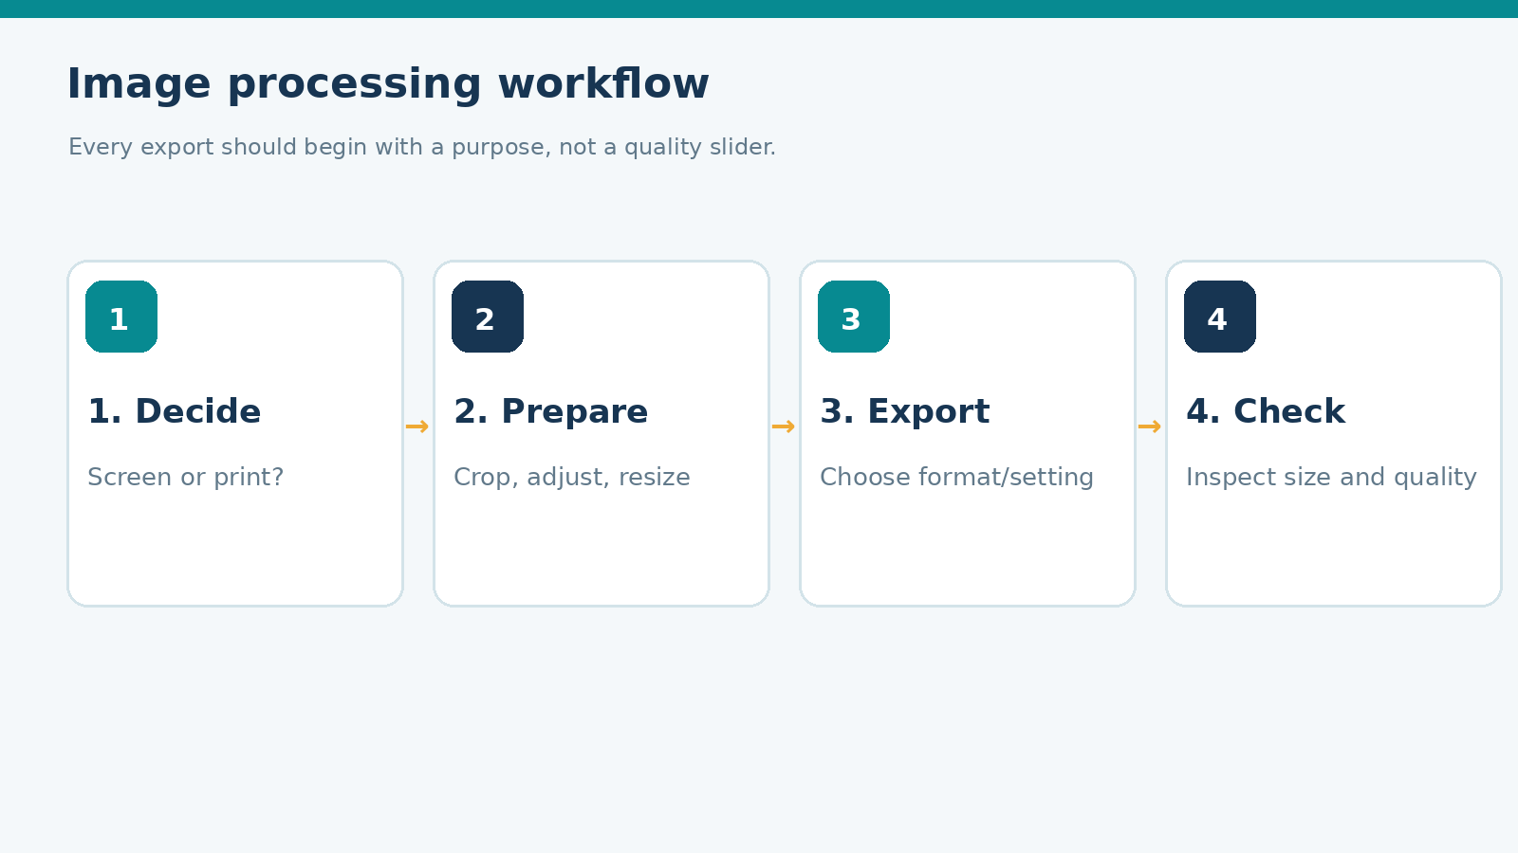
ITT06105 / DESKTOP PUBLISHING
ILLUSTRATION
A simple image-processing workflow
Four stages help avoid repeated trial and error.
Start with a purpose
Decide where the image will be used. Make necessary corrections; export a suitable format and setting; then inspect the result at the intended size. If it fails, adjust the source or export rather than accepting a poor output.
DESKTOP PUBLISHING • IMAGE PROCESSING • 2026/2027
05

Slide 6
ITT06105 / DESKTOP PUBLISHING
EXPLAIN
Three common processing operations
These actions are related, but not identical.
Cropping
Resizing and correction
Cropping removes unwanted outer parts of a picture. The remaining image may have a different shape or composition. A crop cannot restore details already outside the selected area.
Resizing changes pixel dimensions, such as 1,200 × 800 to 600 × 400. Correction changes appearance, for example exposure, contrast or colour. Both may be necessary before exporting.
DESKTOP PUBLISHING • IMAGE PROCESSING • 2026/2027
06

Slide 7
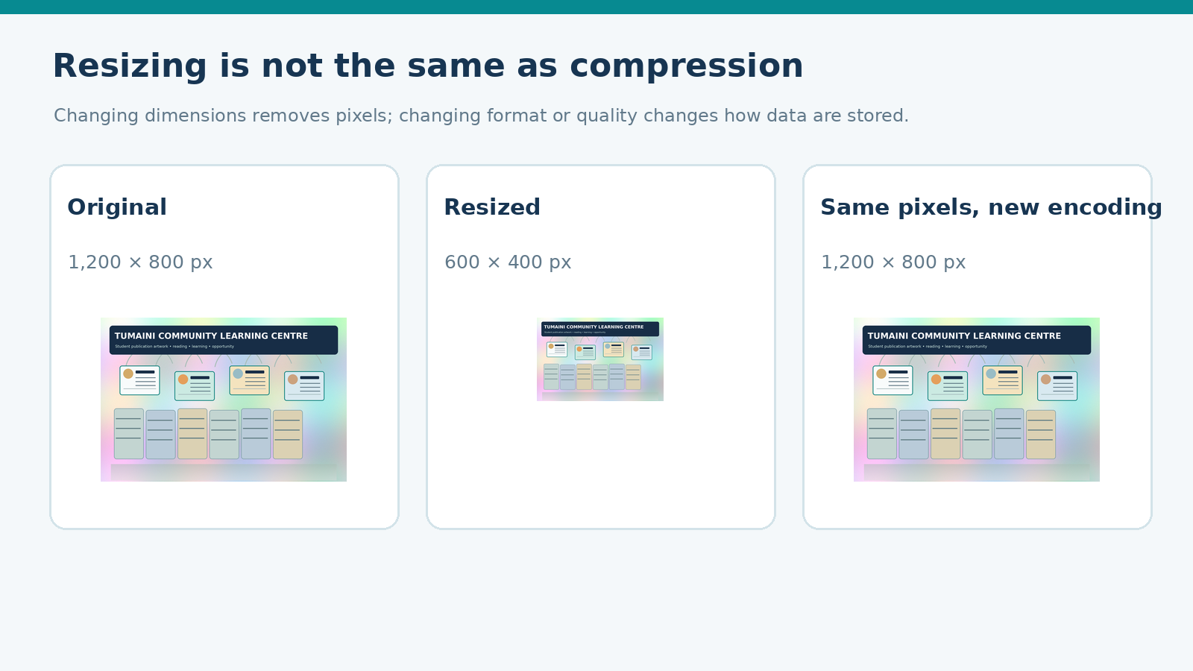
ITT06105 / DESKTOP PUBLISHING
ILLUSTRATION
Resizing versus compression
File size can change for different reasons.
Distinguish the changes
Resizing reduces or increases the pixel grid. Compression changes how image information is encoded. Two exports can have exactly the same pixel dimensions but different file sizes. A fair comparison needs both dimensions and file sizes recorded.
DESKTOP PUBLISHING • IMAGE PROCESSING • 2026/2027
07

Slide 8
ITT06105 / DESKTOP PUBLISHING
KEY CONCEPT
Pixels and image dimensions
Raster images store colour at positions in a pixel grid.
Pixel dimensions
A raster picture measuring 1,200 × 800 contains 1,200 pixels horizontally and 800 vertically. Those numbers describe pixel count, not the physical width in centimetres or the size of the stored file in KiB.
If we double its printed width without adding detail, its effective PPI becomes lower.
DESKTOP PUBLISHING • IMAGE PROCESSING • 2026/2027
08

Slide 9
ITT06105 / DESKTOP PUBLISHING
KEY CONCEPT
Cropping as a design decision
A crop should strengthen the message without hiding important information.
What the Crop Tool changes
Cropping removes areas outside the chosen region. It can improve emphasis and make a photograph fit a text-and-image layout. However, removing part of a person, object or caption may change the meaning. Always check that essential content remains visible.
Example: crop a classroom picture to show the learner and computer more clearly.
DESKTOP PUBLISHING • IMAGE PROCESSING • 2026/2027
09

Slide 10
ITT06105 / DESKTOP PUBLISHING
PRACTICAL STEPS
Basic image preparation
Use a beginner-friendly workflow in Photoshop or GIMP.
1
Open safely
Work from a copy, keeping the original untouched.
2
Crop
Choose a suitable aspect ratio and keep meaningful content.
3
Resize if needed
Set sensible pixel dimensions without distorting proportions.
4
Adjust lightly
Improve contrast or brightness only when the result is better.
5
Export and review
Save the source, then inspect the exported image.
DESKTOP PUBLISHING • IMAGE PROCESSING • 2026/2027
10

Slide 11
ITT06105 / DESKTOP PUBLISHING
STUDENT PRACTICE
Choose the correct operation
Consider what the student wants to change.
YOUR TURN
A photo is 1,200 × 800 pixels. Its subject is too small, and the image is too large to upload. Which two separate operations might help?
Explain the goal of cropping and the goal of export compression separately.
DESKTOP PUBLISHING • IMAGE PROCESSING • 2026/2027
11

Slide 12
ITT06105 / DESKTOP PUBLISHING
KEY CONCEPT
What does image compression do?
Compression is about storing and distributing image information.
Definition
Image compression reduces the amount of digital storage required to represent an image. A compressed image may upload faster or require less space. Compression can be lossless or lossy, and the visible result depends on the format, settings and image content.
Compression should not be confused with simply changing image dimensions.
DESKTOP PUBLISHING • IMAGE PROCESSING • 2026/2027
12

Slide 13
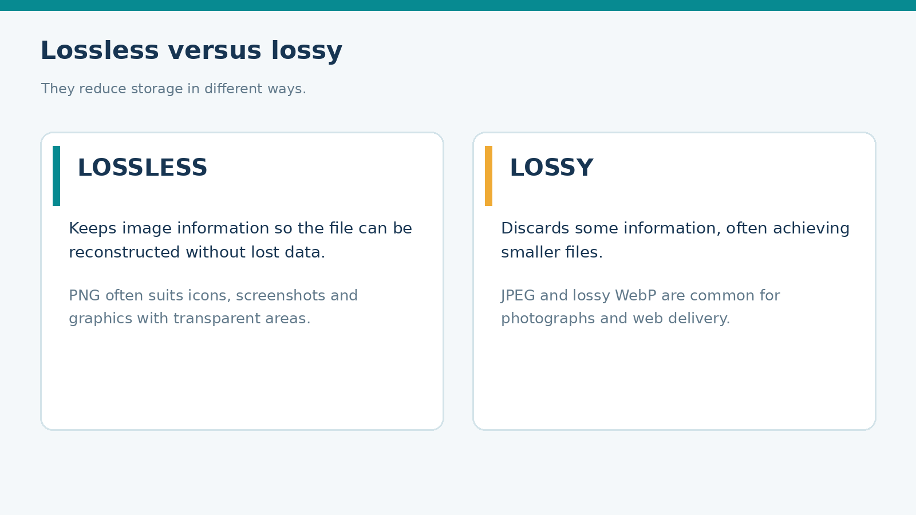
ITT06105 / DESKTOP PUBLISHING
ILLUSTRATION
Two main kinds of compression
Know the difference before choosing a file format.
Two strategies
Lossless methods preserve all image information needed for exact reconstruction of the encoded image. Lossy methods discard selected information to produce potentially smaller outputs, but may harm fine details.
DESKTOP PUBLISHING • IMAGE PROCESSING • 2026/2027
13

Slide 14
ITT06105 / DESKTOP PUBLISHING
KEY CONCEPT
Lossless compression
Useful when faithful detail or crisp graphic edges matter.
Basic idea
A lossless format can recover the stored pixels without data being removed by the compression process. PNG uses lossless compression and is commonly chosen for screenshots, graphic elements and images that require transparency.
Lossless does not mean every PNG is small; complicated images can still have large files.
DESKTOP PUBLISHING • IMAGE PROCESSING • 2026/2027
14

Slide 15
ITT06105 / DESKTOP PUBLISHING
KEY CONCEPT
Lossy compression
Smaller files can involve a visible quality trade-off.
Basic idea
Lossy compression discards some image information. JPEG is a common lossy format. When compression is stronger, the file may become smaller, but smooth areas, fine lines and text may show blocks, halos or loss of detail.
Lossy image quality should be judged by looking at the actual export at a suitable viewing size.
DESKTOP PUBLISHING • IMAGE PROCESSING • 2026/2027
15

Slide 16
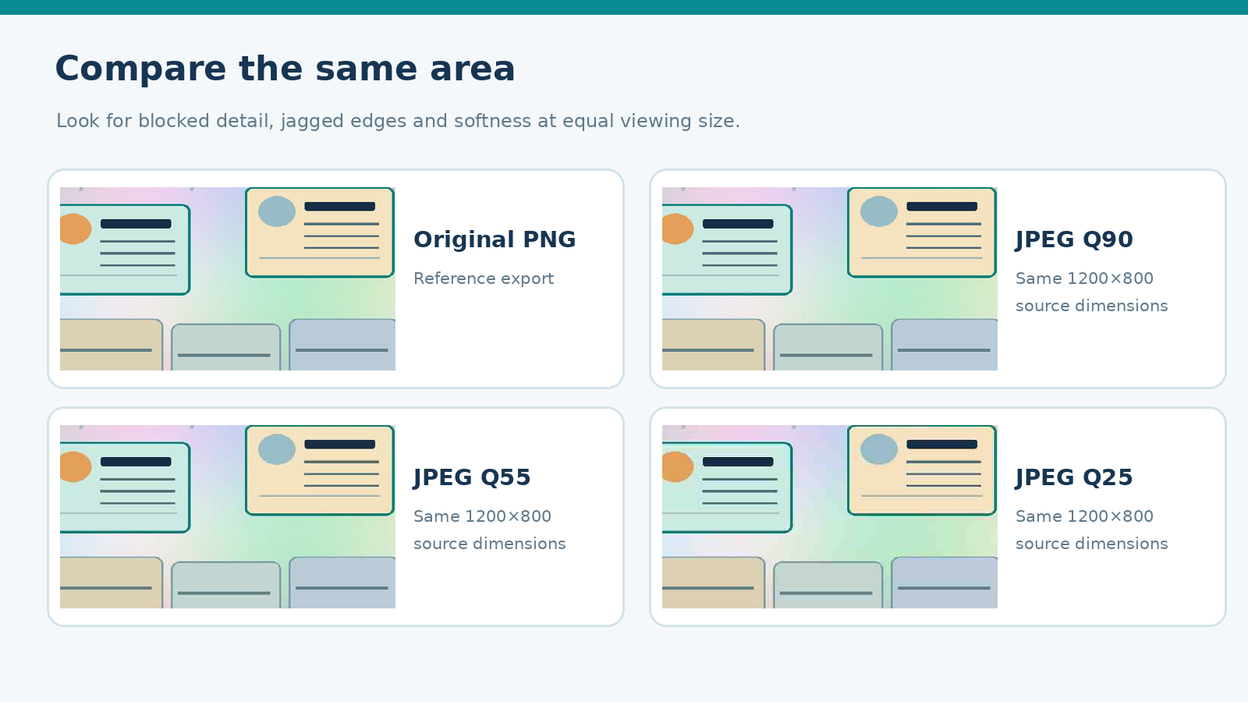
ITT06105 / DESKTOP PUBLISHING
ILLUSTRATION
Compare image details
The practical uses four exports with equal pixel dimensions.
Inspect fairly
Each version is based on the same 1,200 × 800 image. Compare the same region at the same displayed scale; then view the file as it would appear in the final publication. Compression differences may be clearer in some regions than others.
DESKTOP PUBLISHING • IMAGE PROCESSING • 2026/2027
16

Slide 17
ITT06105 / DESKTOP PUBLISHING
EXPLAIN
What does JPEG quality mean?
A useful setting, but not a universal numerical measurement.
Higher setting
Lower setting
A high-quality JPEG setting usually retains more visual detail but tends to produce a larger file. A photographic announcement may benefit from this when fine edges or colour transitions matter.
A lower setting often gives a smaller file, but may create visible artefacts. Settings such as Q90 and Q55 are encoder controls, not a universal claim that the resulting image retains exactly 90% or 55% of its information.
DESKTOP PUBLISHING • IMAGE PROCESSING • 2026/2027
17

Slide 18
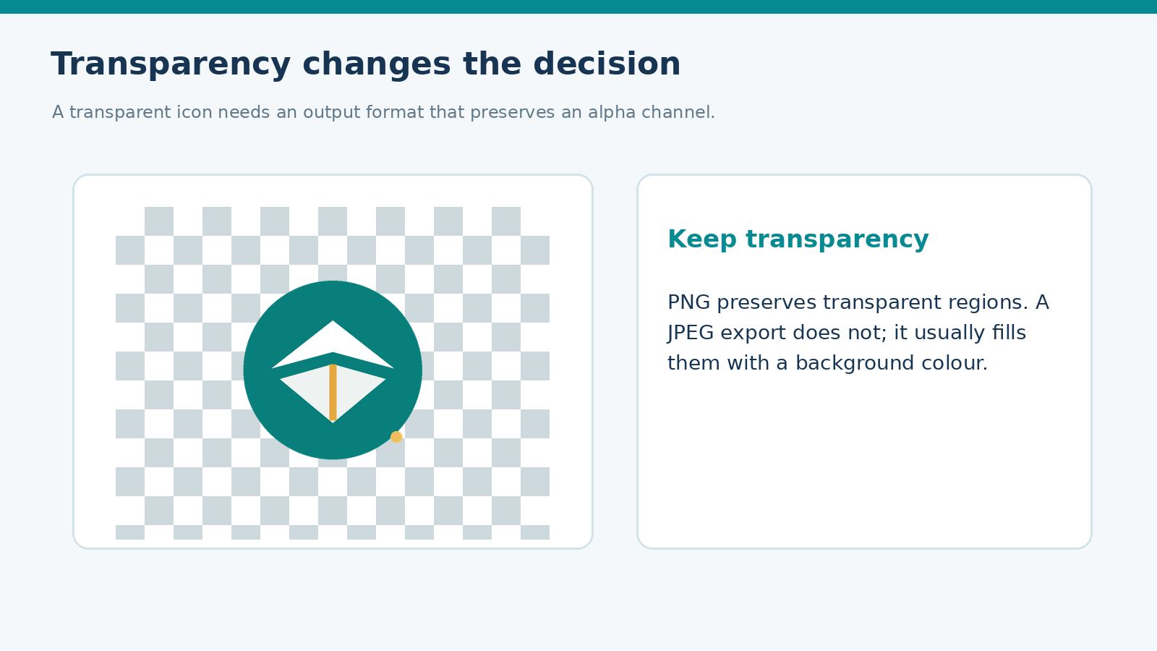
ITT06105 / DESKTOP PUBLISHING
ILLUSTRATION
Transparency needs attention
The background can be part of a graphic requirement.
PNG and SVG can help
A transparent badge can sit over different page colours. PNG preserves raster transparency, while SVG can keep a vector icon scalable. Ordinary JPEG does not preserve a transparency channel, making it a poor choice for an icon that needs a clear background.
DESKTOP PUBLISHING • IMAGE PROCESSING • 2026/2027
18

Slide 19
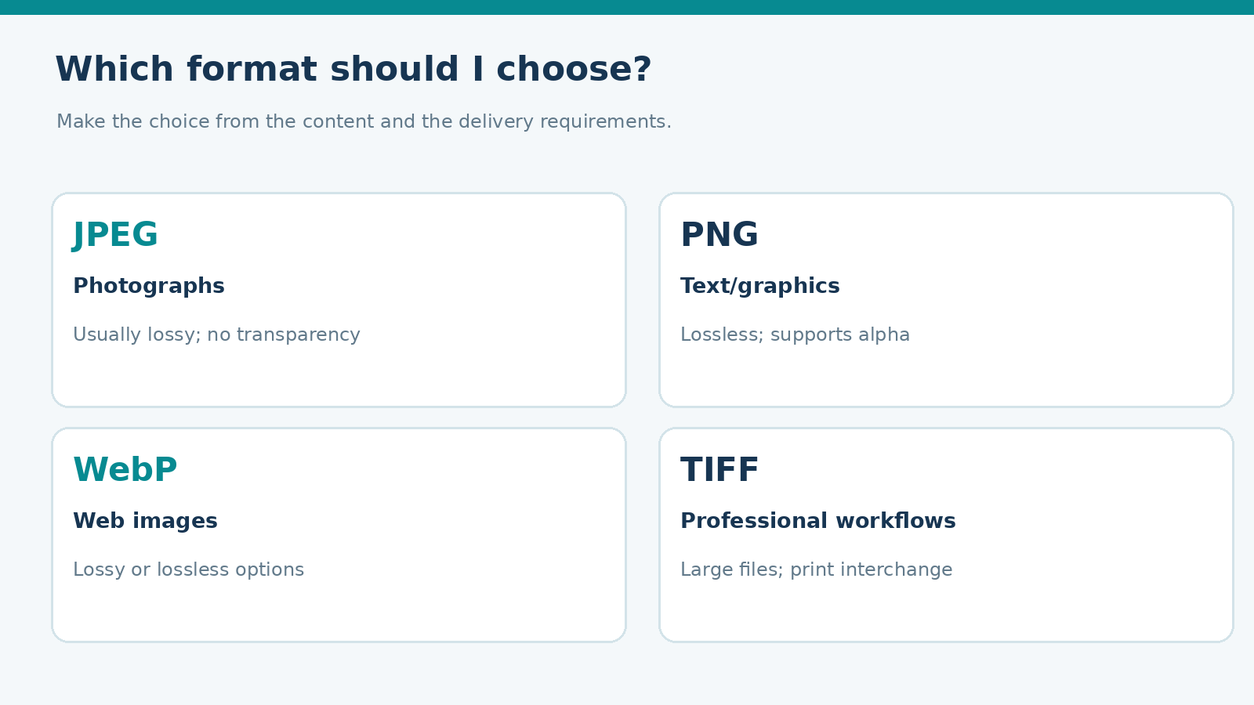
ITT06105 / DESKTOP PUBLISHING
ILLUSTRATION
Common image formats
A quick comparison of basic publishing choices.
Match format to content
JPEG is often used for photographs. PNG is useful for crisp graphics or transparency. WebP supports efficient web exports when compatible with the delivery platform. TIFF may appear in specialist print workflows; follow the print provider’s requirements.
DESKTOP PUBLISHING • IMAGE PROCESSING • 2026/2027
19

Slide 20
ITT06105 / DESKTOP PUBLISHING
EXPLAIN
JPEG and PNG in practice
Both may be used in the same publication.
JPEG — photographs
PNG — graphic elements
Usually effective for natural photographic images with many colours and gradients. It does not support alpha transparency, and repeated lossy re-saving should be avoided when an editable source is available.
Often useful for flat-colour graphics, screenshots, diagrams and transparent icons. It stores pixels without lossy compression, though photographic PNG files may be much larger than suitable JPEG exports.
DESKTOP PUBLISHING • IMAGE PROCESSING • 2026/2027
20

Slide 21
ITT06105 / DESKTOP PUBLISHING
EXPLAIN
WebP, TIFF and source files
Not every file is intended for the same workflow.
WebP and TIFF
Keep editable source files
WebP can provide efficient delivery for websites and supported applications; it offers lossy and lossless modes. TIFF is commonly encountered in some high-quality image and print exchanges and may generate larger files.
A Photoshop PSD is a working project with layers, while an exported JPEG or PNG is intended for delivery. Preserve the editable version so later changes do not require repeatedly degrading an exported image.
DESKTOP PUBLISHING • IMAGE PROCESSING • 2026/2027
21

Slide 22
ITT06105 / DESKTOP PUBLISHING
STUDENT PRACTICE
Choose a format
A good answer explains why the format fits the purpose.
YOUR TURN
Would you normally use a transparent PNG or a JPEG to place a lightbulb icon over a coloured hand-out background? Explain your choice.
You may also mention an SVG if an editable vector icon is supported.
DESKTOP PUBLISHING • IMAGE PROCESSING • 2026/2027
22

Slide 23
ITT06105 / DESKTOP PUBLISHING
KEY CONCEPT
How do we measure file size?
Two units you may encounter on a computer.
Bytes and kibibytes
A byte is a unit of stored digital information. One kibibyte (KiB) is 1,024 bytes. File size and image dimensions are different measurements; two 1,200 × 800 images may have very different file sizes because of encoding and content.
The practical uses KiB to describe the files measured from its supplied image set.
DESKTOP PUBLISHING • IMAGE PROCESSING • 2026/2027
23

Slide 24
ITT06105 / DESKTOP PUBLISHING
KEY FORMULA
Percentage file-size reduction
A simple calculation describes how much smaller an export becomes.
Formula
Percentage reduction = ((Original size − New size) ÷ Original size) × 100. Use the same size unit on both sides and make sure the new size is smaller. A reduction of 75% means that one-quarter of the original file size remains.
Example: original 800 KiB, new 200 KiB → (800 − 200) ÷ 800 × 100 = 75%.
DESKTOP PUBLISHING • IMAGE PROCESSING • 2026/2027
24

Slide 25
ITT06105 / DESKTOP PUBLISHING
WORKED EXAMPLE
Worked example: 800 KiB to 200 KiB
Write the units and show your arithmetic.
Calculation
Original file O = 800 KiB; exported file N = 200 KiB. Difference = 600 KiB. Percentage reduction = (600 ÷ 800) × 100 = 75%. The export is 25% of the original size.
A smaller file does not prove that the visual result remains acceptable.
DESKTOP PUBLISHING • IMAGE PROCESSING • 2026/2027
25

Slide 26
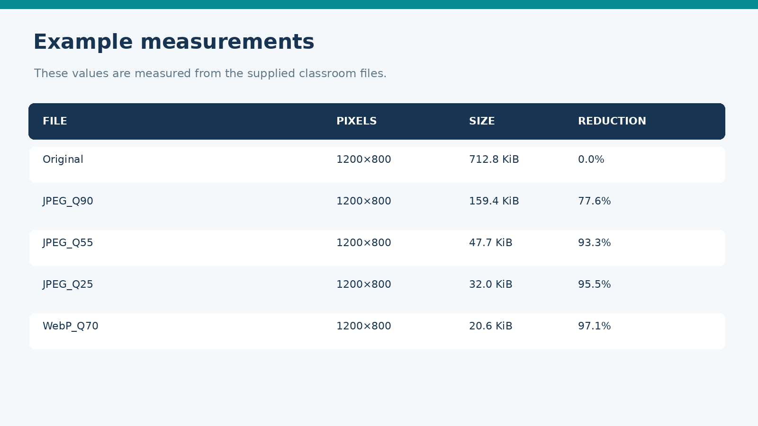
ITT06105 / DESKTOP PUBLISHING
ILLUSTRATION
Real measurements from our files
The class can verify these sizes with a file manager.
Interpret the table
The original PNG is approximately 712.8 KiB. JPEG Q55 is approximately 47.7 KiB, a reduction of about 93.3%. These measured files all have 1,200 × 800 pixel dimensions. Another encoder may produce different values.
DESKTOP PUBLISHING • IMAGE PROCESSING • 2026/2027
26

Slide 27
ITT06105 / DESKTOP PUBLISHING
WORKED EXAMPLE
Worked example: PNG versus JPEG
Use measured bytes or rounded KiB consistently.
Approximate reduction
Original PNG = 712.8 KiB. JPEG Q55 = 47.7 KiB. Reduction = (712.8 − 47.7) ÷ 712.8 × 100 ≈ 93.3%. The JPEG file occupies roughly 6.7% of the PNG size.
Check readability before recommending the JPEG simply because it is smaller.
DESKTOP PUBLISHING • IMAGE PROCESSING • 2026/2027
27

Slide 28
ITT06105 / DESKTOP PUBLISHING
KEY FORMULA
What is a compression ratio?
Another way to express the size change.
Original size : New size
An original-to-new compression ratio describes how many units of old storage correspond to one unit of new storage. For 800 KiB reduced to 200 KiB, the ratio is 800:200, or 4:1.
A 4:1 ratio is not the same number as the 75% reduction, though they describe the same size change.
DESKTOP PUBLISHING • IMAGE PROCESSING • 2026/2027
28

Slide 29
ITT06105 / DESKTOP PUBLISHING
STUDENT PRACTICE
Calculate with a colleague
Try the calculation before checking the solution.
YOUR TURN
A file of 600 KiB becomes 150 KiB. What are the percentage reduction and original-to-new compression ratio?
Expected reasoning: calculate the difference first, then divide by the original.
DESKTOP PUBLISHING • IMAGE PROCESSING • 2026/2027
29

Slide 30
ITT06105 / DESKTOP PUBLISHING
KEY CONCEPT
Make fair comparisons
Do not change too many variables at once.
Control pixel dimensions
To compare export settings, begin with one original image and keep pixel dimensions constant. Record each format, quality setting and resulting file size. A 600 × 400 resized image should be analysed separately from the 1,200 × 800 exports because pixel count has also changed.
The smallest file in our practice set is not necessarily the preferred print image.
DESKTOP PUBLISHING • IMAGE PROCESSING • 2026/2027
30

Slide 31
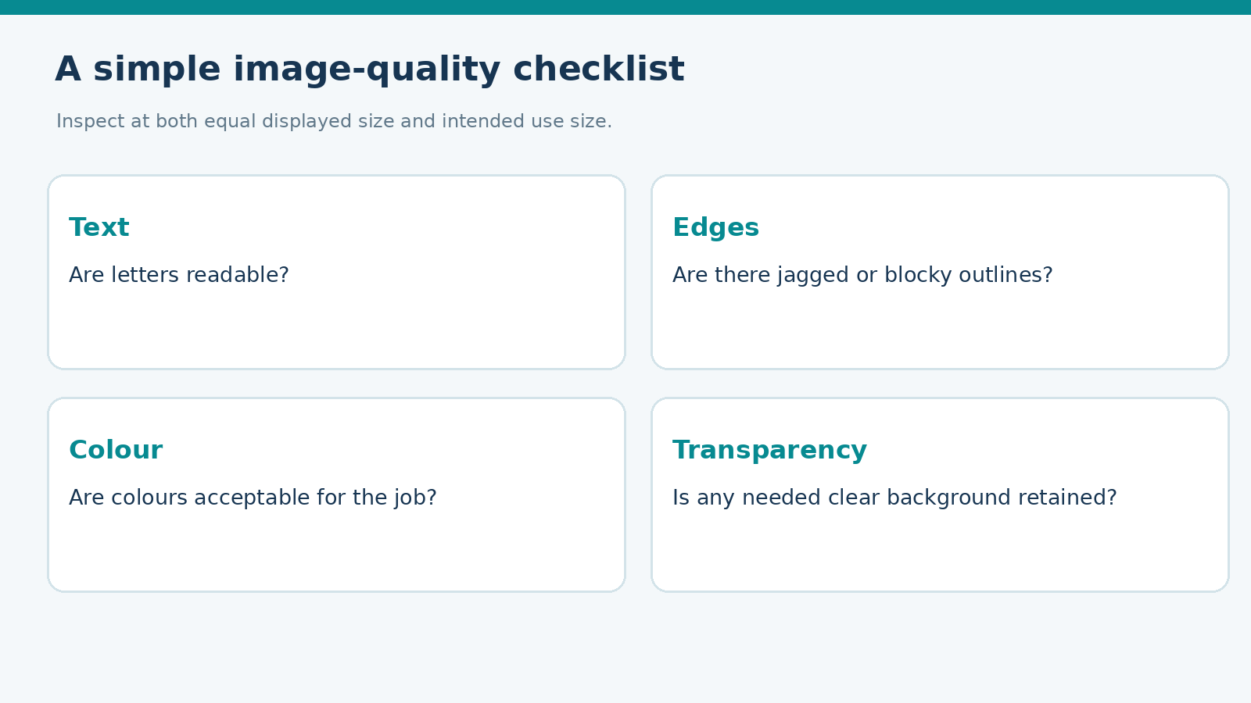
ITT06105 / DESKTOP PUBLISHING
ILLUSTRATION
What should be checked visually?
View exports at equal size and at their real intended display size.
A practical inspection
Look at text, edges, colour, photographic detail and transparency where needed. Strong compression artefacts can make a graphic hard to read, even if the file transfers quickly. Notice whether the output still communicates its intended message.
DESKTOP PUBLISHING • IMAGE PROCESSING • 2026/2027
31

Slide 32
ITT06105 / DESKTOP PUBLISHING
KEY CONCEPT
What are compression artefacts?
Sometimes lost detail appears as visible defects.
Recognising common problems
At strong lossy settings, an image may show square blocks, fuzzy edges, ringing around high-contrast lines or blurred small lettering. Artefacts are more noticeable in some types of content than others. Compare both the detailed view and normal viewing size.
A clean high-resolution source will not be restored by increasing JPEG export quality after it has already been damaged.
DESKTOP PUBLISHING • IMAGE PROCESSING • 2026/2027
32

Slide 33
ITT06105 / DESKTOP PUBLISHING
COURSE CONNECTION
Image quality for printing
Recall effective PPI from Lecture 9.
Effective PPI
Image pixel density at the final physical print size can affect clarity. Effective PPI = (pixel width × 25.4) ÷ printed width in millimetres. This is not the same as printer DPI. The required image quality depends on the print context and provider.
An image that looks fine on a phone may not be detailed enough when printed much larger.
DESKTOP PUBLISHING • IMAGE PROCESSING • 2026/2027
33

Slide 34
ITT06105 / DESKTOP PUBLISHING
WORKED EXAMPLE
Worked print example
Link image dimensions to the size on the page.
1,200 pixels across 150 mm
Effective PPI = 1,200 × 25.4 ÷ 150 = 203.2 PPI. This tells us the pixel density at the intended printed width. It is one factor in print suitability, not a universal guarantee of acceptable output.
Ask the printer for any required image-resolution specification.
DESKTOP PUBLISHING • IMAGE PROCESSING • 2026/2027
34

Slide 35
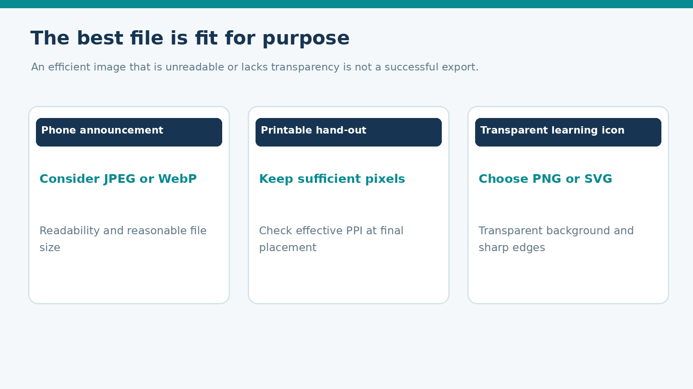
ITT06105 / DESKTOP PUBLISHING
ILLUSTRATION
Choosing images for three uses
A suitable format depends on the job.
Three different decisions
A mobile announcement may favour a compact JPEG or supported WebP. A printed hand-out needs suitable image detail at final output size. A transparent icon can be kept as SVG or exported to a PNG that preserves transparent areas.
DESKTOP PUBLISHING • IMAGE PROCESSING • 2026/2027
35

Slide 36
ITT06105 / DESKTOP PUBLISHING
PRACTICAL TASK
Our practical exercise
Use the provided images and measurement sheet.
1
Open and compare
Review original PNG, JPEG and WebP exports.
2
Record measurements
Note dimensions, KiB values and settings.
3
Calculate
Find a percentage reduction and compression ratio.
4
Inspect quality
Look for artefacts at equal viewing sizes.
5
Recommend
Select suitable images for phone, print and icon use.
DESKTOP PUBLISHING • IMAGE PROCESSING • 2026/2027
36

Slide 37
ITT06105 / DESKTOP PUBLISHING
STUDENT TASK
What students should submit
A short record of evidence is enough for this beginner exercise.
Minimum student output
Submit the completed practical worksheet, identified file versions and a brief explanation of the trade-off between quality and file size. If software access is limited, use the prepared exports and measurements to complete the analysis.
When you can access Photoshop or GIMP, repeat the export process using your own saved settings.
DESKTOP PUBLISHING • IMAGE PROCESSING • 2026/2027
37

Slide 38
ITT06105 / DESKTOP PUBLISHING
KEY TAKEAWAY
Key lesson: small is not always better
An export is successful when it serves the intended audience.
Summary
Image processing includes preparing, adjusting and exporting images. Resizing changes pixels; compression changes stored information. Lossless and lossy methods have different trade-offs. Record file sizes, dimensions and visual quality before choosing an output.
Keep editable sources, label your exports and choose file formats for their actual purpose.
DESKTOP PUBLISHING • IMAGE PROCESSING • 2026/2027
38

Slide 39
ITT06105 / ORDINARY DIPLOMA IN IT
THE COMPLETE
DTP WORKFLOW
Plan → create → arrange → print → optimise
Choose an image format by considering image quality, file size and the intended use.
Keep practising with the Tumaini educational hand-out.

