Slide 1
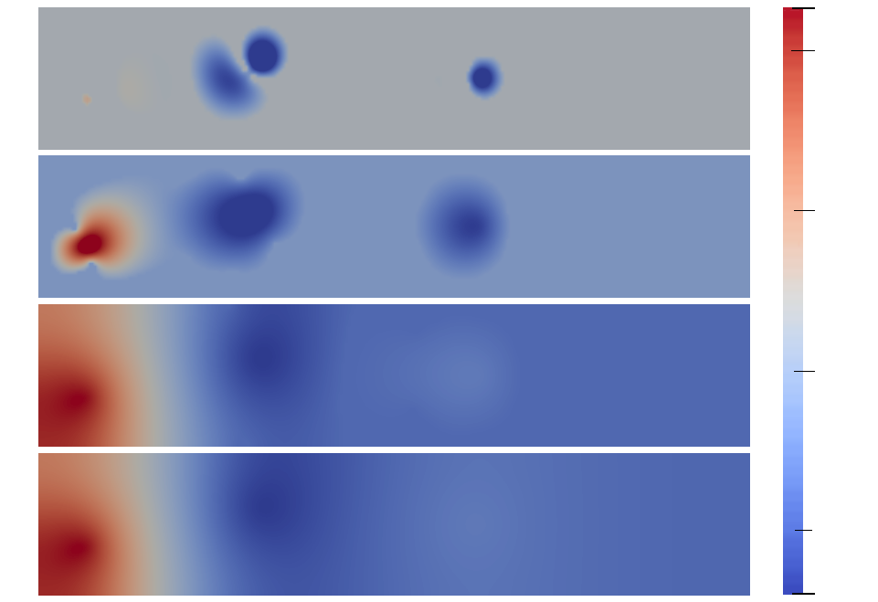
0.326
MF1
(10% HF)
0.3
MF3
(30% HF)
0.2
MF6
(60% HF)
0.1
HF
0.0
x2
-0.039
x1

