Slide 1
SIOC 實驗8：SPI
歐俊良 /陳慶瀚
MIAT實驗室

Slide 2
大綱
SPI introduction
SPI Standard Driver Library
實驗項目

Slide 3
SPI Introduction
Serial Peripheral Interface Bus(SPI)
The SPI bus specifies four logic signals:
SCLK: Serial Clock (output from master)
MOSI; SIMO: Master Output, Slave Input (output from master)
MISO; SOMI: Master Input, Slave Output (output from slave)
SS: Slave Select (active low, output from master).

Slide 4
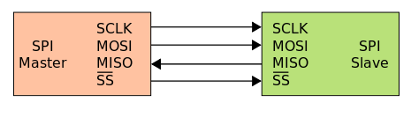
單一 master 對單一 slave
單一 master 對單一 slave SPI架構

Slide 5
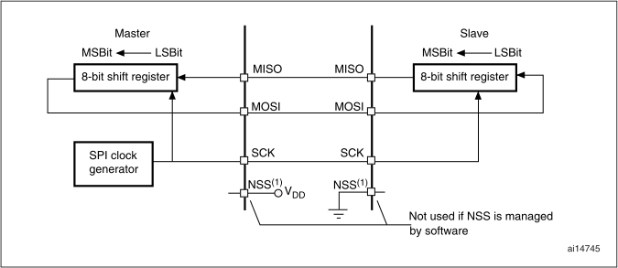
SPI Protocol

Slide 6
SPI Standard Driver Library

Slide 7
SPI_InitTypeDef structure
typedef struct
{
u16 SPI_Direction;
u16 SPI_Mode;
u16 SPI_DataSize;
u16 SPI_CPOL;
u16 SPI_CPHA;
u16 SPI_NSS;
u16 SPI_BaudRatePrescaler;
u16 SPI_FirstBit;
u16 SPI_CRCPolynomial;
} SPI_InitTypeDef;

Slide 8
SPI_Direction
SPI_Direction configures the SPI unidirectional or bidirectional data mode
SPI_Direction | Description
SPI_Direction_2Lines_FullDuplex | SPI configured as 2 lines unidirectional full duplex
SPI_Direction_2Lines_Rx | Only SPI configured as 2 lines unidirectional Rx only
SPI_Direction_1Line_Rx | SPI configured as 1 line bidirectional Rx only
SPI_Direction_1Line_Tx | SPI configured as 1 line bidirectional Tx only

Slide 9
SPI_Mode
SPI_Mode configures the SPI operating mode
SPI_Mode | Description
SPI_Mode_Master | SPI configured as a master
SPI_Mode_Slave | SPI configured as a slave

Slide 10
SPI_DataSize
SPI_DataSize configures the SPI data size.
SPI_DataSize | Description
SPI_DataSize_16b | SPI 16-bit data frame format for transmission and reception
SPI_DataSize_8b | SPI 8-bit data frame format for transmission and reception

Slide 11
SPI_CPOL
SPI_CPOL selects the serial clock steady state.
SPI_CPOL | Description
SPI_CPOL_High | Clock idle high
SPI_CPOL_Low | Clock idle low

Slide 12
SPI_CPHA
SPI_CPHA configures the clock active edge for the bit capture.
SPI_DataSize | Description
SPI_CPHA_2Edge | Data is captured on the second edge
SPI_CPHA_1Edge | Data is captured on the first edge

Slide 13
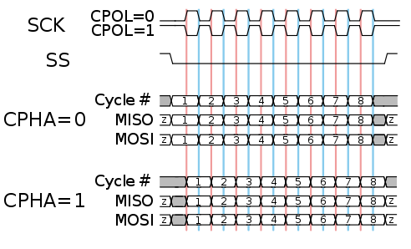
SPI Protocol Cont.,

Slide 14
SPI_NSS
SPI_NSS specifies whether the NSS signal is managed by hardware (NSS pin) or by software using the SSI bit..
SPI_NSS | Description
SPI_NSS_Hard | NSS managed by external pin
SPI_NSS_Soft | Internal NSS signal controlled by SSI bit

Slide 15
SPI_BaudRatePrescaler
SPI_BaudRatePrescaler is used to define the Baud Rate prescaler value which will be used to configure the transmit and receive SCK clock.
SPI_BaudratePrescaler | Description
SPI_BaudRatePrescaler2 | Baud Rate Prescaler equal to 2
SPI_BaudRatePrescaler4 | Baud Rate Prescaler equal to 4
SPI_BaudRatePrescaler8 | Baud Rate Prescaler equal to 8
SPI_BaudRatePrescaler16 | Baud Rate Prescaler equal to 16
SPI_BaudRatePrescaler32 | Baud Rate Prescaler equal to 32
SPI_BaudRatePrescaler64 | Baud Rate Prescaler equal to 64
SPI_BaudRatePrescaler128 | Baud Rate Prescaler equal to 128
SPI_BaudRatePrescaler256 | Baud Rate Prescaler equal to 256

Slide 16
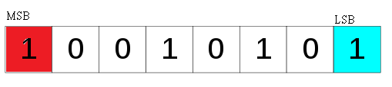
SPI_FirstBit
SPI_FirstBit specifies whether data transfers start from MSB or LSB bit.
149二進位表示法
SPI_FirstBit | Description
SPI_FisrtBit_MSB | First bit to transfer is the MSB
SPI_FisrtBit_LSB | First bit to transfer is the LSB

Slide 17
Initialize the SPI1 example
SPI_InitTypeDef SPI_InitStructure;
SPI_InitStructure.SPI_Direction = SPI_Direction_2Lines_FullDuplex;
SPI_InitStructure.SPI_Mode = SPI_Mode_Master;
SPI_InitStructure.SPI_DatSize = SPI_DatSize_16b;
SPI_InitStructure.SPI_CPOL = SPI_CPOL_Low;
SPI_InitStructure.SPI_CPHA = SPI_CPHA_2Edge;
SPI_InitStructure.SPI_NSS = SPI_NSS_Soft;
SPI_InitStructure.SPI_BaudRatePrescaler =
SPI_BaudRatePrescaler_128;
SPI_InitStructure.SPI_FirstBit = SPI_FirstBit_MSB;
SPI_Init(SPI1, &SPI_InitStructure);

Slide 18
SPI_I2S_SendData function
Function name | SPI_I2S_SendData
Function prototype | SPI_I2S_SendData(SPI_TypeDef* SPIx, u16 Data)
Behavior description | Transmits data through the SPIx/I2Sx peripheral.
Input parameter1 | SPIx: where x can be 1, 2 or 3 to select the SPI peripheral.
Input parameter 2 | Data: Byte or half word (in SPI mode), or half word (in I2S mode) to be transmitted.

Slide 19
SPI_I2S_SendData function Cont.,
Example:
/* Send 0xA5 through the SPI1 peripheral */
SPI_I2S_SendData(SPI1, 0xA5);
Output parameter | None
Return parameter | None
Required preconditions | None
Called functions | None

Slide 20
SPI_I2S_ReceiveData function
Function name | SPI_I2S_ReceiveData
Function prototype | u16 SPI_I2S_ReceiveData(SPI_TypeDef* SPIx)
Behavior description | Returns the most recent data received through the SPIx/I2Sx peripheral.
Input parameter1 | SPIx: where x can be 1, 2 or 3 to select the SPI/I2S? peripheral.
Ouput parameter | None

Slide 21
SPI_I2S_ReceiveData function Cont.,
Example:
/* Read the most recent data received by the SPI2 peripheral */
u16 ReceivedData;
ReceivedData = SPI_I2S_ReceiveData(SPI2);
Output parameter | None
Return parameter | The value of the received data.
Required preconditions | None
Called functions | None

Slide 22
SPI_I2S_GetFlagStatus function
Function name | SPI_I2S_GetFlagStatus
Function prototype | FlagStatus SPI_I2S_GetFlagStatus(SPI_TypeDef* SPIx, u16 SPI_I2S_FLAG)
Behavior description | Checks whether the specified SPI/I2S flag is set or not.
Input parameter1 | SPIx: where x can be 1, 2 or 3 to select the SPI peripheral.
Input parameter 2 | SPI_I2S_FLAG: flag to be checked. Refer to SPI_I2S_FLAG for more details on the allowed values for this parameter.

Slide 23
SPI_I2S_GetFlagStatus function Cont.,
Example:
/* Send 0xA5 through the SPI1 peripheral */
SPI_I2S_SendData(SPI1, 0xA5);
Output parameter | None
Return parameter | The new state of SPI_I2S_FLAG (SET or RESET).
Required preconditions | None
Called functions | None

Slide 24
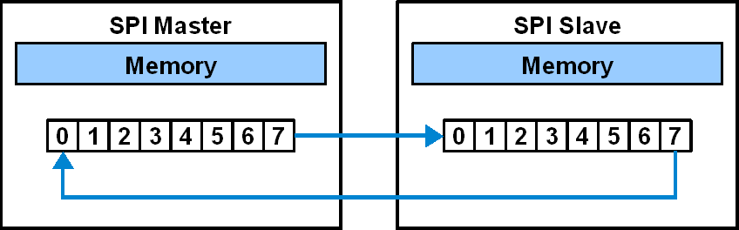
SPI_I2S_FLAG
Example:
/* Test if the SPI1 transmit buffer empty flag is set or not */
FlagStatus Status;
Status = SPI_I2S_GetFlagStatus(SPI1, SPI_I2S_FLAG_TXE);
SPI_I2S_FLAG | Description
SPI_I2S_FLAG_TXE | Transmit buffer empty flag
SPI_I2S_FLAG_RXNE | Receive buffer not empty flag

Slide 25
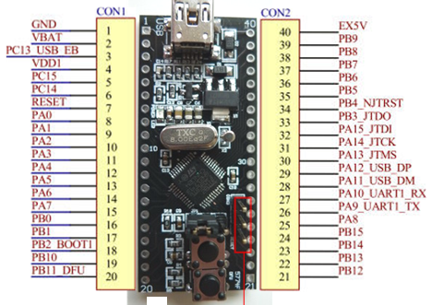
Wire Connecting Table
Pin Mapping
Master | Slave
GND | GND
VDD1 | VDD1
SPI1 SCK (PA.05) | SPI2 SCK (PB.13)
SPI1 MISO (PA.06) | SPI2 MISO (PB.14)
SPI1 MOSI (PA.07) | SPI2 MOSI (PB.15)

Slide 26
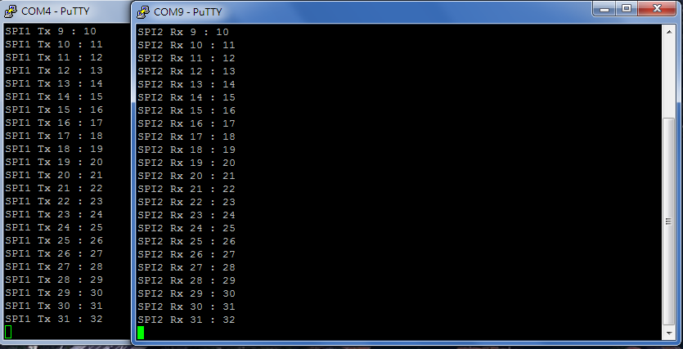
實驗一
將master (SPI1)32筆16位元資料傳到slave(SPI2)

Slide 27
實驗一說明
TX程式為master，RX程式為slave
#define BufferSize 32
uint16_t SPI1_Buffer_Tx[BufferSize]={1,2,3….,32}
uint16_t SPI2_Buffer_Rx[BufferSize]
uint32_t TxIdx = 0, RxIdx = 0;
將TX程式中SPI1_Buffer_Tx[BufferSize]，傳到RX程式中
SPI2_Buffer_Rx[BufferSize]

Slide 28
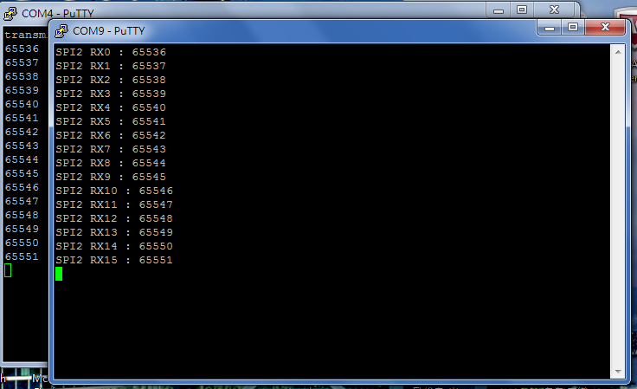
實驗二
將master (SPI1)16筆32位元資料傳到slave(SPI2)

Slide 29
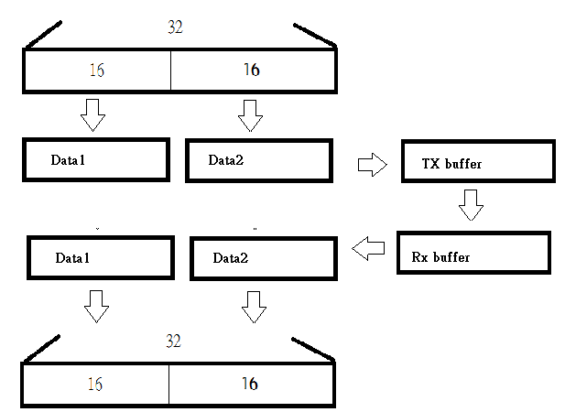
實驗二說明
uint32_t SPI1_Buffer_Data[BufferSize/2] ={65536,65537,65538,… 65551};
uint32_t SPI2_Buffer_Data[BufferSize/2]

Slide 30
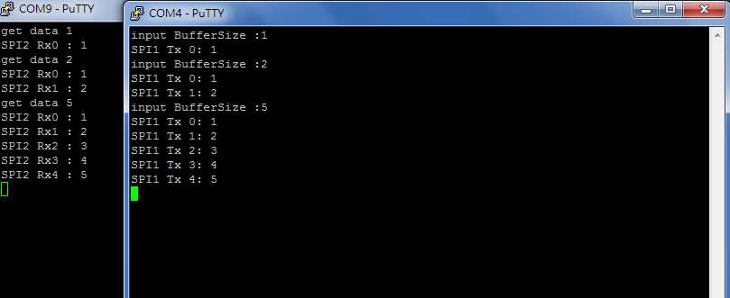
實驗三
將master (SPI1)任意傳1到32筆16位元資料傳到slave(SPI2)

Slide 31
實驗三說明
while (1)
{
}

