Slide 1
Introduction to Sorting
  By Saad Malik

Slide 2
What is Sorting?
  Sorting: an operation that segregates items into groups according to specified criterion.
  A = { 3 1 6 2 1 3 4 5 9 0 }
  A = { 0 1 1 2 3 3 4 5 6 9 }

Slide 3
Why Sort and Examples
Consider:
Sorting Books in Library (Dewey system)
Sorting Individuals by Height (Feet and Inches)
Sorting Movies in Blockbuster (Alphabetical)
Sorting Numbers (Sequential)

Slide 4
Types of Sorting Algorithms
There are many, many different types of sorting algorithms, but the primary ones are:
Bubble Sort
Selection Sort
Insertion Sort
Merge Sort
Shell Sort
Heap Sort
Quick Sort
Radix Sort
Swap Sort

Slide 5
Review of Complexity
Most of the primary sorting algorithms run on different space and time complexity.
Time Complexity is defined to be the time the computer takes to run a program (or algorithm in our case).
Space complexity is defined to be the amount of memory the computer needs to run a program.

Slide 6
O(n), Ω(n), & Θ(n)
An algorithm or function T(n) is O(f(n)) whenever T(n)'s rate of growth is less than or equal to f(n)'s rate.
An algorithm or function T(n) is Ω(f(n)) whenever T(n)'s rate of growth is greater than or equal to f(n)'s rate.
An algorithm or function T(n) is Θ(f(n)) if and only if the rate of growth of T(n) is equal to f(n).

Slide 7
Common Big-Oh’s
Time complexity
Example
O(1)
constant
Adding to the front of a linked list
O(log
N
)
log
Finding an entry in a sorted array
O(
N
)
linear
Finding an entry in an unsorted array
O(
N
log
N
)
n-log-n
Sorting n items by ‘divide-and-conquer’
O(
N
2
)
quadratic
Shortest path between two nodes in a graph
O(
N
3
)
cubic
Simultaneous linear equations
Front
1
1
Initial:
1
5
0
5
8
(Binary) Finding 8:
8
(Linear) Finding 8:
Final:
6
3
9
9
21
21
22
22
50
50
http://www.cs.sjsu.edu/faculty/lee/cs146/23FL3Complexity.ppt

Slide 8
Big-Oh to Primary Sorts
Selection Sort = n²
Insertion Sort = n²
Merge Sort = n log(n)
Quick Sort = n log(n)

Slide 9
Stable sort algorithms
Ann
98
Ann
98
A stable sort keeps equal elements in the same order
This may matter when you are sorting data according to some characteristic
Example: sorting students by test scores
Bob
90
Joe
98
Dan
75
Bob
90
Joe
98
Sam
90
Pat
86
Pat
86
Sam
90
Zöe
86
Zöe
86
Dan
75
original array
stably sorted
www.cis.upenn.edu/~matuszek/cit594-2002/ Slides/searching.ppt

Slide 10
Unstable sort algorithms
An unstable sort may or may not keep equal elements in the same order
Stability is usually not important, but sometimes it is important
Ann
98
Joe
98
Bob
90
Ann
98
Dan
75
Bob
90
Joe
98
Sam
90
Pat
86
Zöe
86
Sam
90
Pat
86
Zöe
86
Dan
75
original array
unstably sorted
www.cis.upenn.edu/~matuszek/cit594-2002/ Slides/searching.ppt

Slide 11
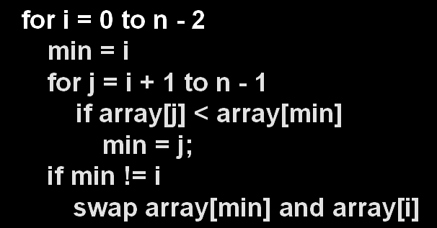
Selection Sort
O(n²)

Slide 12
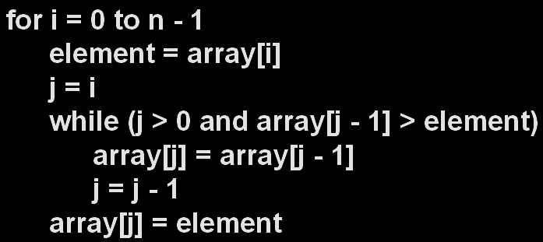
Insertion Sort
O(n²)

Slide 13
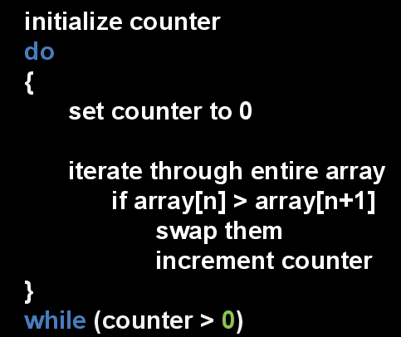
Bubble Sort
O(n²)

Slide 14
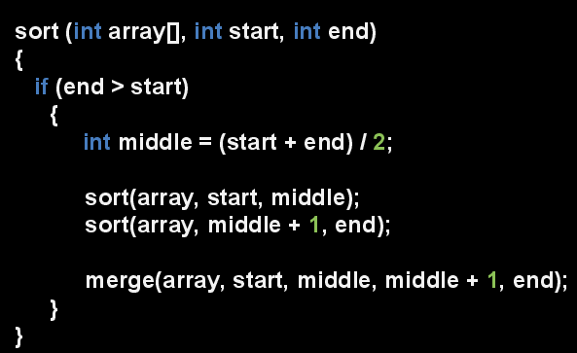
Merge Sort
O(nlog₂(n))

Slide 15
Sorting Webpage
http://www.cs.ubc.ca/spider/harrison/Java/sorting-demo.html

