Slide 1

Algorithms

Slide 2
Recurrences and Running Time
An equation or inequality that describes a function in terms of its value on smaller inputs.
T(n) = T(n-1) + n
Recurrences arise when an algorithm contains recursive calls to itself
What is the actual running time of the algorithm?
Need to solve the recurrence
  Find an explicit formula of the expression
  Bound the recurrence by an expression that involves n

Slide 3
Example Recurrences
T(n) = T(n-1) + n Θ(n²)
  Recursive algorithm that loops through the input to eliminate one item
T(n) = T(n/2) + c Θ(lgn)
  Recursive algorithm that halves the input in one step
T(n) = T(n/2) + n Θ(n)
  Recursive algorithm that halves the input but must examine every item in the input
T(n) = 2T(n/2) + 1 Θ(n)
  Recursive algorithm that splits the input into 2 halves and does a constant amount of other work

Slide 4
Recurrent Algorithms
BINARY-SEARCH
for an ordered array A, finds if x is in the array A[lo…hi]
Alg.: BINARY-SEARCH (A, lo, hi, x)
if (lo > hi)
return FALSE
mid ← ⎣(lo+hi)/2⎦
if x = A[mid]
return TRUE
if ( x < A[mid] )
BINARY-SEARCH (A, lo, mid-1, x)
if ( x > A[mid] )
BINARY-SEARCH (A, mid+1, hi, x)
1
2
3
4
5
6
7
8
2
3
5
7
9
10
11
12
mid
lo
hi

Slide 5
Example
A[8] = {1, 2, 3, 4, 5, 7, 9, 11}
  lo = 1 hi = 8 x = 7
1
2
3
4
5
6
7
8
1
2
3
4
5
7
9
11
mid = 4, lo = 5, hi = 8
5
6
7
8
1
2
3
4
5
7
9
11
mid = 6, A[mid] = x Found!

Slide 6
Another Example
A[8] = {1, 2, 3, 4, 5, 7, 9, 11}
  lo = 1 hi = 8 x = 6
1
2
3
4
5
6
7
8
1
2
3
4
5
7
9
11
mid = 4, lo = 5, hi = 8
low
high
1
2
3
4
5
7
9
11
mid = 6, A[6] = 7, lo = 5, hi = 5
low
high
1
2
3
4
5
7
9
11
mid = 5, A[5] = 5, lo = 6, hi = 5
NOT FOUND!
1
2
3
4
5
7
9
11
high
low

Slide 7
Analysis of BINARY-SEARCH
Alg.: BINARY-SEARCH (A, lo, hi, x)
if (lo > hi)
return FALSE
mid ← ⎣(lo+hi)/2⎦
if x = A[mid]
return TRUE
if ( x < A[mid] )
BINARY-SEARCH (A, lo, mid-1, x)
if ( x > A[mid] )
BINARY-SEARCH (A, mid+1, hi, x)
T(n) = c +
  T(n) – running time for an array of size n
constant time: c₁
constant time: c₂
constant time: c₃
same problem of size n/2
same problem of size n/2
T(n/2)

Slide 8
Methods for Solving Recurrences
Iteration method
Substitution method
Recursion tree method
Master method

Slide 9
The Iteration Method
Convert the recurrence into a summation and try to bound it using known series
  Iterate the recurrence until the initial condition is reached.
  Use back-substitution to express the recurrence in terms of n and the initial (boundary) condition.

Slide 10
The Iteration Method
T(n) = c + T(n/2)
T(n) = c + T(n/2)
= c + c + T(n/4)
= c + c + c + T(n/8)
Assume n = 2^{k}
T(n) = c + c + … + c + T(1)
= clgn + T(1)
= Θ(lgn)
T(n/2) = c + T(n/4)
T(n/4) = c + T(n/8)
k times

Slide 11
Iteration Method – Example
T(n) = n + 2T(n/2)
T(n) = n + 2T(n/2)
= n + 2(n/2 + 2T(n/4))
= n + n + 4T(n/4)
= n + n + 4(n/4 + 2T(n/8))
= n + n + n + 8T(n/8)
… = in + 2^{i}T(n/2^{i})
= kn + 2^{k}T(1)
= nlgn + nT(1) = Θ(nlgn)
Assume: n = 2^{k}
T(n/2) = n/2 + 2T(n/4)

Slide 12
The substitution method
Guess a solution
Use induction to prove that the solution works

Slide 13
Substitution method
Guess a solution
Prove the induction goal
  Use the induction hypothesis to find some values of the constants d and n₀ for which the induction goal holds

Slide 14
Example: Binary Search
T(n) = c + T(n/2)
Guess: T(n) = O(lgn)
  Induction goal: T(n) ≤ d lgn, for some d and n ≥ n₀
  Induction hypothesis: T(n/2) ≤ d lg(n/2)
Proof of induction goal:
T(n) = T(n/2) + c ≤ d lg(n/2) + c
= d lgn – d + c ≤ d lgn

Slide 15
Example 2
T(n) = T(n-1) + n
Guess: T(n) = O(n²)
  Induction goal: T(n) ≤ c n², for some c and n ≥ n₀
  Induction hypothesis: T(n-1) ≤ c(n-1)² for all k < n
Proof of induction goal:
T(n) = T(n-1) + n ≤ c (n-1)² + n
= cn² – (2cn – c - n) ≤ cn²

Slide 16
Example 3
T(n) = 2T(n/2) + n
Guess: T(n) = O(nlgn)
  Induction goal: T(n) ≤ cn lgn, for some c and n ≥ n₀
  Induction hypothesis: T(n/2) ≤ cn/2 lg(n/2)
Proof of induction goal:
T(n) = 2T(n/2) + n ≤ 2c (n/2)lg(n/2) + n
= cn lgn – cn + n ≤ cn lgn

Slide 17

Changing variables
T(n) = 2T( ) + lgn
  Idea: transform the recurrence to one that you have seen before

Slide 18
Changing variables
T(n) = 2T( ) + lgn
  Rename: m = lgn ⇒ n = 2^{m}
  T (2^{m}) = 2T(2^{m/2}) + m
  Rename: S(m) = T(2^{m})
  S(m) = 2S(m/2) + m ⇒ S(m) = O(mlgm) (demonstrated before)
  T(n) = T(2^{m}) = S(m) = O(mlgm)=O(lgnlglgn)
  Idea: transform the recurrence to one that you have seen before

Slide 19
The recursion-tree method

Slide 20
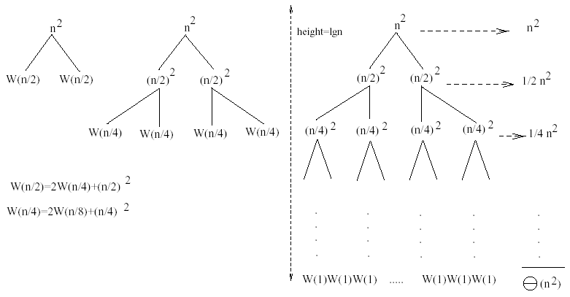
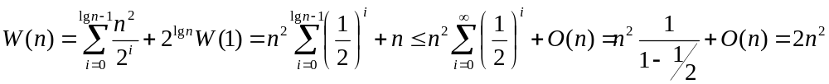
Example 1
W(n) = 2W(n/2) + n²
Subproblem size at level i is: n/2^{i}
Subproblem size hits 1 when 1 = n/2^{i} ⇒ i = lgn
Cost of the problem at level i = (n/2^{i})² No. of nodes at level i = 2^{i}
Total cost:
⇒ W(n) = O(n²)

Slide 21
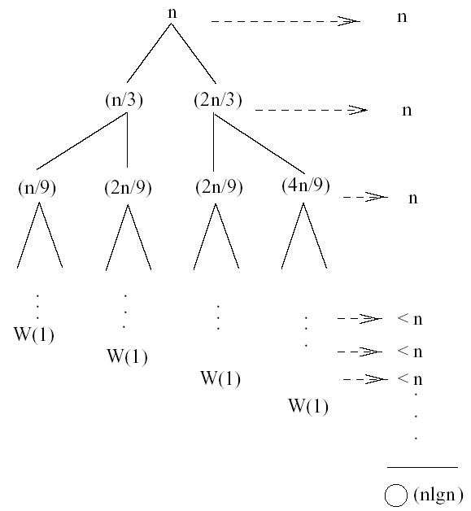
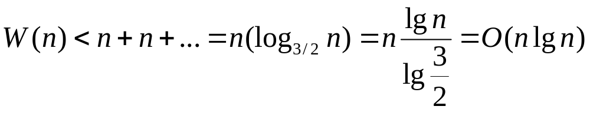
Example 3 (simpler proof)
W(n) = W(n/3) + W(2n/3) + n
The longest path from the root to a leaf is: n → (2/3)n → (2/3)² n → … → 1
Subproblem size hits 1 when 1 = (2/3)^{i}n ⇔ i=log_{3/2}n
Cost of the problem at level i = n
Total cost:
⇒ W(n) = O(nlgn)

Slide 22
Example 3 - Substitution
W(n) = W(n/3) + W(2n/3) + O(n)
Guess: W(n) = O(nlgn)
  Induction goal: W(n) ≤ dnlgn, for some d and n ≥ n₀
  Induction hypothesis: W(k) ≤ d klgk for any K < n (n/3, 2n/3)
Proof of induction goal:
Try it out as an exercise!!
T(n) = O(nlgn)

