Slide 1
Analyse: les clients d'e-commerce
Kamel, Indira, Ahmed et Eliana

Slide 2
Contexte, et, Organisation.

Slide 3
Chiffres Clé
CA = 16 293 876 BRL (3 122 449 in USD)
Période : du 04-09-2016 au 03-09-2018
Nombre de clients : 96 096
dont 60 076 ont attribué la note de 5 étoiles
Note moyenne des avis clients 4.1
Clients dans 4 097 villes regroupé dans 27 états
Notes:
Contexte : Vous voulez connaître vos clients
Partie 1 : Total ventes et total par mois et histogramme
le CA est de 16 293 876 BRL
date : 04-09-2016 au 03-09-2018
nombre clients : 96 096
dataset : 105 383 lignes et 13 colonnes

Slide 4

Deux Approches Possible
K-Means
Scoring

Slide 5
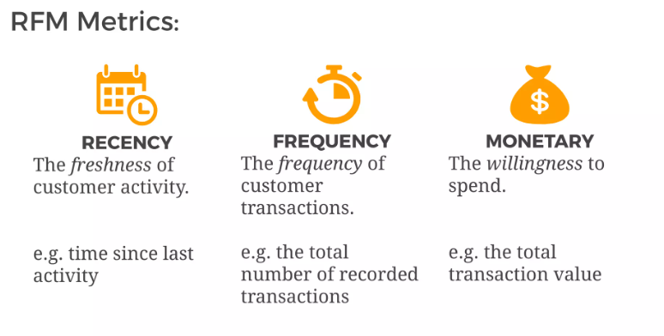
Notes:
In RFM analysis, we’re mainly interested in the monetary values of every customer, their first and last transaction dates, etc. Other columns are company-related areas that we don’t have to deal with.

Slide 6
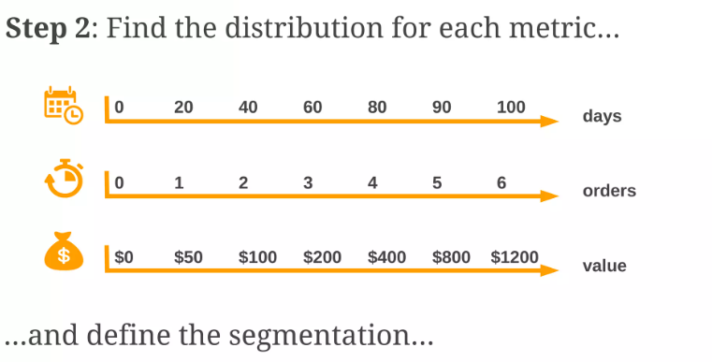

Slide 7
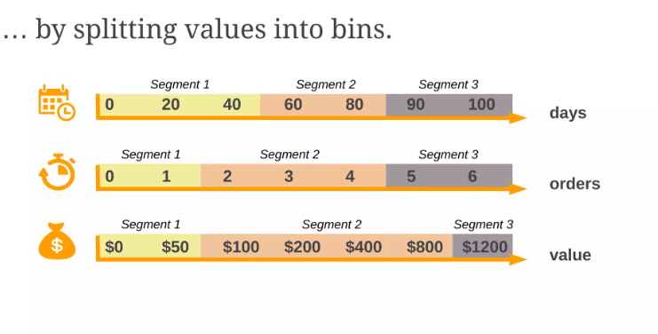

Slide 8
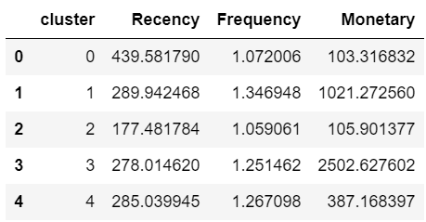
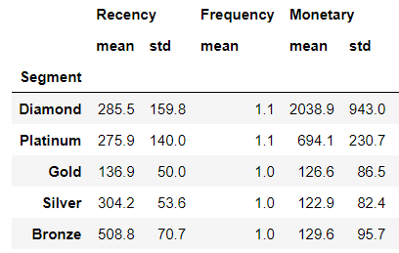

Slide 9
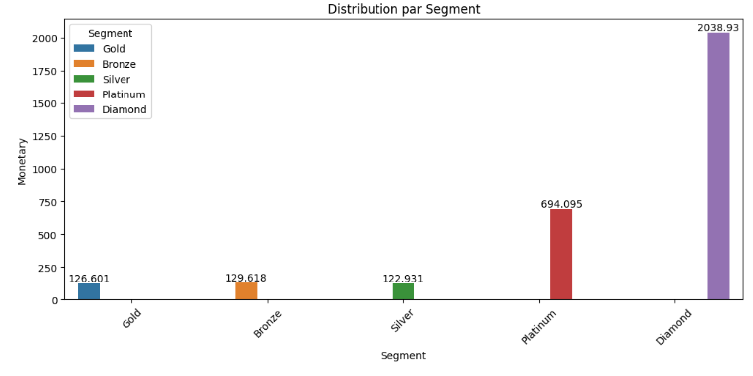

Slide 10
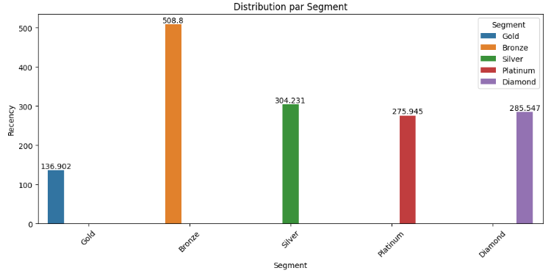

Slide 11
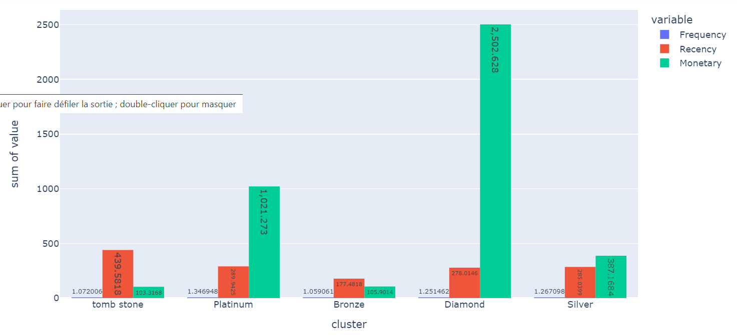

Slide 12
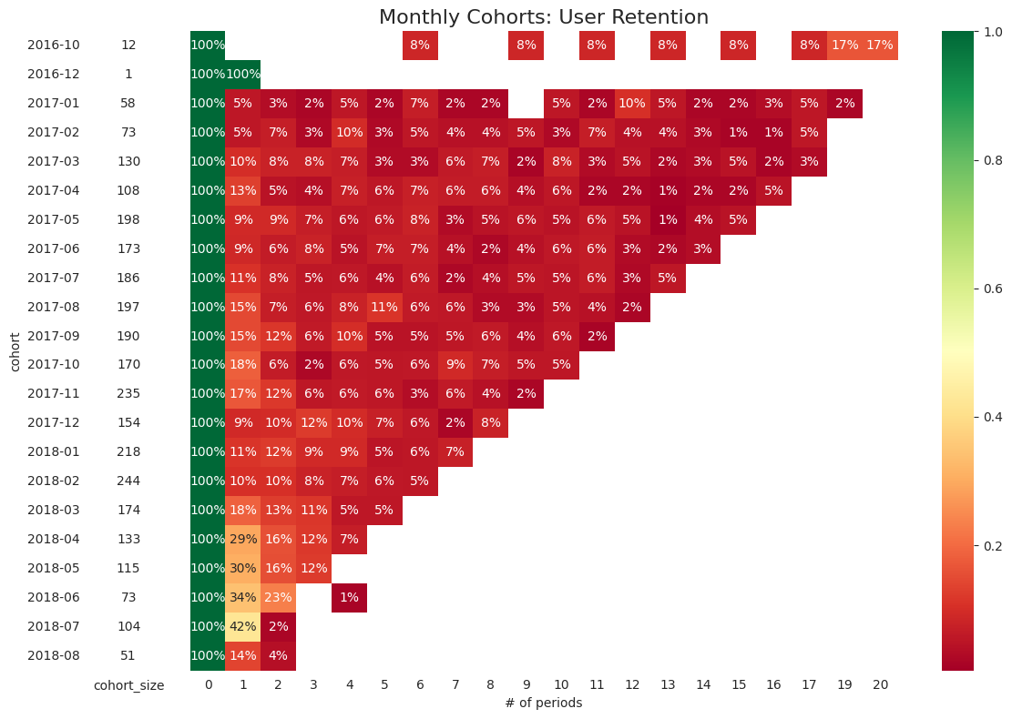
Cohorts

Slide 13
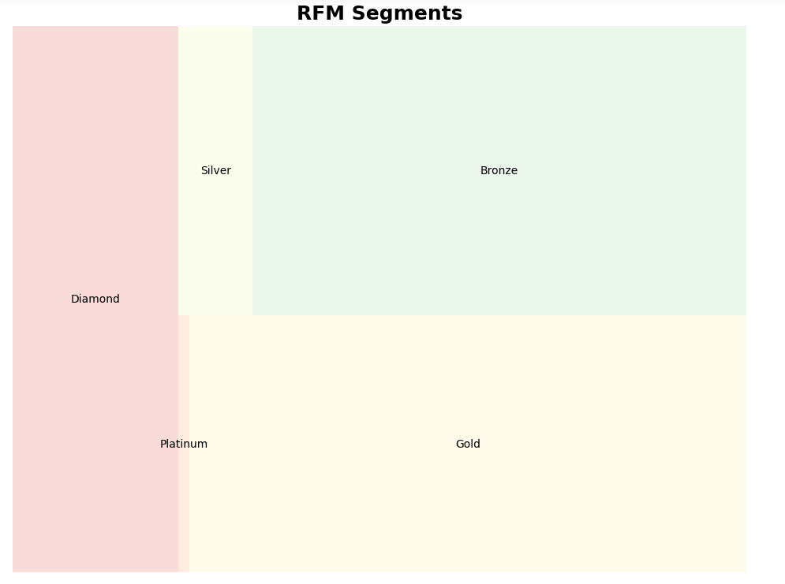
Diamond 0.68%
Platinum 5.37%
Gold 35.68%
Silver 35.67%
Bronze 22.6%

Slide 14
How do my clients feel after buying on my site?
How to bring my customers back?
How to make my clients enjoy my products?

Slide 15
Some additional information :
TOP 10 best-selling product names:
bed/bath table 10110
health and beauty 9085
sports and leisure 7955
computer accessories 6889
furniture and decor 6777
housewares 6186
watches and gifts 5781
telephony 4316
auto 4001
toys 3986
9.92%
8.92%
7.81%
6.76%
6.65%
6.07%
5.68%
4.24%
3.93%
3.91%
Payment Types :
Credit card 73.96%
Cash 19.03%
Voucher 5.54%
Debit card 1.47%

Slide 16
Thank you !!
Love 100%

