Slide 1
Bank Queue Management System
Design and Implementation

Slide 2
Introduction
Overview of the bank queue system project
Objectives: minimize wait time, improve customer experience, automate staff assignments
Work breakdown:
Docs: Turki Alqahtani (g20240220)
Backend Dev: Kamel Gerado (g202408240)
Frontend Dev: Abdulrahman Aljebreen (g202408040)
System Designer: Abdullah Alzhrani ( (g202422300)

Slide 3
System Architecture Overview
High-level architecture with components:
Client-Side: Kiosks, Queue Display, Dashboards
Server-Side: Queue Engine,
Database: Stores client tickets, logs, timestamps
Architecture type: Client-Server with distributed system
Data Flow: Ticket issued → added to queue → staff notification → completion → report logged

Slide 4
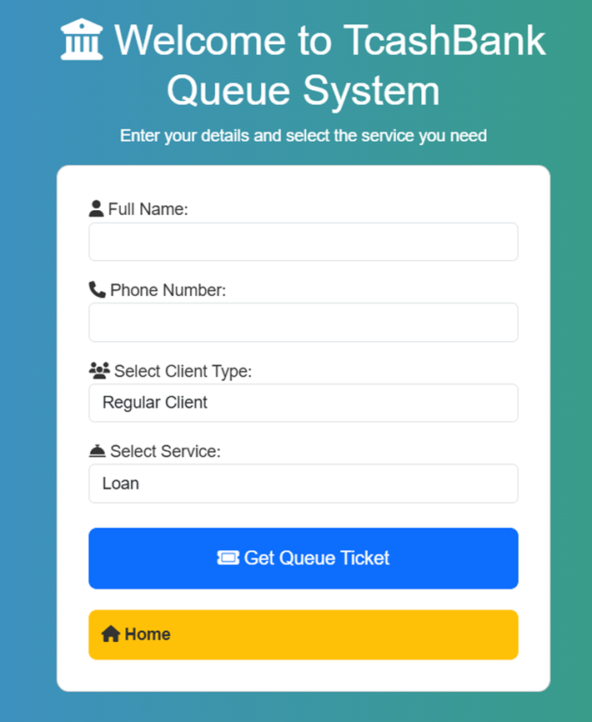
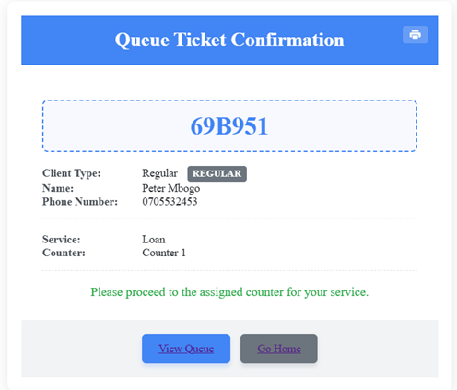
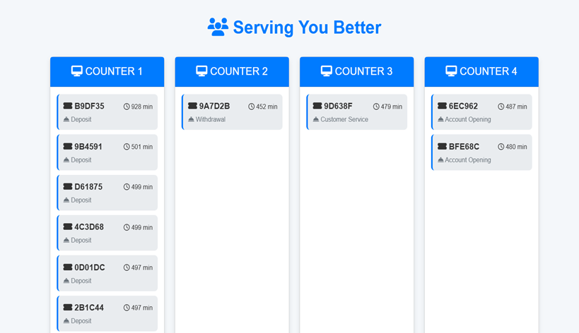
User Interface
Customer-Facing UI:
Kiosk: Service selection + ticket generation
Queue Display: Live ticket status
Client Kiosks
Ticket Generation
Queue Display

Slide 5
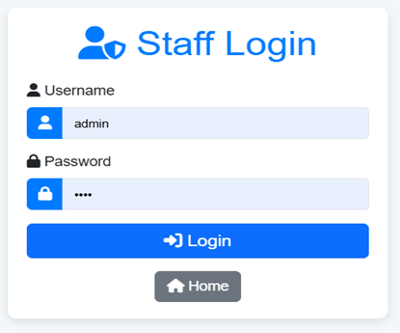
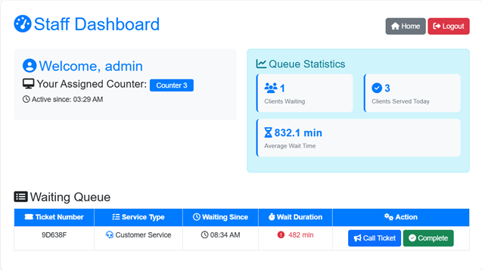
Staff Interface
Dashboard to call next ticket and mark service completion
Staff Login
Staff Dashboard

Slide 6
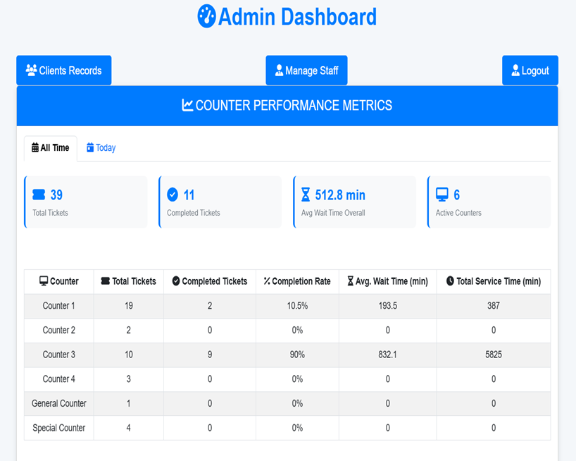
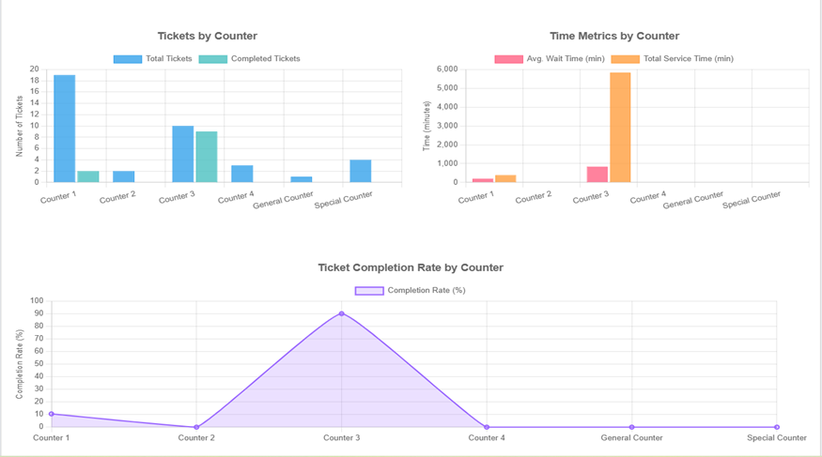
Admin Panel Interface
Monitor queue load, assign staff, view analytics
Real time Monitoring and report

Slide 7
Distributed Communication
Communication Architecture:
Client–Server + Message Broker Hybrid: Kiosks, staff dashboards, admin panels, and display screens all talk to a central Node.js server over REST API. Ticket completions and queue changes are published into RabbitMQ as ticket.completed messages, decoupling producers (staff UI) from consumers (DB worker).
Real-Time Updates using AJAX Polling: Clients send asynchronous requests at regular intervals to the server to fetch updates (e.g., next ticket, completed service, or system alerts) without refreshing the entire page.
Asynchronous Processing with RabbitMQ: Staff “Complete” actions send a message into a durable RabbitMQ queue. A separate listener worker consumes those messages and updates the database via TypeORM, ensuring reliable, retriable delivery even under failure.
Backend API Endpoints: These endpoints handle all communication logic—receiving ticket requests, processing actions like 'next ticket' or 'complete service', and sending updated queue data back to the front end.
Components involved:
Kiosk → API → Server
Staff Dashboard ↔ API ↔ Queue DB
Admin Panel → API for monitoring & control
Fault Handling:
Includes retry logic and error display on failure

Slide 8
Detailed Implementation
Backend: Node.js + TypeScript with Express for REST APIs and RabbitMQ for reliable, asynchronous message bus.
Database: MySQL accessed via TypeORM entities (Admins, Staff, Clients, Services, Queue).
Frontend: EJS‑templated UIs (kiosk, staff, admin, display) served by Express.
Message Handling: AJAX requests fetch updates without reload and staff “Complete” actions publish to RabbitMQ with separate listener worker consumes those messages and updates the DB.
Error Detection: Try-catch and status codes for failed processes
System Reliability: Durable RabbitMQ queues ensure no lost “complete” events, even during outages and ticket states tracked throughout lifecycle, even during partial failures.

Slide 9
Conclusion
Architecture and UI worked together to deliver a reliable, efficient solution
Automated queuing reduces manual errors and enhances customer experience
System is modular and can be expanded
Q&A

