Slide 1

ReactJS Kick Start
Prepared by Wey Kean

Slide 2

What is ReacyJS?
ReactJS, one of the most popular JavaScript library created by Jordan Walke (software engineer at Facebook) for building fast and interactive user interfaces for web and mobile applications.
It is used by large, established companies and newly-minted startups alike (Netflix, Airbnb, Instagram, and the New York Times, to name a few).

Slide 3
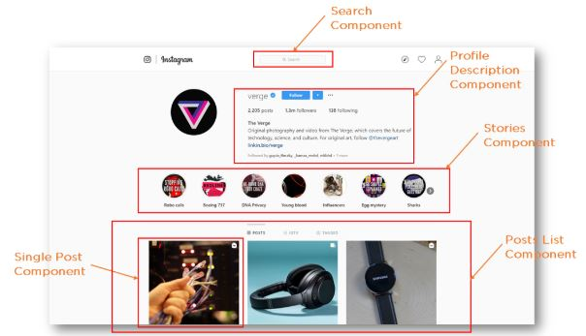
Figure from What is ReactJS: Introduction To React and Its Features (simplilearn.com)

Slide 4
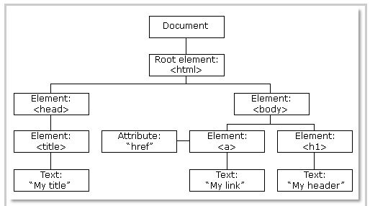
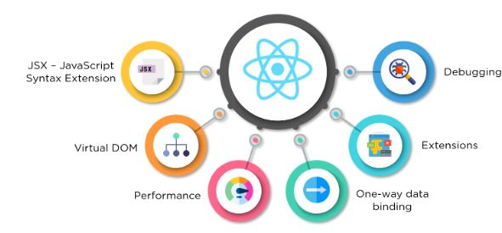
Why ReacyJS?
Improved performance
React uses Virtual DOM and it creates a virtual copy of the original DOM as the representation of a DOM object.
It compares the components’ previous states and updates only the items in the Real DOM that were changed, instead of updating all the components again, as conventional web applications do.
Figure from What is ReactJS: Introduction To React and Its Features (simplilearn.com)
DOM of a webpage Figure from What is ReactJS: Introduction To React and Its Features (simplilearn.com)

Slide 5
Why ReacyJS?
Reusable components
Components are the building blocks of any React application.
These components have their logic and controls, and they can be reused throughout the application.
Which mean it can dramatically reduce the application’s development time.
Figure from What is ReactJS: Introduction To React and Its Features (simplilearn.com)

Slide 6
Why ReacyJS?
Can be used for the development of both web and mobile apps
There is a framework called React Native, derived from React itself, that is hugely popular and is used for creating beautiful mobile applications.
So, react can be used for making both web and mobile applications.
Figure from What is ReactJS: Introduction To React and Its Features (simplilearn.com)

Slide 7
Why ReacyJS?
Dedicated tools for easy debugging
Facebook has also released a Chrome extension that can be used to debug React applications.
This makes the process of debugging React web applications faster and easier.
Figure from What is ReactJS: Introduction To React and Its Features (simplilearn.com)

Slide 8
References
What is ReactJS: Introduction To React and Its Features (simplilearn.com)
Plunker - Component Lifecycle in React (plnkr.co)
Getting Started – React (reactjs.org)

