Slide 1
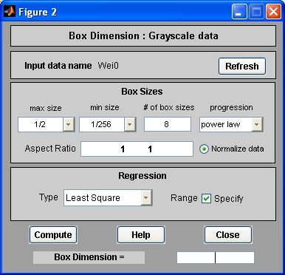
0
1
2
3
4

