Slide 1
Vector Search & Semantic Indexing in Full-Stack Apps
Querying data by meaning, not just by matching strings
LIS 467 — Client/Server & Full-Stack Architectures

Slide 2
The Concept
• Traditional queries (SQL WHERE, Mongo $regex) match exact strings or structured fields.
• Modern AI-driven apps query by semantic similarity instead.
• Text, images, or documents are converted into high-dimensional numeric vectors called embeddings.
• Vectors that are close together in that space represent similar meaning — even with zero shared words.
  – "organizing books so people can find them" ≈ "cataloging and classification in libraries"
• Similarity is measured with cosine similarity: the cosine of the angle between two vectors.

Slide 3
Why This Fits Full-Stack Development
• Deepens backend database and document-store skills beyond CRUD.
• Real systems: MongoDB Atlas Vector Search, PostgreSQL + pgvector, Pinecone, Milvus.
• Pairs naturally with Node.js / Express backends you already know how to build.
• This is the retrieval layer behind Retrieval-Augmented Generation (RAG) — how LLM apps
  – ground answers in your own data instead of relying only on training data.
• Same skills apply across the stack: JSON documents in → embeddings → vector index → API endpoint.

Slide 4
Architecture: How It Works
• 1. Indexing (offline / build step)
  – JSON documents → embedding model → 384-dim vectors → stored alongside each document
• 2. Query time (API request)
  – User query → same embedding model → query vector
  – Compare query vector to every stored vector using cosine similarity
  – Sort by score, return top-K most similar documents
• 3. (Production) Approximate Nearest Neighbor index (HNSW) replaces brute-force scan at scale

Slide 5
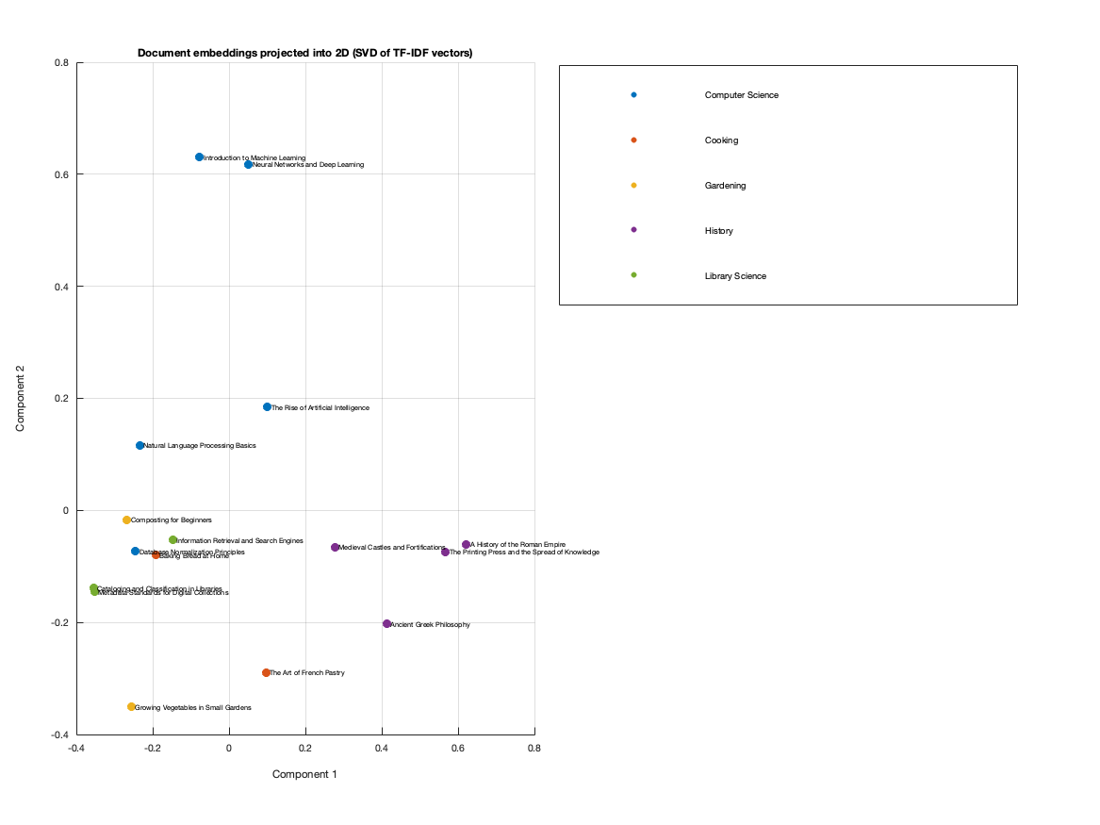
Visualizing the Vector Space (MATLAB)
• Companion MATLAB script builds the same idea from scratch: TF-IDF vectors instead of a neural model.
• SVD (the math behind PCA) reduces the high-dimensional space to 2D so it can be plotted.
• Documents from the same category cluster together — visual proof that distance in vector space reflects meaning.

Slide 6
Class Exercise
• Goal: implement a retrieval-augmented search endpoint in Node.js.
• Dataset: small collection of JSON documents (title, category, text).
• Step 1 — Embed: convert each document's text into a vector using a local embedding model
  – (transformers.js, no API key needed).
• Step 2 — Index: store {document, embedding} pairs (data/index.json).
• Step 3 — Retrieve: embed the incoming query, compute cosine similarity against every
  – stored vector, return the top-K ranked results.
• Step 4 — Compare: run the same query through naive keyword matching and observe the gap.

Slide 7
Live Demo
Node.js + Express + local embeddings, semantic vs. keyword search side-by-side

Slide 8
Key Takeaways
• Semantic search retrieves by meaning; keyword search retrieves by exact substring.
• Embeddings + cosine similarity are the core primitives behind modern AI search and RAG.
• These concepts map directly onto production tools: pgvector, MongoDB Atlas Vector Search, Pinecone.
• A brute-force cosine scan works for small datasets; production systems need an ANN index (HNSW).
• Full-stack takeaway: the backend pattern is the same you already know —
  – JSON in, API endpoint out — only the storage and matching logic changes.

