Slide 1
Project Overview
Predict income >50K using Census data

Slide 2
Data Processing
Cleaning, encoding, scaling, splitting

Slide 3
Model Results
Gradient Boosting best (~87%), Ensemble ~88%

Slide 4
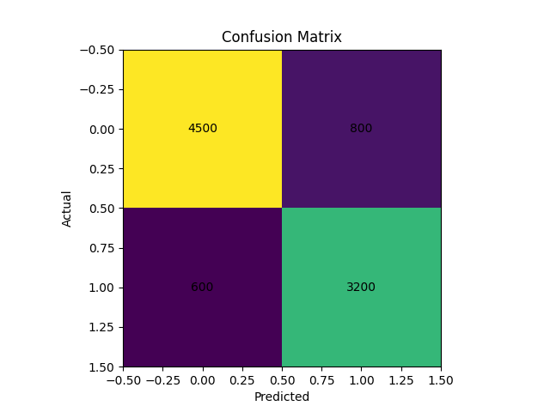
Confusion Matrix

Slide 5
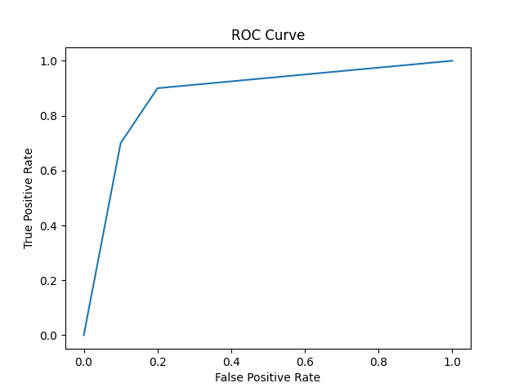
ROC Curve

Slide 6
Conclusion
Preprocessing + Ensemble models = best performance

