Slide 1
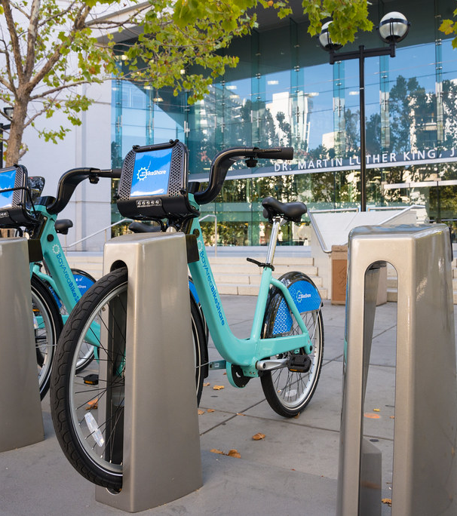

Title: Bike Rental Demand Analysis Subtitle: Key Drivers of Rental Bookings Presenter:
BY KAMESH DEWANGAN
A PROJECT BY NEXTHIKES IT SOLUTIONS
K
This Photo by Unknown Author is licensed under CC BY
This Photo by Unknown Author is licensed under CC BY-NC

Slide 2
Overall Rental Booking Summary
Key Insight: Present the overall distribution of rentals (Casual vs. Registered and cnt ) and the Total Count.
Total Rentals: Mention the grand total of 'Sum of cnt'.
User Split: Show the percentage or sum comparison between 'Sum of casual' and 'Sum of registered'. (Registered users typically dominate).
Visual: A simple pie chart or bar chart comparing 'Sum of casual' and 'Sum of registered' across the entire dataset.

Slide 3
Hourly Demand Trends (hr)
Focus File: hr of average.csv
Key Insight: Identify the peak hours for bike rentals.
Peak Hours: Which 'hr' values show the highest 'Average of cnt'? (Typically morning and late afternoon commute times).
User Type Difference: Are casual and registered users peaking at the same time? (Registered users usually peak during commute hours, casual users during leisure hours).
Visual: A coulam chart showing 'Average of cnt' over 'hr' (0 to 23). Consider adding separate lines for 'Average of casual' and 'Average of registered'.

Slide 4
Weekly Rental Patterns (weekday)
Key Insight: Understand how demand changes throughout the week.
Weekend vs. Weekday: Compare the average rentals (especially 'Average of cnt') on weekdays (1-5) versus weekend/holiday days (0 or 6).
Casual vs. Registered by Day: Note how 'Average of casual' might be higher on weekends, while 'Average of registered' is higher on weekdays.
Visual: A line chart of 'Average of cnt' by 'weekday' (0=Sunday, 1=Monday, ... 6=Saturday).

Slide 5
Impact of Weather Conditions (weathersit) 🌧️☀️
Key Insight: Show how rental numbers decline with worse weather.
Weather Categories: Use the 'weathersit' column (e.g., 1=Clear/Few clouds, 2=Mist/Cloudy, 3=Light Snow/Rain, 4=Heavy Rain/Snow).
Demand Drop: Show the 'Average of cnt' for each 'weathersit'. Note the significant drop for category 4.
Visual: A coulam chart showing 'Average of cnt' for each 'weathersit'.

Slide 6
Temperature and Bike Usage (from merged data)
(You'd need to calculate this, but based on typical patterns):
Key Insight: Rentals are generally highest at moderate to warm temperatures.
Correlation: Mention the relationship between 'temp'/'atemp' and 'cnt'. (It's usually positive).

Slide 7
Impact of Weather (Casual vs. Registered)
Insight:
Registered users show more resilience to weather conditions than Casual users, suggesting a higher reliance on bikes for essential travel.
The drop-off in Casual users is much steeper when moving from 'Clear' to 'Cloudy/Mist' conditions. Chart: Bar chart showing Average Casual vs. Registered Rentals by Weather Situation

Slide 8
The Role of Casual vs. Registered Users
Synthesized Insight: Summarize the differences between the two user groups based on the previous slides (hr, weekday, etc.).
Registered: Are the primary riders, drive commute-time peaks, and dominate weekday usage.
Casual: Contribute significantly on weekends and during leisure hours/favorable weather.
Actionable Takeaway: Different marketing and operational strategies are needed for each group.

Slide 9
Key Findings and Conclusions
Summary of 3-4 Major Findings:
Registered users are the backbone of the service.
Peak demand occurs during typical commute hours (morning/evening).
Weather (weathersit) has a strong negative impact on usage.
Demand is usually higher on weekdays/weekends depending on the user type.

