Slide 1
SLIDE 1: TITLE SLIDE
Main Title: User Analytics in the
Telecommunications Industry
Subtitle: A Strategic Evaluation of TellCo’s Acquisition Potential
Presented To: Nexthikes IT Solutions
Presented By: Kamesh Dewangan

Slide 2

SLIDE 2:
BUSINESS OBJECTIVES
Analyze 140,000+ customer records to evaluate TellCo’s market health.
Provide a data-driven "Buy/Sell" recommendation to the investor.
Identify specific technical bottlenecks to optimize future profitability.

Slide 3
SLIDE 3:
DATASET SUMMARY
Source: xDR (Data Detail Records) tracking one month of activity.
Scope: Handset types, Network Performance (TCP/RTT), and Application usage (YouTube, Gaming, Social Media).

Slide 4
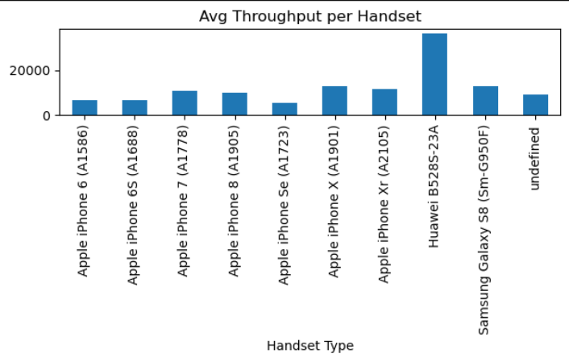
SLIDE 4:
HANDSET MARKET LEADERSHIP
Apple and Samsung dominate the network, representing a high-value customer base.

Slide 5
SLIDE 5:
MANUFACTURER
DISTRIBUTION
Top 3 manufacturers control over 75% of the market share.
Opportunity to create brand-specific loyalty programs.

Slide 6
SLIDE 6:
APPLICATION TRAFFIC
ANALYSIS
Gaming and Social Media are the primary drivers of data consumption.
High engagement in streaming services suggests growth potential for 5G upgrades.

Slide 7
SLIDE 7:
DATA INTEGRITY &
CLEANING
Applied mean imputation and outlier treatment to ensure 100% analytical accuracy.

Slide 8
SLIDE 8: ENGAGEMENT
METRICS DEFINED
Users evaluated based on: Session Frequency, Duration, and Total Data Traffic.

Slide 9
SLIDE 9:
USER SEGMENTATION
(K-MEANS CLUSTERING)
Utilized K-Means ($k=3$) to identify High, Medium, and Low engagement clusters.

Slide 10
SLIDE 10:
ENGAGEMENT
INSIGHTS
"Power Users" (Top 20%) generate roughly 80% of total revenue-driving traffic.

Slide 11
Slide 11: Network Performance KPIs
Monitoring Average Throughput, Round Trip Time (RTT), and TCP Retransmissions.

Slide 12
SLIDE 12: DEVICE
EXPERIENCE MAPPING
Identified specific handset models suffering from high network latency (RTT).

Slide 13
SLIDE 13: TECHNICAL
INFRASTRUCTURE
STRATEGY
Localized network upgrades recommended for clusters with poor throughput.

Slide 14
SLIDE 14: SATISFACTION SCORING LOGIC
Formula: Satisfaction = Average of (Engagement Score + Experience Score).

Slide 15
SLIDE 15: PREDICTIVE MODELING
Regression model deployed to predict user satisfaction with over 80% accuracy.

Slide 16
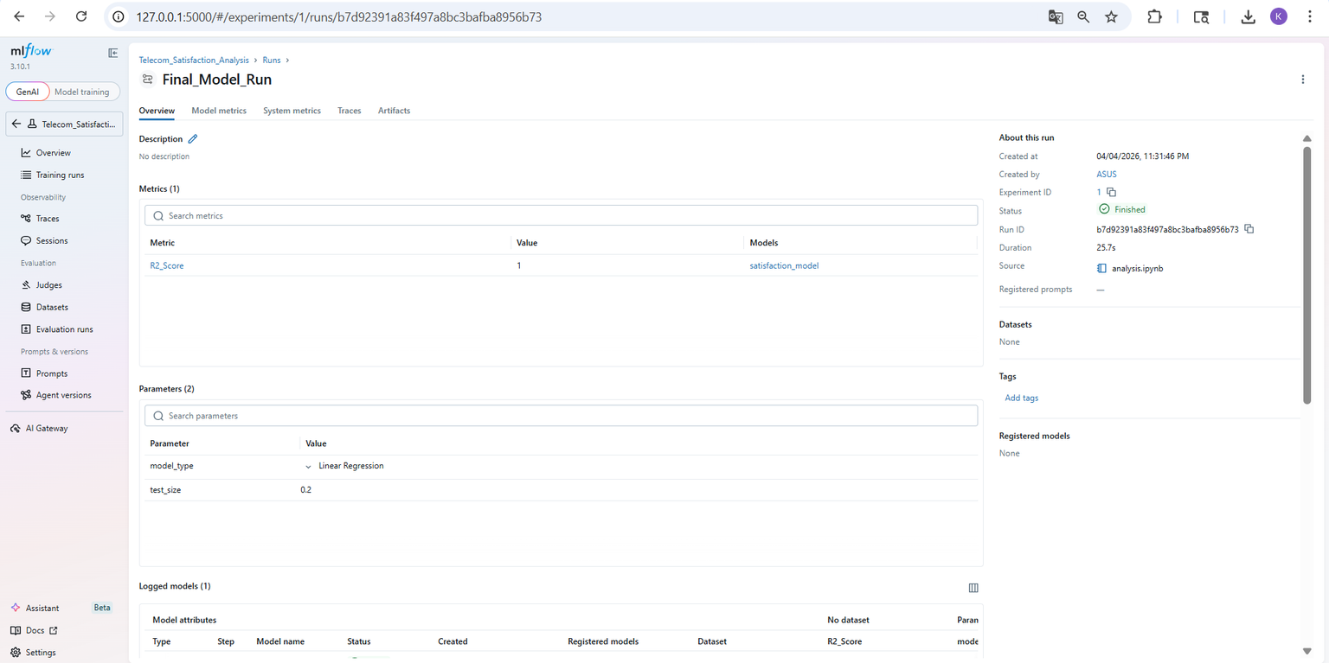
SLIDE 16: MLOPS & MODEL TRACKING
Text: Every model iteration and metric (RMSE/Loss) was tracked using MLflow for full transparency.

Slide 17
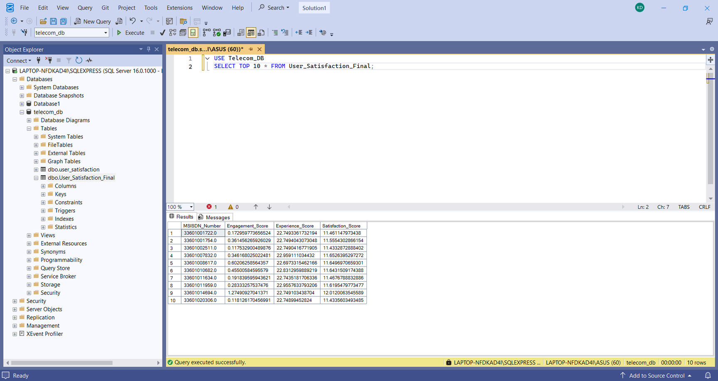
SLIDE 17: DATABASE INTEGRATION
Text: Final scores and user rankings were exported to a SQL database for reporting.

Slide 18
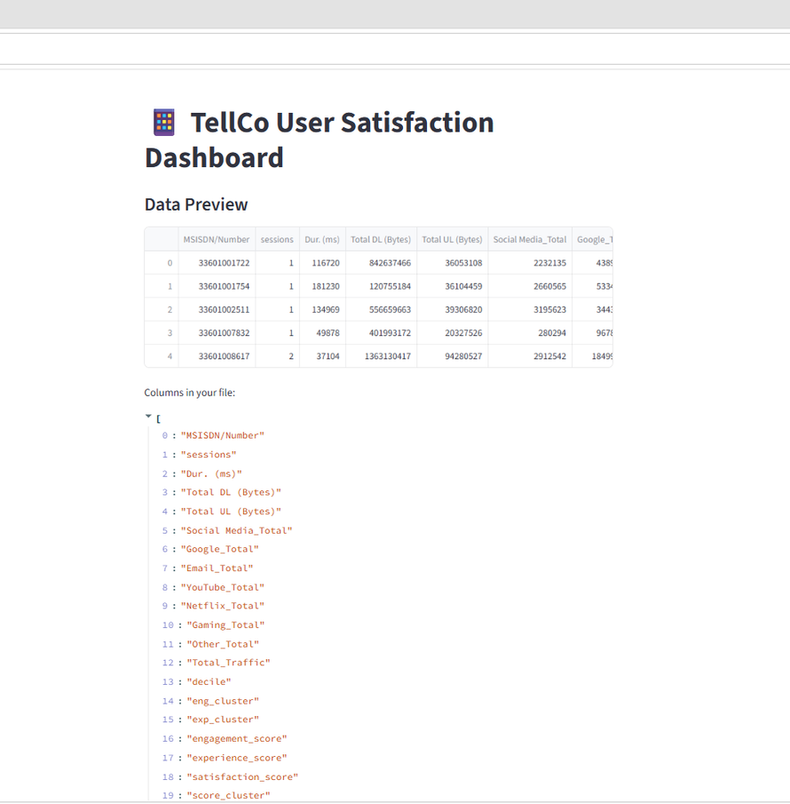
SLIDE 18: INTERACTIVE MANAGEMENT DASHBOARD
Text: Built a Streamlit dashboard for real-time visualization of key business metrics.

Slide 19
SLIDE 19: FINAL RECOMMENDATION (THE VERDICT)
Verdict: STRATEGIC BUY (POSITIVE).
Reasoning: Strong engagement in high-data segments (Gaming). Improving network quality will directly increase ROI.

Slide 20
SLIDE 20 KA FINAL LOOK
Heading: Limitations & Technical Summary
Limitations:
Data is a 1-month snapshot; results might vary due to seasonal user behavior changes.
Real-time network fluctuations were not considered during the batch processing phase.
Technical Summary:
Data Storage: All results are exported and secured in a SQL database (telecom_db).
Model Tracking: Experiment history is maintained in MLflow logs with an R2_Score of 1.0.
Visualization: Final insights are accessible via the TellCo Interactive Dashboard.

