Slide 1
Introduction To Big Data

Slide 2
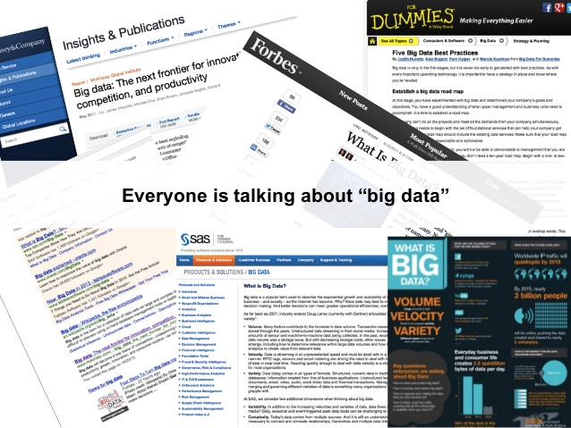
What is Big Data

Slide 3
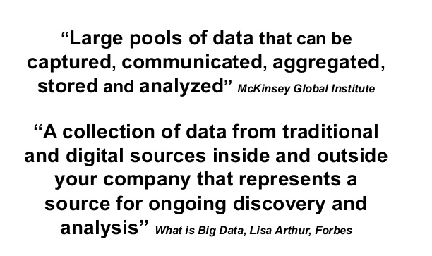
Big Data Definition

Slide 4
Big Data in 1 minute
https://www.youtube.com/watch?v=2O7UZBcWStU

Slide 5
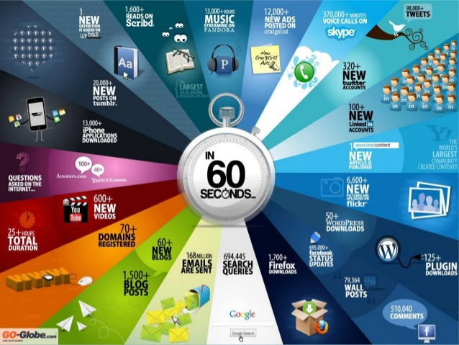
From Where Data is Generated
Notes:
http://www.digitalinformationworld.com/2014/05/Twitter-Facebook-GooglePlus-Instagram-Pinterest-Real-Time-Internet-infographic.html

Slide 6
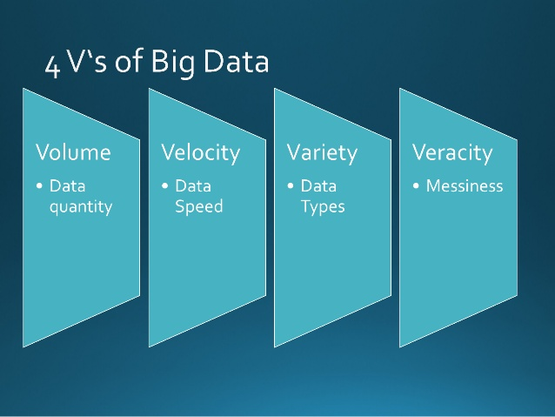

Slide 7
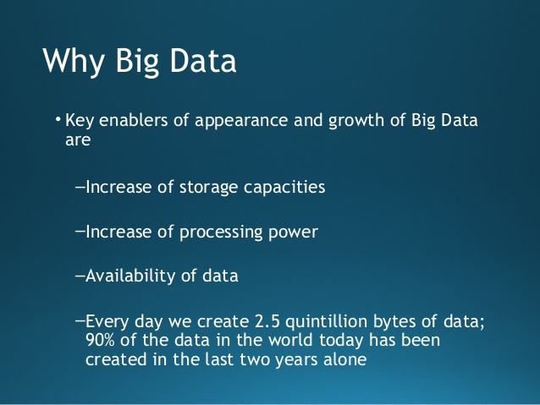

Slide 8
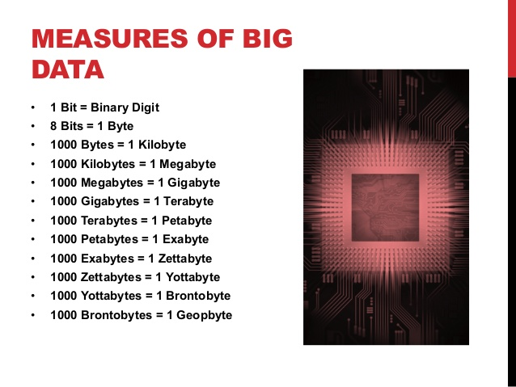
Big Data Measures

Slide 9
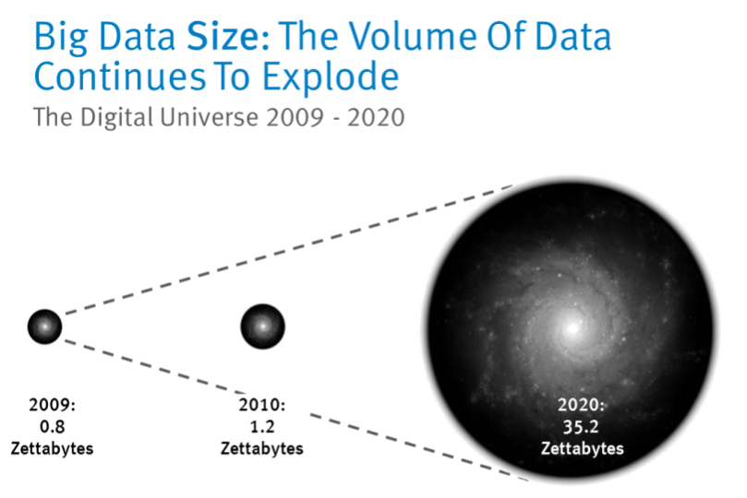
Key Characteristics of Big Data
Data Volume
44x increase from 2010 to 2020
(1.2zettabytes to 35.2zb)
Processing Complexity
Changing data structures
Use cases warranting additional transformations and analytical techniques
Data Structure
Greater variety of data structures to mine and analyze

Slide 10
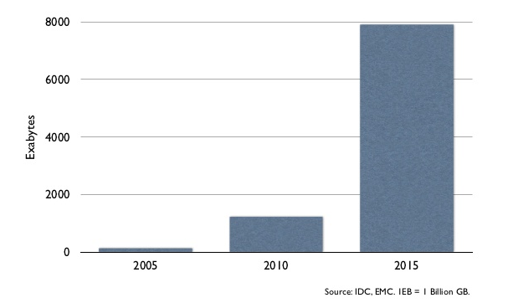
Worldwide Data Growth at 7.9EB/Yr in ‘15

Slide 11
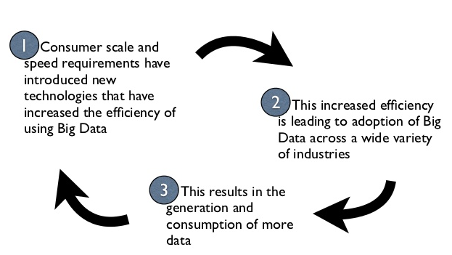
Big Data Cycle

Slide 12
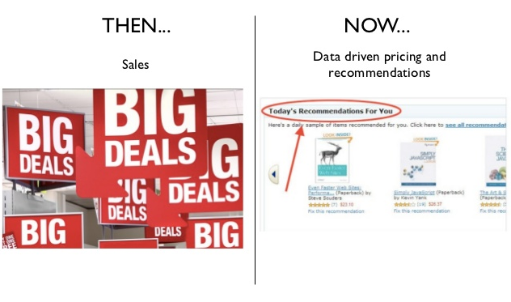
Transformation of Retail

Slide 13
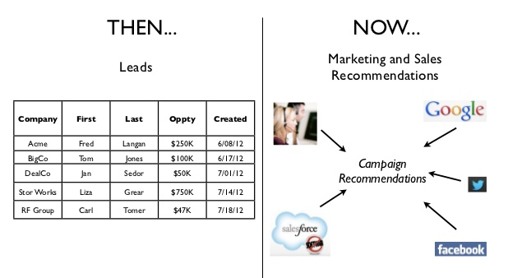
Transformation of Online Marketing

Slide 14
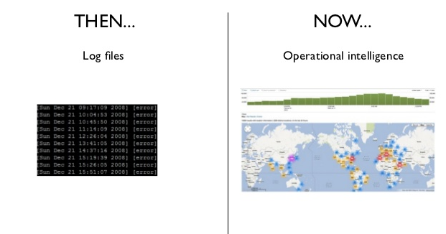
Transformation of IT

Slide 15
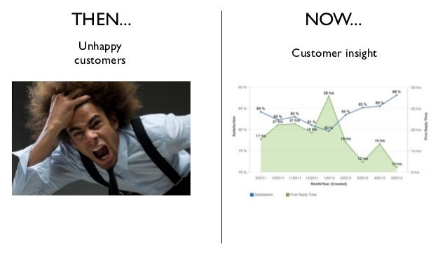
Transformation of Customer Service

Slide 16
Discuss in Groups
https://www.youtube.com/watch?v=449twsMTrJI

Slide 17

Transformation of Billing

Slide 18
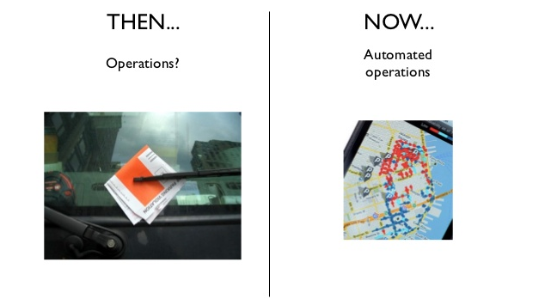
Transformation of Operations Management

Slide 19
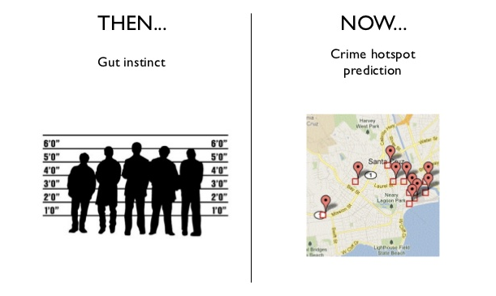
Transformation of Law Enforcement

Slide 20
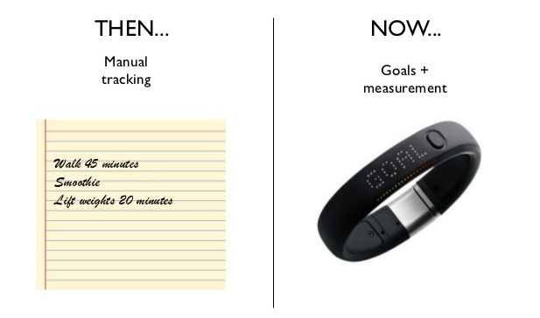
Big Data Sensors

Slide 21
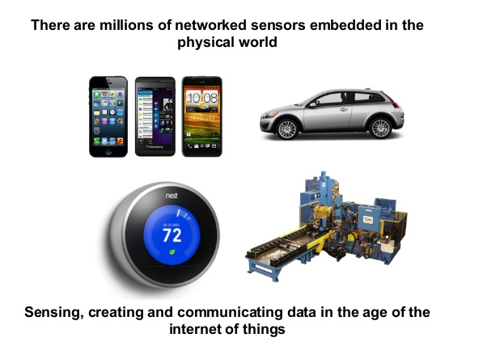
Internet of Things

Slide 22
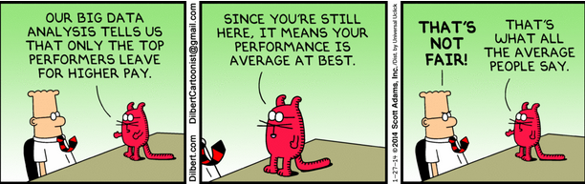
Big Data Accuracy ?

