Slide 1
Big Data Architecture - Hadoop Components

Slide 2
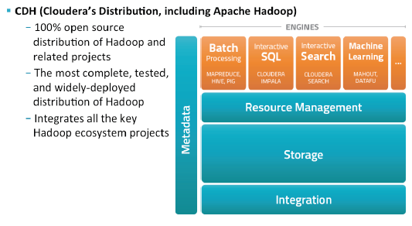
Cloudera Distribution - Hadoop

Slide 3
Hadoop Cluster
CLUSTER
RACK
Node
Node
Node
Node
Node
Node
Node
RACK
Notes:
A set of machines running HDFS and MapReduce is known as a Hadoop Cluster
Individual machines are known as nodes
A cluster can have as few as one node, as many as several thousands
More nodes = better performance!

Slide 4
Hadoop Components
Hadoop
Hadoop Distributed File System (HDFS)
MapReduce
YARN
Manages Resources
Hadoop Ecosystem
Stores data on the cluster
Hive
Mahout
Processes data on the cluster
Pig
HBase
Oozie
Hue
Sqoop
Flume
Notes:
If you need to do large-­‐scale data processing, you need two things: a place to store
large amounts of data and a system for processing it. HDFS provides the storage and MapReduce provides a way of processing it.
Hadoop got its name from a stuﬀed elephant toy owned by Doug Curng’s son. Names for other projects related to Hadoop tend to use animal themes, parPcularly those related to elephants (Mahout is derived from the Hindi word for “elephant driver” while Oozie is Burmese for “elephant handler”). Mahout is generally pronounced in the Hadoop community as “muh-­‐HAUT” (where the last syllable rhymes with “doubt” or “clout”), though some (most notably, those actually from India) pronounce it as “muh-­‐HOOT” (in which the last syllable rhymes with “boot” or “loot”).
Pig, Hive and HBase are built on Hadoop, while Flume, Oozie and Sqoop help you use or integrate Hadoop.
“In YARN, the ResourceManager is, primarily, a pure scheduler. In essence, it’s strictly
limited to arbitra<ng available resources in the system among the compe<ng applica<ons – a market maker if you will. It op<mizes for cluster u<liza<on (keep all resources in use all the <me) against various constraints such as capacity guarantees, fairness, and SLAs. To allow for diﬀerent policy constraints the ResourceManager has a pluggable scheduler that allows for diﬀerent algorithms such as capacity and fair
scheduling to be used as necessary.

Slide 5
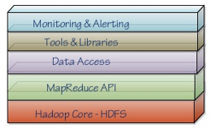
Hadoop Components
Hue, Sqoop
Pig, Hive, Hbase, Mahout

Slide 6
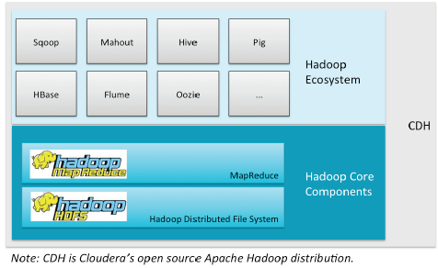
Hadoop 1.0 Components

Slide 7
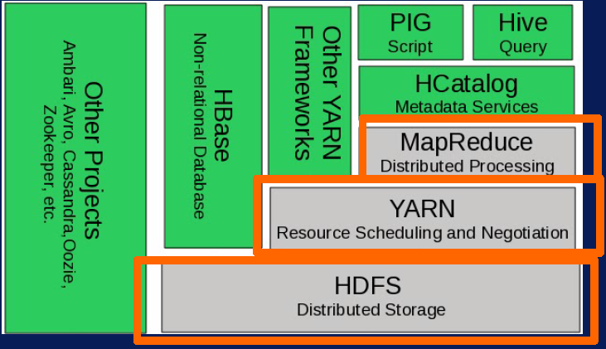
Hadoop 2.0 Components

Slide 8
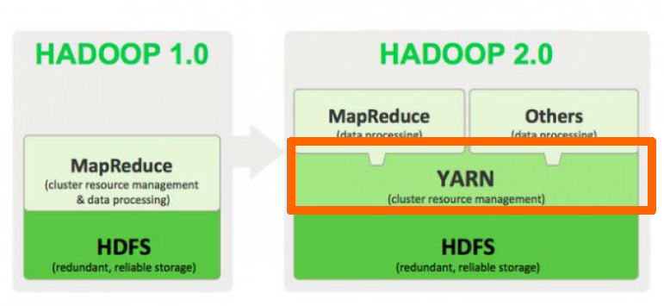

Slide 9
Hadoop Components : HDFS
Stores data on the cluster
Data is split into blocks and distributed across multiple nodes in the cluster
Each block is typically 64MB or 128MB in size
Each block is replicated multiple times
Default – 3 times
Replicas are stored in different nodes
Reliable
Available
Notes:
The HDFS block size is HUGE (perhaps 4000 Pmes larger) when compared to the block size of a naPve UNIX ﬁlesystem. This is because HDFS is opPmized for reading large amounts of data in order to minimize the overall performance impact (latency) associated with gerng the disk head posiPoned to read the ﬁrst byte.
ReplicaPon increases reliability (because there are mulPple copies), availability (because those copies are distributed to diﬀerent machines) and performance (because more copies means more opportuniPes to “bring the computaPon to the data”). Re licaPon also means a corresponding decrease in the amount of usable
disk space,

Slide 10
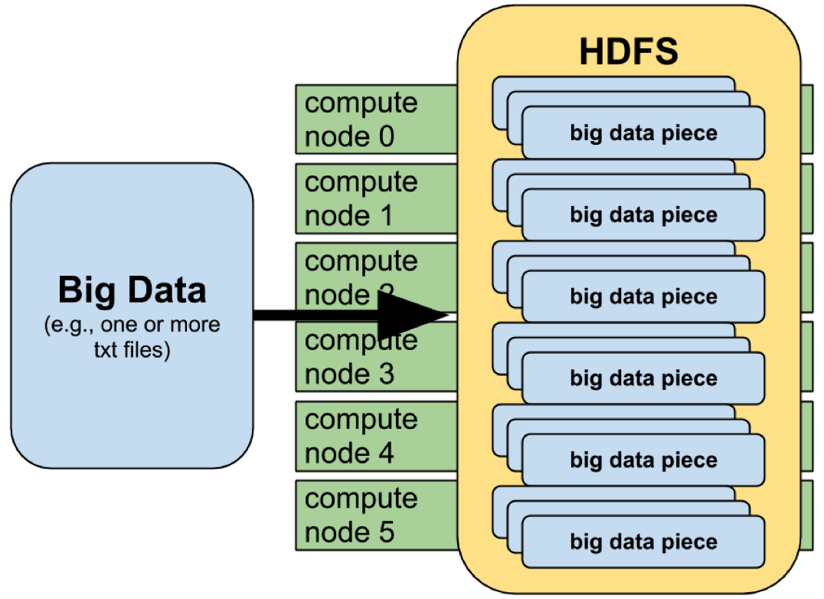
Hadoop Components : HDFS
Notes:
http://www.glennklockwood.com/data-intensive/hadoop/overview.html

Slide 11
Hadoop Components : YARN
Yet Another Resource Navigator
Interacts with applications and schedules resources for their use
Enables running multiple applications over HDFS
YARN
Resource Manager
Node Manager
Is in-charge of a single node
Operates at machine level
Controls all resources
Decides who gets what

Slide 12
Hadoop Components : YARN
Node Manager (NM)
Application Master
Container
Client
Resource Manager (RM)
Node Manager (NM)
Application Master
Container
Negotiates resource from RM
Talks to NM to get the tasks completed
One per application
Runs in a container
Requests more containers to run application tasks

Slide 13
Hadoop Components : MapReduce
System used to process data in the Hadoop Cluster
Each Map task operates on a discrete portion of overall dataset
Typically one HDFS block of data
After all maps are complete,MapReduce system distributes the intermediate data to nodes which perform Reduce Phase
MapReduce
Map
Reduce
Notes:
Between the two is a stage known as shuffle and sort : Input | Map() | Shuffle/Sort | Reduce() | Output
MapReduce is not a programming language or even a speciﬁc framework; rather, it
could more accurately be described as a “programming model” which was originally implemented by Google internally, then later re-­‐implemented by the open source world in Apache Hadoop. There are other MapReduce implementaPons (such as Disco and Phoenix), but most are either proprietary or “toy” projects that very people use. Hadoop is by far the most widely-­‐used implementaPon of MapReduce.
Map and Reduce have foundaPons in funcPonal programming languages like Common Lisp, Scheme and ML. In fact, many computer languages (including perl, Ruby and Python) have a map funcPon which applies a user-­‐speciﬁed funcPon to every element in a list in order to produce a new list. For example, given the “square” funcPon and the list [2, 3, 4], the map funcPon in these languages would produce a new list [4, 9, 16] (i.e. each element is mulPplied by itself). This is indeed quite similar to what’s done in the Map phase of MapReduce.
Likewise, many computer languages have a reduce funcPon (though it is oxen called “fold” or “inject”) that applies a funcPon to every element in a list in order to build a ﬁnal result. For example, reducing the list [1, 2, 3] with a “sum” funcPon produces the ﬁnal result of 6 (i.e. 1 + 2 + 3). This is again similar to what’s done in the reduce
phase in MapReduce.

Slide 14
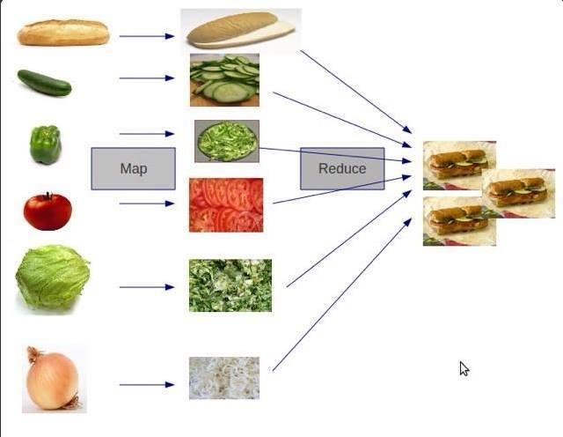
Map Reduce Example

Slide 15
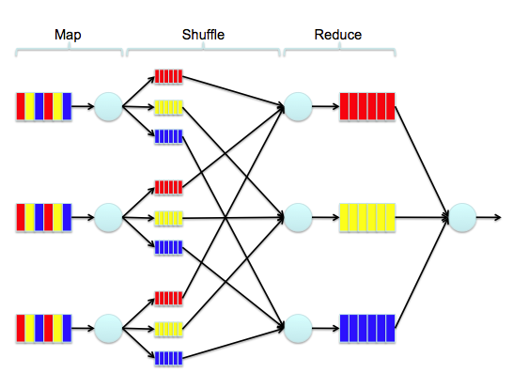
One more example…
Notes:
http://mm-tom.s3.amazonaws.com/blog/MapReduce.png

