Slide 1
Differences between Traditional Data Store Architecture & Big Data

Slide 2
Big Data differs from Traditional BI
Data is retained in a distributed file system instead of on a central server.
The processing functions are taken to the data rather than data being taking to the functions.
Data is of different formats, both structured as well as unstructured.
Data is both real-time data as well as offline data.
Technology relies on massively parallel processing (MPP) concepts.

Slide 3
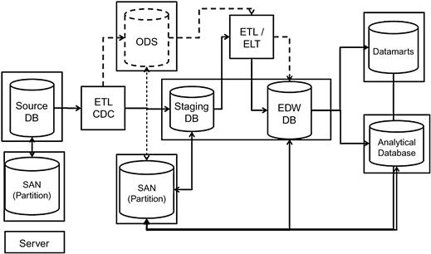
Typical Data Warehouse Architecture

Slide 4
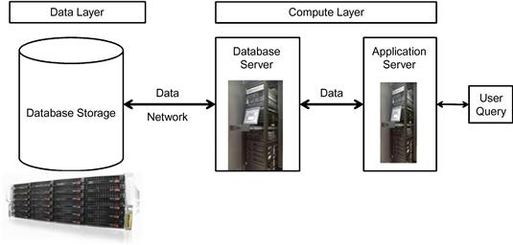
Data Warehouse Processing

Slide 5
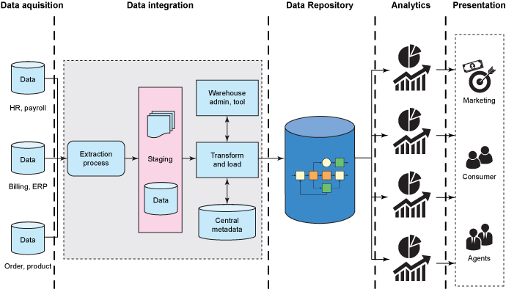
Traditional Data Warehouse Reference Architecture
Notes:
http://www.ibm.com/developerworks/library/b
Data acquisition layer: Consists of components to get data from all the source systems, such as human resources, finance, and billing.
Data integration layer: Consists of integration components for the data flow from the sources to the data repository layer in the architecture.
Data repository layer: Stores data in a relational model to improve query performance and extensibility.
Analytics layer: Stores data in cube format to make it easier for users to perform what-if analysis.
Presentation layer: Applications or portals that give access to different set of users. Applications and portals consume the data through web pages and portlets that are defined in the reporting tool or through web services.
a-augment-data-warehouse1/index.html

Slide 6
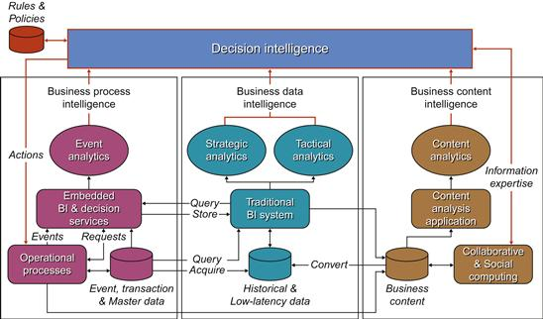
Second Generation Data Warehouse Architecture
Notes:
Source:www.beyenetwork.com.

Slide 7
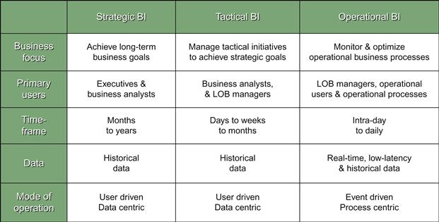
Decision Support System
Notes:
Source: Courtesy of Claudia Imhoff and Colin White.
In the DSS 2.0 model, the authors have suggested compartmentalizing the workload of the operational and analytical business intelligence (BI) and adding the content analytics as a separate module. The three different modules can be harnessed using corporate business rules deployed through a decision support integration platform called decision intelligence. The matrix in explains the different types of business intelligence needs that can be addressed by the DSS 2.0 approach. The authors explain in the matrix the different types of users, their data needs, and the complexity of processing, and introduce the concept of managing user expectations by understanding their query behaviors.

Slide 8
Challenges of Data Warehousing
Dependence on RDBMS
Shared-everything architecture
Explosive growth of data and complexity in querying
Evolving performance and scalability demands
Unpredictable dynamic workloads
Notes:
• Dependence on RDBMS. The relational model restricts the ability to create flexible architectures. Enforcing relationships and integrity is needed to keep the quality of the data warehouse, but there is no rule that mandates this as a precursor to build a data warehouse.
• Shared-everything architecture. Except for Teradata, all the other databases are built on the shared-everything architecture.
• Explosive growth of data—new data types, volumes, and processing requirements.
• Explosive growth of complexity in querying.
• Evolving performance and scalability demands.
• Unpredictable dynamic workloads.
• Analytical support.
• User evolution from static report consumers to interactive analytical explorers.

Slide 9
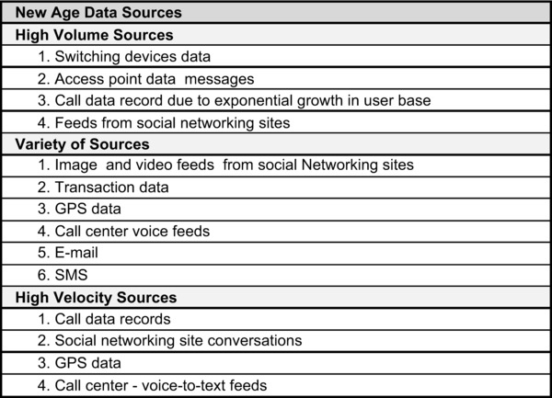
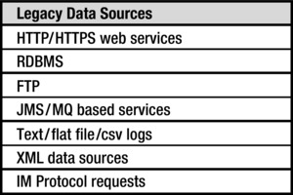
Legacy & New Data Sources

Slide 10
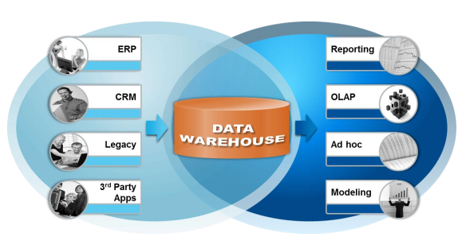
Optimizing the data warehouse
Old approaches to data warehousing are struggling.
Standard ETL is no longer the answer.
Notes:
http://docs.media.bitpipe.com/io_10x/io_102267/item_725049/Big-Data-in-Big-Companies.pdf
Relational data needs to be supported by non-relational information to ensure that decisions are made against as much information as possible. The use of extended value chains across organisations means that other sources of data are being accessed. ETL windows are shrinking – yet ETL tasks are trying to extend at the same time and encompass new emerging technologies. Something has to change to make business intelligence workable.
The use of standard ETL approaches no longer meets the needs of the organisation. Many now have to cut back on the amount of data being moved to the data warehouse in order to fit in with the time windows available to them. Decisions are therefore being based on a sub-set of the available data – and do not include the non-relational information that now makes up a sizeable proportion of an organisation’s electronic assets.

Slide 11
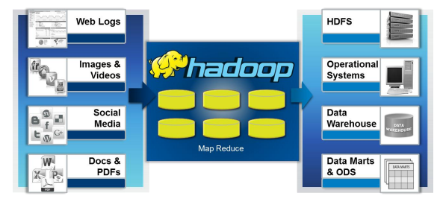
Dealing with Large Volumes of Mixed Data
Mapping multiple, diverse data sources is an increasing problem Standard ETL is no longer the answer.
Mixing different data types (relational and non-relational) is important .
Notes:
http://docs.media.bitpipe.com/io_10x/io_102267/item_725049/Big-Data-in-Big-Companies.pdf
If only two or three different data sources are used in a data warehouse, mapping the various data schemas is relatively easy. However, in today’s environment there can be many different data sources. Maintaining the schemas can be a major issue – and a change in any one of the sources can lead to major issues in the data warehouse itself. A more automated means of maintaining schemas needs to be found through the use of suitable systems.
Basing corporate decisions only on data held within relational systems is dangerous. With an increasing amount of information held outside of a standard database, these sources have to be included in the mix to ensure that decisions are made against as much of the available information as possible. The use of binary large objects (BLObs) is not the best way to do this.

Slide 12
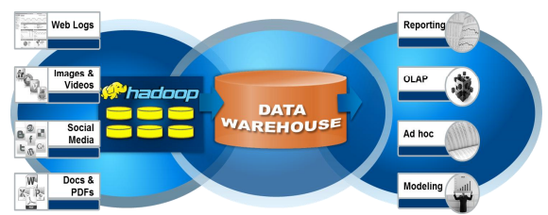
Bringing in Big Data can help solve many of the issues
An optimized data warehouse requires a new approach
The use of a specialized non-relational store, such as Hadoop, can provide a platform where a mixed environment of relational and non-relational data can be brought together in a better way
Notes:
http://docs.media.bitpipe.com/io_10x/io_102267/item_725049/Big-Data-in-Big-Companies.pdf
The use of a specialized non-relational store, such as Hadoop, can provide a platform where a mixed environment of relational and non-relational data can be brought together in a meaningful manner. The use of MapReduce can help bring the size of the data warehouse back under control – and can make the end analysis and reporting of the available information far faster.
New technologies are available that can make a data warehouse far more effective. However, it has to be simple to implement and run, as well as easy for end users to interact with and use directly to gain the insights required. Vendors are now providing systems that hide the complexities of the underlying technology and speed the integration and aggregation of the multiple different relational and non-relational data sources.
Existing approaches to data warehousing are increasingly unfit for purpose. The creation of ever-larger warehouses or data marts counts against any meaningful analysis being carried out, and the financial performance of organizations will suffer as they struggle to compete in markets where others have adopted a more modern approach. Data warehouses have to be brought up to date: a different approach is required in how multiple relational and non-relational data sources are dealt with so that the amount of data needing to be analyzed and reported against in the warehouse is better controlled and managed. However, the technologies chosen must also be easy for IT staff to implement and manage – the complexities of the underlying technologies must be hidden to provide a system that is easy for all to use.

Slide 13
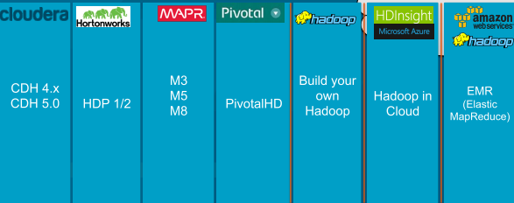
Common Big Data Applications
Data Processing / ETL offload
Data Warehouse offload
Telemetry
360-degree customer view
Enterprise data hub

Slide 14
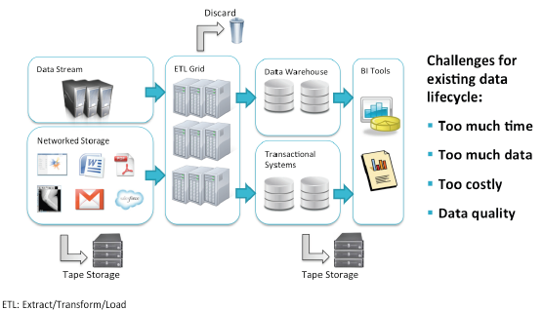
Data Processing / ETL offload – Traditional Way
Notes:
h?p://www.cloudera.com/content/dam/cloudera/documents/Using-­‐Cloudera-­‐to-­‐
Improve-­‐Data-­‐Processing_WP_2012-­‐09.pdf
From the website: “Data processing is criPcal to supporPng organizaPons’ everyday operaPons such as generaPng reports for suppliers and customers, measuring internal metrics day to day and reporPng quarterly ﬁnancial results. Hadoop is rapidly becoming a mainstay in organizaPons due to its ﬂexibility, scalability and low cost of storing and processing raw data. With an increased focus on improving operaPonal eﬃciency, leading organizaPons across industries are moving mission-­‐criPcal data processing and historical data storage to Cloudera Enterprise. This enables them to store raw data in its naPve format and develop and maintain complex data pipelines faster, and at signiﬁcantly lower costs, than were possible using tradiPonal systems.”
Many organizaPons are not able to process or access all of their data. They may collect data (such as weblogs) and discard most of it because they don’t have the capacity to process or even store it all. Therefore they are losing potenPally valuable data. Files may be processed then stored to tape, where accessing them becomes impracPcal. Any data not originally gleaned is eﬀecPvely inaccessible. TransacPonal data (e.g. order history) may also be moved to tape storage because it is required to be kept, but again, unavailable for analysis.

Slide 15
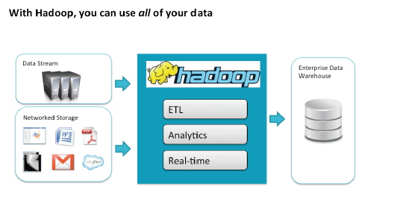
Data Processing / ETL offload – Big Data
Notes:
Because with Hadoop you can use commodity hardware to store and process your data economically, you can store and make use of all of it. Hadoop can handle the processing/ETL, analyPcs and real-­‐Pme access (through Impala, discussed later), and you can also conPnue to export key data to your data warehouse.

Slide 16
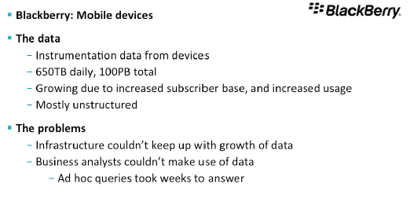
Data Processing / ETL offload Use Case
Notes:
From h?p://www.cloudera.com/content/cloudera/en/resources/library/
recordedwebinar/the-­‐business-­‐advantage-­‐of-­‐hadoop-­‐lessons-­‐from-­‐the-­‐ﬁeld-­‐ cloudera-­‐summer-­‐webinar-­‐series-­‐451-­‐research-­‐video-­‐recording.html Includes a presentaPon by Aaron Wiebe at BlackBerry at about 36 minutes. BlackBerry (formerly Research in MoPon) makes mobile devices
The data from individual devices across the globe is growing “exponenPally”. Most of the data is unstructured. Due to numerous acquisiPons, the only common structure is a Pmestamp.
Those anPcipated analysis and queries worked well, however, “ad hoc” queries required by business analysts were nearly impossible to process in a reasonable amount of Pme. For example: “What percentage of BlackBerry 7 users in Indonesia
use BlackBerry messenger?” required weeks to answer.

Slide 17
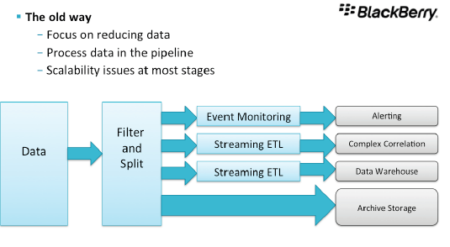
Data Processing / ETL offload Use Case(cont’d)
Notes:
Key points:
-­‐ So much data that the main goal was to reduce data so that only data they cared about was analyzed. The problem: they need to know ahead of Pme which data they would care about later.
-­‐ Analysis was done in the data pipeline, as it was streaming, so that costly queries to disk were avoided. E.g. if you want to know “How many BlackBerry 7 users are using BB Messenger?” they ﬁlter and calculate that as the data is streaming.
-­‐ The problem: what if they want to answer diﬀerent quesPons later? Answering new quesPons is a very expensive process.
-­‐ Analyzing data from the archive was so Pme-­‐consuming that it was basically
unusable. By the Pme the answer was produced, it was no longer useful.

Slide 18
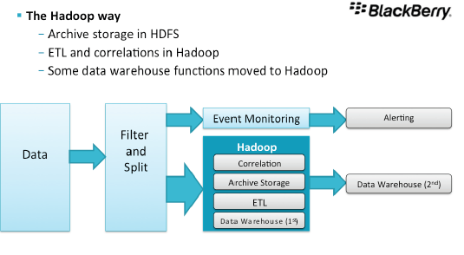
Data Processing / ETL offload Use Case(cont’d)

Slide 19
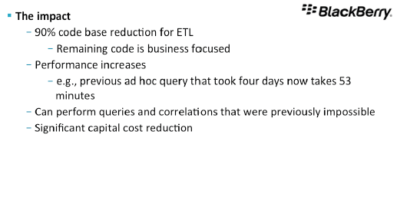
Data Processing / ETL offload Use Case(cont’d)
Notes:
Previously they had to create, maintain and update the whole ETL infrastructure to
read content as it streamed through, and coordinate mulPple machines using very complex code. All that is now gone. The remaining code is business-­‐driven rather than framework-­‐oriented.
Huge performance increase in ad hoc queries. Most were impossible before. Even criPcal quesPons before took days or weeks, now take minutes or hours.
Cost reducPon: replacing enterp ise grade storage systems with commodity
hardware reduced capital costs.

