Slide 1
HDFS and Map Reduce

Slide 2
Hadoop is not for all types of work
Hadoop is not for all types of work:
Not to process transactions (random access)
Not good when work cannot be parallelized
Not good for low latency data access
Not good for processing lots of small files
Not good for intensive calculations with little data

Slide 3
Main Challenges for Hadoop
Query speed
Hadoop query engines still aren't as fast as running queries against mainstream relational databases.
Updating data in Hadoop
Hadoop currently is a read-only system
Tools like Impala and Hawq provide interfaces that enable end users to write queries in the SQL programming language.
The queries then get translated into MapReduce for execution on a Hadoop cluster, but that process is inherently slower than running a SQL query directly against a relational database
once data has been written into the Hadoop Distributed File System(HDFS), users can't easily insert, delete or modify individual pieces of data stored in the file system like they can in a relational database.
Hadoop 2 includes a capability for appending data to HDFS files.
Notes:
http://searchbusinessanalytics.techtarget.com/feature/Hadoop-still-too-slow-for-real-time-analysis-applications

Slide 4
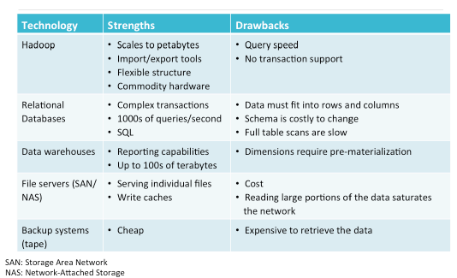
Technology – Weakness & Strengths
Notes:
Source : Cloudera Lecture 02

Slide 5
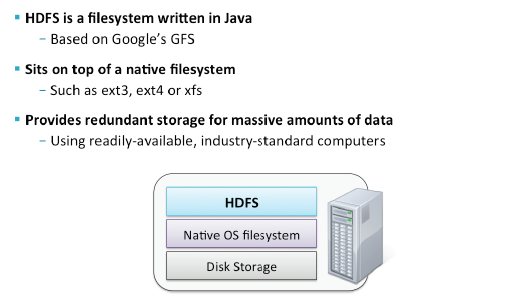
HDFS Basic Concepts
Notes:
GFS: Means “Google File System” in this context and should not be confused with Global File System, which is another open source distributed ﬁlesystem also commonly abbreviated as GFS.
HDFS runs in “user space” which means it is not coupled to the operaPng system’s kernel. It is really just an applicaPon that stores its data as ﬁles on the naPve ﬁlesystem (such as ext3) of the system on which it is running. Thus, you cannot generally use it like a normal ﬁlesystem (that is, do things like type “ls” at a shell prompt and see its contents or click File -­‐> Open in your text editor to view ﬁles stored in HDFS). There are ways to provide this kind of access though, such as FUSE and NFS proxy, that are menPoned a bit later.
“Readily-­‐available, industry-­‐standard” replaced “commodity” in the slide, which replaced “cheap, unreliable.” It doesn’t mean you should buy second-­‐hand computers at a garage sale, it means that you could buy servers towards the lower-­‐ end of the vendor’s range without expensive redundancy features like RAID or hot-­‐ swappable CPUs. In other words, you could buy something like a Dell C2100 for
$6,000 rather than a Sun Fire Enterprise 25K that costs 100 Pmes as much (or more). This advice applies mainly to the “worker” nodes; however, the “master” nodes (Name Node, Secondary Name Node and Job Tracker) should use high-­‐quality, reliable hardware. Be sensiPve to the fact that that some of our partners -­‐ Oracle and NetApp, for example -­‐ deply Hadoop on higher end conﬁguraPons at reasonably favorable price points.

Slide 6
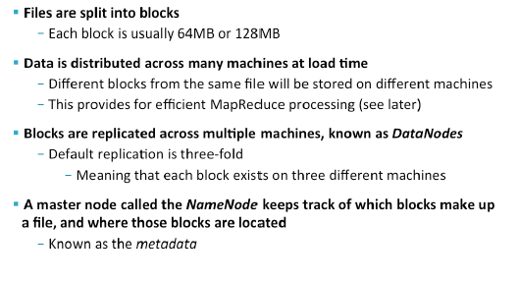
HDFS File Storage
Notes:
Cloudera typically recommends using a block size of 128MB, rather than the default
of 64MB. One beneﬁt of doing so is to reduce the memory requirements for the NameNode, since each block in HDFS requires about 150 bytes on the NameNode (h?p://www.mail-­‐archive.com/hdfs-­‐user@hadoop.apache.org/msg00815.html). By having larger blocks, you will have fewer of them and therefore use less memory overall.
The ﬁlesystem “namespace” is basically the overall ﬁle/directory structure of the ﬁlesystem, while metadata is informaPon about the ﬁles such as ownership and permissions.
Basic informaPon about the NameNode can be found in TDG 3e, page 46 (TDG 2e,
44), and Lin & Dyer (page 30).

Slide 7
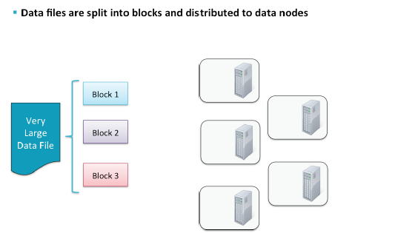
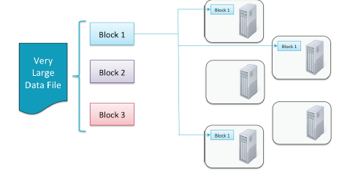
How Files are Stored in HDFS
Notes:
Data ﬁles are split into blocks and distributed across mulPple nodes in the cluster.
Block size is conﬁgurable. Typically blocks are 64M or 128M. Default block size is 64M. Note that these “blocks” are not related to ﬁle system/disk “blocks”. Think of them as ﬁle chunks.
Each block is replicated mulPple Pmes. (Default is three.)
Replicas are stored on diﬀerent nodes, known as Data Nodes. ReplicaPon ensures reliability and availability. (What are the odds that all three nodes containing a parPcular block will be unavailable at the same Pme?)
Compare to RAID [Redundant Array of Independent Disks]: RAID stores mulPple copies of data across disks on the same computer. Data may be safe from loss, but it is not available if the computer itself goes down or is busy.
HDFS stores data across mulPple disks on separate computers, ensuring data safety and availability. This is part of being fault tolerant as discussed earlier.
This provides for eﬃcient MapReduce processing (see later).
A master node called the NameN locks make up a ﬁle, and
where those blocks are located.

Slide 8
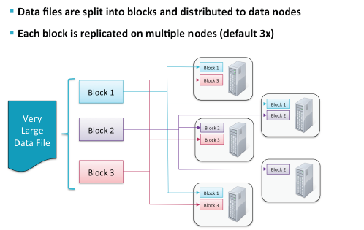
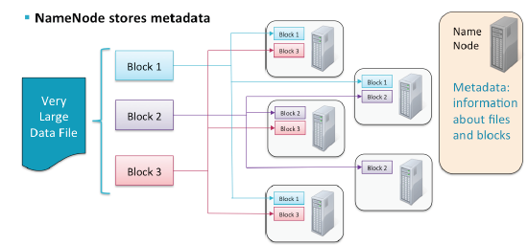
How Files are Stored in HDFS

Slide 9
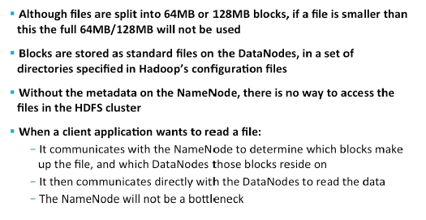
HDFS : Points to Note
Notes:
In a tradiPonal naPve ﬁlesystem, a ﬁle which occupies less space than the block size
winds up wasPng the unused amount. For example, a ﬁle that is 1KB in size stored on a ﬁlesystem with a 4KB block size will waste 3KB. At ﬁrst glance, it would seem that a 3MB ﬁle stored on HDFS with a 64MB block size would waste 61MB, but this doesn’t actually happen because HDFS is just an addiPonal layer on top of a naPve ﬁlesystem.
NameNode is a single point of failure for availability, though failure of the NameNode doesn’t mean all your data in HDFS is lost forever (provided you’ve conﬁgured things according to our recommendaPon/best pracPce and the NameNode is wriPng to a remote NFS mount). In pracPce, this single point of failure is not the big problem it seems to be at ﬁrst. If it were, you can bet it would have been addressed much earlier. Nevertheless, it is an area where things could be improved and in fact there is work being done in Hadoop to provide a High Availability NameNode. This feature
will be available in CDH4.

Slide 10
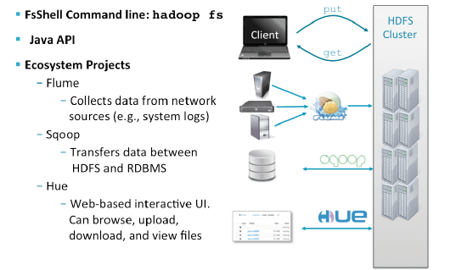
Options for Accessing HDFS
Notes:
Since HDFS is not a normal UNIX ﬁlesystem (i.e. one that is Ped into the operaPng system’s kernel), it is not available like a regular ﬁlesystem would be. In other words, you can not click File -­‐> Open in your text editor and open a ﬁle that is stored in HDFS. Instead, you must copy it from HDFS to your local ﬁlesystem (e.g. using the “hadoop fs –copyToLocal” command).
Typically, ﬁles are created on a local ﬁlesystem and must be moved into HDFS. Likewise, ﬁles stored in HDFS may need to be moved to a machine’s local ﬁlesystem
Access to HDFS from the command line is achieved with the hadoop fs command

Slide 11
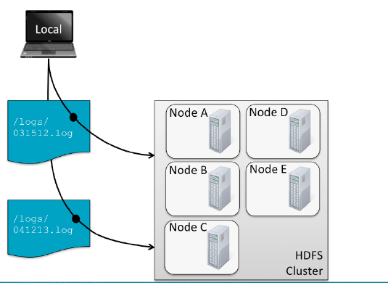
Storing and Retrieving files

Slide 12
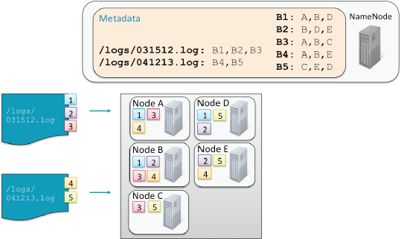
Storing & Retrieving Files

Slide 13
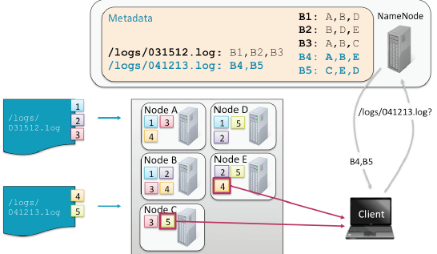
Storing & Retrieving Files(Cont’d)

Slide 14
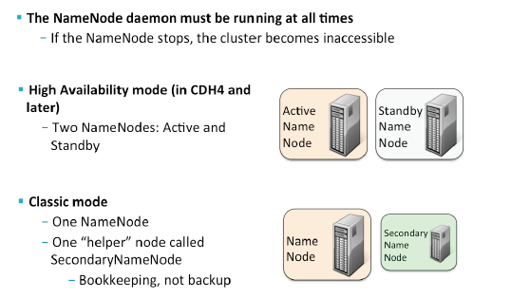
HDFS Name Node Availability

Slide 15
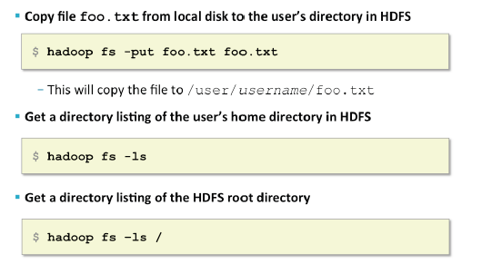
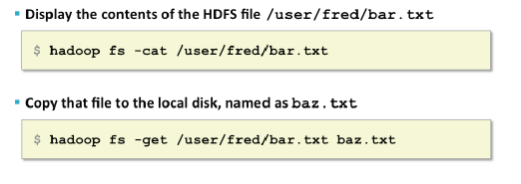
Hadoop FS Examples
Notes:
Hadoop
documentation
(http://archive.cloudera.com/cdh/3/hadoop-0.20.2-cdh3u3/file_system_shell.html).

Slide 16
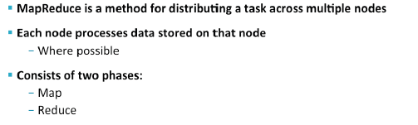
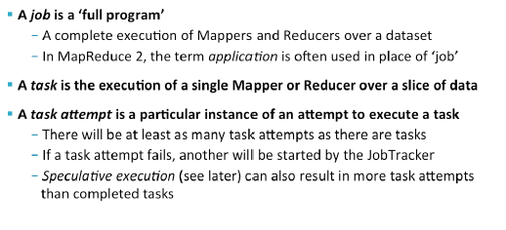
Hadoop Components : Map Reduce

Slide 17


MapReduce explained
Hadoop computation model:
Data is stored in a distributed file system spanning many inexpensive computers.
Bring function to the data.
Distribute application to the compute resources where the data is stored.
Scalable to thousands of nodes and petabytes of data.
public static class TokenizerMapper
extends Mapper<Object,Text,Text,IntWritable> {
private final static IntWritable
one = new IntWritable(1);
private Text word = new Text();
public void map(Object key, Text val, Context
StringTokenizer itr =
new StringTokenizer(val.toString());
while (itr.hasMoreTokens()) {
word.set(itr.nextToken());
context.write(word, one);
}
}
}
public static class IntSumReducer
extends Reducer<Text,IntWritable,Text,IntWrita
private IntWritable result = new IntWritable();
public void reduce(Text key,
Iterable<IntWritable> val, Context context){
int sum = 0;
for (IntWritable v : val) {
sum += v.get();
. . .
Hadoop Data Nodes
Map Phase: Break job into small parts.
Shuffle: Transfer interim output for final processing.
Reduce Phase: Boil all output down to a single result set.
Distribute map tasks to cluster
MapReduce Application
Shuffle
Result Set
Return a single result set
Introduction to Hadoop
Notes:
Source : IBM
There are two aspects of Hadoop that are important to understand:
MapReduce is a software framework introduced by Google to support distributed computing on large data sets of clusters of computers.
The Hadoop Distributed File System (HDFS) is where Hadoop stores its data. This file system spans all the nodes in a cluster. Effectively, HDFS links together the data that resides on many local nodes, making the data part of one big file system. Furthermore, HDFS assumes nodes will fail, so it replicates a given chunk of data across multiple nodes to achieve reliability. The degree of replication can be customized by the Hadoop administrator or programmer. However, by default it replicates every chunk of data across three nodes: Two on the same rack, and one on a different rack.
The key to understanding Hadoop lies in the MapReduce programming model. This is essentially a representation of the divide and conquer processing model, where your input is split into many small pieces (the map step), and the Hadoop nodes process these pieces in parallel. Once these pieces are processed, the results are distilled (in the reduce step) down to a single answer.

Slide 18
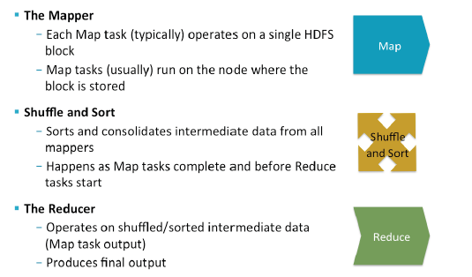
Map Reduce Components

Slide 19
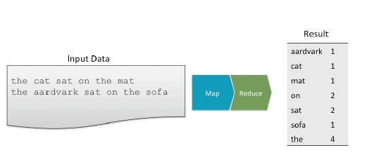
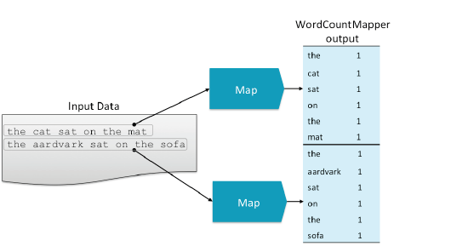
Map Reduce Example : Word Count

Slide 20
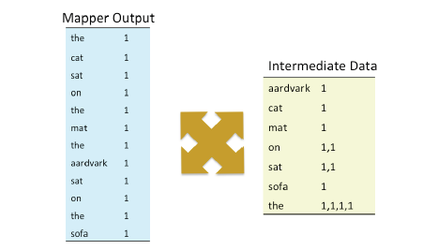
Map Reduce Example : Shuffle & Sort

Slide 21
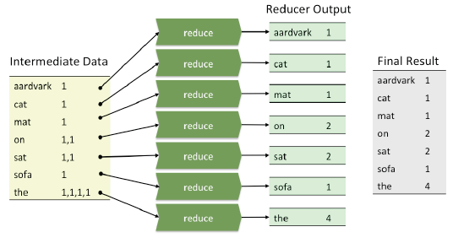
Map Reduce Example : Sum Reducer

Slide 22
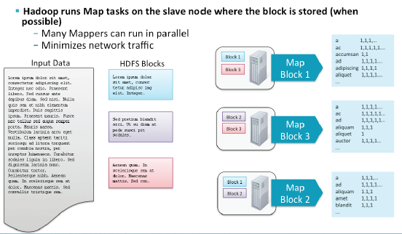
Mappers run in parallel

Slide 23
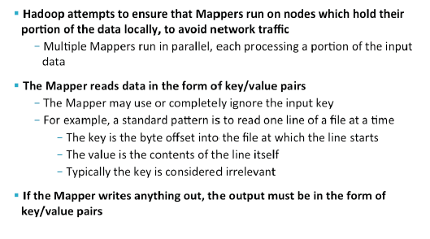
MapReduce : The Mapper

Slide 24
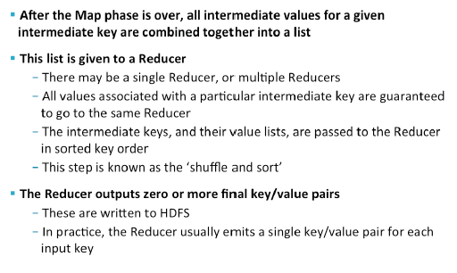
MapReduce : The Reducer

Slide 25
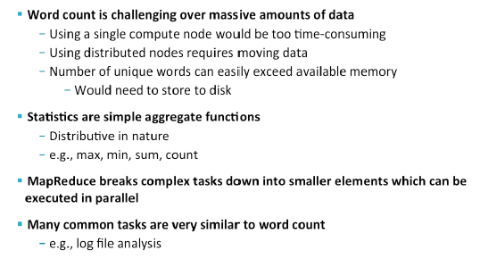
Why is Simple Counting Words Relevant

Slide 26
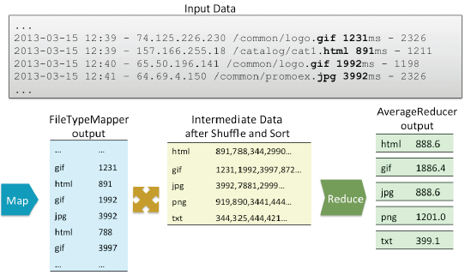
Analyzing Log Data

Slide 27
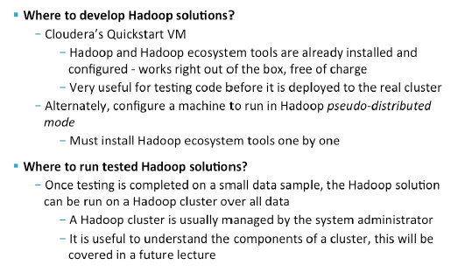
Hadoop Environments

