Slide 1
Introduction to UNIX / Linux

Slide 2
UNIX History
The UNIX operating system was born in the late 1960s. It originally began as a one man project led by Ken Thompson of Bell Labs, and has since grown to become the most widely used operating system
In the time since UNIX was first developed, it has gone through many different generations and even mutations
Some differ substantially from the original version, like Berkeley Software Distribution (BSD) or Linux
Others, still contain major portions that are based on the original source code.

Slide 3
General Characteristics of UNIX as an Operating System (OS)
Multi-user & Multi-tasking
Large Number of Applications
Free Applications and Even a Free Operating System
Less Resource Intensive
Internet Development

Slide 4
Parts of the UNIX OS
The Kernel - handles memory management, input and output requests, and program scheduling. Technically speaking, the kernel is the OS. It provides the basic software connection to the hardware. The kernel is very complex and deals with the inner workings of these things, and is beyond the scope of this course. The kernel is covered in detail in “Operating Systems.”
The Shell and Graphical User Interfaces (GUIs) - basic UNIX shells provides a “command line” interface which allows the user to type in commands. These commands are translated by the shell into something the kernel can comprehend, and then executed by the kernel.
The Built-in System Utilities - are programs that allow a user to perform tasks which involve complex actions. Utilities provide user interface functions that are basic to an operating system, but which are too complex to be built into the shell. Examples of utilities are programs that let us see the contents of a directory, move & copy files, remove files, etc...
Application Software & Utilities – these are not part of the operating system, per se. They are additional programs that are bundled with the OS distribution, or available separately. These can range from additional or different versions of basic utilities, to full scale commercial applications

Slide 5
Flavors of UNIX
These can be grouped into two categories: Open Source and Proprietary
Proprietary: (redistribution and modification prohibited or restricted; not free)
Solaris - Access to a Solaris UNIX server (solaris.gl.umbc.edu) via SSH access.
IRIX - There are a couple of IRIX machines in the basement of the library, as well as server access (irix.gl.umbc.edu) via SSH access.
Mac OS X - no access currently available at UMBC.
and many others...
Open Source: (source code is readily available and free to modify)
FreeBSD - no access currently available at UMBC.
Linux Distributions - access is available in the form of dual-boot PCs scattered throughout the Engineering building. There are also several Linux servers (linux.gl.umbc.edu) through which access is available.
RedHat (used by UMBC) and the Fedora Project (maintained by RedHat)
Mandrake
Debian
SuSE
Slackware
and many others...
As a side note, Linux is a open source UNIX-based OS that was originally developed in 1991 by Linus Torvalds, a Finnish undergraduate student.

Slide 6
Kernel & Shell
Kernel
CPU scheduling
Memory management
Process management
Shell
interacts between kernel and user, analogous to the “desktop” on other OS
user invokes commands through shell
Choices
BASH
Bourne
Korn
Kernel
Shell

Slide 7
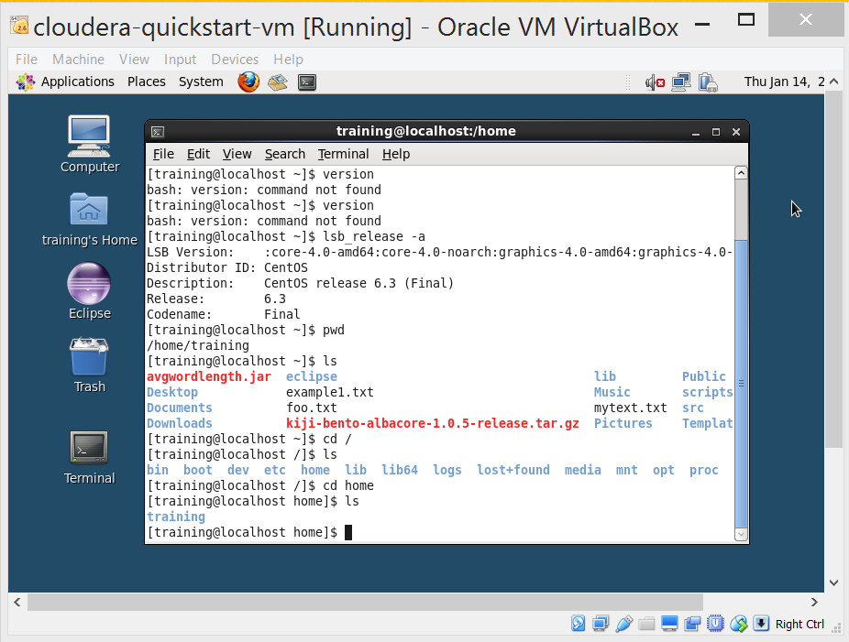
The Terminal

Slide 8
Centos File System
The file system is a collection of files and directories
The top directory is called the “root”
Some directories contain actual files, others provide access to hardware devices

Slide 9
Directory Structure
/
bin
dev
etc
home
usr
sbin
lib
…
training
Desktop
workspace
…

Slide 10
Commands
General format of commands:
<command> -<options> <file>

Slide 11
Commands
What is in the current folder
ls
Change to a new folder
cd <folder>
Delete a file
rm
Delete a folder and all contents (use with caution):
rm –rf <folder>
Move a file
mv <src> <dest>
Copy a file:
cp <scr> <dest>
Make a directory
mkdir
Remove a directory
rmdir
Absolute (full) path
pwd
Extract file
tar –zxvf
Extract the files from gzipped

Slide 12
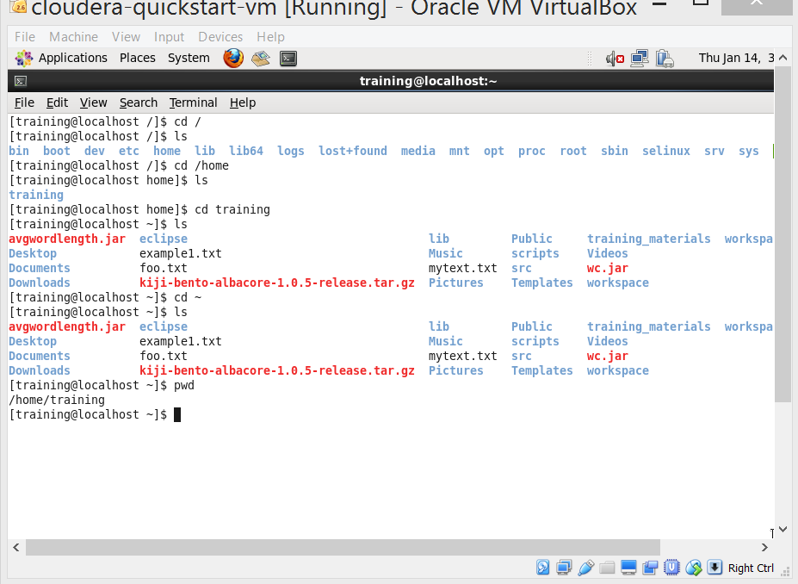
Hands-on Exercise

Slide 13
Permission format

Slide 14
Viewing/changing permission
View permission
ls -l
Change permissions with chmod
Chmod {ugo} {+-} {rwx} file
Change owner with chown
chown <users>: <group> <file>

Slide 15
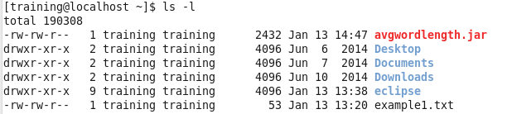
Hands-on Exercise

Slide 16
Abbreviation for nearby directories
. (dot)
Current working directory
..(two dots)
Directory above the one in which you are working (parent directory)
~ (tilde)
Home directory

