Slide 1
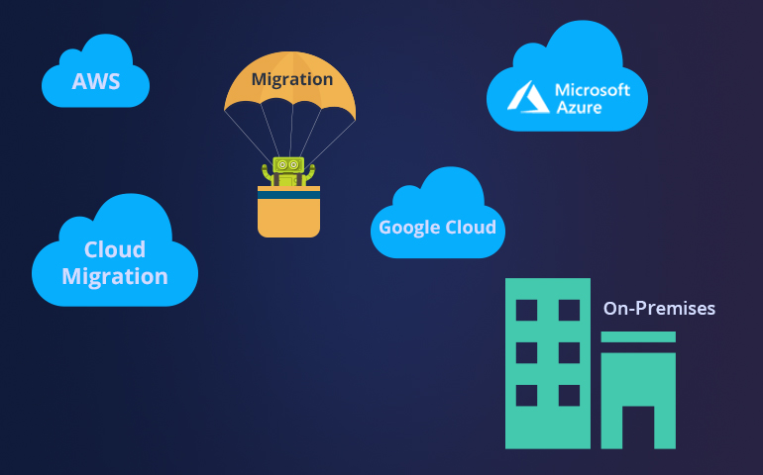
Azure Stack

Slide 2
DevSecOps Cloud Automation Tool
I
Automation

Slide 3
DevSecOps – All infra leads to Cloud
IaaC(Infrastructure as a Code) with Terraform
Kameswara Rao Pudi Solution Architect

Slide 4
Deploying Infrastructure to Cloud
Azure, Azure Stack: ARM Templates + PowerShell/Azure CLI & Terraform
AWS: CloudFormation & Terraform
 | ARM Templates | CloudFormation | Terraform
Configuration Format | JSON | JSON | HCL/JSON
State Management | Yes | No | Yes
Manage already created resources | Yes | No | Yes
Providers supported | Only Azure | Only AWS | 20+(Azure,AzureStack,AWS,GCP)

Slide 5

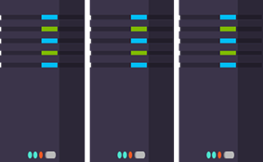
Terraform Write, plan and create infrastructure as code
Same workflow for all deployment scenarios across multiple clod providers.
Plan – what will happen?
Plan – what will happen?
Cloud
Change
Cloud
Write IaaC
Deploy
Deploy
Notes:
Terraform is an open source tool that codifies Azure ARM APIs into config files that could then be treated as any other source code: shared, versioned, and collaborated on. Note the parallel between application development and the operations space – this is exactly what Terraform allows you to do.

Slide 6

Environment Parity
DEV
Same Terraform Code
Replace Desired Environments
Speed Up Infra provisioning
NON PROD
OPS
PRODUCTION
DEV
OPS

Slide 7
DevSecOps Automation Tool: Infrastructure provisioning in Cloud using Terraform.
This tool used to build the infrastructure within public and private cloud. It consist of following components:
GitHub - Code repository(infrastructure provisioning & chef cookbooks for post configurations)
Jenkins – Continous Integration tool.
Terraform Enterprise - IaaC(Infrastructure as a code) configurations to provision secure infrastructure across multiple cloud providers.
Chef - Performs post configuration activities like security compliance(Antivirus installations and on-board local user accounts to CyberArk).

Slide 8
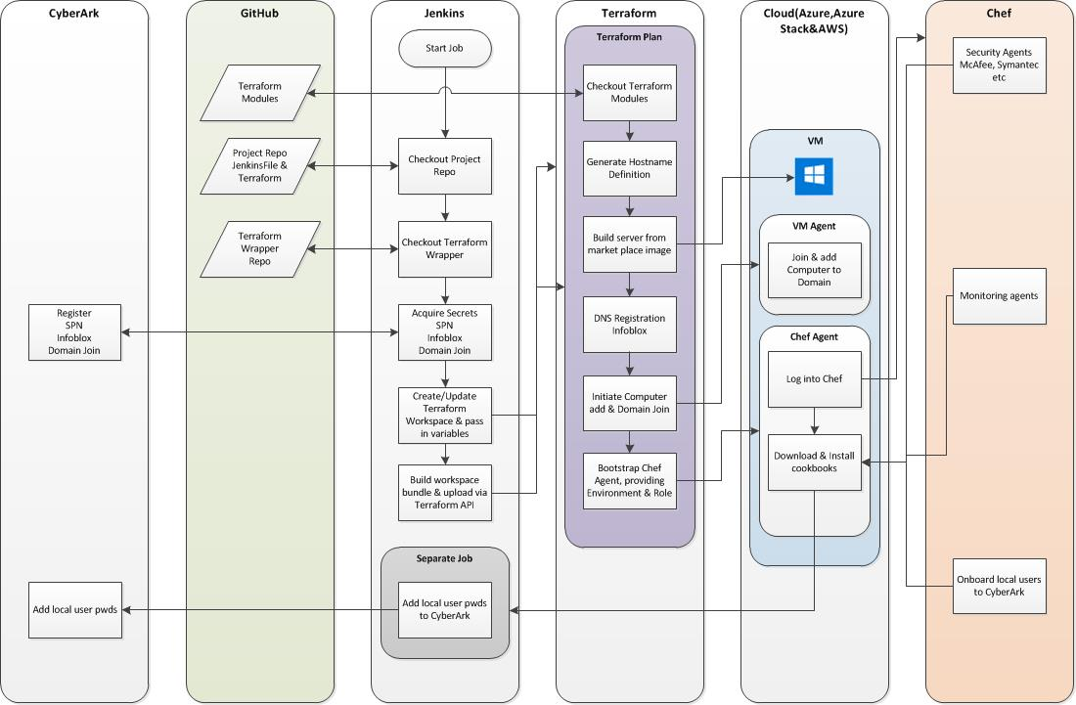
DevSecOps Cloud automation tool workflow for Infrastructure Provisioning and configurations

Slide 9
Questions?
(email kamesh.pudi@gmail.com )

