Slide 1



Cloud Automation
The business benefits
Notes:
Welcome to today’s presentation on Cloud Automation.
We are going to discuss the problems we currently face with our cloud services, what the real-world impact is.
We will propose a solution to these issues that, via automation, reduces manual effort, eliminates human error and guarantees consistency.

Slide 2



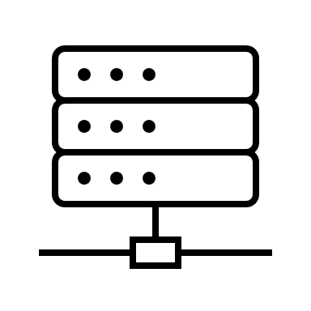
What’s the problem?
Manual processes can be error-prone
Low confidence – no guarantees of quality
Large QA team manually testing
Long lead time
Downtime & outages
Notes:
We deploy monthly updates to production. These updates contain new functionality for our customers and bug-fixes.
Statistics from the last 12 releases are not good. Only 2 went smoothly. 3 were rolled back as issues were found during the release, adding hours of downtime, and 7 went out to production and caused serious issues impacting our customers.
Why such poor stats? The way we deliver change is very manual. Developers are responsible for ensuring that changes are present in a build, testing is manual, the final deployment is manual. Manual steps mean opportunities for human error. Until now our approach has been to create more detailed documentation and whilst this helps it doesn’t completely remove the chances of mistakes, what it does do is slow down delivery. It now takes an average of 3 months for new features from start of development to successful delivery to production.
This is bad for our customers, bad for our reputation and bad for team morale.

Slide 3
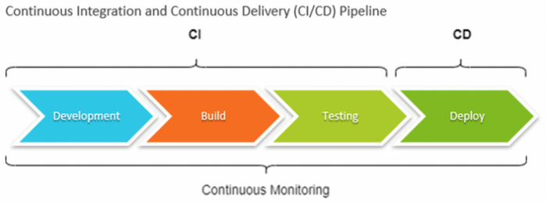
How does automation work?
Notes:
Automation removes manual steps from our delivery pipeline. How is this achieved?
Once a developer has completed a work item the changes are saved to our code repository and that triggers what’s known as a CI/CD Pipeline – Continuous Integration and Continuous Delivery, which is a series of automated steps:
After development the first step in the pipeline is “Build”, here the new code is use to create a new version of our product. Validity of the code is automatically checked here preventing invalid code from being incorporated.
Next the complete product is tested, automatically. Tests check all the individual components in isolation and working together. It’s a requirement of any new development that tests are added that validate the new behaviour. It’s crucial that whenever any problem is found that a test is added so we know it’s fixed and then it never recurs in future.
If all tests succeed then we have a working product that can be shipped. Again no manual steps needed. Deployment creates a new running service in the cloud, checks that it’s working and then automatically switches our customers over with zero downtime.
The pipeline is continuously monitored, alerting the development team as soon as any problem is detected. Any problems are fixed early on, which is what we want – the longer problems remain unnoticed the more expensive it is to remediate.

Slide 4
What will it cost?
Investment
Software licenses - $2k
2 developers for 1 month
Ongoing costs
Additional cloud servers ($200 / month)
Notes:
Setting up this automation isn’t free. There are up-font costs for the software of approximately 2k, plus monthly on-going costs to keep it running plus time and effort to get it all going.
We estimate that our two top developers can turn this around in a month.
The reduction in time spent by our development team no longer performing manual steps will more than cover these costs in the first month.

Slide 5

Real benefits for us and for our customers
Developers spend more time building new features
Faster time-to-market
Virtually zero down-time
Guaranteed quality
Aware of potential problems before they happen
Notes:
In summary,
We currently have many manual steps in delivering software. The manual nature makes things slow and error-prone.
Automation removes this, meaning we can deliver changes much more quickly.
Automated tested means we don’t waste time manually checking but still validate every product feature - no unexpected regression issues
Automated deployments into the cloud mean no downtime during the release and near instantaneous rollback in the unlikely situation that issues are spotted
Continuous monitoring of the pipeline means problems are detected as early as possible, before they become customer-impacting issues.

