Slide 1
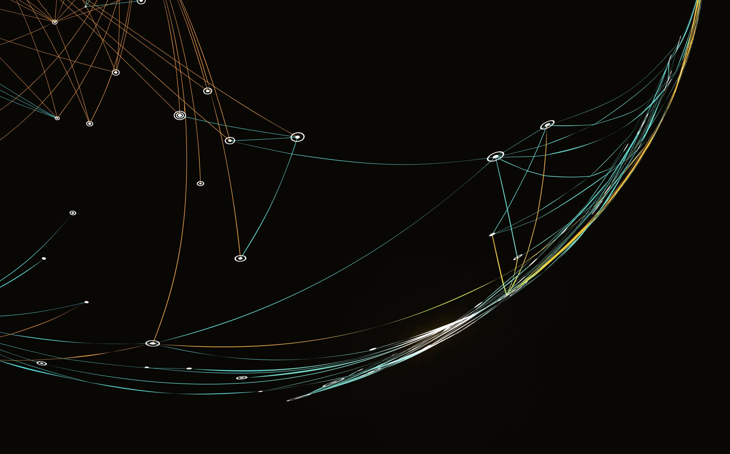
Licensing & Permitting:
Mining companies must secure several government approvals before operations begin. As shown in Rio Tinto’s Winu project:
They first obtain an Exploration License (e.g., License E45/4833) to legally explore the land for minerals.
They secure Miscellaneous Licenses for road access, camp setup, airstrips, and supporting infrastructure.
They then file a Mining Lease Application (e.g., M45/1288), which must receive formal government approval before extraction can start.
Exploration-BHP Example
Mining companies conduct early-stage exploration to identify viable mineral deposits. BHP states that in FY2024 it advanced exploration opportunities across Australia, Canada, Chile, Peru, Sweden, Serbia and the US, involving prospect testing and concept evaluation. The company spent US$457 million on exploration and resource assessment.
(Citations: BHP Annual Report 2024)
Extraction :
Extraction is the core operation where the mineral ore is physically removed from the earth through open-cut or underground mining. For example, BHP’s Mt Arthur Coal mine is permitted to conduct “extraction of up to 36 Mtpa of run-of-mine coal from underground and open-cut operations. BHP

Slide 2
Concentration of Ore (Beneficiation):
Mining companies process raw ore to increase metal grade before refining. This includes crushing, grinding, washing, flotation, and other beneficiation steps.
BHP states that iron ore is “crushed, beneficiated (where necessary) and blended at the processing hubs.”
(BHP Annual Report 2024)
Their glossary also notes that certain ores undergo “grinding/flotation concentration processes.”
(BHP Annual Report 2024)
Glencore reports operating “concentrator… beneficiation plants” in its industrial facilities.
(Glencore Sustainability Report 2023)
Rio Tinto indicates processing of ore (e.g., “ilmenite mined… processed in Canada”), a key beneficiation step.
(Rio Tinto Annual Report 2024)
Mineral Refining (Smelting / Hydrometallurgy):
Refining converts concentrated ore into pure metal through smelting, solvent extraction, or chemical processing.
BHP defines “Smelting — the process of extracting metal from its ore by heating and melting,” and also highlights solvent extraction for metal separation. (BHP Annual Report 2024)
Glencore describes its industrial operations as involving “processing of minerals and metals”, which includes refining.
(Glencore Sustainability Report 2023)
Rio Tinto reports ore being processed into refined mineral feedstocks (e.g., ilmenite → TiO₂ feedstock).
(Rio Tinto Annual Report 2024)
Transportation & Logistics (A Core Mining Operation)
After concentration and refining, mining companies must transport minerals to ports, customers, smelters, or processing plants. This includes large-scale rail, road, conveyor, pipeline, and shipping operations. For example:
Rio Tinto describes transporting ore from multiple mine sites to processing hubs and port export terminals.
(Rio Tinto Annual Report 2024)

Slide 3
Major Expenses of a Mining Company (Rio Tinto Example)
Mining companies incur high costs across operations. According to Rio Tinto’s 2024 Annual Report, significant expense categories include:
Energy costs, which contributed to EBITDA movement
(Rio Tinto Annual Report 2024)
General inflation and operating cash unit costs, which increased the cost of mining, processing and labour
(Rio Tinto Annual Report 2024)
Exploration and evaluation expenditure for discovering and developing new mineral resources
(Rio Tinto Annual Report 2024)
Employee compensation, including short-term benefits and share-based payments
(Rio Tinto Annual Report 2024)
Capital expenditure, such as purchases of property, plant and equipment (US$9.6 billion in 2024)
(Rio Tinto Annual Report 2024)
Based on BHP’s Annual Report 2024, the major operational expenses in mining include:
External contractor services
Tailings management work
Maintenance costs
Stripping and overburden removal costs
Contractor labour costs
Other operating expenses linked to mine productionOther operating expenses linked to mine production
These cost items are clearly identified when BHP states:
“Total expenses excluding net finance costs of US$36.8 billion increased … due to higher external contractor services, additional tailings work, higher maintenance, and higher stripping and contractor costs.”
(BHP Annual Report 2024)

Slide 4
Task-2
5 major impact are –
Groundwater contamination
Induced seismicity
Land subsidence
Water usage & depletion
Toxic waste & tailings risk

Slide 5
Impact | Mitigation Plan
Groundwater Contamination & Aquifer Disruption- Deep-earth drilling can intersect freshwater aquifers, creating leakage pathways. Heavy metals, drilling fluids, and saline water may migrate into groundwater. Pressure imbalance at 20 km depth can cause aquifer mixing and loss of potable water. | Preventive Design 3D hydrogeological mapping to identify aquifers. Directional drilling to avoid sensitive water-bearing zones. 2. Closed-Loop Drilling & Containment Fully sealed closed-loop drilling fluids system (zero discharge). Dual-casing + cement grouting to isolate drilling pathways. Built-in leak detection sensors for instant containment. 3. Real-Time Monitoring & AI Prediction Sensor-based monitoring wells around the site (pH, conductivity, pressure). AI anomaly detection to predict leaks before they spread. Automatic well shut-off + packer seal activation.
Induced Seismicity Due to Geomechanical Stress Imbalance Ultra-deep mining (up to 20 km) can disturb natural stress fields in the crust. Drilling and rock removal may transfer stress to nearby faults, causing small earthquakes. Repeated pressure fluctuations can trigger micro-seismic swarms. | Pre-Mining Geomechanical Stress Mapping 3D seismic surveys + rock stress modelling to identify fault lines & stress hotspots. Create no-drill exclusion zones around unstable geological features. 2. Controlled Drilling & Pressure Management Maintain stable borehole pressure to avoid abrupt rock failure. Use slow-rate drilling when approaching stress-sensitive zones. 3. Micro-Seismic Sensor Network Install a ring of high-sensitivity geophones around the mine site. Continuous monitoring of micro-earthquake frequency, magnitude, and depth. Build a threshold-based alert system that pauses drilling when activity spikes. 4. AI-Based Seismic Prediction & Active Stress Balancing
Land Subsidence & Surface Deformation Removal of large rock volumes at 20 km depth may create underground voids. Over time, the roof of these cavities may collapse, causing gradual sinking or surface cracking. This deformation can affect infrastructure, forests, farmlands, and community settlements. | Subsurface Void Management & Backfilling Immediately backfill extracted zones with hydraulic backfill, cemented paste, or waste rock. Use high-strength engineered backfill to maintain structural stability. 2. Controlled Extraction Sequence Mine using a staggered sequence to avoid creating large unsupported voids. Use “pillar-and-room” or “sub-level stoping” designs adapted for extreme depths. 3. Surface & Subsurface Stability Monitoring Install GPS-based surface displacement sensors (mm-level accuracy). Use InSAR satellite imaging to detect early ground movement.

Slide 6
Task-3 – here I calculated the optimal depth for location a,b and c . I can for the few depth . I will make assumption of depth 8 for the task 4 for the location A.

Slide 7
Horizon | Location | Optimal depth | Profit(B usd/ton)
5(2030) | A | 2 | 1408.4
10(2035) | A | 4 | 3447.2
15(2040) | A | 8 | 9644.6
5(2030) | B | 6 | 3438.24
10(2035) | B | 10 | 3007.7
15(2040) | B | 12 | 5734.6
5(2030) | C | 4 | 824.6
10(2035) | C | 4 | 1905.9
15(2040) | C | 4 | 2908.6

Slide 8
Task 4- assume depth 8 and location A
For this task I will choose the top 7 minerals:
Lithium
Lead
Zinc
Chromium
Tin
Antimony
Cobalt

Slide 9
TASK5-
I would treat this as a multi-period portfolio optimisation problem for Location A. First,I compute per mineral margins vs depth then define a few operating modes (shallow/mid/deep) and rank minerals by margin and demand growth. Using an optimisation model with decisions on depth per phase and ore quantity per mineral per year, I design a phased plan: shallow high-margin mining in the first 5 years, expansion into deeper, high-grade minerals in 5–10 years, and an optional deep-mining phase in 10–15 years if price scenarios justify it. The model is rerun periodically as market conditions change, so the strategy is dynamic, not static.

