Slide 1
















Acoustic Adaptation Hypothesis (AAH)
P1 AAH
Mean Peak Frequency
Mean Peak Frequency
$$f_{peak}$$
Habitat Structural Complexity
Agriculture
Regeneration
Old-growth
Recovery Gradient

Slide 2
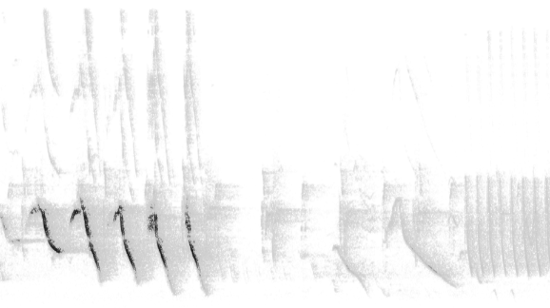

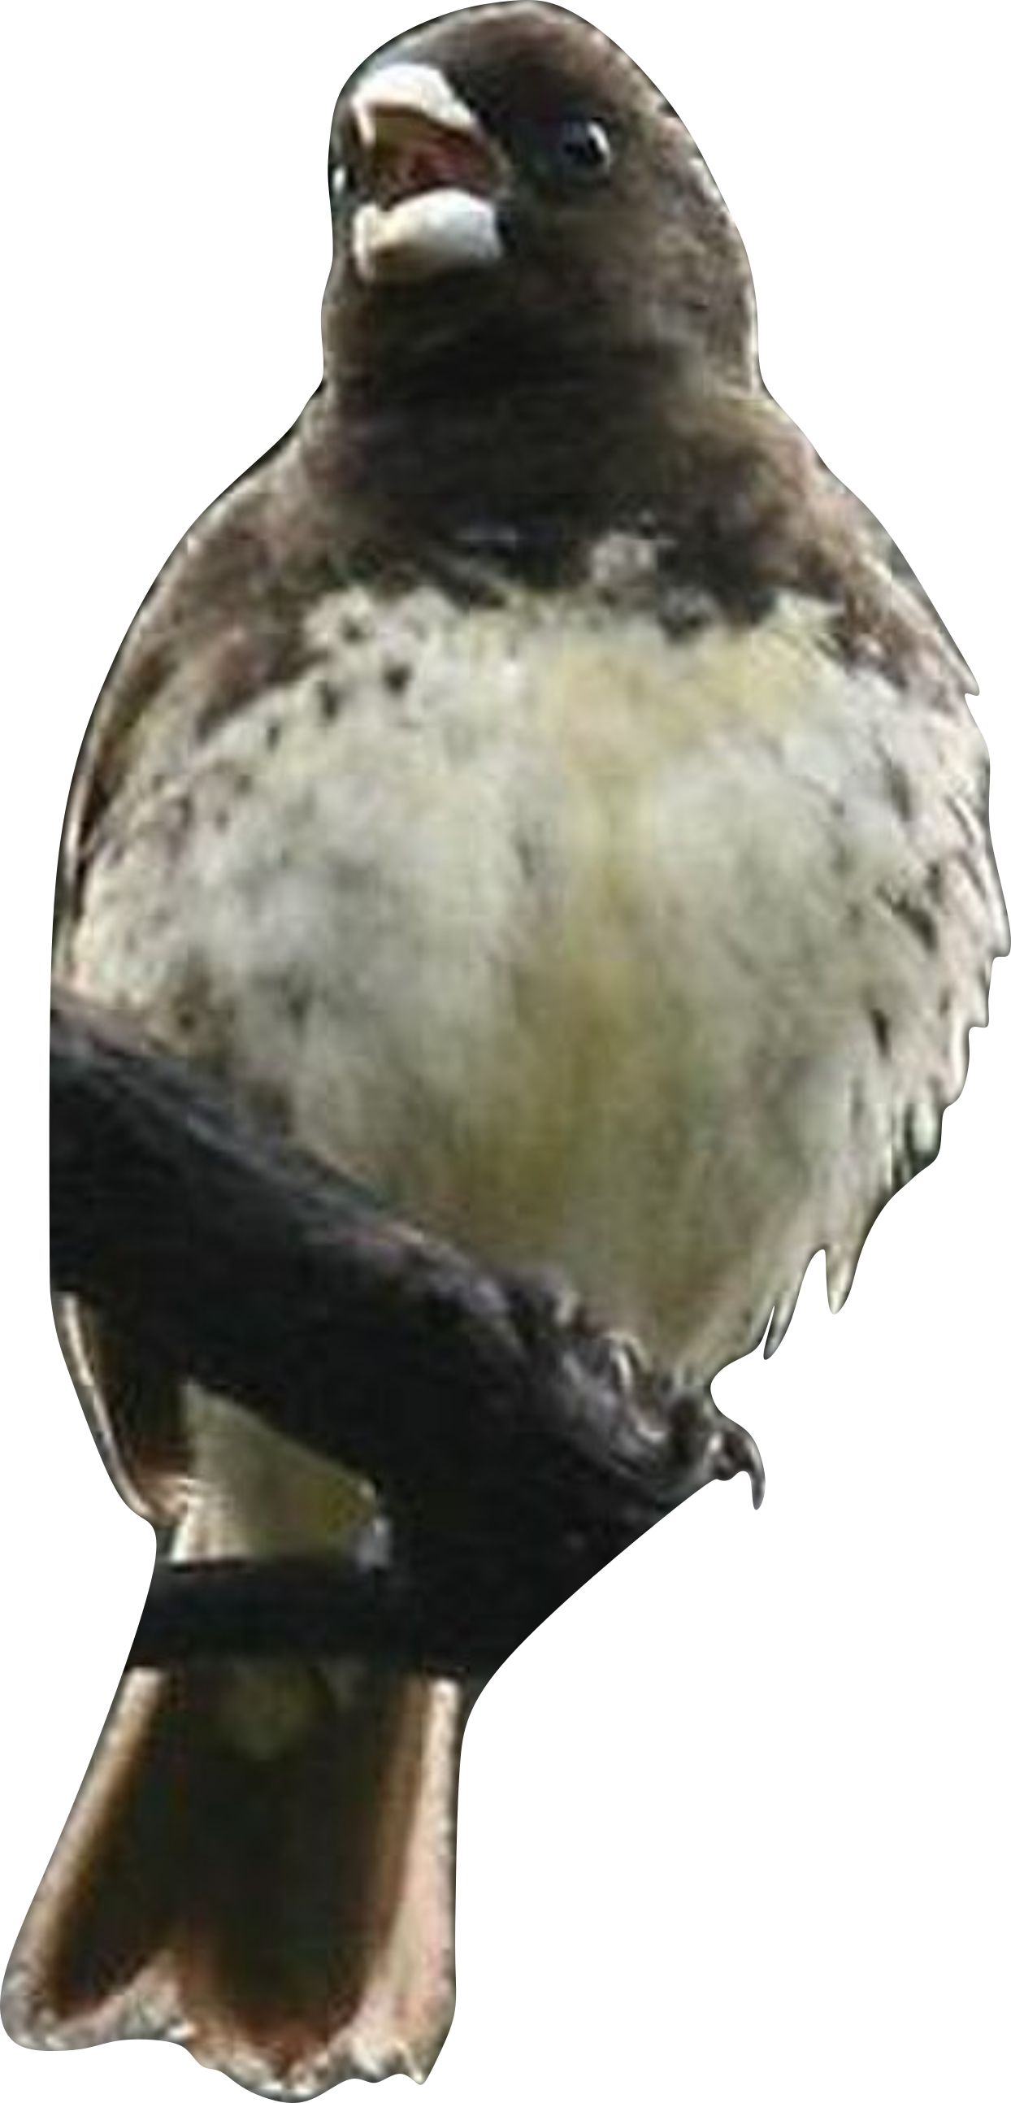
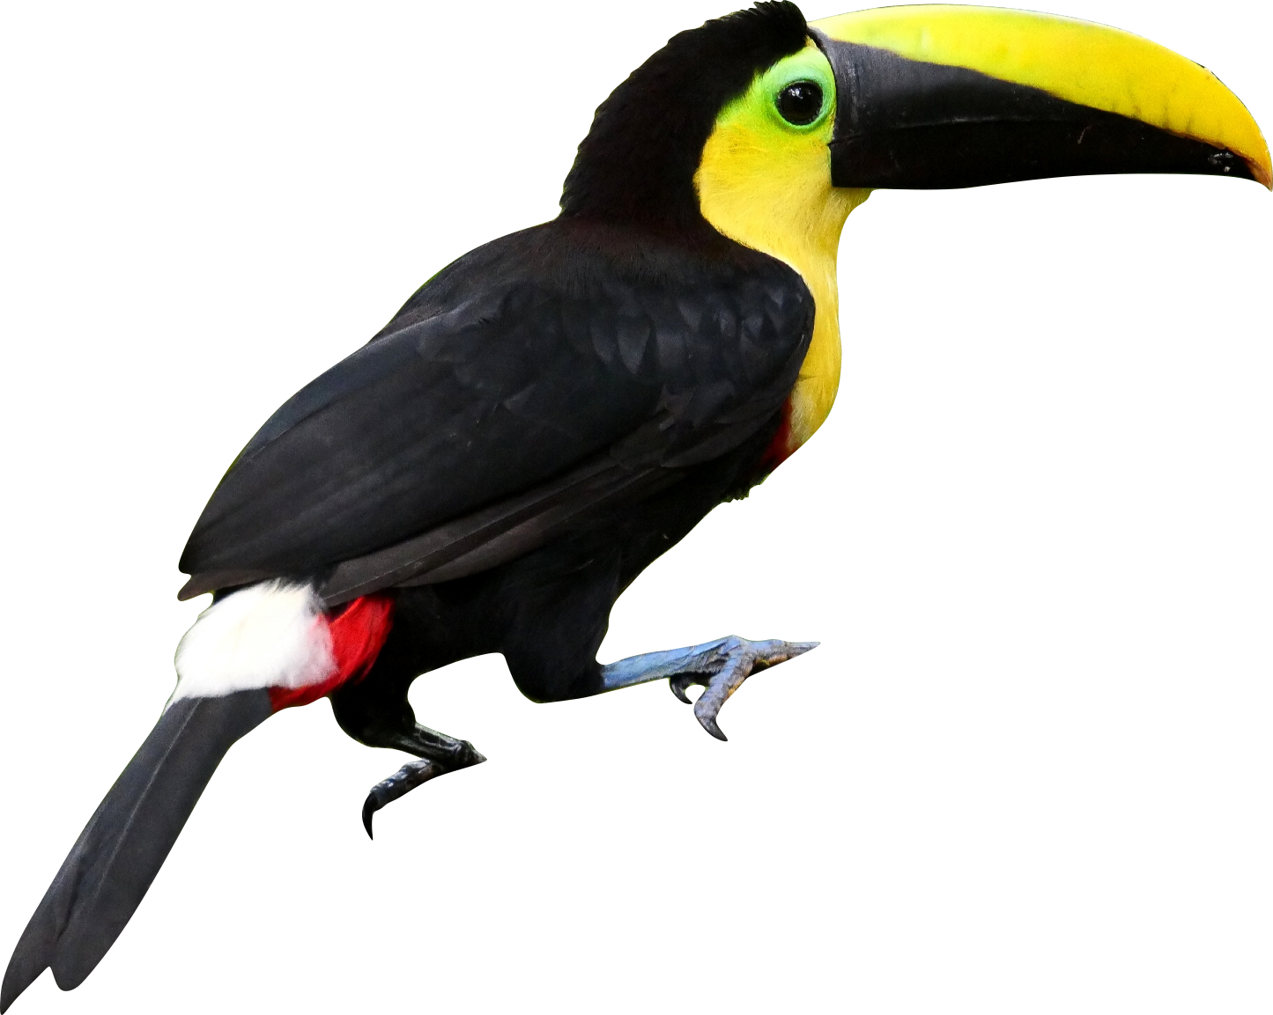



Acoustic Niche Hypothesis (ANH) – Spectral Partitioning
P3 Evolutionary ANH
Co-occurrence Type
Spectral
Niche A
negative
positive
$$f_{peak}$$
Frequency
Peak Frequency Distance
Spectral
Niche B
$$f_{peak}$$
Time
Agriculture
Regeneration
Old-growth
Recovery Gradient

Slide 3
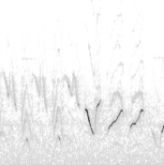
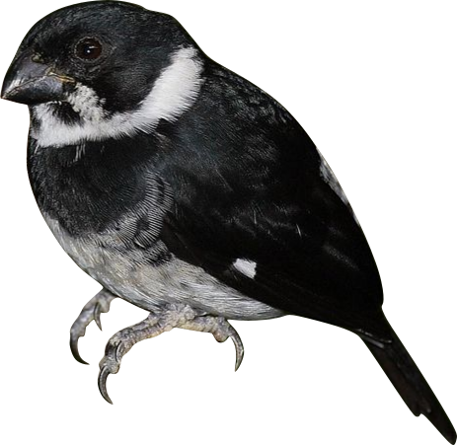


Acoustic Niche Hypothesis (ANH) – Temporal Partitioning
P2 Pattern-level ANH
Co-occurrence Type
negative
positive
$$f_{peak}$$
$$f_{peak}$$
Frequency
Proportion
Temporal Niche A
Temporal Niche B
Time
Agriculture
Regeneration
Old-growth
Recovery Gradient

