Slide 1
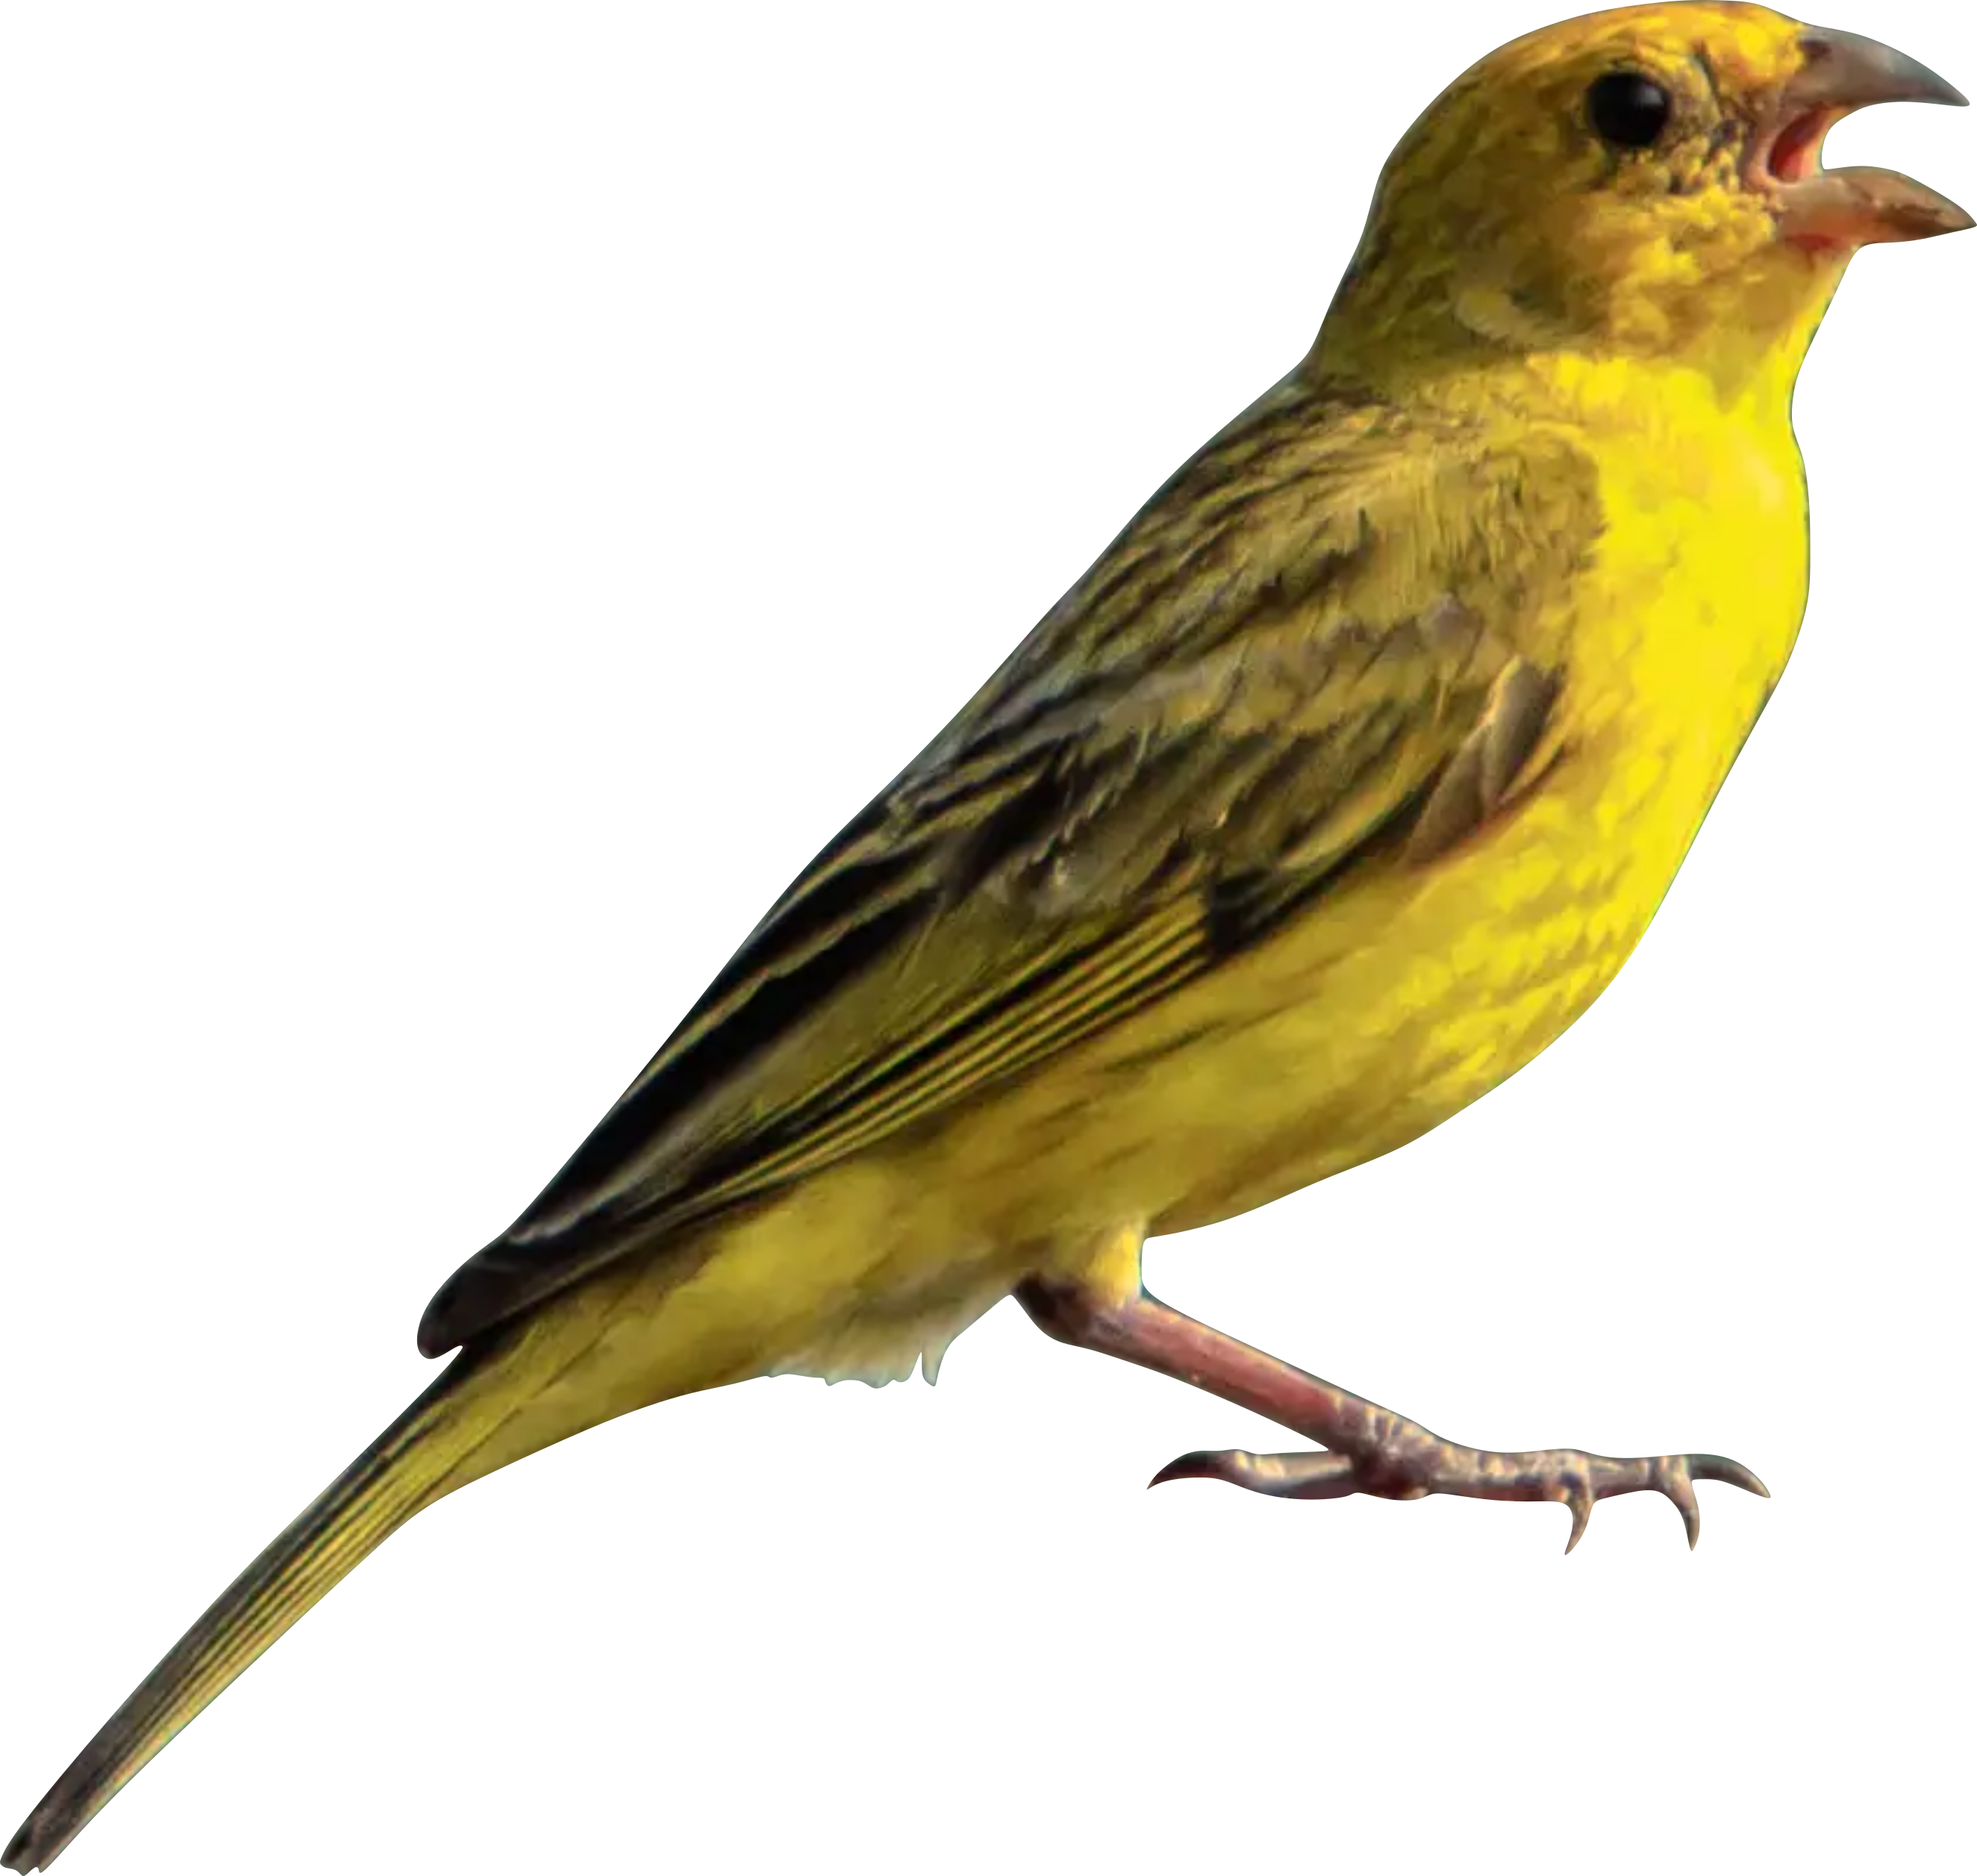
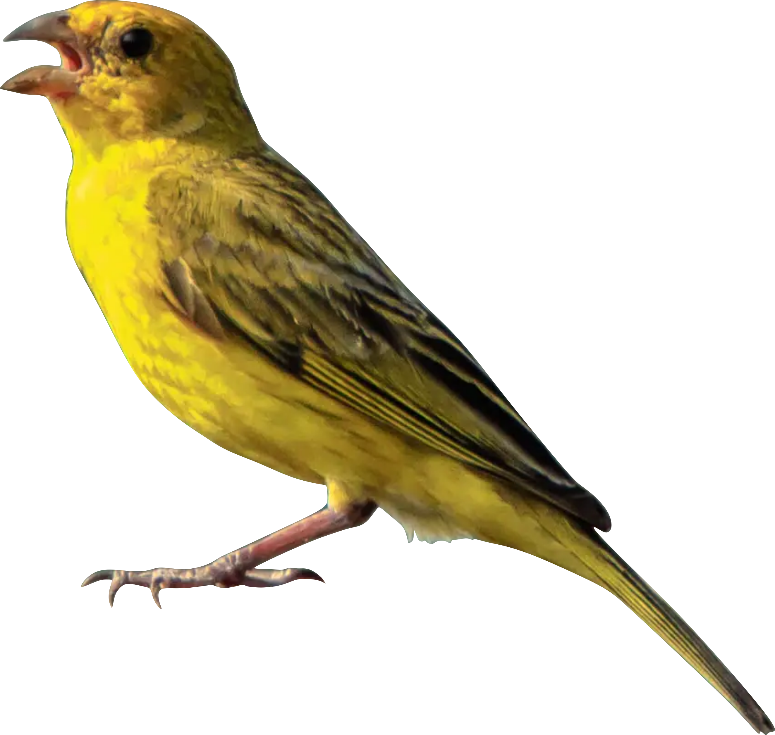
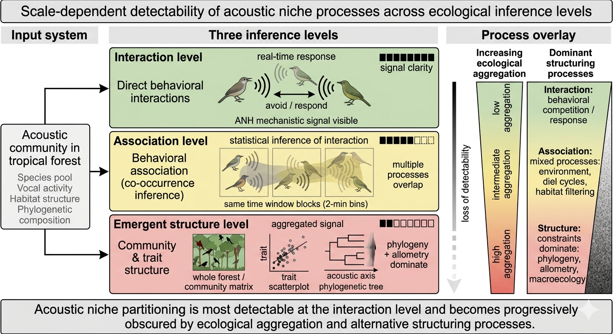
Emergent structure level
Signal clarity
Environmental structure & constraints
Allometry
Phylogeny
Aggregated community signal
Acoustic community
Association level
Detectability
Species pool
Vocal activity
Habitat structure
Phylogenetic composition
…
Ecological Aggregation
Inferred association patterns
Interaction level
avoid / respond
Direct interaction

