Slide 1
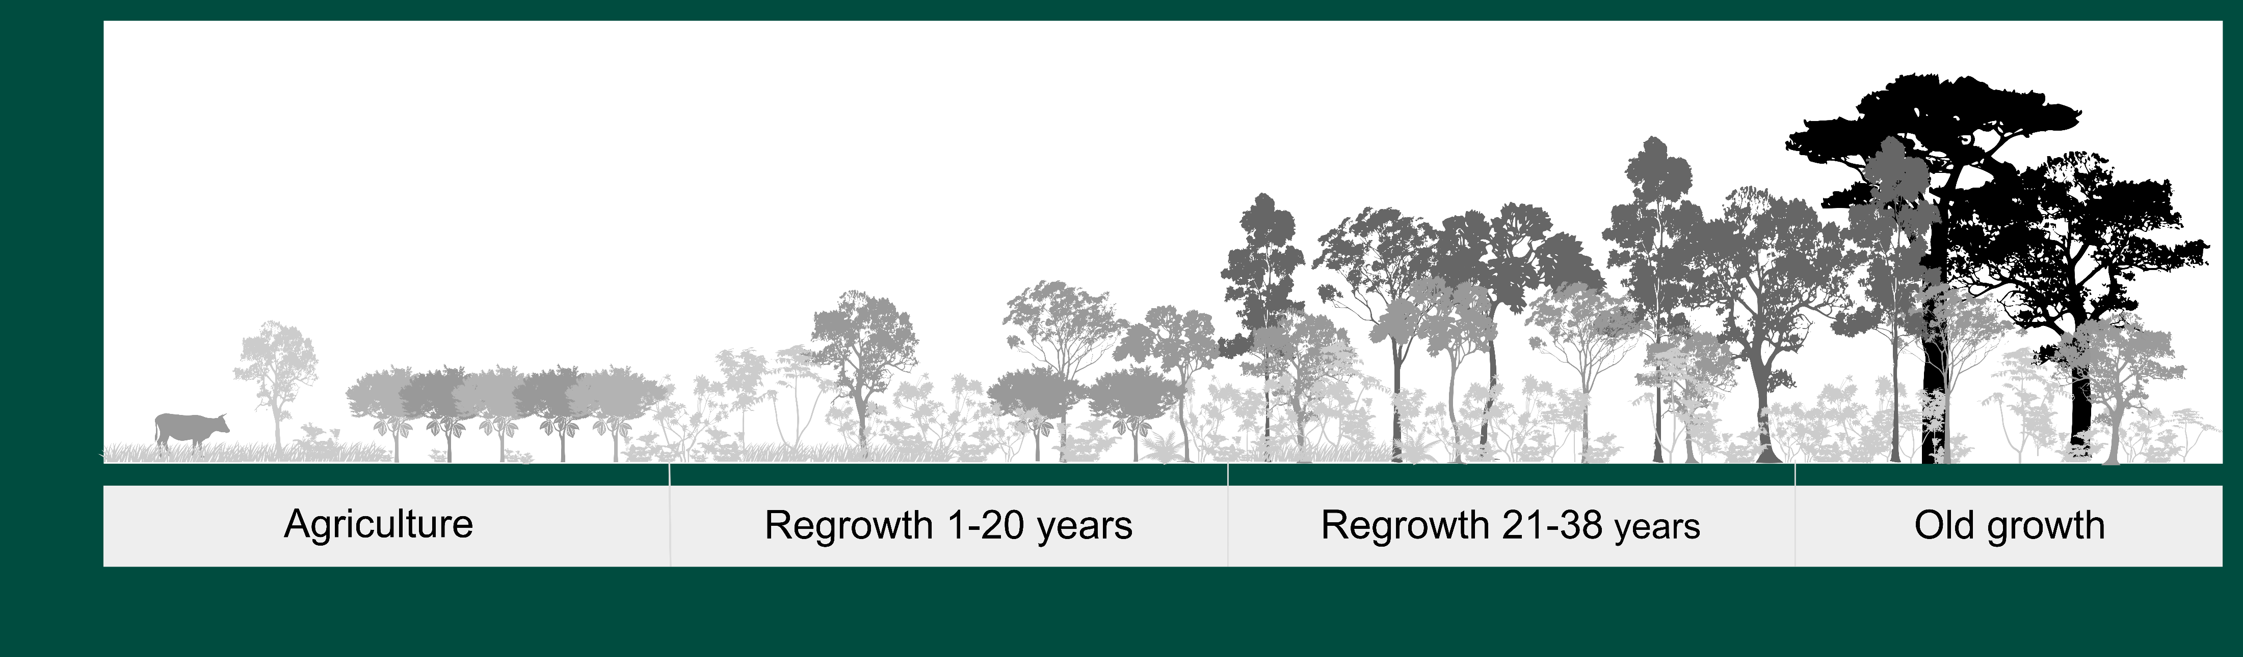
Mean Peak Frequency
Successional Stage (Habitat Density)

Slide 2


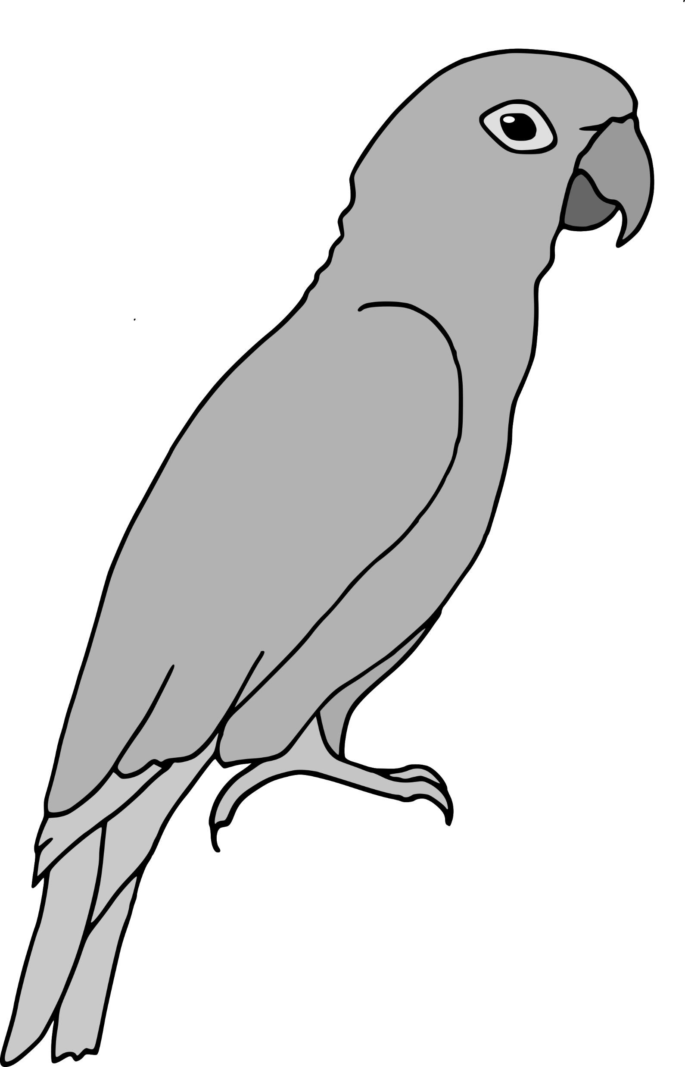
Peak Frequency
Peak Frequency
Time

