Slide 1
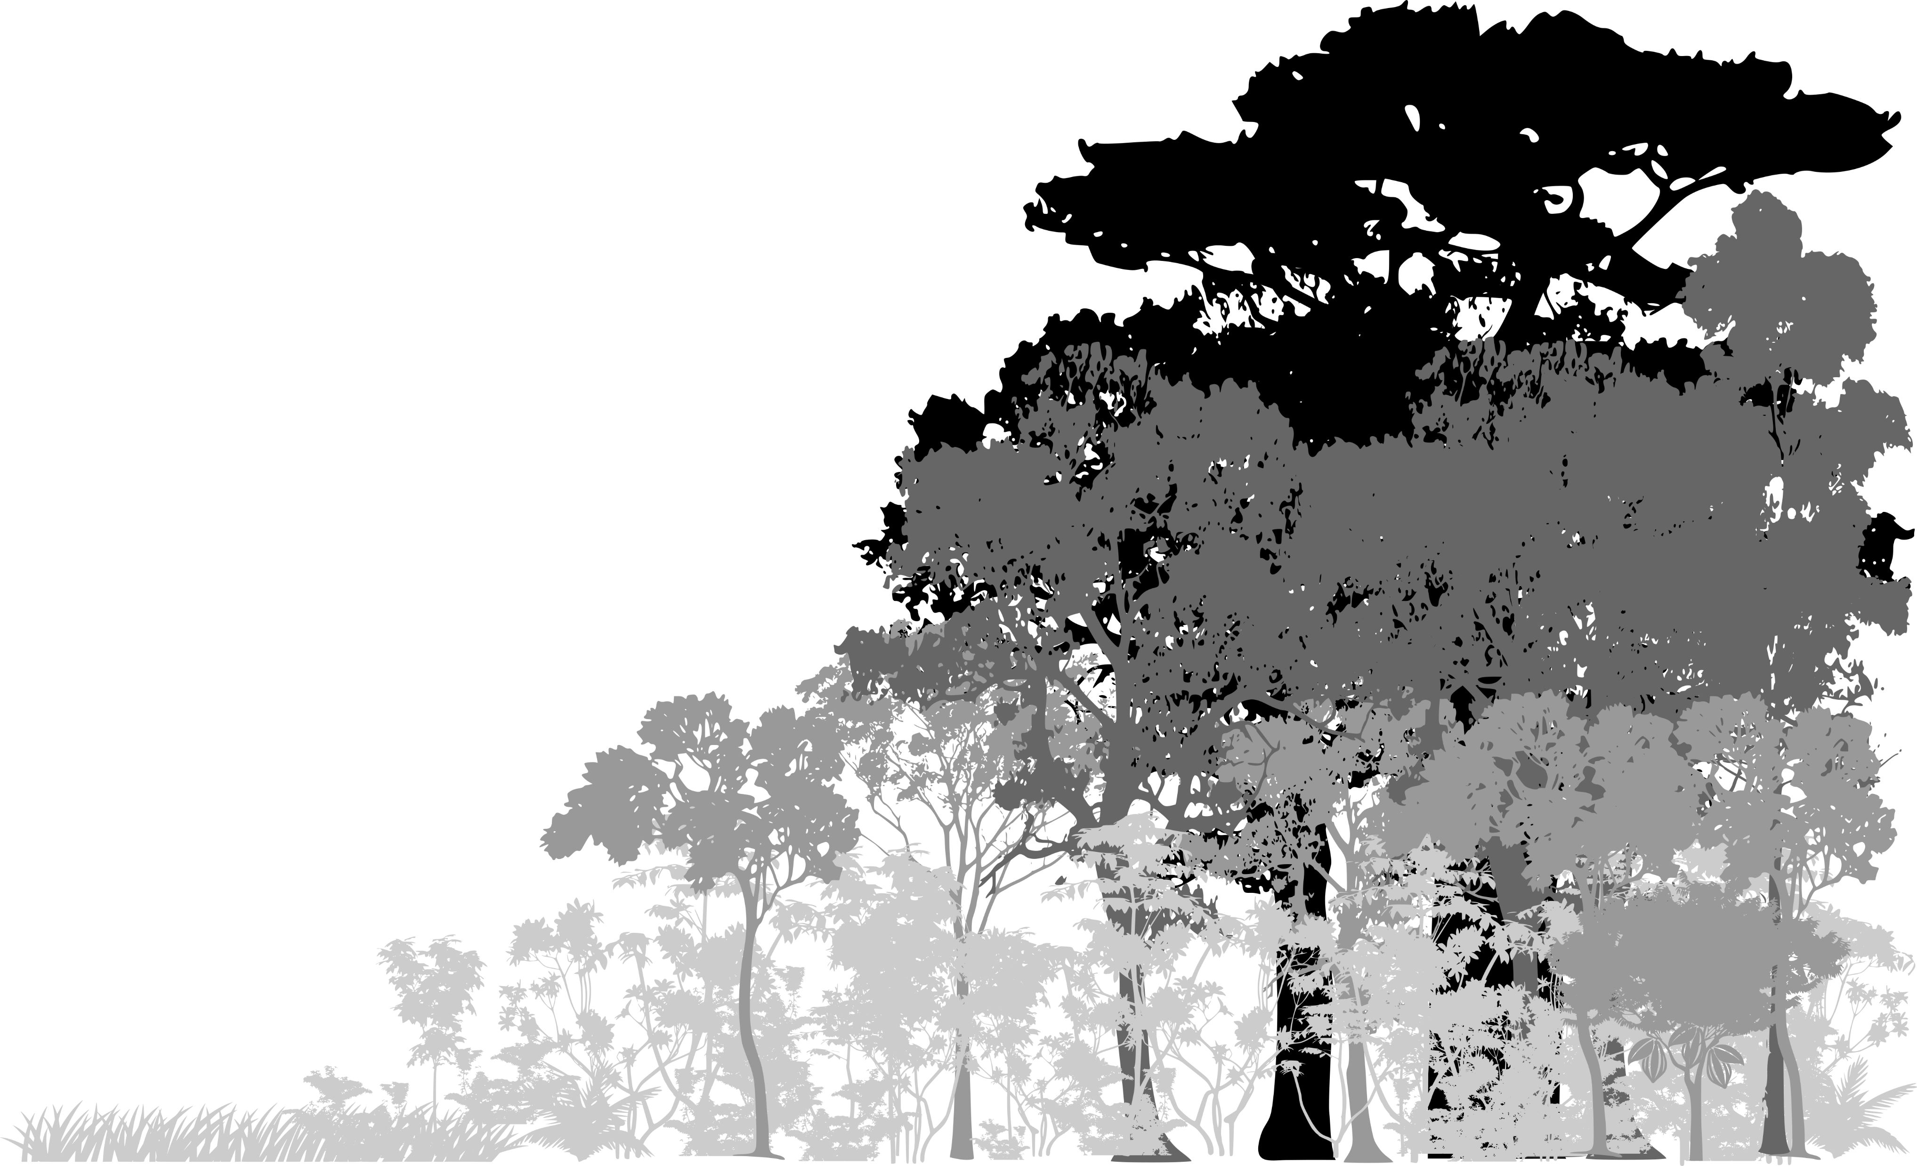
Acoustic Adaptation Hypothesis (AAH)
Mean Peak Frequency
Open
Habitat Density
Closed

Slide 2
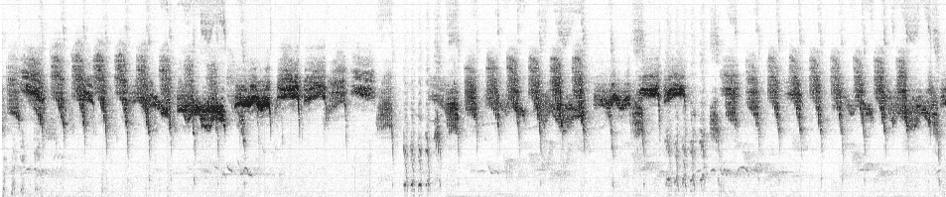
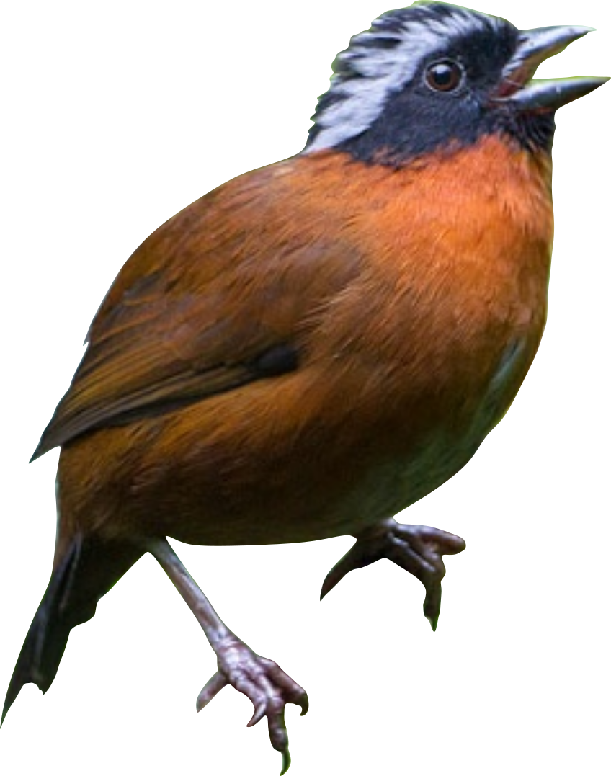
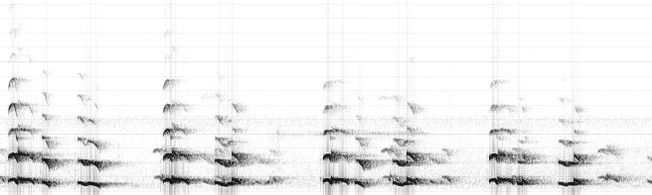



Acoustic Niche Hypothesis (ANH) – Spectral Partitioning
Spectral
Niche A
$$f_{peak}$$
Frequency
Spectral
Niche B
$$f_{peak}$$
Time

Slide 3
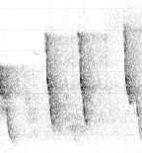
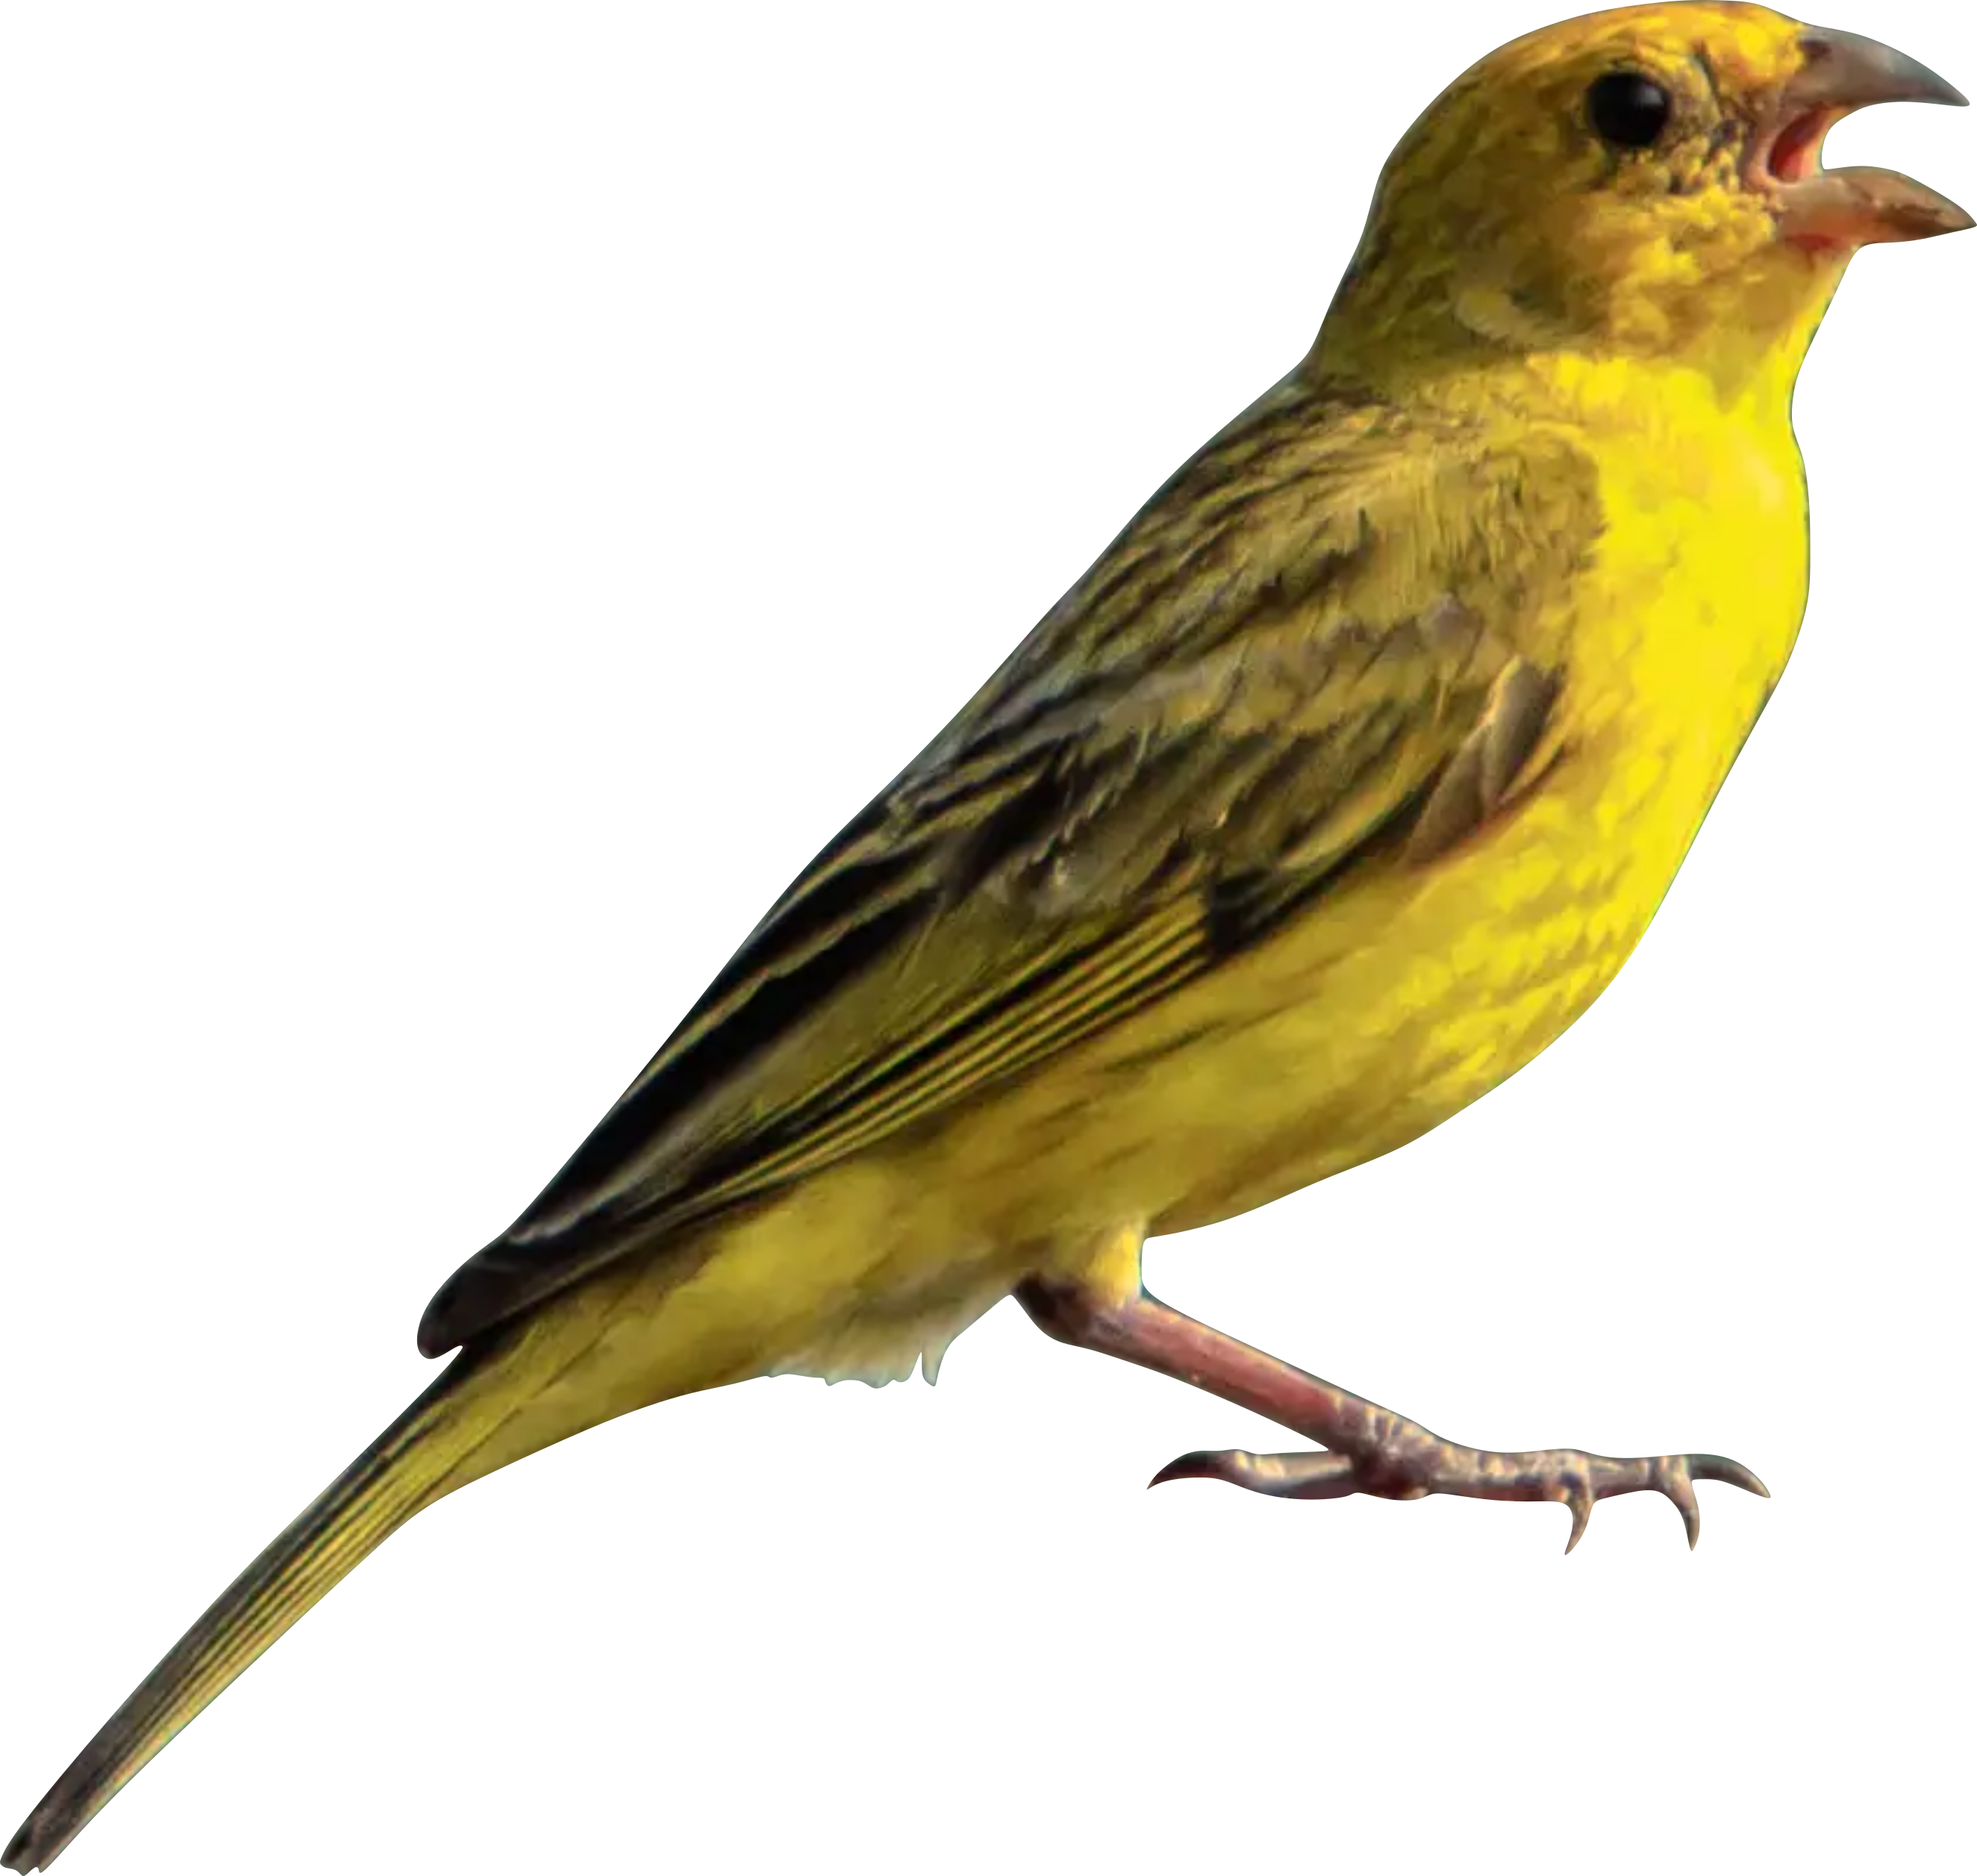

Acoustic Niche Hypothesis (ANH) – Temporal Partitioning
$$f_{peak}$$
Frequency
Temporal Niche A
Temporal Niche B
Temporal Niche A
Time

