Slide 1
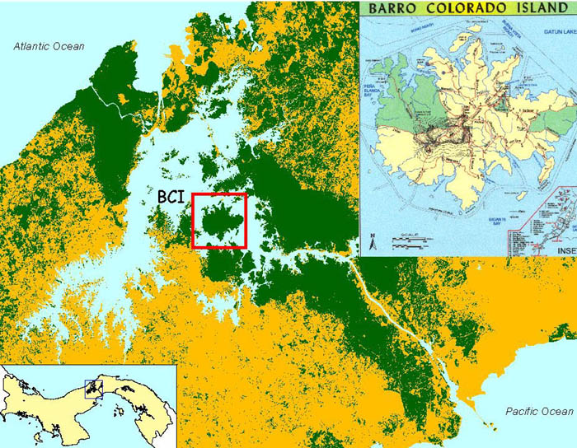
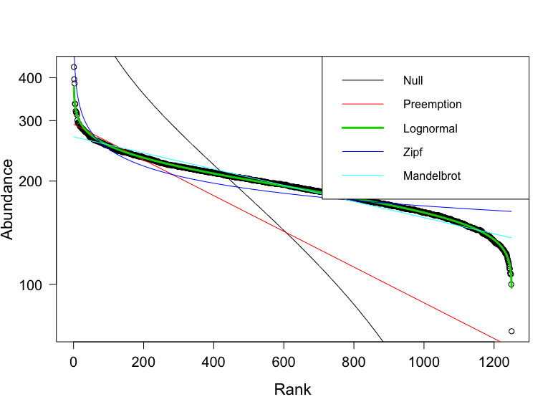
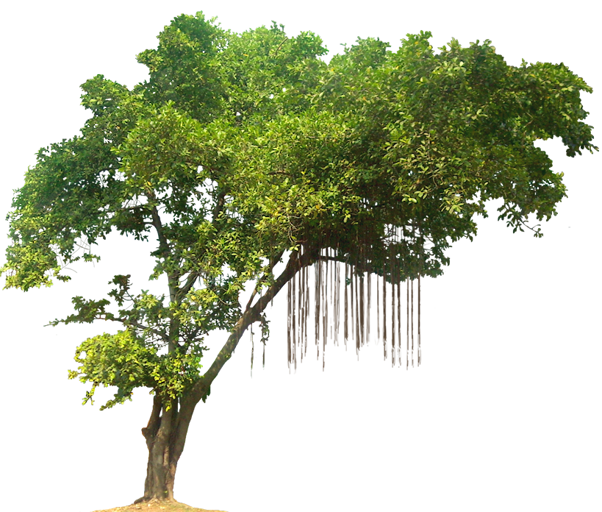
Co-occurrence of tree species in a small tropical island setting
BCI, Panama
Census year 2010
# Species: 297
Extent: 50 hectares
Grain: 20 X 20 meters
# of Quadrats: 1250
Coverage: 0.75 – 0.99
Species 1 | Species 2 | Emp.co | Exp.co | > | </= | mean | sd | p-value
Adelia triloba | Adelia triloba | 8 | … | 999 | 1 | 5 | 1 | 0.001
Adelia triloba | Alseis blackiana | 3 | … | 500 | 500 | 3 | 1 | NS
Adelia triloba | Aspidosperma spruceanum | 7 | … | 999 | 1 | 4 | 1 | 0.001
Alseis blackiana | Calophyllum longifolium | 1 | … | 650 | 350 | 2 | 1 | 0.5
 |  |  | * generated from 999 simulations
Top four abundant species:
H. prunifolius = 37,077
F. occidentalis = 27,467
D. panamensis = 12,911
T. tuberculata = 12,266
Neutral Theory
Notes:
Question: Do species in BCI co-occur with each other or conspecifics more than randomly expected? Do highly abundant species in BCI co-occur with other highly abundant species?
Background: Hubbell (2001) developed the unified Neutral Theory of Biodiversity to explain the diversity and abundances of species in ecological communities by assuming per capita ecological equivalence among all individuals of every species in the same trophic level. NT acts as a null hypothesis for niche-theory by stripping away the complexity and asking: How much of the patterns of ecological communities assembly is explained by species similarity rather than differences? Hubbell (2006) argues that ecological equivalence is thought to easily evolve in high diversity, dispersal and recruitment limited communities, like BCI. In a highly complex environment, species do not evolve or evolves slowly due to low pairwise encounters frequencies between any two species (Hubbell 2006). So this idea of species co-occurrence is central to the fundamental assumptions of NT and we aim to explore if indeed this co-occurrences between species on BCI is just by random change.

