Slide 1

Air Quality Meter
Team We Have Idea

Slide 2
Idea
Problem: Air Pollution
Solution:
  Improve air quality by raising awareness
  Let people see there local air quality to inspire them to try to improve it
  Uses public data from Scottish Government

Slide 3
Project Management
We used a Kanban board to manage splitting up the tasks and keep track of what needs doing.
We each worked on a different bit of the project, using git and GitHub to collaborate
We made sure to comment our code to keep it readable.

Slide 4
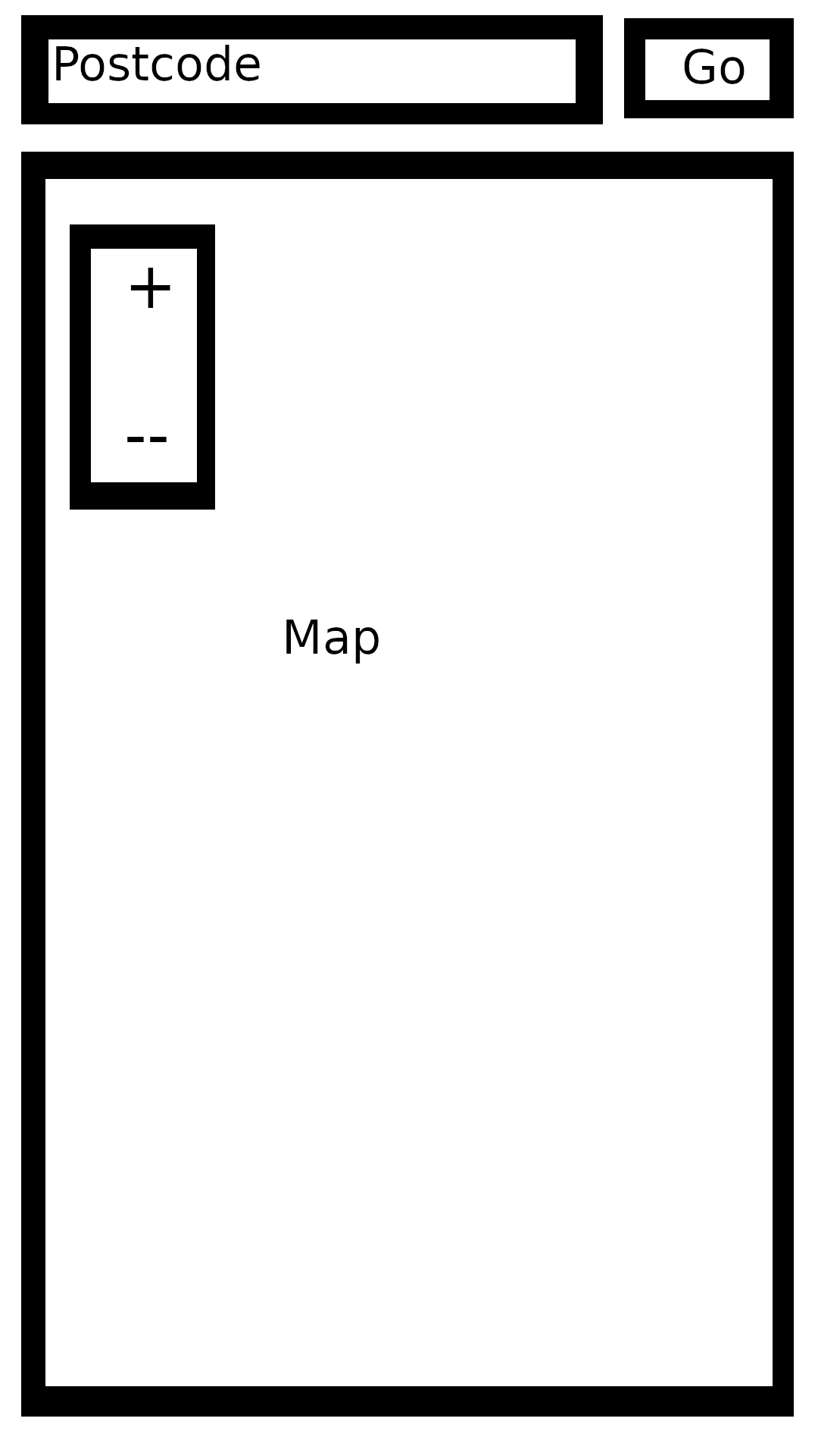
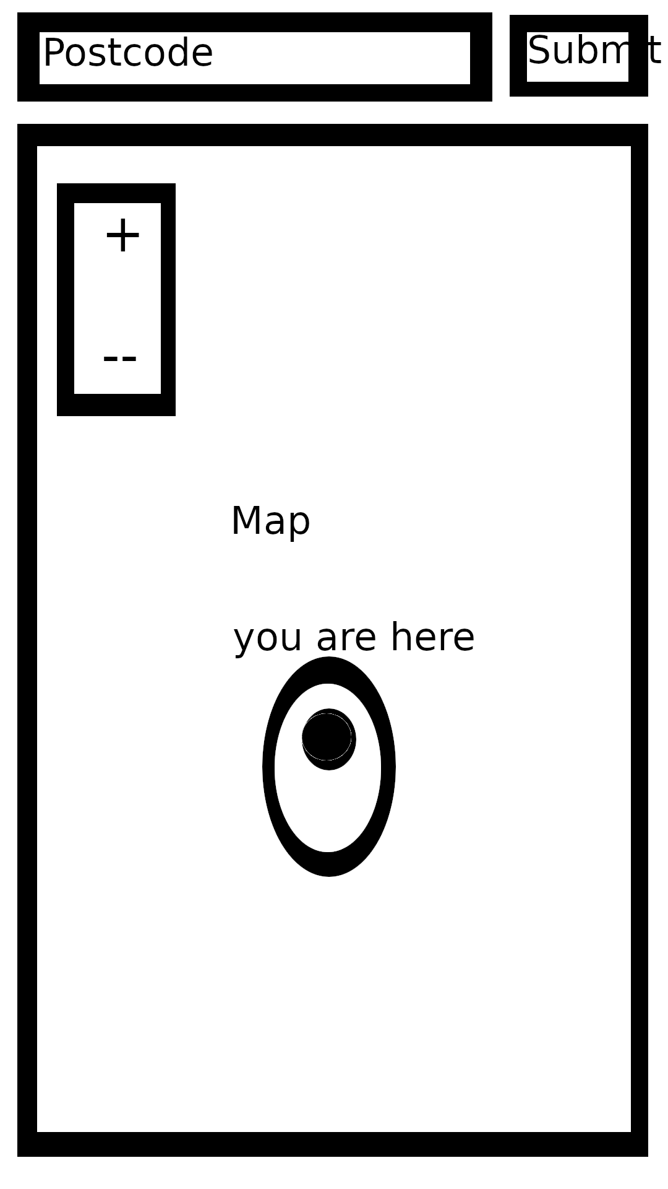
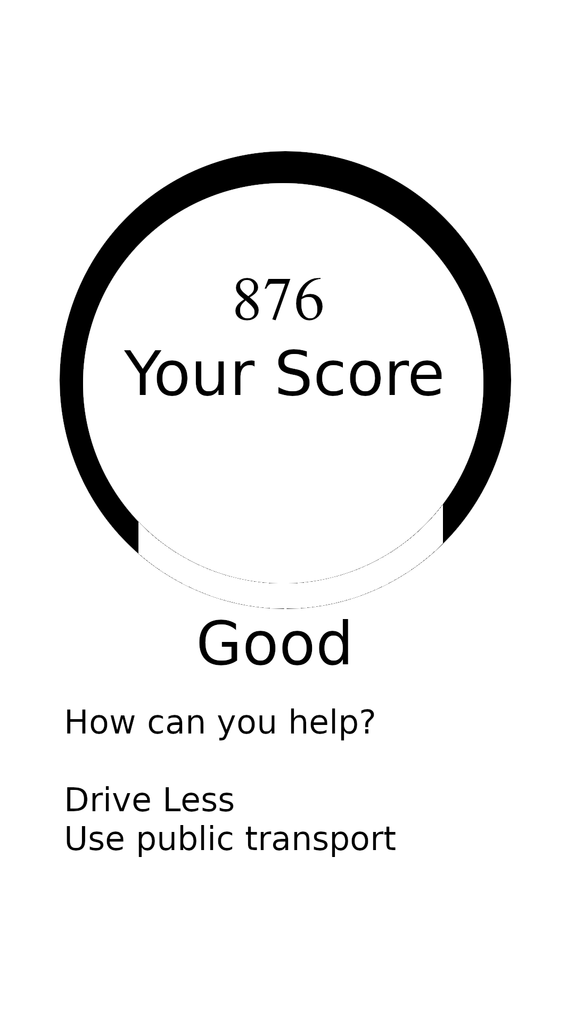
UI Design

Slide 5
UI Design
We designed our web app to be simultaneously good looking and easy to use.
Our target audience is people concerned about them or their families health

Slide 6
Architecture
Software
  Python
  Nginx
  JavaScript
  CSS
  HTML

Slide 7
Demo and Questions
There will now be a short demo
Future Ideas
  Calculating quality of your commute
  Setting up monitoring stations at your house

Slide 8
Air Quality Meter
Thank you
Team We Have Idea

