Slide 1
SP AI Applied ML CA1
Kami Cheung

Slide 2
Objective
Create a set of slides with the highlights of your Jupyter notebook report.
Explain the entire machine learning process you went through, data exploration, data cleaning, feature engineering, and model building and evaluation. Write your conclusions.

Slide 3
A. Classification, Titanic dataset
Data exploration, data cleaning, feature engineering, and model building and evaluation. Write your conclusions.

Slide 4
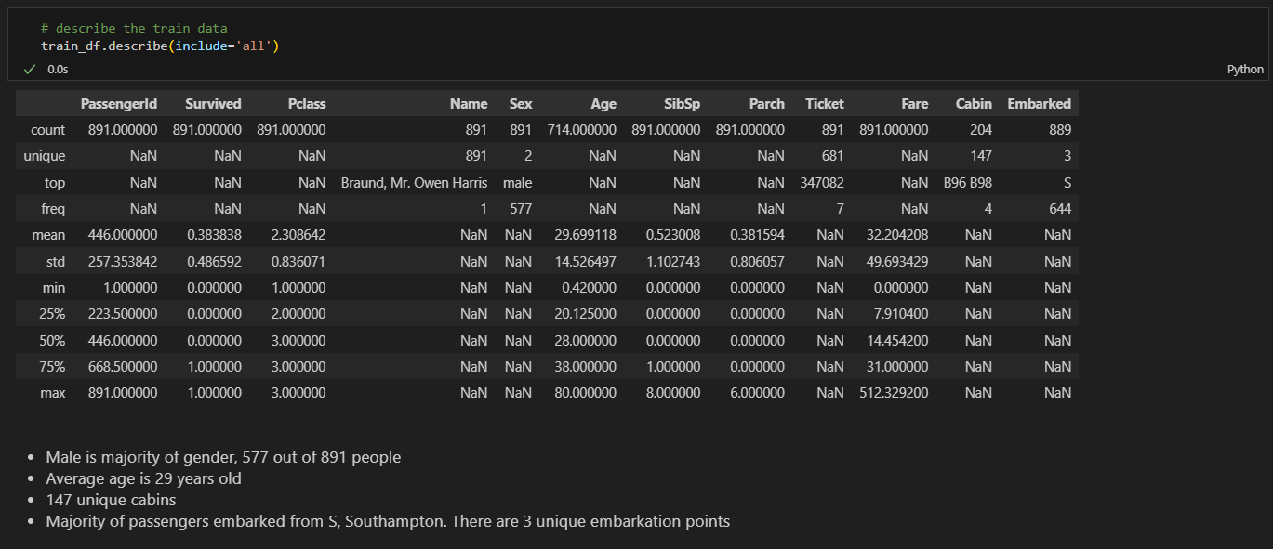
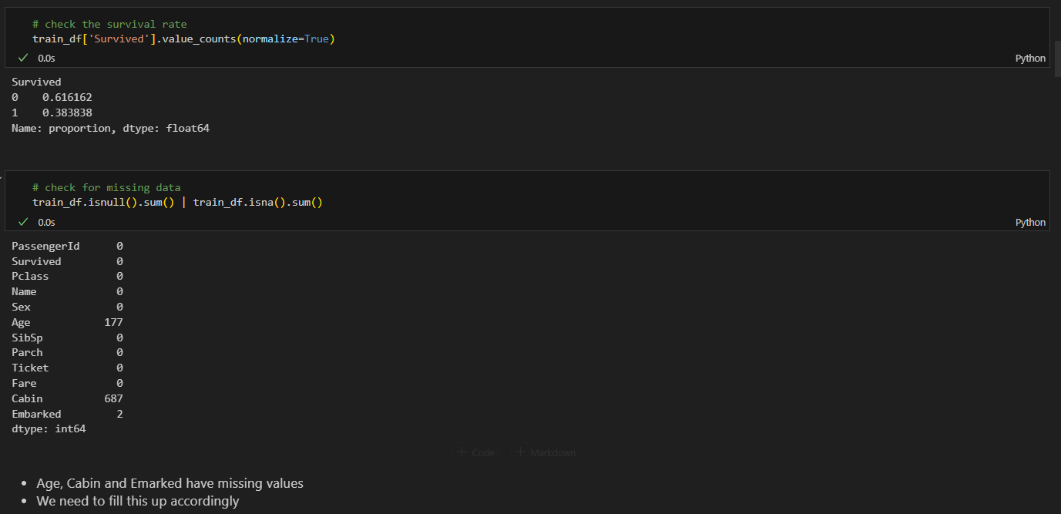
Data exploration

Slide 5
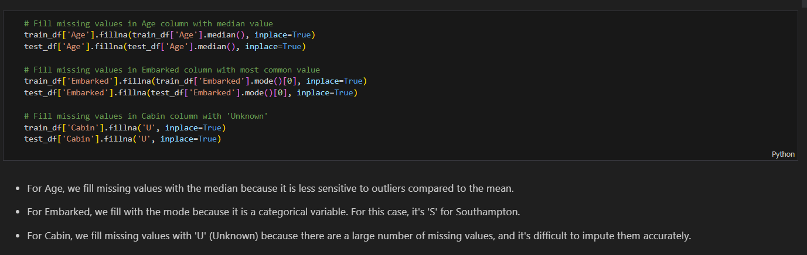
Data processing

Slide 6
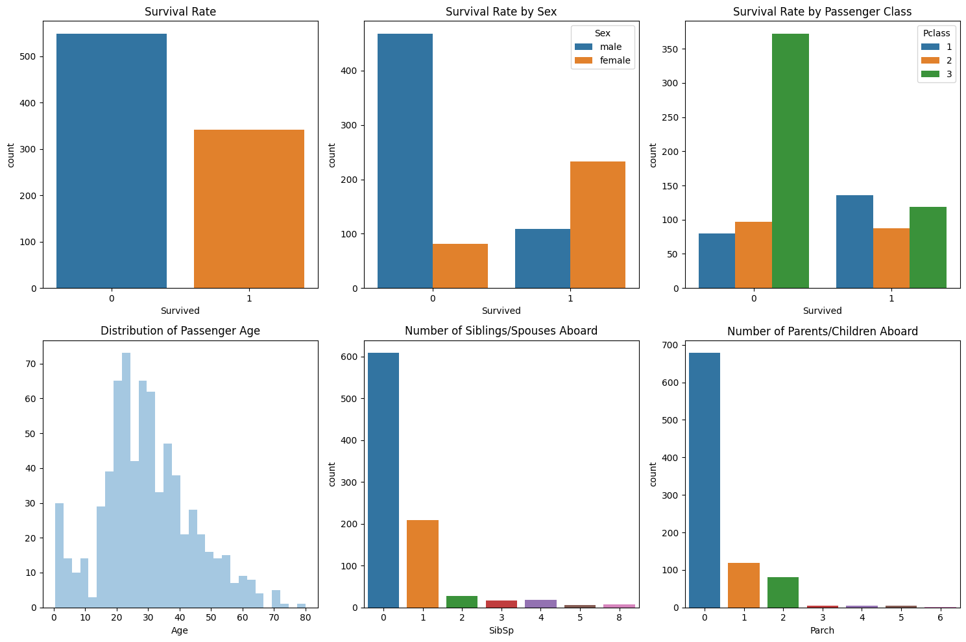
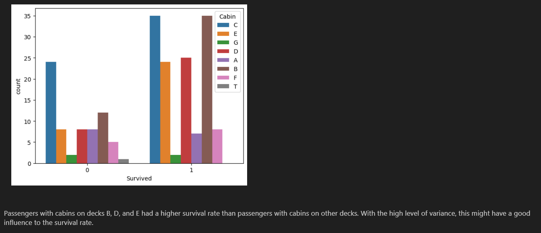
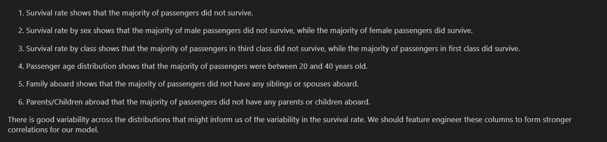
EDA

Slide 7
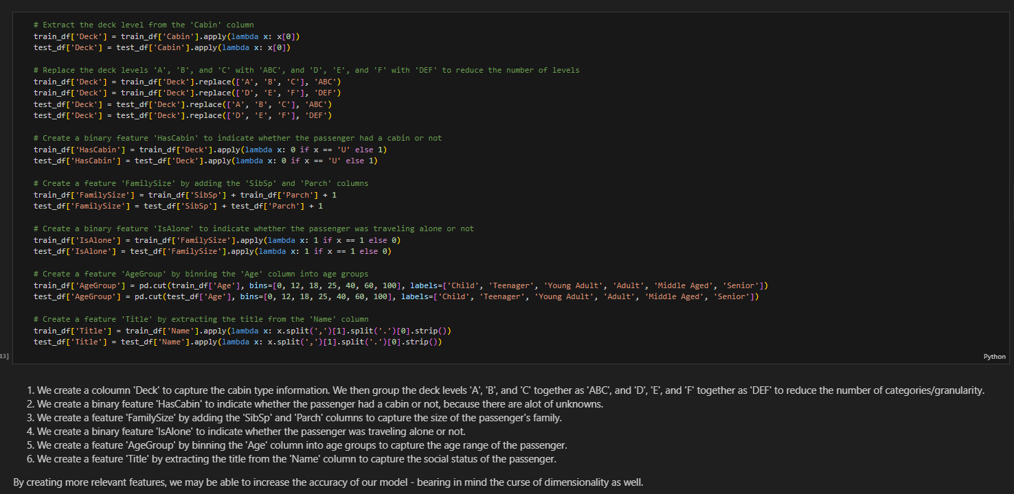
Feature engineering

Slide 8
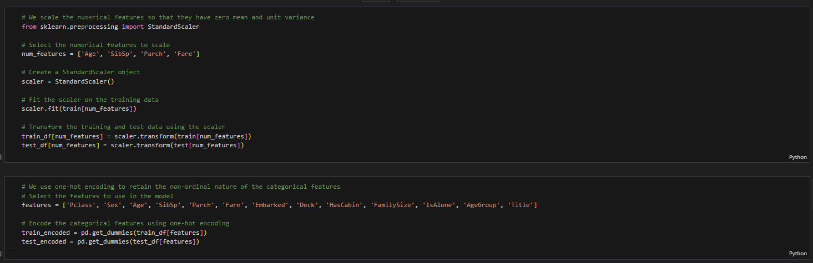
Scaling and encoding

Slide 9
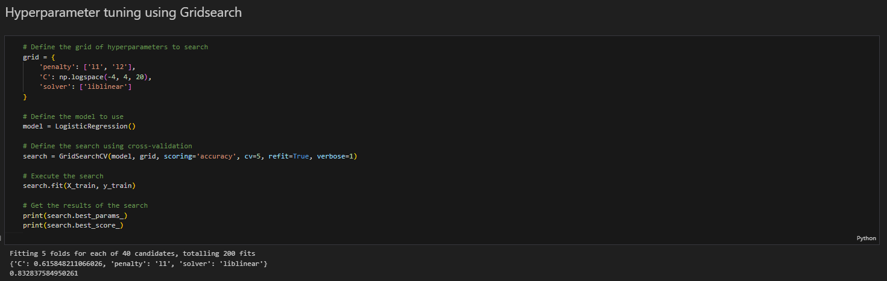
Hyper-parameter tuning

Slide 10
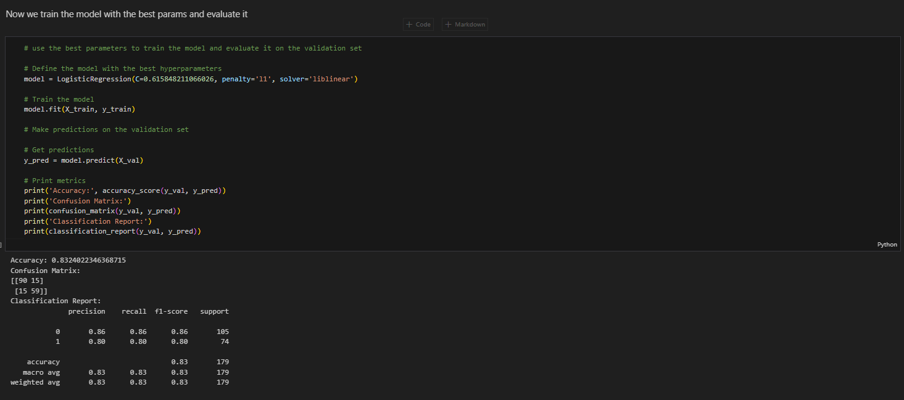
Results

Slide 11
Conclusion
Accuracy: the accuracy score is 0.832, which means that the model correctly predicted the survival status of 83.2% of the passengers in the validation set.
Confusion matrix: the model correctly predicted that 90 passengers did not survive and 59 passengers did survive, but it incorrectly predicted that 15 passengers did not survive when they actually did, and 15 passengers did survive when they actually did not.
Classification report: The precision represents the percentage of correct positive predictions made by the model, while the recall represents the percentage of actual positive cases that were correctly identified by the model. The F1 score is the harmonic mean of precision and recall. In this case, the precision and recall for the 'not survived' class (0) are both 0.86, while the precision and recall for the 'survived' class (1) are both 0.80, respectively. The weighted average F1 score is 0.83, which means that the model has a good balance between precision and recall for both classes.
Overall, the results show that the logistic regression model with the best hyperparameters has an accuracy score of 0.832, which means that it correctly predicted the survival status of 83.2% of the passengers in the validation set.
With feature engineering and hypertuning, there was a 3.35% accuracy improvement from baseline model, however there was a 5% improvement for F1 for people who did survive which is a good improvement of performance as majority of people did not.

Slide 12
B. Regression, Titanic dataset
Data exploration, data cleaning, feature engineering, and model building and evaluation. Write your conclusions.

Slide 13
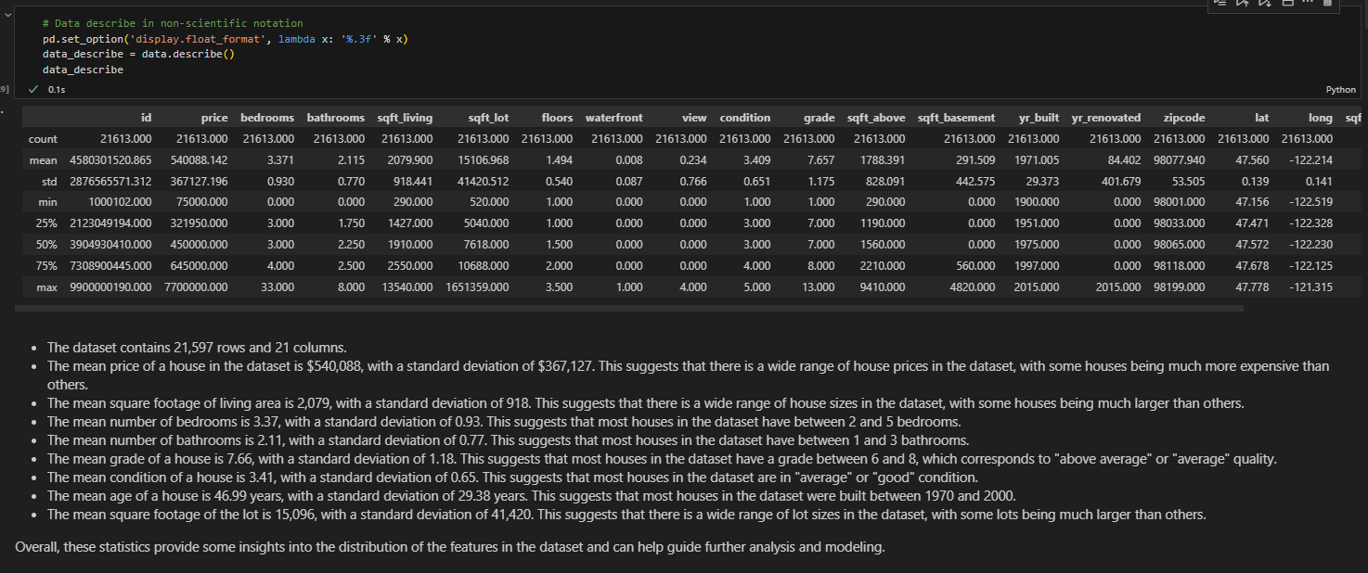
Data exploration

Slide 14
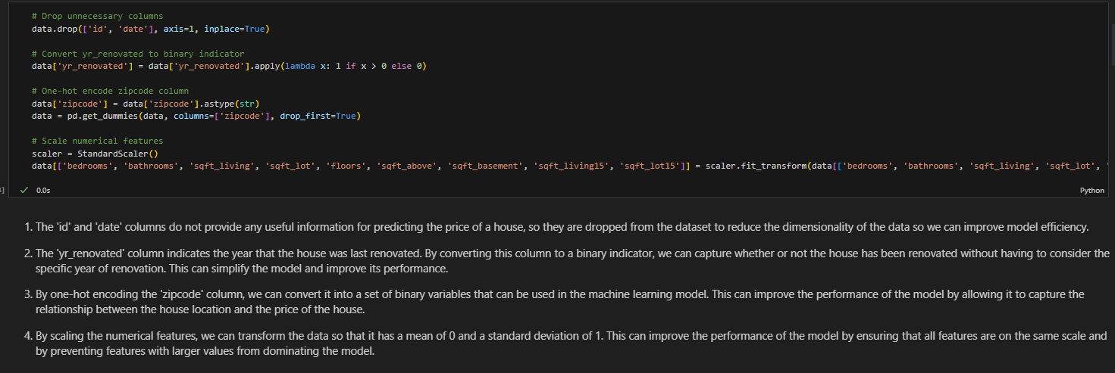
Data processing

Slide 15
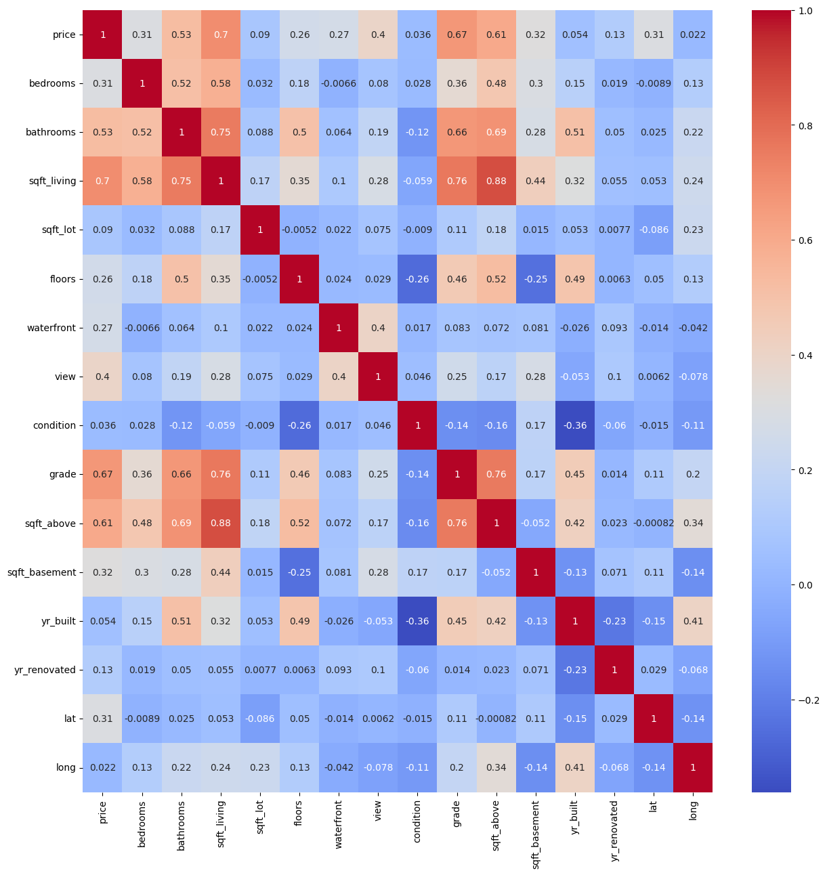
EDA
There are several features that are strongly correlated with the target variable 'price'. For example, the 'sqft_living' feature has a strong positive correlation with 'price', which means that as the square footage of the living area increases, the price of the house tends to increase as well. Similarly, the 'grade' feature has a strong positive correlation with 'price', which means that as the overall grade of the house increases, the price tends to increase as well.
On the other hand, there are also several features that are negatively correlated with 'price'. For example, the 'age' feature has a negative correlation with 'price', which means that as the age of the house increases, the price tends to decrease. Similarly, the 'condition' feature has a negative correlation with 'price', which means that as the overall condition of the house decreases, the price tends to decrease as well.
Overall, these strongly correlated features can help guide model prediction - and we should feature engineer from these columns to improve accuracy.

Slide 16

Feature engineering

Slide 17
Model selection: XGBoost does best
Linear Regression:
Mean Squared Error: 22554059775.708694
Root Mean Squared Error: 150180.09114296307
Mean Absolute Percentage Error: 19.946037117265295
R2 Score: 0.8103493937015573
SVM:
Mean Squared Error: 124737616198.13356
Root Mean Squared Error: 353182.1289336899
Mean Absolute Percentage Error: 42.608619582671714
R2 Score: -0.048882763256538286
Decision Tree:
Mean Squared Error: 12531466921.310663
Root Mean Squared Error: 111944.03477323239
Mean Absolute Percentage Error: 8.693587962314744
R2 Score: 0.8946264963793744
Random Forest:
Mean Squared Error: 4631492719.259622
Root Mean Squared Error: 68055.07122367606
Mean Absolute Percentage Error: 5.800608327525877
R2 Score: 0.9610551088802012
XGBoost:
Mean Squared Error: 2882154237.539199
Root Mean Squared Error: 53685.69863137853
Mean Absolute Percentage Error: 6.017385259944897
R2 Score: 0.9757647933883886
LightGBM:
Mean Squared Error: 4569784202.009298
Root Mean Squared Error: 67600.1790087075
Mean Absolute Percentage Error: 8.107417783722784
R2 Score: 0.9615739980658593

Slide 18
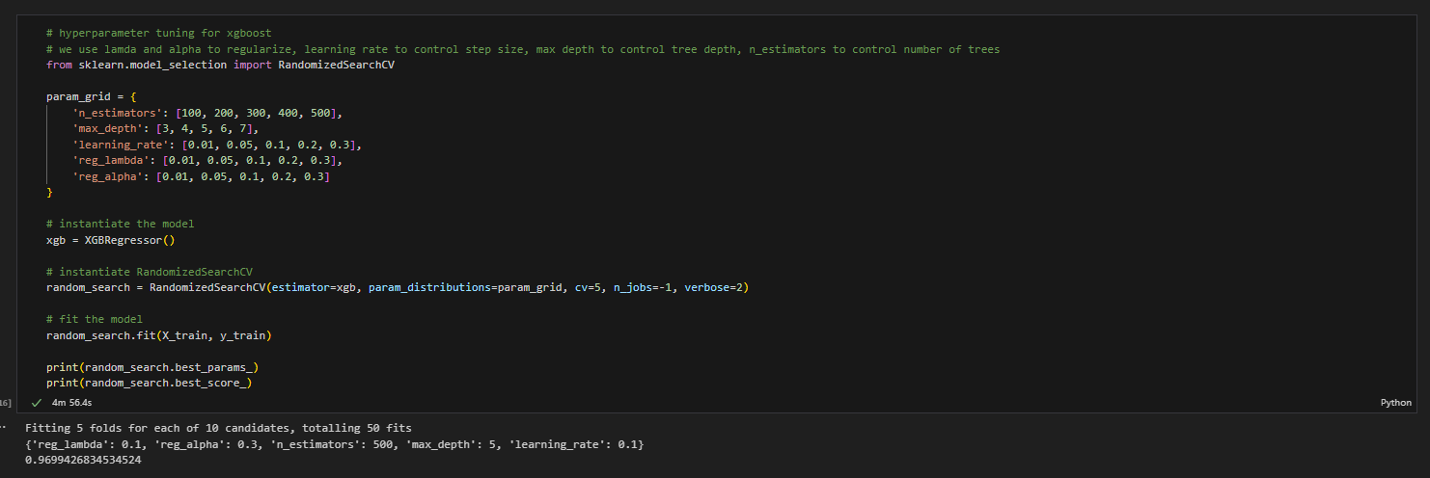
Hyper-parameter tuning

Slide 19
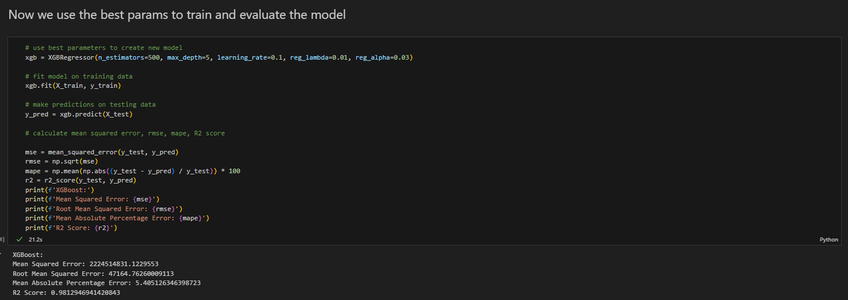
Results

Slide 20
Conclusion
XGBoost Final Performance:
Mean Squared Error: 2224514831.1229553
Root Mean Squared Error: 47164.76260009113
Mean Absolute Percentage Error: 5.405126346398723
R2 Score: 0.9812946941420843
Conclusion:
Feature engineering and tuning brought xgboost metrics from
MAPE 14% & R2 85% to MAPE 5% & R2 98%
13% increase in R2 with almost 3x MAPE reduction; a significant improvement in performance
We can say that this model is able to predict the house prices well on this given dataset due to our specific processing and building of stronger correlations within the data.

