Slide 1
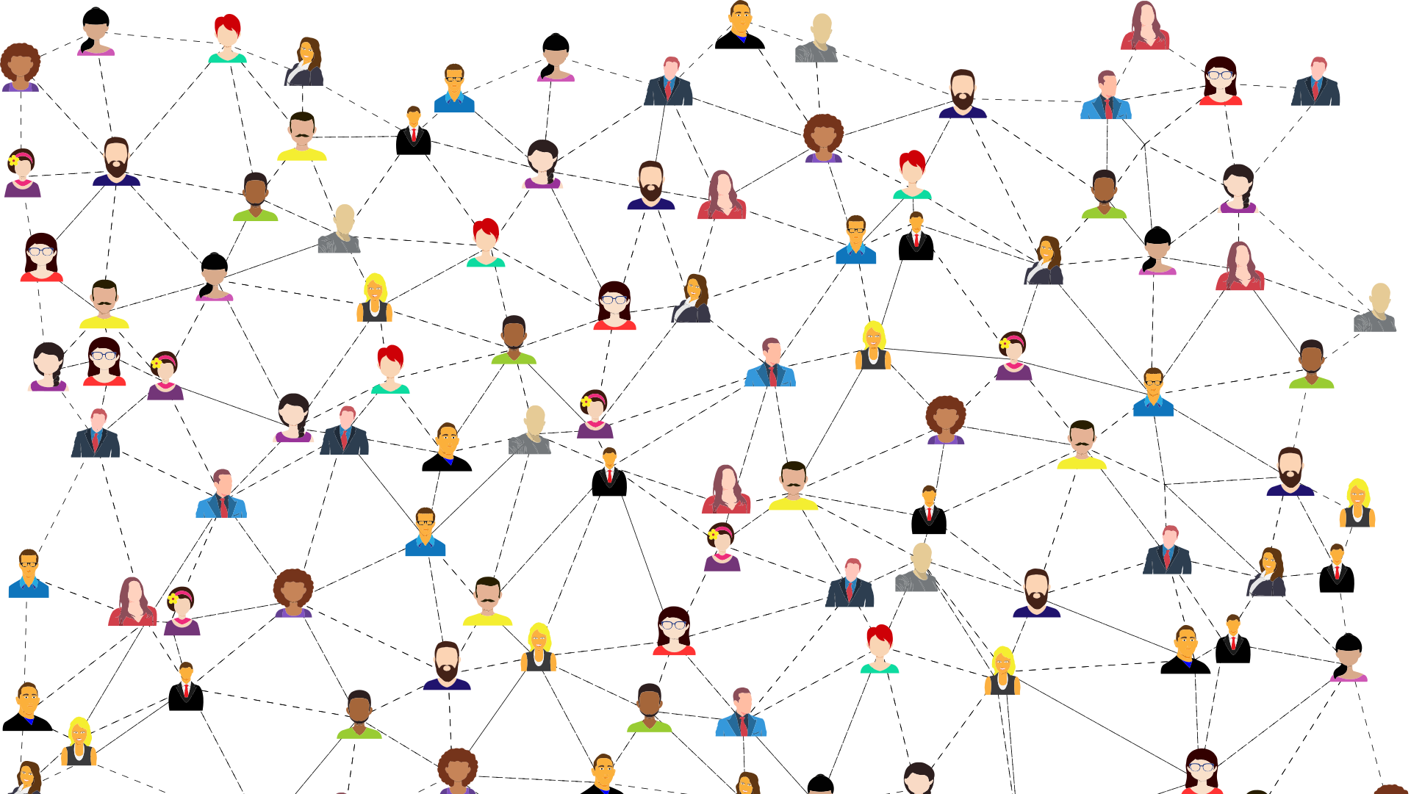
Constructing a digital twin of the social network of Amsterdam
Thesis presentation of Kamiel Gülpen
Examinator: Dr. Debraj Roy
Assessor: Dr. Vítor Vasconcelos
Daily supervisor: Msc Dhruv Mittal

Slide 2

Presentation outline
Data explanation
Data sources main data structure
Layers
Characteristics
Structure
Static network
Basic static network
Extensions
Homophily
SDA Model
Our model
Dynamics

Slide 3
Data
Network data of Amsterdam
Source: CBS 2019
4 network layers:
Household
Family
Neighbours
Work / School relationships
240 groups based on personal characteristics
age x 8 ethnicity x 5, gender x 2, education x3

Slide 4
Layers
Household
Household relationships
Symmetrical
Include:
Partner,
Housemate,
Housemate institute
Family
Family relationships
Symmetrical
Include:
Aunt/uncle,
co-parent,
sister/brother
Neighbours
10 closest neighbour households
Not Symmetrical
Randomly chosen if multiple neighbours have same distance
Work/School
Work, school and university relationships
Not symmetrical
If more than 100 persons work in the company the 100 geographically closest, in terms of

Slide 5
Person characteristics
240 groups based on person characteristics:
Age group: [0-20), [20-30) … [80-120]
Ethnicity: Native, Moroccan, Turkish, Surinamese, Other
Education: 1, 2, 3
Gender: Man, Woman

Slide 6
Data structure
2 different kind of datasets:
Agent dataset
Connection dataset
Age | Ethnicity | Education | Gender | Amount(n)
[0-20) | Native | 1 | Man | 30829
[50-60) | Moroccan | 3 | Woman | 105
Age Source | Ethnicity Source | Education Source | Gender Source |  | Age Dest | Ethnicity Dest | Education Dest | Gender Dest |  | Amount(n)
[0-20) | Native | 1 | Man |  | [20-30) | Moroccan | 1 | Man |  | 600
[50-60) | Moroccan | 3 | Woman |  | [0-20) | Moroccan | 1 | Woman |  | 440

Slide 7
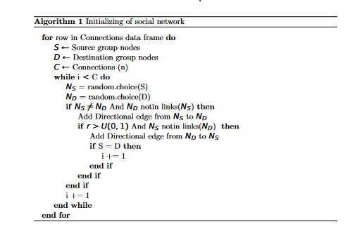
Creation basic static network
Creating a static network based on datasets
Basic random network

Slide 8
Making extensions on the static network
Adding a scale-free parameter where 1 will give a scale-free network and 0 a normal distributed network (and exponential between 0 and 1)
Adding neighbourhoods
Adding Households from household data
Overlapping the household and family network

Slide 9
Homophily
Social structure and social networks are related through the fundamental principle of homophily
Agents that are similar with respect to some significant social features are more likely to be somehow connected than dissimilar agents
How this idea would be presented in the data

Slide 10
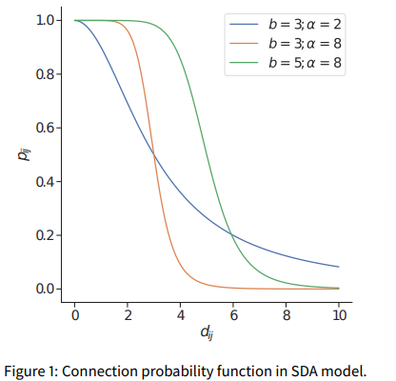

Social Distance Attachment model
$p_{ij}=\frac{1}{{1+[b^{−1}d\left(x_{i},x_{j }\right)]}^{α}}$
$p_{ij}$ is the probability of connection between i and j
b is the characteristic distance
d is the distance between i and j
$α$ is the level of homophily

Slide 11
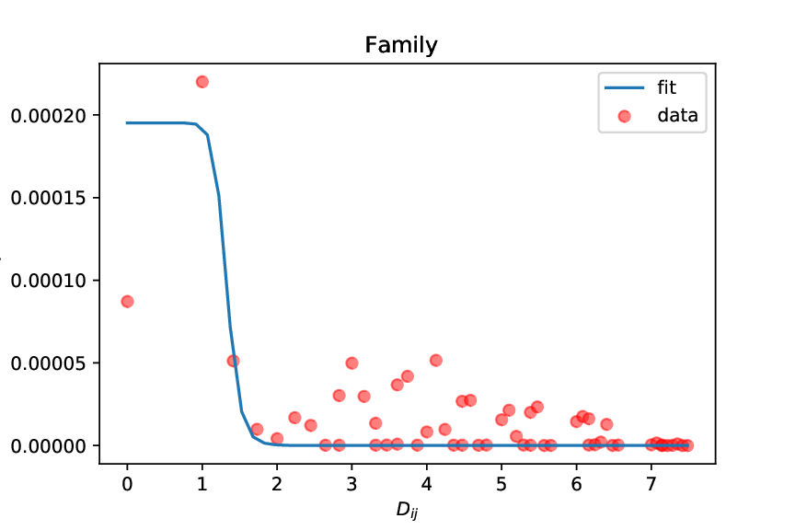
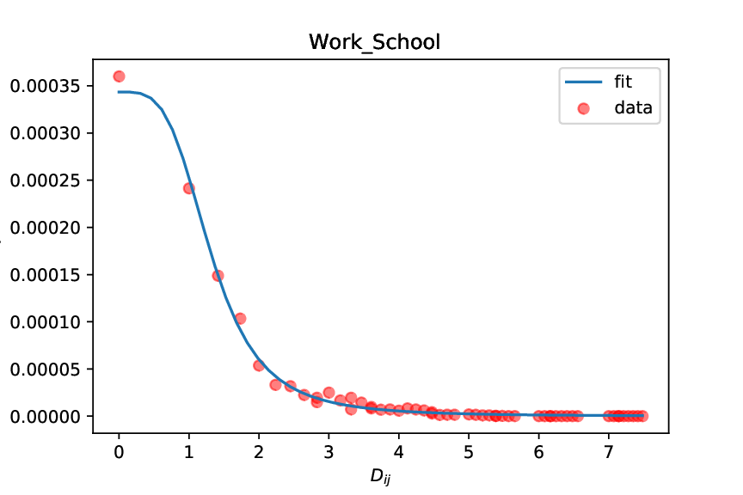
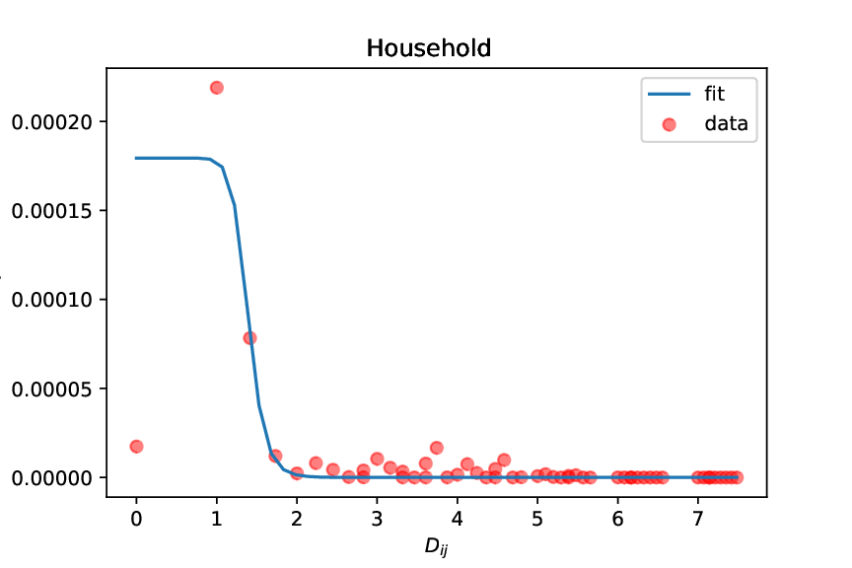
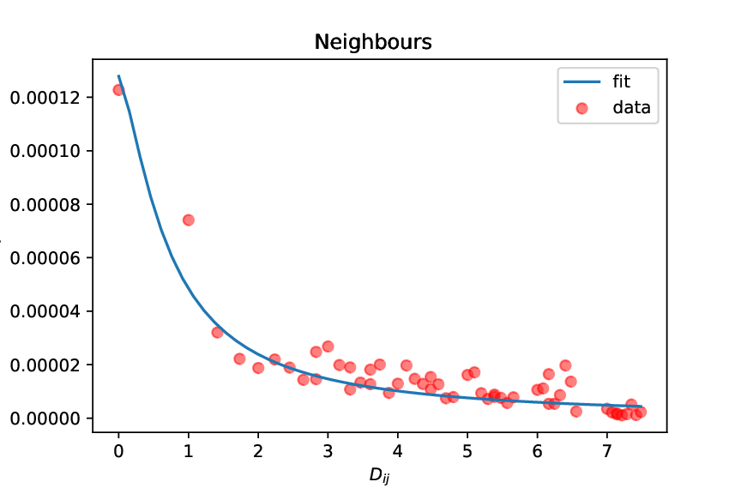

Using this model to fit the data
$p_{ij}=\frac{a}{{1+[b^{−1}d\left(x_{i},x_{j }\right)]}^{α}}$
$a$ is a free variable which is the maximum probability in the original formula

Slide 12
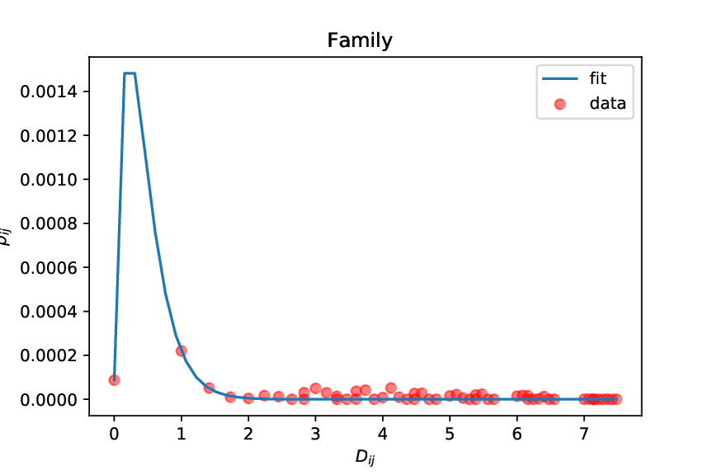
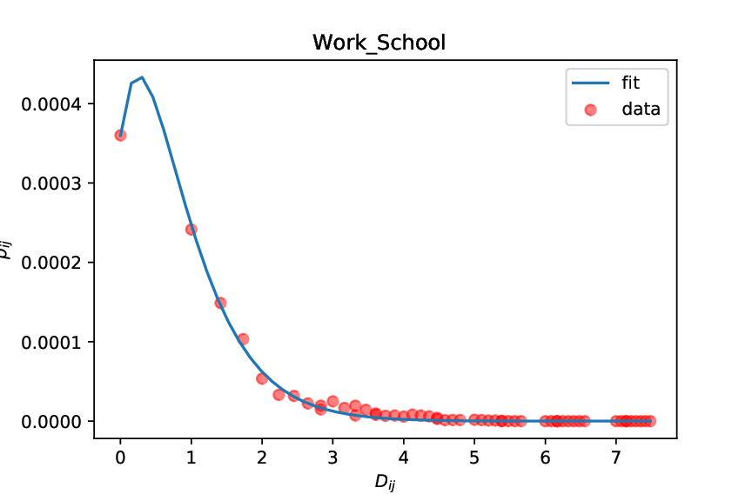
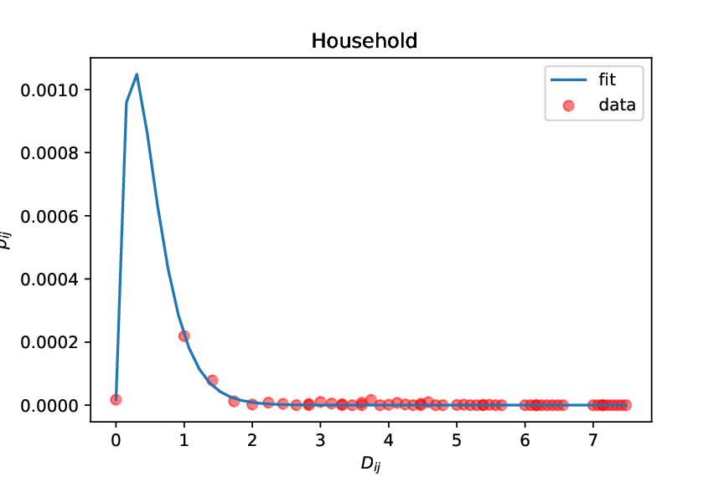
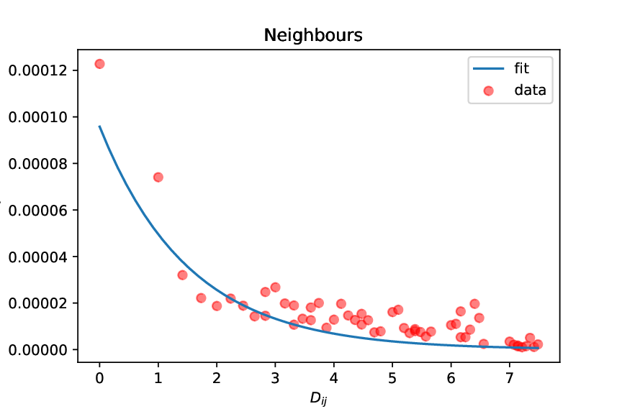

Redefining the formula
Formula does not fit all layers
Rewrite so it can fit all layers
$p_{ij }=\left(a+β∗D_{ij}\right)e^{−α∗D_{ij}}$

Slide 13

Weighted function
Distance of agents are based on different characteristics
Not all characteristics evenly important (McPherson, Smith-Lovin & Cook 2001)
Weighted function is introduced to find the characteristic importance
$p_{ij }=\left(a+β∗{\sum_{c}^{n}{W_{c}D_{ijc}}}_{ }\right)e^{−α∗\sum_{c}^{n}{W_{c}D_{ijc}}}$

Slide 14
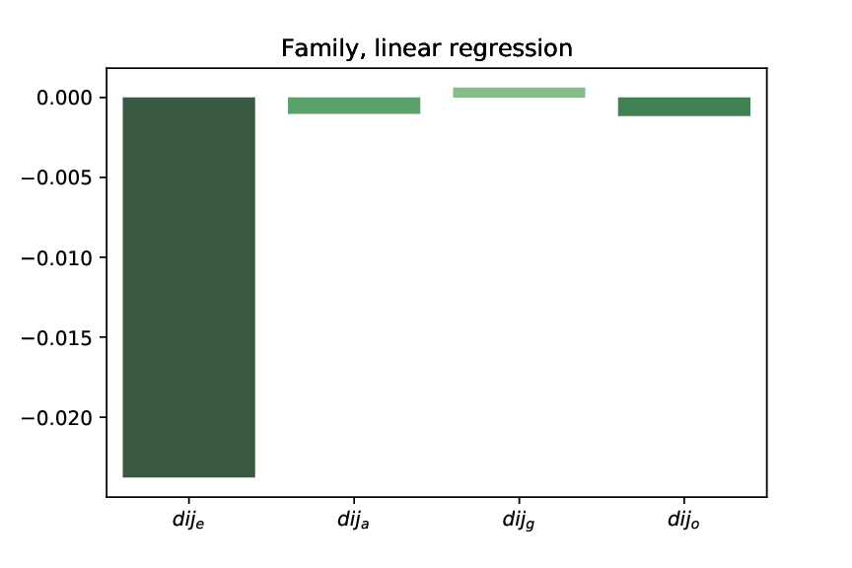
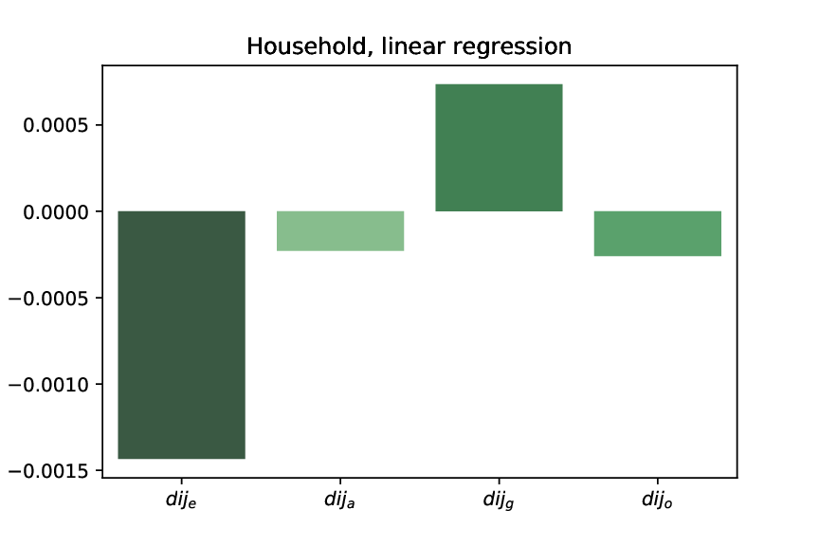
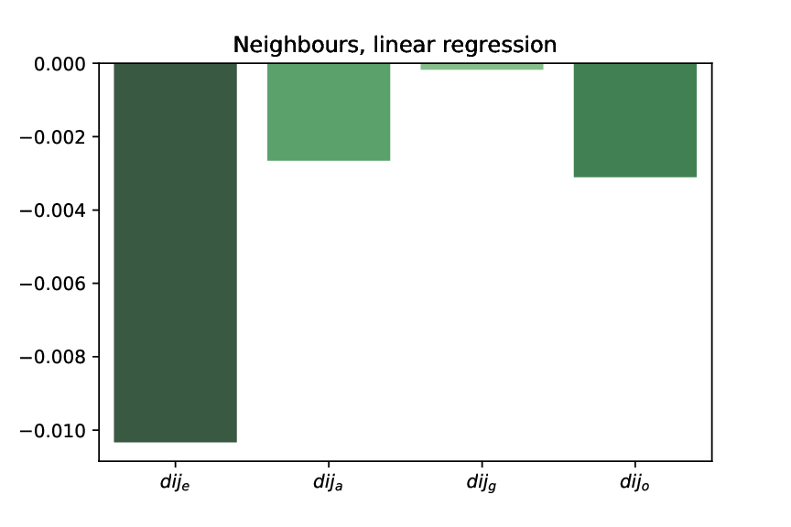
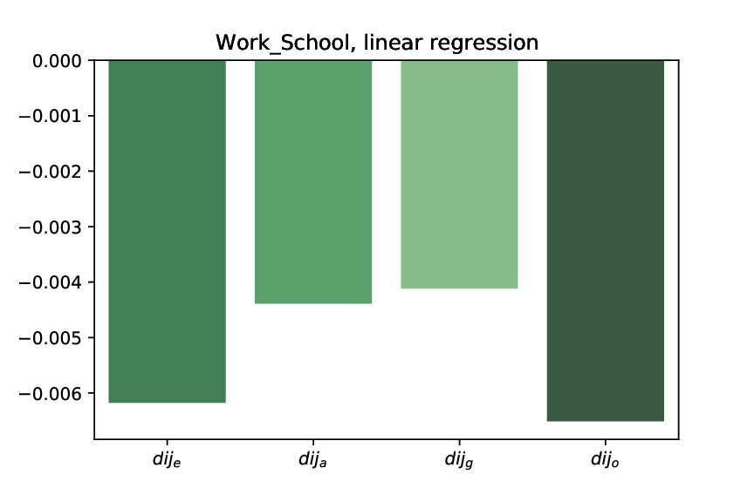
Results weighted function
Ethnicity
Family , household & Neighbours ➔ biggest influence
Work/School ➔ Second highest influence
Age
Family , household & Neighbours ➔ Medium influence
Work/School ➔ High influence
Gender
Family, household ➔ Positive influence
Work/School, Neighbours ➔ Lowest influence
Education
Family, household, neighbours ➔ med high influence
Work/school ➔ Highest influence

Slide 15
Dynamics
An Agent-based approach is used to include the dynamics
Each person is an agent in the Agent-based model
Use Static networks as starting point
Use probability function as for making new connections
Introducing other dynamics such as death and birth

Slide 16
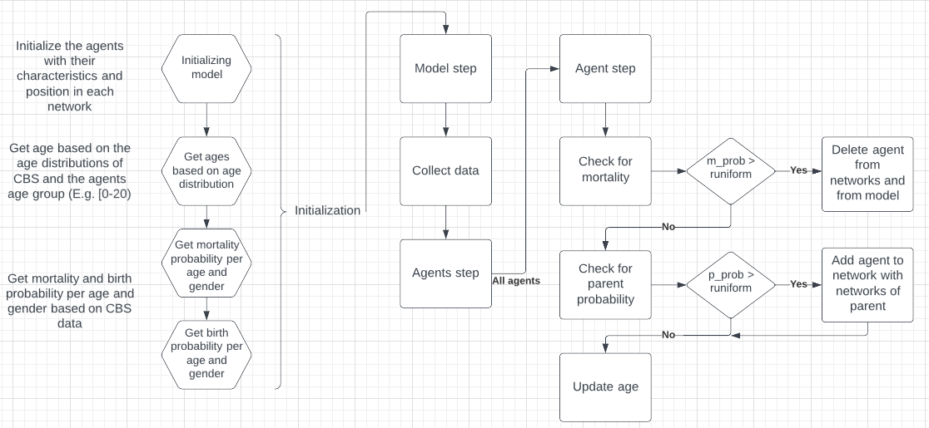
Agent based model flow chart

Slide 17
Questions
Do you have any ideas or recommendations ideas for the dynamic part?

