Slide 1
Prediction of Flight Delays Micro-Project #3 https://github.com/kamikahughes/ANA500_2022
Kamika Hughes
16 October 2022

Slide 2
Problem Statement
Problem Statement & Hypothesis Formulation
Background: A plane delay dataset will be used to investigate what factors cause the most flight delays. Additionally, a machine learning regression model will be used to predict flight delays.
Objectives:
Which factors have the largest impact on flight delays?
Which variables cause the most delays?
Which factors caused the least delays?
Are there any factors that don’t influence delays?

Slide 3
Hypothesis Formulation
Problem Statement & Hypothesis Formulation
H₀ : The month, day of the month, day of the week, plane age, distance, airtime, departure time, and arrival time have no effect on flight delays
H_{A}: The month, day of the month, day of the week, plane age, distance, airtime, departure time, and arrival time have a positive effect on flight delays
The null hypothesis states that the month, day of the month, day of the week, plane age, distance, airtime, departure time, and arrival time (independent variables) have no association with flight delays(dependent variable).
The alternative hypothesis states that the factors have a positive effect, increases, delays.

Slide 4
Top-Down Program Design
Program Design
Top-Down Program Design
Program: Flight delay Prediction using Machine Learning Regression
Overall Task:
Design a Python program that can be used to predict flight (output) using the flight dataset as input.
Data Science Process steps are as follows:
Step 1 Acquire- Find dataset that contains required data.
Step 2 Prepare- Pre-process and gather information on variables that could be useful.
Step 3 Analyze Data- Use techniques to explore and analyze relationships between variables and build models.
Step 4 Report- Give thorough breakdown of results.
Step 5 Act- Use results to make predictions.

Slide 5
Hierarchy Chart
Program Design
Hierarchy Chart
[ArrDelay]=Flight_dataset (month, day of the month, day of the week, plane age, distance, airtime, departure time, and arrival time )
Output: flight delays
Input: flight dataset

Slide 6
Flowchart
Program Design
Start
Load Data
Step 1:
Acquire Data
Preliminary analysis
Identify variables and features, describe data
Step 2:
Prepare
Visualize: plot each feature against outcome variable
Clean data:
Verify all necessary data is there

Slide 7
Flowchart
Multiple linear regression
Program Design
Test Data and show predicted vs actual
Step 3:
Analyze
Analysis
Breakdown findings and make interpretations
Step 4:
Report
Report findings

Slide 8
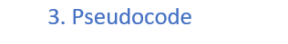
Pseudocode
Program Design
Start
Step 1 get data
Import pandas numpy and matplotlib
Read in dataset df =……
Step 2 prepare data
Check which variables could influence dependent variable
Use top 3 or 4 that could be used to predict price
Summary stats on variables I plan to use
Visualization
Plot variables against the dependent variable
Step 3 analyze
Do prelim analyzation on variables
Test prediction and accuracy
Step 4 Report
Show prediction plots and compare against the actual plot
end

Slide 9
Acquire
The Data Science Process (1/5)
Flight data was acquired through Kaggle.com, which is used in many professions to find and share datasets and challenges.
Data Source:
https://www.kaggle.com/datasets/lcsldatasets/flights
I looked for other websites that had flight delay datasets and there were no other options

Slide 10
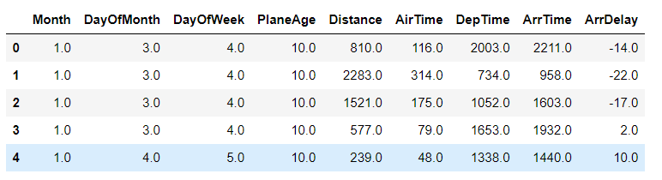
Prepare
The Data Science Process (2/5)
Features:

Slide 11
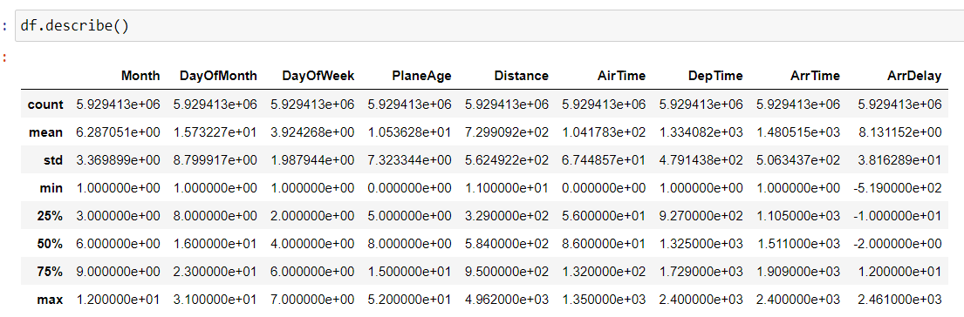
Prepare
The Data Science Process (2/5)
Features:
Summary Stats

Slide 12
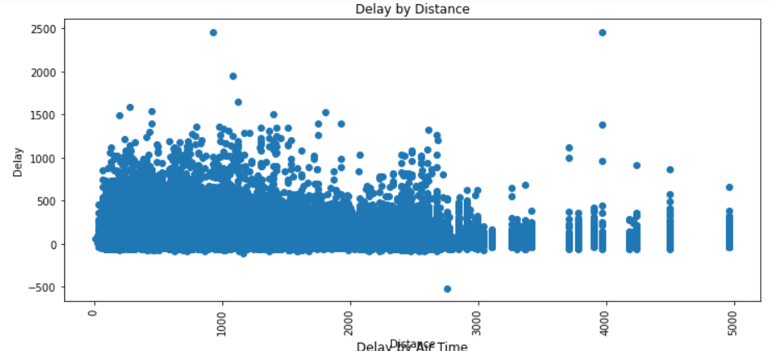
Prepare
The Data Science Process (2/5)
There is a large cluster of delays for flights that go less than 3000 miles.
Visualizations of delays and its relationship with distance

Slide 13
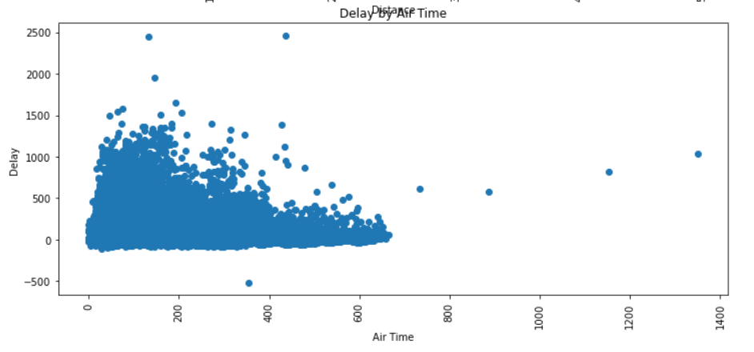
Prepare
The Data Science Process (2/5)
The duration of the flight related to delays seem to have a few outliers, but when the airtime is less than 700 hours, the chances of delays are higher.

Slide 14
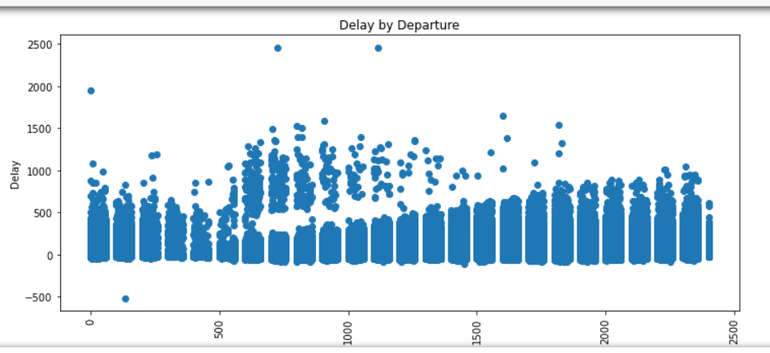
Prepare
The Data Science Process (2/5)
Flights that take off earlier in the day are shown to have no big difference when compared to the flights that take off at the end of the day, however in the middle of the day, there appear to be more frequent delays that last longer.

Slide 15
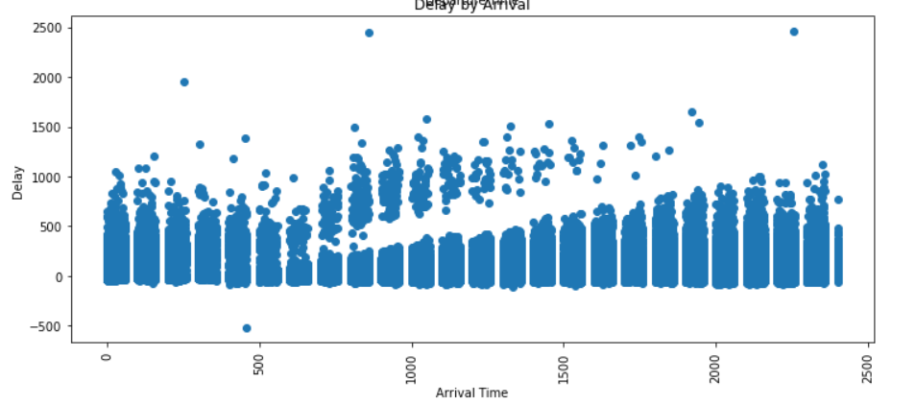
Prepare
The Data Science Process (2/5)
The arrival time appears not to have a real effect on the delay when focusing only on early or late, but there is a longer delay mid day with an interesting gap in the middle

Slide 16
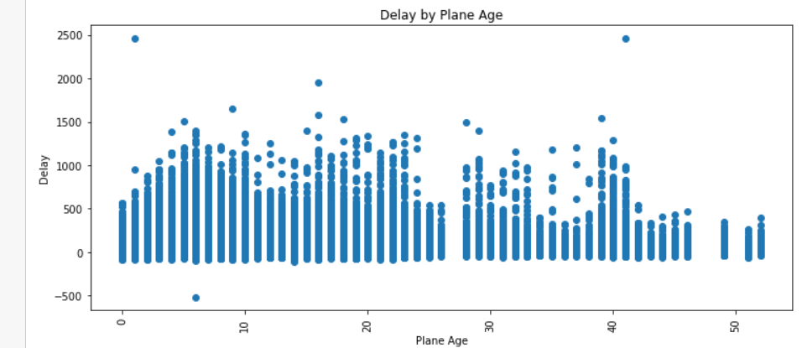
Prepare
The Data Science Process (2/5)
The age of the plane appears to have an unusual relationship with delay. It shows that the older the plane primarily, if the plane is 50 years old, the less the delay.

Slide 17
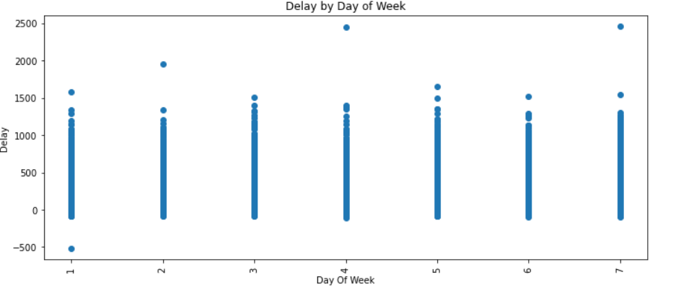
Prepare
The Data Science Process (2/5)
There appear to be no major difference in delay across the day of the week. There are some outliers in this plot.

Slide 18
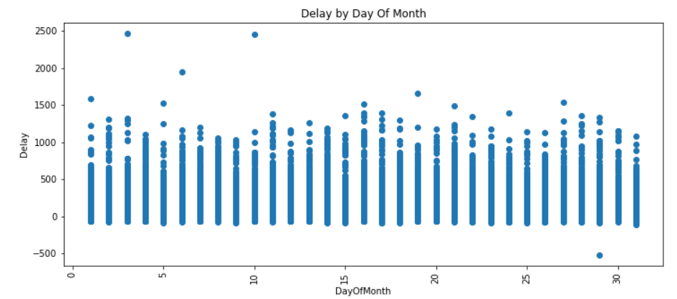
Prepare
The Data Science Process (2/5)
There are no significant differences in delays across the day of the month.

Slide 19
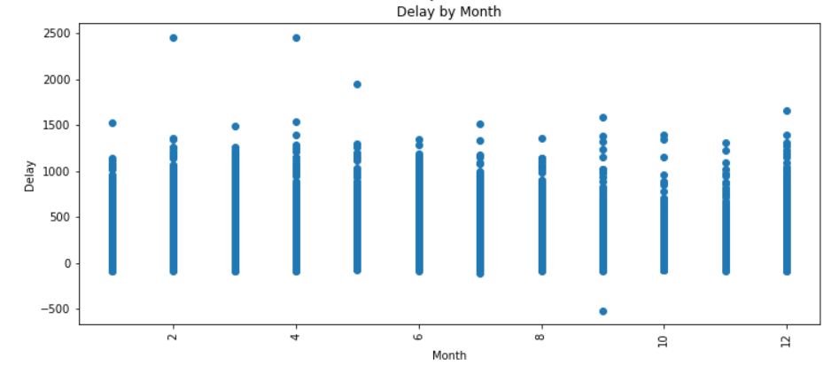
Prepare
The Data Science Process (2/5)
There are outliers here, as with a majority of the data plots, but there are not any obvious difference in delay across month.

Slide 20
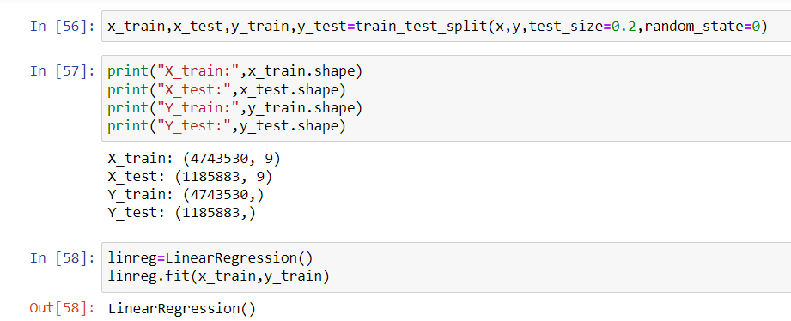
Analyze data
The Data Science Process (3/5)

Slide 21
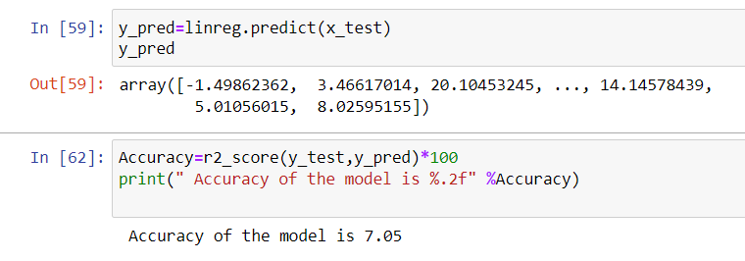
Analyze data
The Data Science Process (3/5)

Slide 22
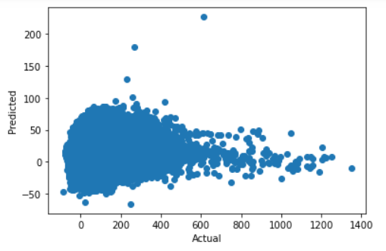
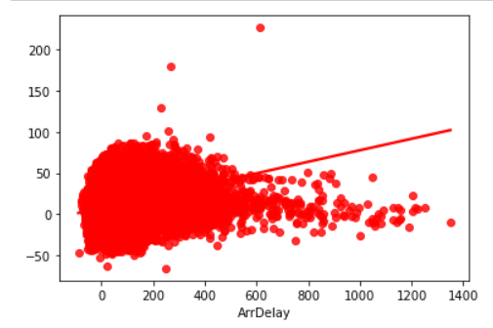
Analyze data
The Data Science Process (3/5)

Slide 23
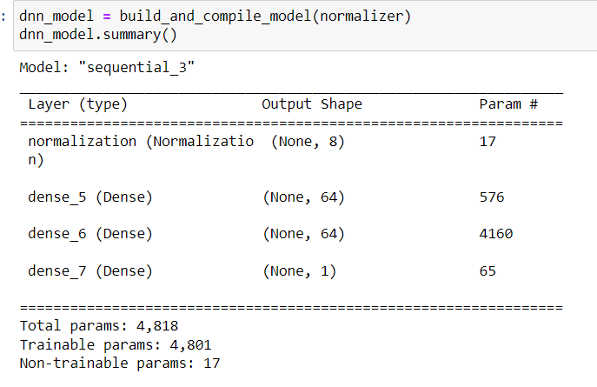
Analyze data
The Data Science Process (3/5)

Slide 24
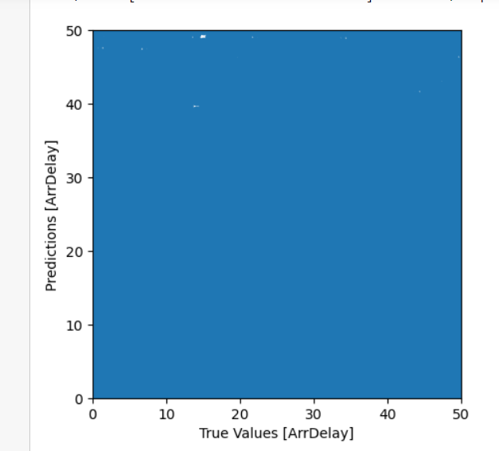
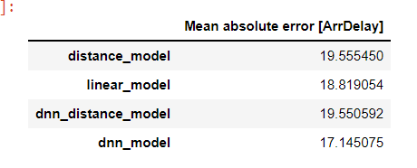
Analyze data
The Data Science Process (3/5)

Slide 25
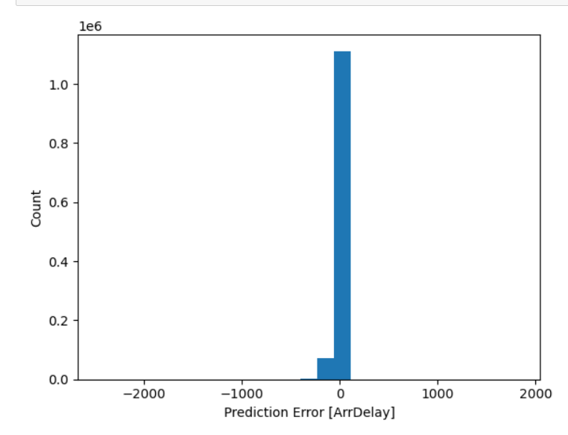
Analyze data
The Data Science Process (3/5)

Slide 26
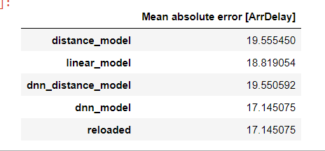
Analyze data
The Data Science Process (3/5)

Slide 27
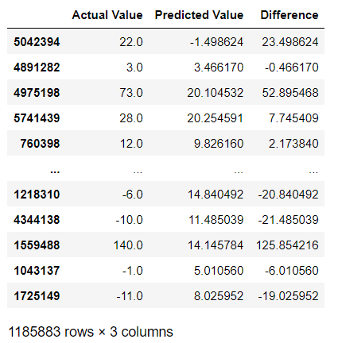
Analyze data
The Data Science Process (3/5)

Slide 28
Analyze data
The Data Science Process (3/5)
A multilinear regression was completed, using all of the variables in the dataset. The accuracy score, R² score is 7.05 which is low, but it is not as close to 1 as we would prefer. I will work on reducing the number of variables used to see if this can correct things enough to allow predictions of delays based on the new independent variables. The ones that I will remove will be the month, day of the month, and week. Those appeared to have no obvious effect on delay.

Slide 29
Report
The Data Science Process (4/5)
There are outliers shown on most of the plots provided.
There was not a strong correlation shown but that could be due to too many variables
The predicted values compared to the actual hade several instances of large differences. When adjustments to the number of variables is made, this could be better at predicting flight delays.
This analysis started off with all variables in the dataset being used. The next step will be to refine the variables and rerun things to see if the prediction power will be better overall.

Slide 30
Report
The Data Science Process (4/5)
There are outliers shown on most of the plots provided.
There was not a strong correlation shown but that could be due to too many variables
The predicted values compared to the actual hade several instances of large differences. When adjustments to the number of variables is made, this could be better at predicting flight delays.
This analysis started off with all variables in the dataset being used. The next step will be to refine the variables and rerun things to see if the prediction power will be better overall.
Update:
Even after removing Month, Day of Month, and Arrival time, there was no change in the accuracy. So, a DNN regression was done to see if predictions could be more accurate. The results show

Slide 31
Act
The Data Science Process (5/5)
Given the predictions of the deep learning NN, and the linear regression, I must fail to reject the null hypothesis. There is not enough information to make an accurate prediction of the arrival delays. Even after the removal of variables, the ability to predict arrival delays using this dataset was not accurate enough to put into use.

