Slide 1
Micro-Architecture Optimization on single-issue 5-stage RISC-V processor
Kei Hong Chan
Yiu Fai Lam

Slide 2
Overview
Data forwarding
Branch instruction
Eliminate jump stall
Load Store extension
Performance evaluation

Slide 4
Branch instruction
Introduce BHR and PHT
Extra module to control the MUX in IF stage
Load Branch dependency check

Slide 5
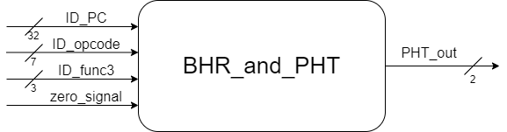
BHR_and_PHT
Input: ID_PC, ID_opcode, ID_func3, zero_signal
Output: PHT_out
4-bit is used for global Branch History Register (BHR)
PHT has 128 entries, 2-bit Branch Predictor with Saturating Up/Down scheme
PHT address is the combination of bit 2 to bit 4 of PC and 4-bit global BHR

Slide 6
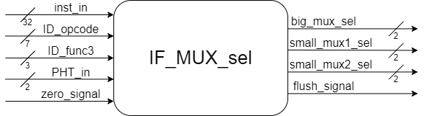
IF_MUX_sel
Input: inst_in, ID_opcode, ID_func3, PHT_in, zero_signal
Output: big_mux_sel, small_mux1_sel, small_mux2_sel, flush_signal
control the MUX in IF stage, select calculated PC value to update
Prediction wrong => flush_signal = 1
When flush_signal = 1:
flush the PC value
flush the instruction stored in IF/ID register
send a NOP instruction to ID stage

Slide 7
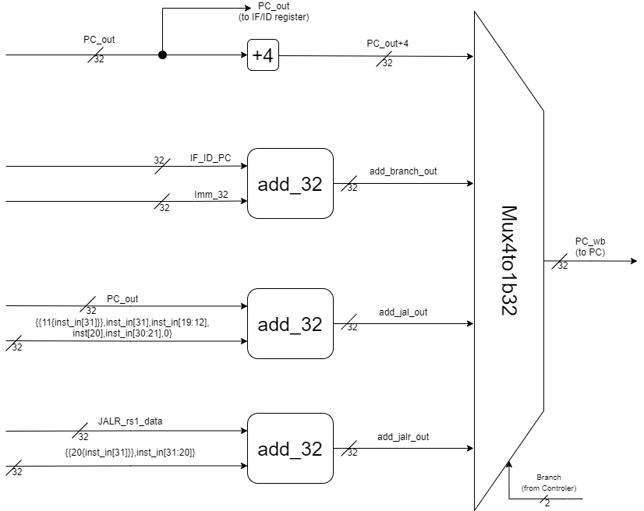
Connection of MUX in IF stage (before adding “IF_MUX_sel” module)

Slide 8
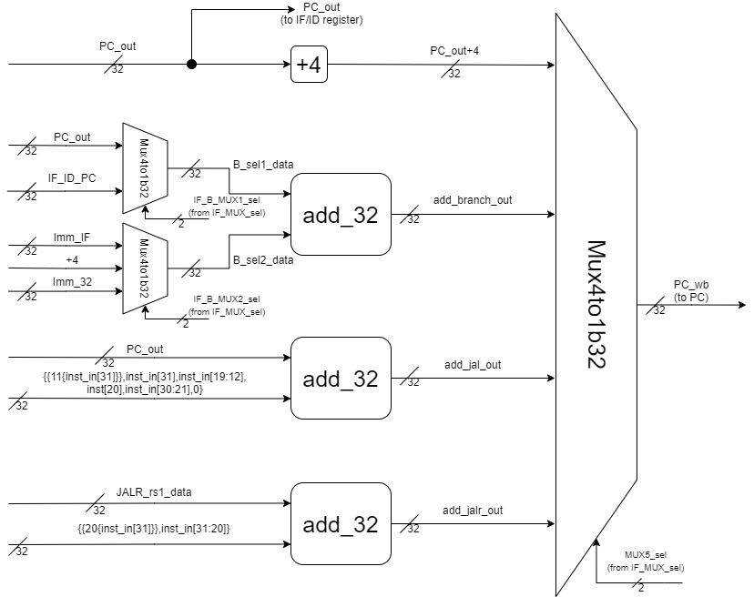
Connection of MUX in IF stage (after adding “IF_MUX_sel” module)

Slide 9
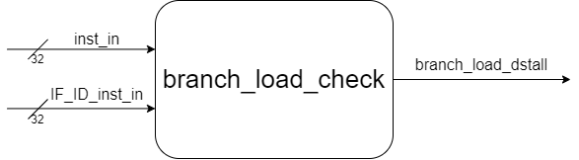
branch_load_check
Input: inst_in, IF_ID_inst_in
Output: branch_load_dstall
check the dependency between branch and load instruction
If dependency occurs => branch_load_dstall = 1
When branch_load_dstall = 1:
Hold PC value
send a NOP instruction to ID stage

Slide 10
Eliminate jump stall
Original: an extra stall for jump instruction to execute in ID stage
Optimized: 0 stall, still execute in ID stage but pass the latest PC value to IMEM and IF/ID resigter directly
Extra MUX in IF stage is needed, control by controller

Slide 11
Connection of MUX in IF stage (before eliminate jump stall)

Slide 12
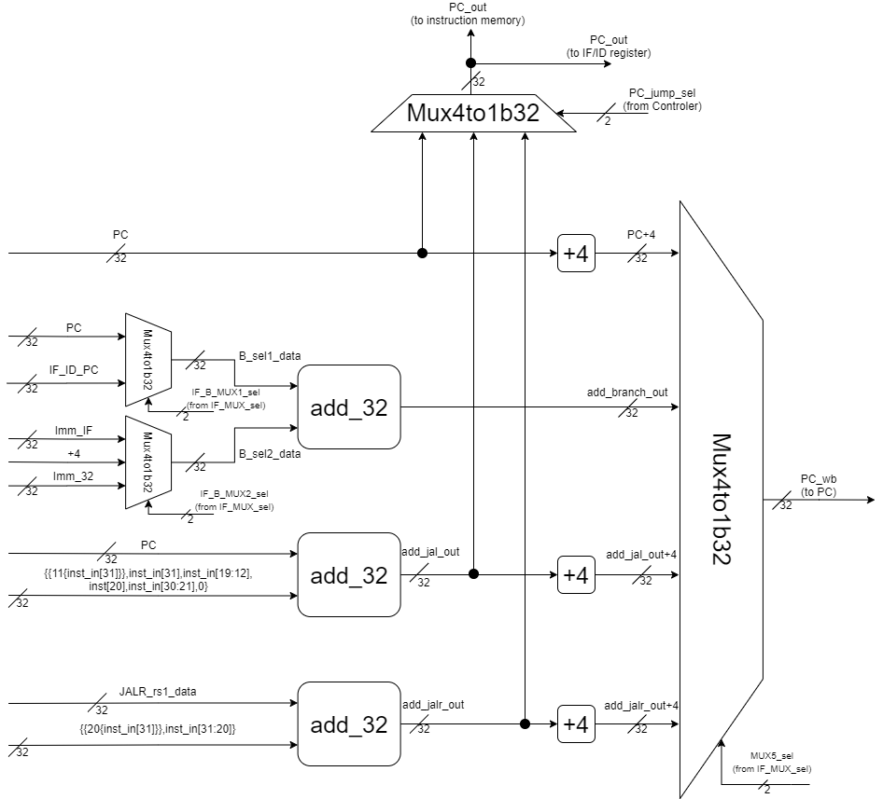
Connection of MUX in IF stage (after eliminate jump stall)

Slide 13
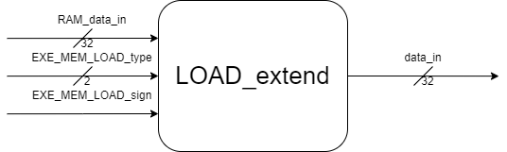
Load_extend
Input: RAM_data_in, EXE_MEM_LOAD_type, EXE_MEM_LOAD_sign
Output: data_in
Placed in MEM stage
Extend the RAM data after read it from RAM
Pass the extended data to MEM/WB register
Support LW, LH, LB, LHU, LBU instruction

Slide 14
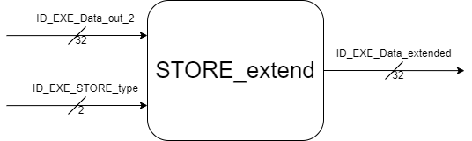
Store_extend
Input: ID_EXE_Data_out_2, ID_EXE_STORE_type
Output: ID_EXE_Data_extended
Placed in EXE stage
Extend the data after data forwarded for store instruction
Pass the extended data to EXE/MEM register
Support SW, SH, SB instruction

Slide 15
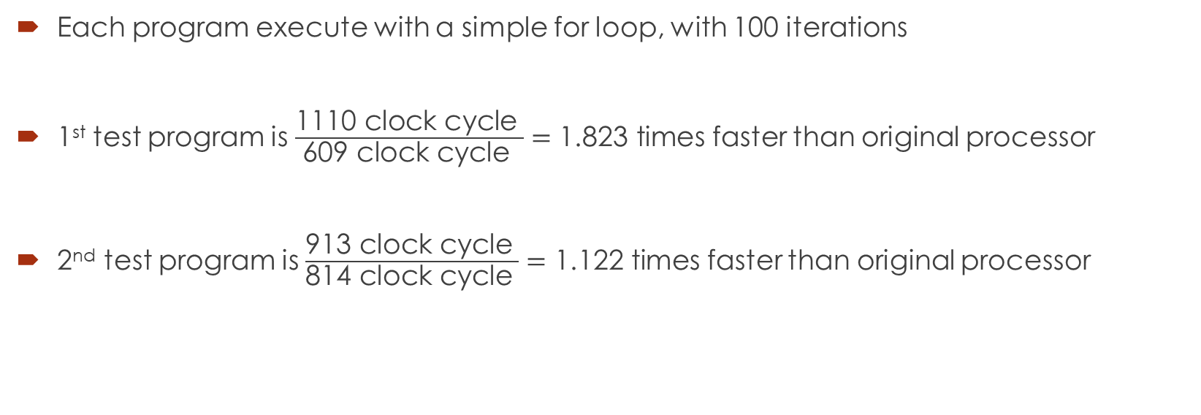
Performance evaluation
Test program type | original processor execution time | optimized processor execution time | Speeded up (optimized vs original)
data dependency + branch + jump | 1110 clock cycle | 609 clock cycle | 1.823 times faster than original processor
branch + jump | 913 clock cycle | 814 clock cycle | 1.122 times faster than original processor
Each program execute with a simple for loop, with 100 iterations
1st test program is $\frac{\text{1110 }\text{clock} \text{cycle} }{\text{609 }\text{clock} \text{cycle} }=\text{1.823 }\text{times}$ faster than original processor
2nd test program is $\frac{\text{913 }\text{clock} \text{cycle} }{\text{814 }\text{clock} \text{cycle} }=\text{1.}\text{122} \text{times}$ faster than original processor

Slide 16
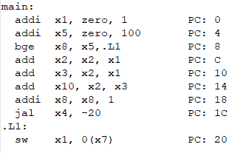
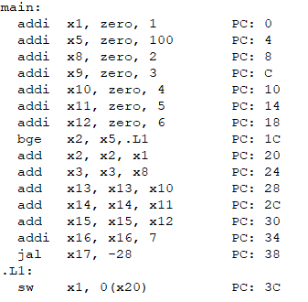
Instruction code for performance evaluation
data dependency + branch + jump
branch + jump

