Slide 1
Debug like a Pro – Kubernetes Edition
Kamil Mrzygłód, Sławomir Kwasiborski

Slide 2

About us
Kamil Mrzygłód: Senior Software Developer @ Demant, Microsoft Azure MVP
Sławomir Kwasiborski: Software Solutions Architect @ Demant

Slide 3
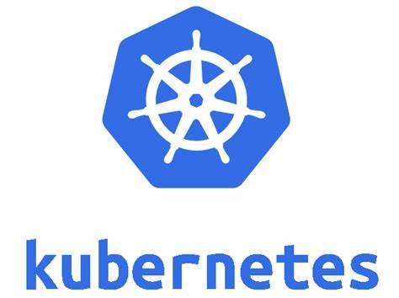




Disclaimer
This is a highly technical session, no basic introduction for the topics will be provided!

Slide 4
Agenda
Local vs Remote debugging, Kubectl
01
Azure Dev Spaces
02
Telepresence
03
Telepresence vs Azure Dev Spaces
04
Extras – Squash, Stackdriver, ephemeral containers
05

Slide 5

Debugging
„The process of identifying and removing errors from computer hardware or software.”

Slide 6
Software debugging
Locally with debugger
Remotely with debugger
Analyzing traces, logs, events
Using additional tools like memory debuggers etc.

Slide 7


Local debugging

Slide 8
Local debugging
Debugger

Slide 9
Local debugging
Debugger

Slide 10

Remote debugging

Slide 11

Remote debugging
Debugger

Slide 12
Architecture assumption
Azure Kubernetes Service, 1 Node
Two services with only internal address + FRONT
Different setups in different namespaces
Linkerd deployed to a single namespace

Slide 13
Demo #1
Using kubectl exec / logs

Slide 14
Azure Dev Spaces
A rapid, iterative Kubernetes development experience for teams in Azure Kubernetes Service (AKS) clusters.

Slide 15
https://docs.microsoft.com/en-us/azure/dev-spaces/about

Slide 16
How Azure Dev Spaces works
https://docs.microsoft.com/en-us/azure/dev-spaces/how-dev-spaces-works

Slide 17
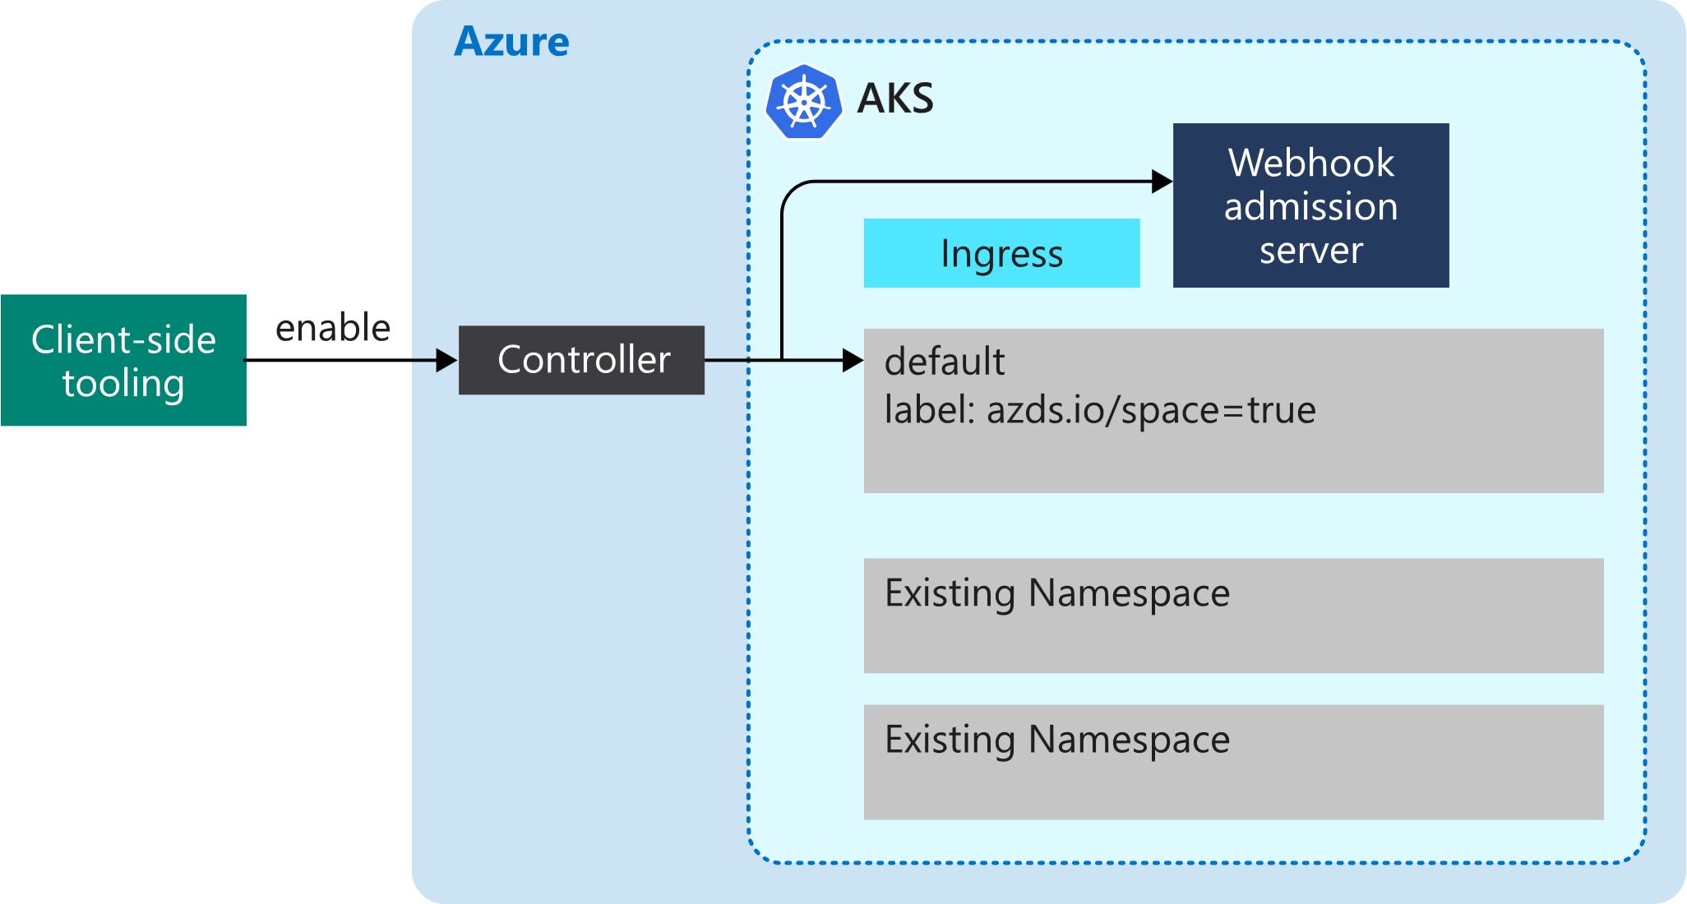
How Azure Dev Spaces works
https://docs.microsoft.com/en-us/azure/dev-spaces/how-dev-spaces-works

Slide 18
How Azure Dev Spaces works
https://docs.microsoft.com/en-us/azure/dev-spaces/how-dev-spaces-works

Slide 19
How Azure Dev Spaces works
https://docs.microsoft.com/en-us/azure/dev-spaces/how-dev-spaces-works

Slide 20
Demo #2
Using Azure Dev Spaces

Slide 21
Telepresence
FAST, LOCAL DEVELOPMENT FOR KUBERNETES AND OPENSHIFT MICROSERVICES
https://www.telepresence.io

Slide 22


Replica count: 3

Slide 23
Replica count: 0

Slide 24
Replica count: 0
T9S Proxy
Replica count: 1

Slide 25
Replica count: 0
T9S Proxy
Replica count: 1

Slide 26

Local network
Replica count: 0
SSH (kubectl port-forward)
T9S Proxy

Slide 27
Local network
Container network
T9S Local
Replica count: 0
SSH (kubectl port-forward)
T9S Proxy

Slide 28
Local network
Container network
T9S Local
Replica count: 0
T9S Proxy
SSH port forward

Slide 29
Local network
Container network
T9S Local
Replica count: 0
SSHUTTLE
T9S Proxy
SSH port forward

Slide 30
Local network
Container network
T9S Local
Replica count: 0
$env
SSHUTTLE
T9S Proxy
SSH port forward
$env

Slide 31
Local network
Container network
T9S Local
Replica count: 0
$env
SSHUTTLE
T9S Proxy
SSH port forward
$env
$env

Slide 32


Local network
Container network
T9S Local
Replica count: 0
$env
SSHUTTLE
T9S Proxy
SSH port forward
$env
$env

Slide 33
Local network
Container network
T9S Local
Replica count: 0
$env
SSHUTTLE
T9S Proxy
SSH port forward
$env
$env

Slide 34
Local network
Container network
T9S Local
Replica count: 0
$env
SSHUTTLE
T9S Proxy
/t9s
SSH port forward
VIEUX/SSHFS
$env
$env

Slide 35
Local network
Container network
T9S Local
Replica count: 0
$env
SSHUTTLE
T9S Proxy
/t9s
SSH port forward
VIEUX/SSHFS
$env
$env

Slide 36
Local network
Container network
T9S Local
Replica count: 0
$env
your container
SSHUTTLE
T9S Proxy
/t9s
SSH port forward
VIEUX/SSHFS
$env
$env

Slide 37
Demo #3
Using Telepresence

Slide 38
docker run^
--net=host^
--rm^
-it^
-v <kube config>:/kube^
-v /tmp:/tmp^
-v /var/run/docker.sock:/var/run/docker.sock^
telepresence^
--docker-mount=/t9s^
--namespace=<k8s namespace>^
--swap-deployment <k8s deployment name>^
--docker-run^
--name <name of local container>^
--rm^
-v <path to source>:/src^
-v <path to nuget folder>:/.nuget/fallbackpackages^
-v <path to vsdbg>:/vsdbg^
-e ASPNETCORE_ENVIRONMENT=Development^
-p 5000:80^
--entrypoint tail^
mcr.microsoft.com/dotnet/core/sdk:2.2^
-f dev/null
Run telepresence

Slide 39
docker run^
--net=host^
--rm^
-it^
-v <kube config>:/kube^
-v /tmp:/tmp^
-v /var/run/docker.sock:/var/run/docker.sock^
address.of.registry/telepresence:0.102^
--docker-mount=/t9s^
--namespace=<k8s namespace>^
--swap-deployment <k8s deployment name>^
--docker-run^
--name <name of local container>^
--rm^
-v <path to source>:/src^
-v <path to nuget folder>:/.nuget/fallbackpackages^
-v <path to vsdbg>:/vsdbg^
-e ASPNETCORE_ENVIRONMENT=Development^
-p 5000:80^
--entrypoint tail^
mcr.microsoft.com/dotnet/core/sdk:2.2^
-f dev/null
Run telepresence
(on windows)

Slide 40
Summary
Azure Dev Spaces vs Telepresence

Slide 41
Comparison
Azure Dev Spaces
Telepresence
Native Azure Kubernetes Service feature, which won’t work with other managed k8s services
Highly automated – very easy to setup
Helm as a tool of choice
IDE integration
Supports both Windows & Linux
Requires a cluster to be configured properly and deploys external controller to work
Does not mix well with complex deployment scenarios (e.g. Service Mesh)
Cross-vendor with no real assumptions how you run k8s
Can be easily incorporated into your custom tools
More complex to set up
Can be integrated with IDEs (manual steps required)
Supports both Windows (with extra setup) & Linux
Leverages a simple idea of swapping a deployment and injecting a proxy
Has little assumptions on how deployments look like

Slide 42
requests, I/O, data

Slide 43
requests, I/O, data
requests, I/O, data
kubectl exec

Slide 44
requests, I/O, data
requests, I/O, data
Azure Dev Spaces
requests, I/O, data
kubectl exec

Slide 45
requests, I/O, data
requests, I/O, data
Azure Dev Spaces
requests, I/O, data
requests, I/O, data
kubectl exec
Telepresence

Slide 46
What’s more?
Squash,
Stackdriver,
Okteto,
ephemeral containers

Slide 47
Ephemeral containers
Alpha feature of Kubernetes 1.16
Meant to run temporarily inside a pod to inspect issues
Built using the very same ContainerSpec, yet many fields are disallowed(ports, probes, resources)
Main use case – when using distroless images, you may not have access to a shell, so you cannot use kubectl exec
kubectl attach -it example-pod -c debugger

Slide 48

Thank you!
Visit us at Demant’s booth!

