Slide 1
Data Mining Project
Using of different Alogorithm
Kamil Shah
20221-33200

Slide 2
PCA (Principal Component Analysis)
Dimensionality reduction technique
Transforms features into principal components
Helps visualize variance in data

Slide 3
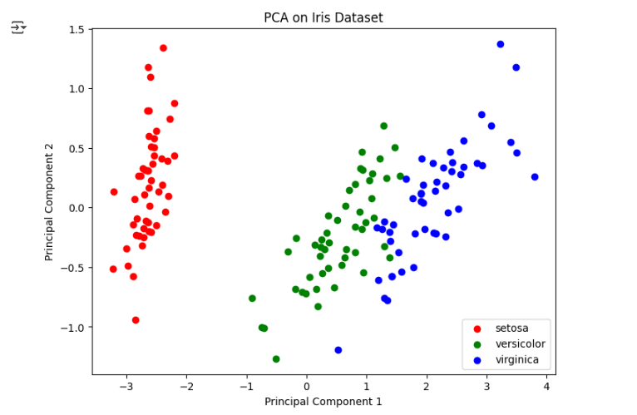

Slide 4
Logistic Regression
Used for classification problems
Outputs probabilities for each class
Evaluated with accuracy and confusion matrix

Slide 5
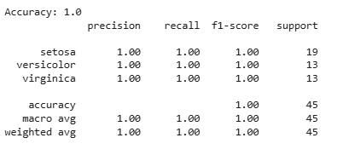
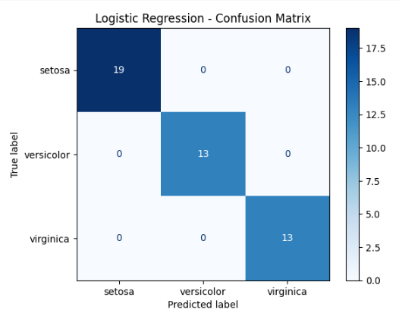

Slide 6
Linear Regression
Predicts continuous numeric values
Used Diabetes dataset for testing
Evaluated using MSE and R² score

Slide 7
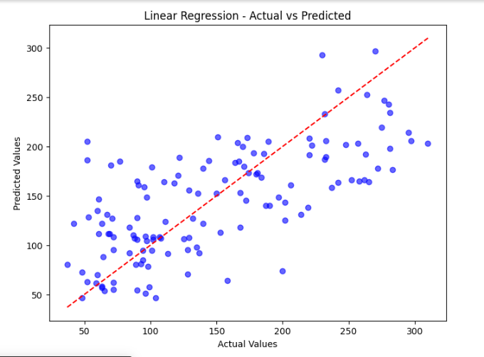

Slide 8
Histogram
Visualizes frequency distribution of data
Example: Sepal Length in Iris dataset
Shows shape and spread of dataset

Slide 9
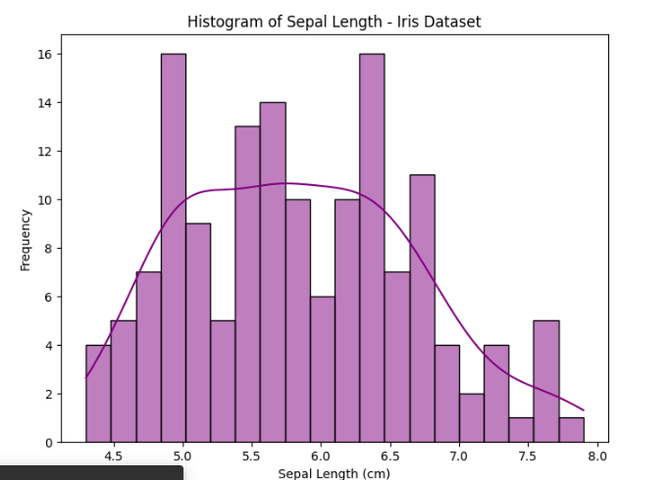

Slide 10
Clustering (K-Means)
Unsupervised learning method
Groups data into K clusters
Evaluated using silhouette score

Slide 11
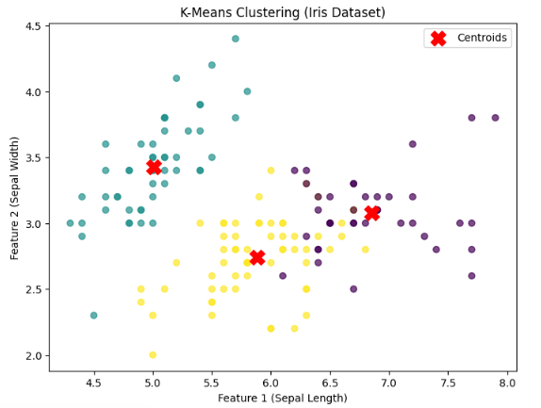

Slide 12
Sampling
Splits dataset into train/test subsets
Random and Stratified sampling used
Maintains balance across classes

Slide 13
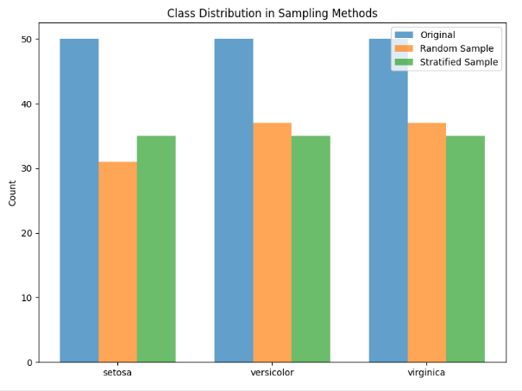

Slide 14
Bayesian Neural Network (BNN)
Neural network with uncertainty estimation
Learns probabilistic boundaries
Achieved classification accuracy similar to logistic regression

Slide 15
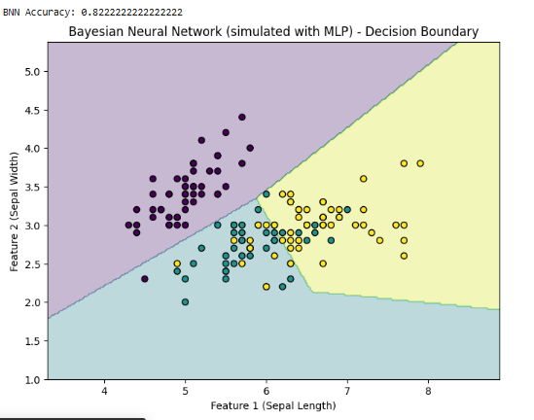

Slide 16
Support Vector Machine (SVM)
Finds best hyperplane for classification
Can use linear or non-linear kernels
Performed strongly on Iris dataset

Slide 17
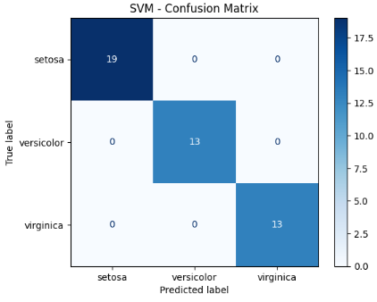

Slide 18
CF-Tree (BIRCH)
Efficient clustering for large datasets
Builds hierarchical clustering feature tree
Compact representation of clusters

Slide 19
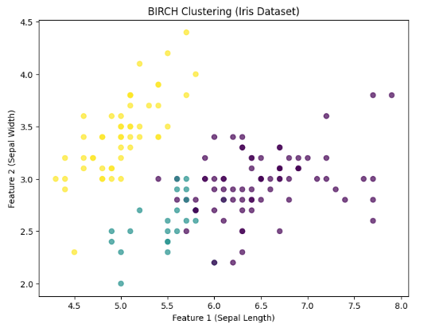

Slide 20
k-Nearest Neighbor (k-NN)
Classifies based on closest neighbors
Simple and effective non-parametric method
High accuracy achieved with k=5

Slide 21
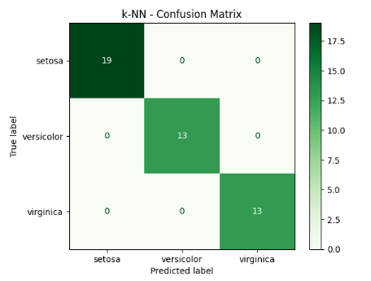

Slide 22
Genetic Algorithm (GA)
Optimization using selection, crossover, mutation
Applied for feature selection
Discovered best subset of features improving accuracy

Slide 23
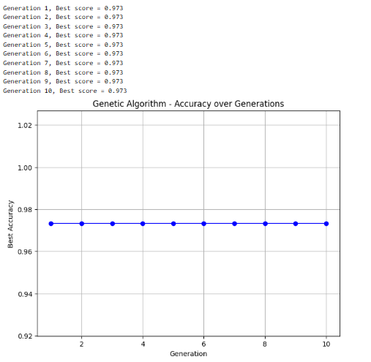

Slide 24
Multiclass Classification
Extends binary classifiers to multiple classes
One-vs-Rest and One-vs-One strategies
Achieved high accuracy on Iris dataset

Slide 25
