Slide 1
python
it loves you too

Slide 2
background
previous coding experience
previous Python experience

Slide 3
syntax
basically pseudocode
whitespace matters: use spaces not tabs
lots of built-in functionality - try and do things “pythonically” (see general/style.md)

Slide 4
running programs
Interactive
$ python
>>> print 'Hello, friends! :D'
'Hello, friends! :D'
From a file
$ python file.py
Hello, friends! :D

Slide 5
variables, yo
# no type declarations
x = 3
print x
# output: 3
# types aren't static
x = 'I\'m a string now!'
print x
# output: I'm a string now!

Slide 6
data structures
2 big ones
lists: basically arrays but easier
dictionaries: map keys to values. you'll see
Notes:
mutable
lists: slicing

Slide 7
arrays are for losers
we use "lists" in Python
have dynamic size
can hold many types of objects
indexing + slicing are easy

Slide 8
arrays are for losers
my_list = ['a', 'b', 'c', 'd', 'e']
my_list.append(24)
# my_list is now ['a', 'b', 'c', 'd', 'e', 24]
# print first element
print my_list[0]
# print last element
print my_list[-1]
# print elements at indices 1, 2, 3, and 4
print my_list[1:5]

Slide 9
dictionaries are cool too
maps keys to values
keys must be "hashable"
values can be anything :o

Slide 10
dictionaries are cool too
animals = {
'sloths': 'cuties',
'dogs': 'friendly as shit'
}
# add new keys
animals['cats'] = 'they\'re soft I guess'
# modify existing key/value pairs
animals['sloths'] = 'AMAZING'
print animals['cats']
# prints "they're soft I guess"

Slide 11
but even!
my_dict = {}
# add new keys
my_dict[(1,2)] = True

Slide 12
for loops are different
c:
int myArray[3] = {18, 21, 35};
int i;
for (i = 0; i < 3; i++) {
int elt = myArray[i];
// do stuff with elt
}
python:
my_list = [18, 21, 35]
for elt in my_list:
# do stuff with elt
for i in xrange(len(my_list)):
# do stuff with the index

Slide 13
iterate over dicts!
spirit_animals = {
'nikhil': 'monkey',
'mark yao': 'pikachu'
}
# iterate over keys
for key in spirit_animals:
val = spirit_animals[key]
print '{0}\'s spirit animal is {1}'.format(key, val)
# iterate over keys AND values
for key, val in spirit_animals.iteritems():
print '{0}\'s spirit animal is {1}'.format(key, val)

Slide 14
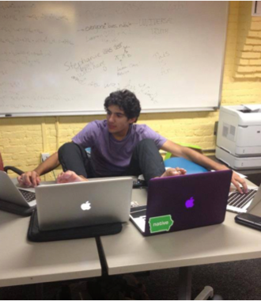
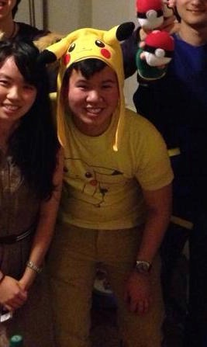

Slide 15
functions
def crash(car, other_car):
s = '{0} totally smashed into {1}!'.format(
car, other_car)
return s
crash('Lambo', 'BMW')
# returns 'Lambo totally smashed into BMW!'

Slide 16
importing things
Python comes with lots of libraries
you can use pip to install more (next week)
importing and using is super easy

Slide 17
importing things
import datetime
# now = today's date
now = datetime.date.today()
# print current year
print now.year
# print current date
print '{0}/{1}/{2}'.format(
now.month, now.day, now.year)

Slide 18
How to Learn Python
resources beyond us
Google
https://wiki.python.org/moin/BeginnersGuide
http://www.learnpython.org/

