Slide 1


Slide 2
Ants
by
Kamil Dutkiewicz

Slide 3


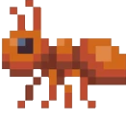
Ants
?

Slide 4
Ants
is left by
follows
follows
is left by

Slide 5
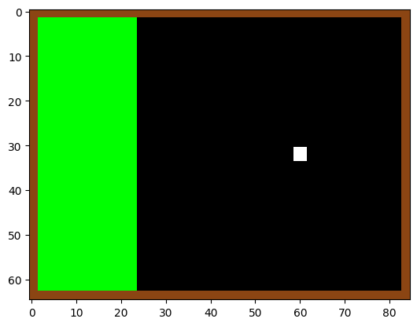
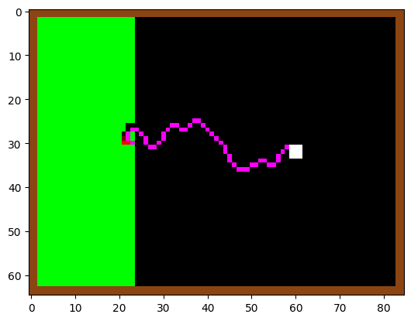
Ants
2D grid
■ Food
■ Nest
■ Foraging
■ Home
■ + ■ = ■

Slide 6
Fin

Slide 7
Ants
2D grid
■ Food
■ Nest
■ Foraging
■ Home
■ + ■ = ■

Slide 8
Fin

Slide 9
Tweaks
Old:
Ants loose smell
Pheromones evaporate
Obstacles
New:
Pheromones diffuse
Ants multiply their smell (s = (s+s₀)*1.5 )

Slide 10



Slide 11
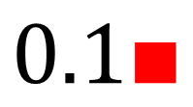


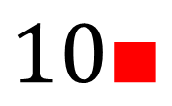
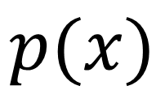
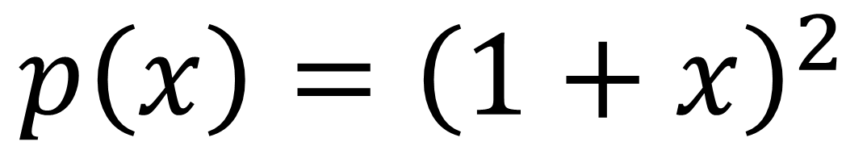


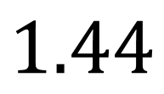
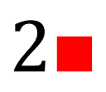
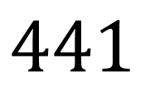
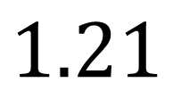

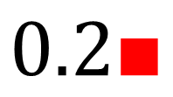
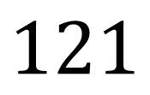
$$p\left(x\right)={\left(1+x\right)}^{2}$$
$$1\text{■}$$
$$2\text{■}$$
$$0.1\text{■}$$
$$0.2\text{■}$$
$$10\text{■}$$
$$20\text{■}$$
$$x$$
$$p(x)$$
$$4$$
$$9$$
$$1.21$$
$$1.44$$
$$121$$
$$441$$
1:2
1:1
1:4

Slide 12
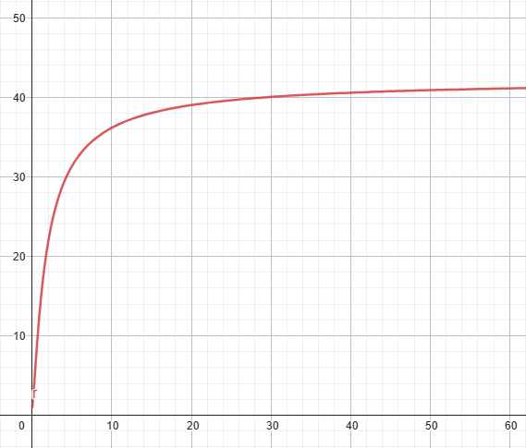
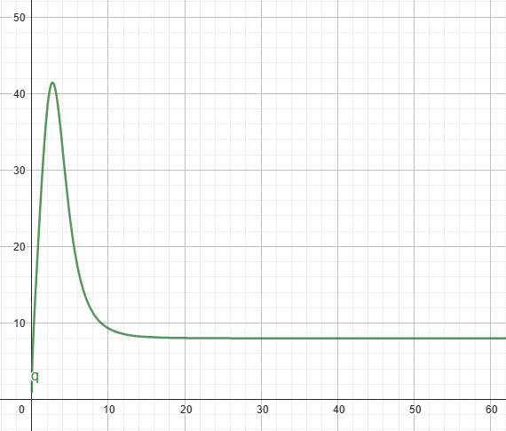



Illusion of free choice
$$p\left(x\right)/p(x/2)$$
$$p\left(x\right)={\left(h+x\right)}^{α}$$
$$p\left(x\right)=?$$

Slide 13
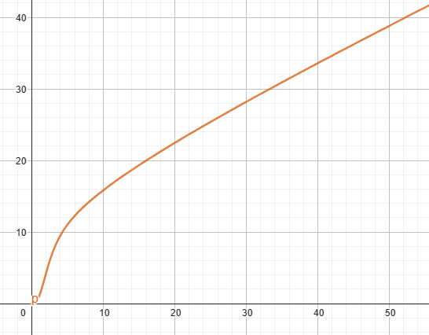
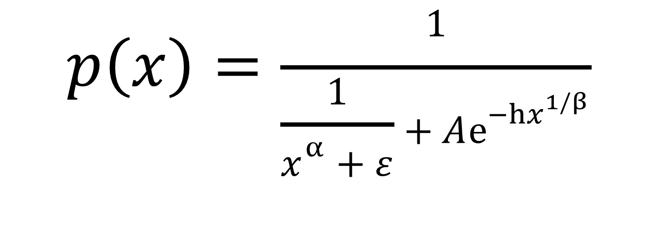
$$p\left(x\right)=\frac{1}{\frac{1}{x^{α}+ε}+Aⅇ^{−hx^{1/β}}}$$

Slide 14
The Fun Part

Slide 15
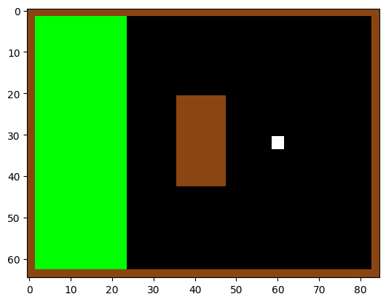
i=0
200 ants

Slide 16
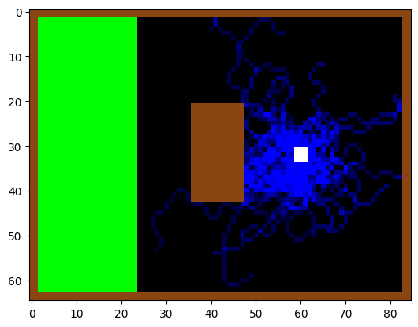
i=50
200 ants

Slide 17
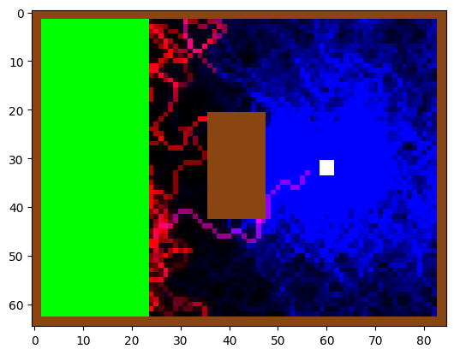
i=200

Slide 18
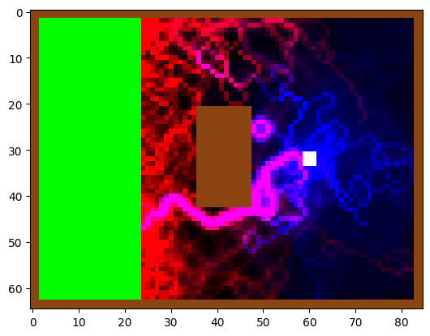
i=400

Slide 19
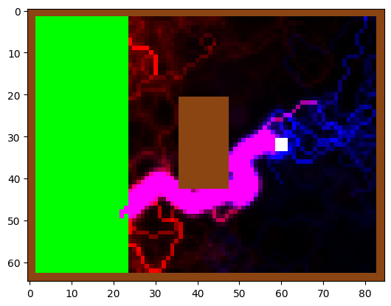
i=800

Slide 20
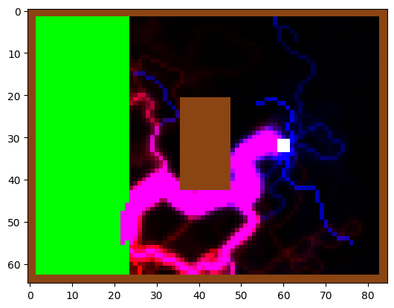
i=1200

Slide 21
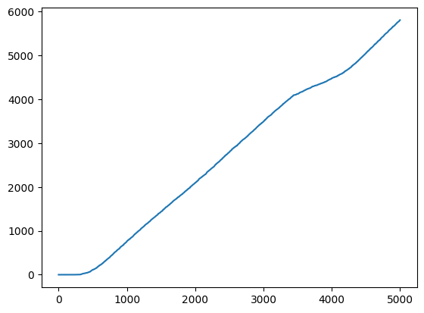
Food(t)

Slide 22
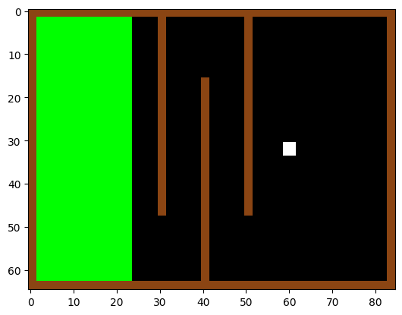
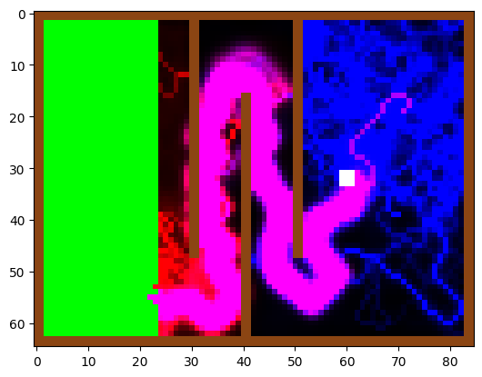
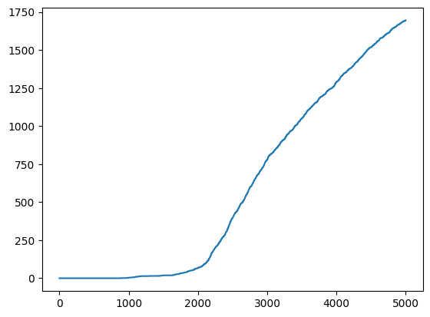
i = 2500
400 ants

Slide 23
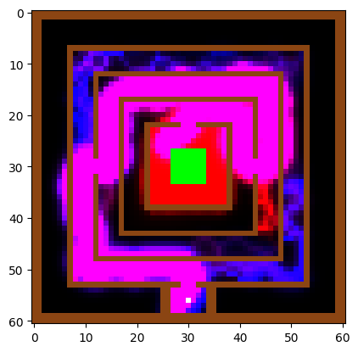
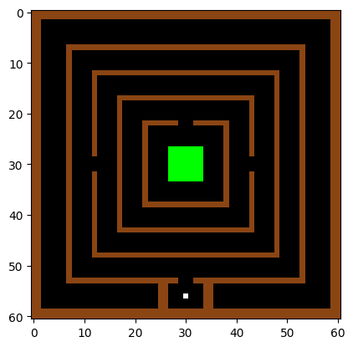
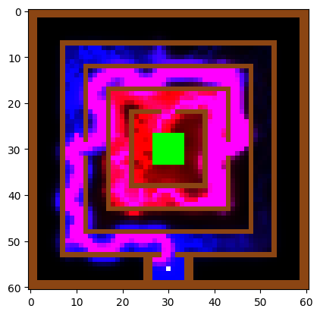

i=4000
400 ants
1m 28s

Slide 24
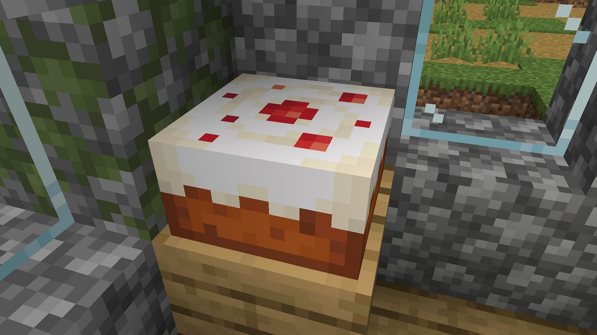

THANK YOU FOR YOUR ANTENTION

