Slide 1

Assessing Access to Healthcare professionals in Missouri
Jarrett Campbell, Andrew Mullenger, Kami Whitehurst-Levy

Slide 2
Research questions
Do lower-income zip codes have fewer doctors offices?
Do zip codes with higher percentages of racial minorities have fewer doctors offices?
Do zip codes with higher populations have more doctors offices?
Do zip codes with higher percentages of people on public insurance have fewer doctors offices?
Do zip codes with more people above the age of 65 have more doctors offices?

Slide 3
Data Sources
Missouri zip code API
Census data
Google Places API
(data.mo.gov)
(census.gov)

Slide 4
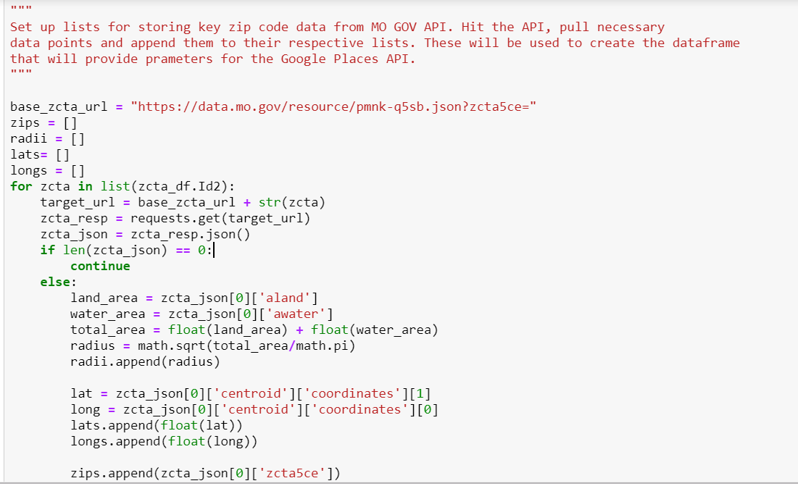
PULLING ZIP CODE METADATA

Slide 5
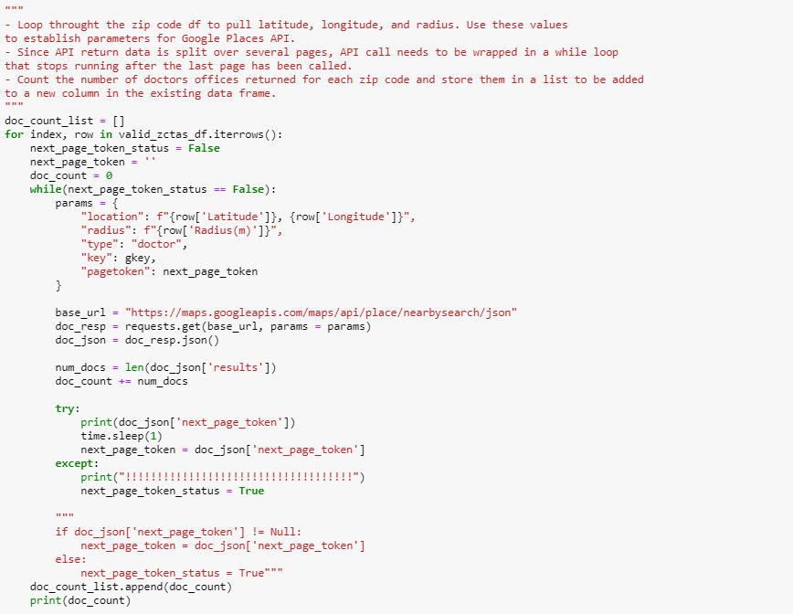
GETTING DOCTOR COUNTS FROM GOOGLE PLACES API

Slide 6
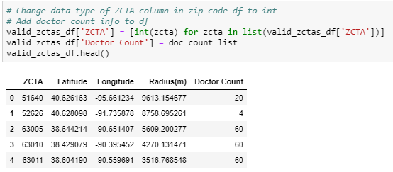
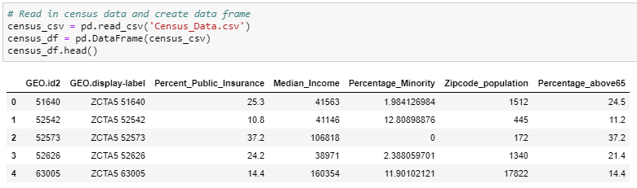
ADDING DOCTOR COUNTS TO ZIP CODE DF
READING IN CENSUS DATA

Slide 7
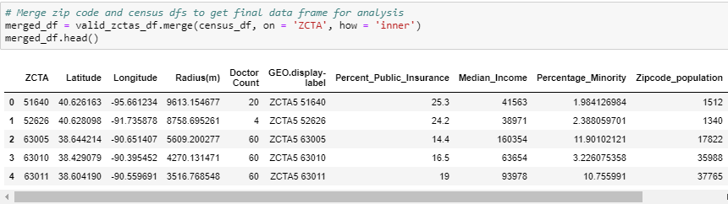
MERGING THE DATA FRAMES

Slide 8
Analysis

Slide 9
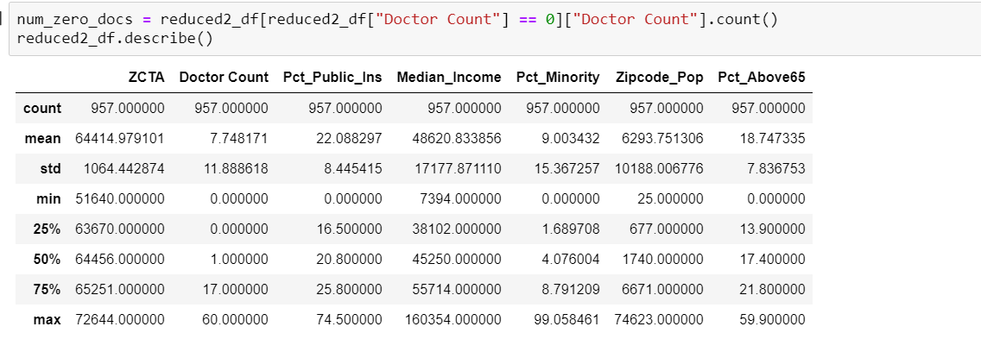

Slide 10
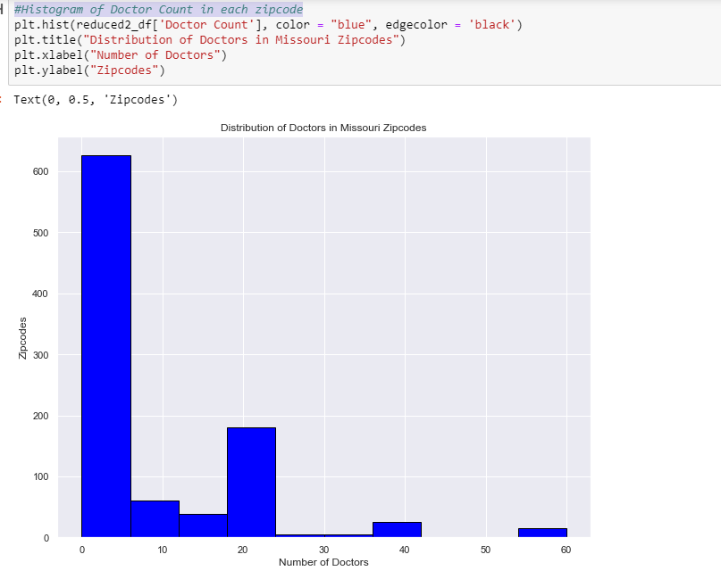

Slide 11
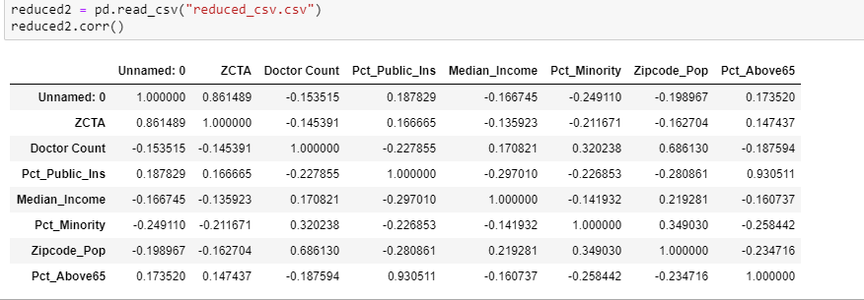

Slide 12
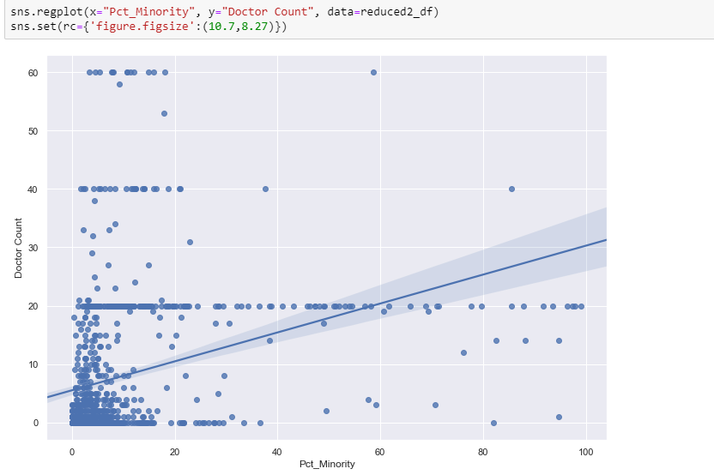

Slide 13
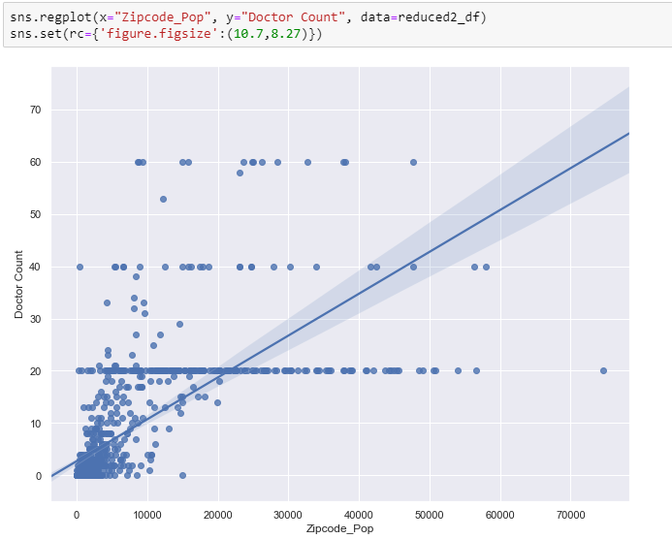

Slide 14
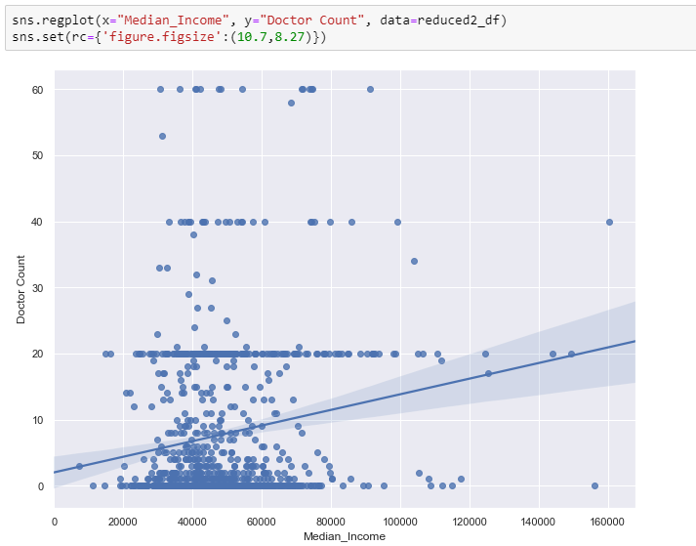

Slide 15
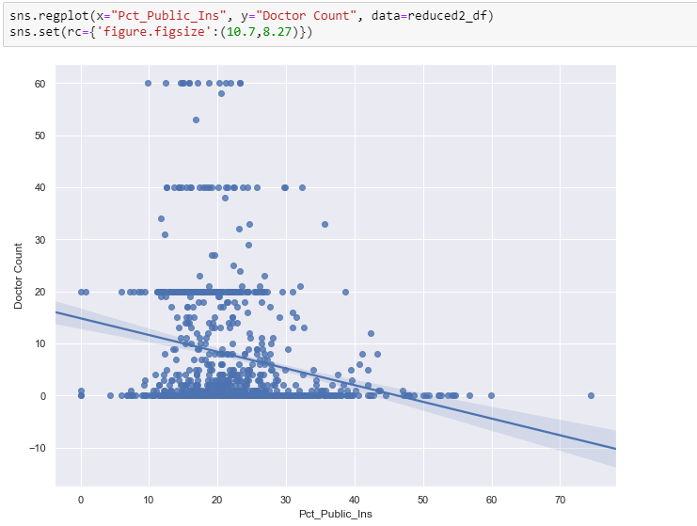

Slide 16
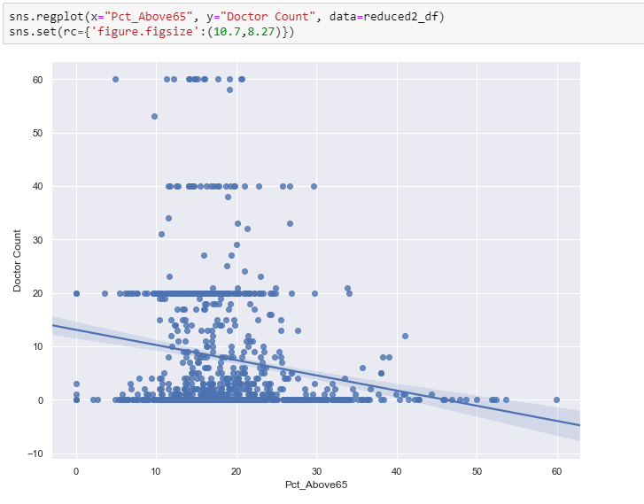

Slide 17
Conclusions and implications

Slide 18
Conclusions
The results of our data analysis provide evidence that support our hypotheses about zipcode population, median income, and number of residents with public health insurance.
Zip code population, minority population and median income have a positive correlation with the number of doctors in Missouri.
The reason that minority population correlation doesn’t support our hypothesis may be that minorities are more likely to live in zip codes that have a high population.
The number of zip code residents above 65 and the number of residents with public health insurance is negatively correlated with number of doctors.

Slide 19
Implications
If healthcare companies want to increase access in areas with high minority populations, our data shows the focus shouldn’t be on decreasing proximity to a doctor. The focus likely should be on finding ways to make healthcare more affordable and increasing number of people insured.
Since lower population areas tend to have fewer doctors per capita, mobile healthcare solutions might help provide more access to smaller, more rural communities.
Areas with higher rates of people over 65 tend to have fewer doctors, but the demand for healthcare is likely high. These would be good areas for healthcare companies to target when expanding.

Slide 20
Further research
To better measure healthcare access, we may want to distinguish between urban, suburban and rural zip codes. There may be a different process underlying the number of doctors in each of the three areas.
If we had more time, we would have run an MLE model rather than an OLS due to the high number of zip codes.
If we had more time or resources, we would use the Better Doctor API which has information on all primary care doctors in each zipcode.

