Slide 1

HR Analytics Dashboard
Data Analysis using Excel, SQL, Power BI, and Tableau

Slide 2

INDEX
Introduction
KPIs and Insights
Excel Dashboard
Tableau Dashboard
Power BI Dashboard
MySQL Queries
Challenges
Conclusion

Slide 3

Introduction
The HR Analytics project aims to analyze employee attrition and performance trends using Excel, SQL, Power BI, and Tableau to identify key factors impacting employee retention, satisfaction, and productivity.

Slide 4

KPIs and Insights
Average Attrition Rate for all Departments
Average Hourly Rate of Male Research Scientists
Attrition Rate vs Monthly Income Stats
Average Working Years for each Department
Job Role vs Work-Life Balance
Attrition Rate vs Years Since Last Promotion
Attrition Rate vs Age Group
Top 3 Highest Earnings Employees per Department

Slide 5
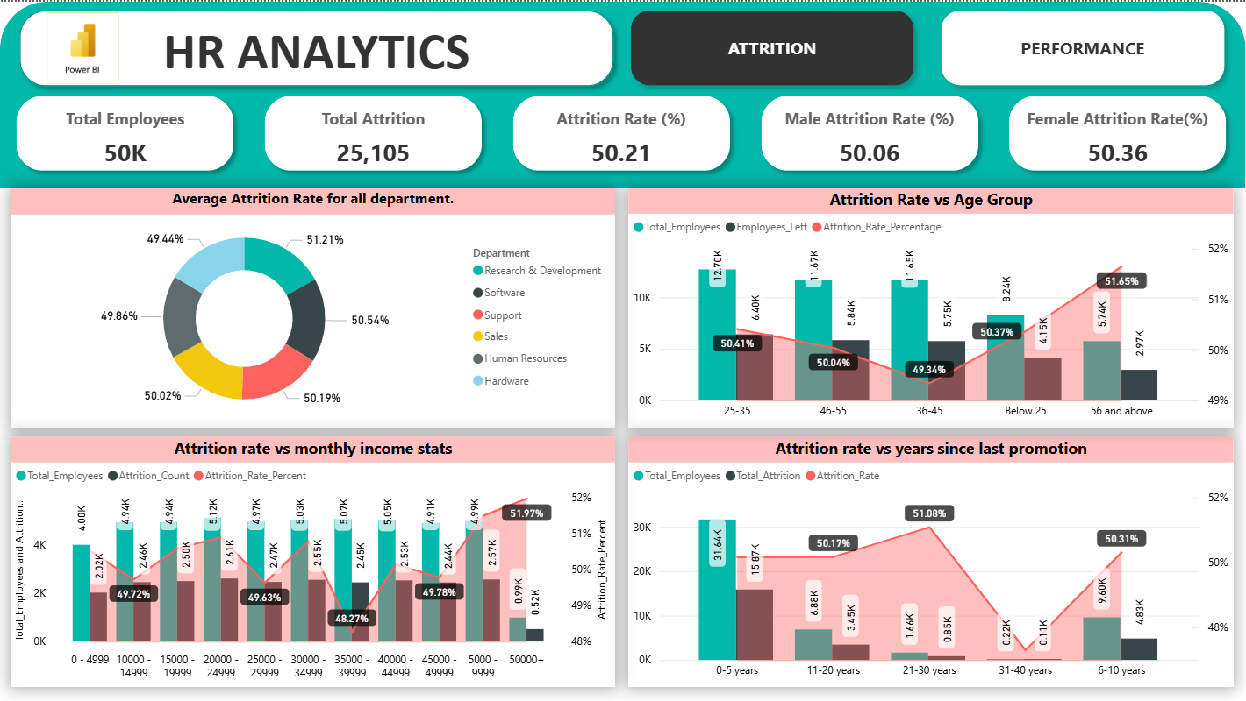
1. Average Attrition Rate for all Departments
Highest Attrition: Research & Development has the highest average attrition rate at 51.21%.
Next Highest: Software follows closely with an average rate of 50.54%.
Lowest Attrition: Hardware has the lowest rate at 49.44%, making it the most stable department.
Overall Trend: All departments have an attrition rate clustering around the 50% mark, showing high and consistent turnover across the board.

Slide 6
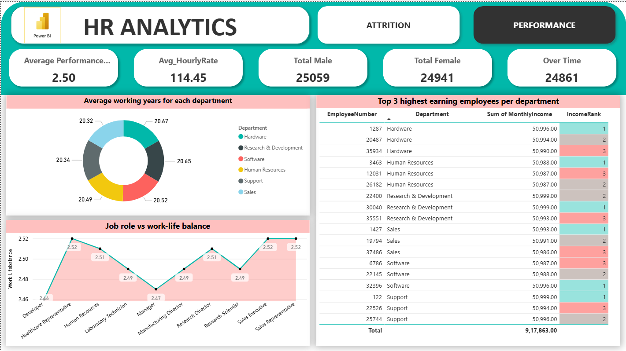
2. Average Hourly Rate of Male Research Scientists
The average hourly rate for male employees working as Research Scientists is ₹114
This indicates that Research Scientist roles are moderately compensated, reflecting a mid-level pay grade in the organization
A deeper comparison across genders and roles could reveal whether pay equity exists within the company

Slide 7
3. Attrition Rate vs Monthly Income Stats
Highest Risk: The highest rate of attrition (51.97%) is in the 50,000+ income group.
Most Leavers: The biggest number of employees leaving are from the mid-level 15k - 25k income range.
Low-Income Impact: The 0 - 5k bracket has both a high rate (49.72%) and a high number of leavers (2.02K).
Best Retention: The 35k - 40k income group has the lowest attrition rate (48.27%).

Slide 8
4. Average Working Years for each Department
Longest Tenure: Hardware has the longest average tenure at 20.67 years.
Shortest Tenure: Sales has the shortest average tenure at 20.32 years.
Key Insight: All departments are extremely similar. There is very little difference in average tenure (all are between 20.3 and 20.7 years).

Slide 9
5. Job Role vs Work-Life Balance
Best Balance (2.52): Healthcare Representative and Sales Executive/Representative roles report the highest Work-Life Balance score.
Worst Balance (2.46): Developer role reports the lowest Work-Life Balance score, indicating the greatest WLB challenge.
WLB Risk: The Developer role is a high-risk area for burnout or dissatisfaction due to poor WLB.
Below Average: Developer (2.46) and Research Scientist (2.49) are also slightly below the average and need attention.

Slide 10
6. Attrition Rate vs Years Since Last Promotion
Highest Risk Period: The highest attrition rate is seen when employees have waited 21-30 years since their last promotion (51.08%).
Initial Danger Zone: The next highest rates are in the 6-10 years (50.31%) and 11-20 years (50.17%) waiting periods.
Lowest Risk: The attrition rate drops sharply for employees waiting 31-40 years (48.4%), though this group has a very small population (0.22K total).
Bulk Attrition: The largest number of people leaving is in the 0-5 years category (15.87K), despite this group having the lowest reported rate (47.96%). This is because it is the largest employee group (31.64K).

Slide 11
7. Attrition Rate vs Age Group
Highest Risk: The highest attrition rate (51.65%) is in the 56 and above age group.
Most Stable Group: The 36-45 age group has the lowest attrition rate (49.34%).
Bulk Attrition: The largest number of employees leaving (6.40K) comes from the 25-35 age group, simply because it's the largest segment of the workforce.

Slide 12
8. Top 3 Highest Earnings Employees per Department
Equal Pay at the Top: The highest reported salaries across all departments are nearly identical, clustering around 50,990 - 51,000.
Income Rank Consistency: For the top 3 spots within each department, the salaries are very closely grouped (e.g., Rank 1, 2, and 3 in Hardware are 50,996, 50,994, and 50,990).

Slide 13
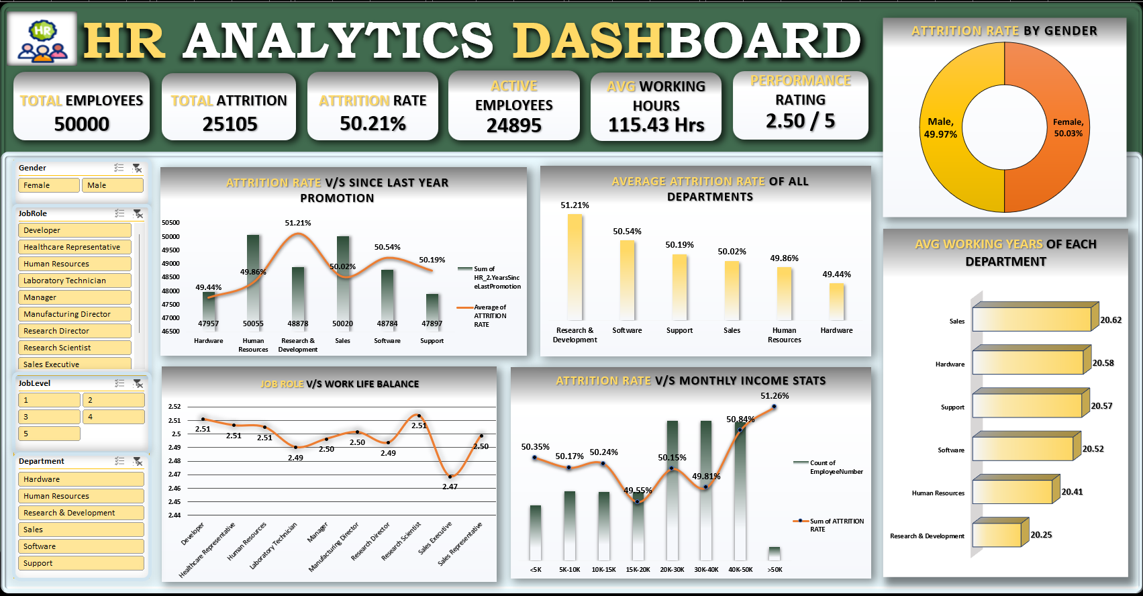
Excel Dashboard

Slide 14
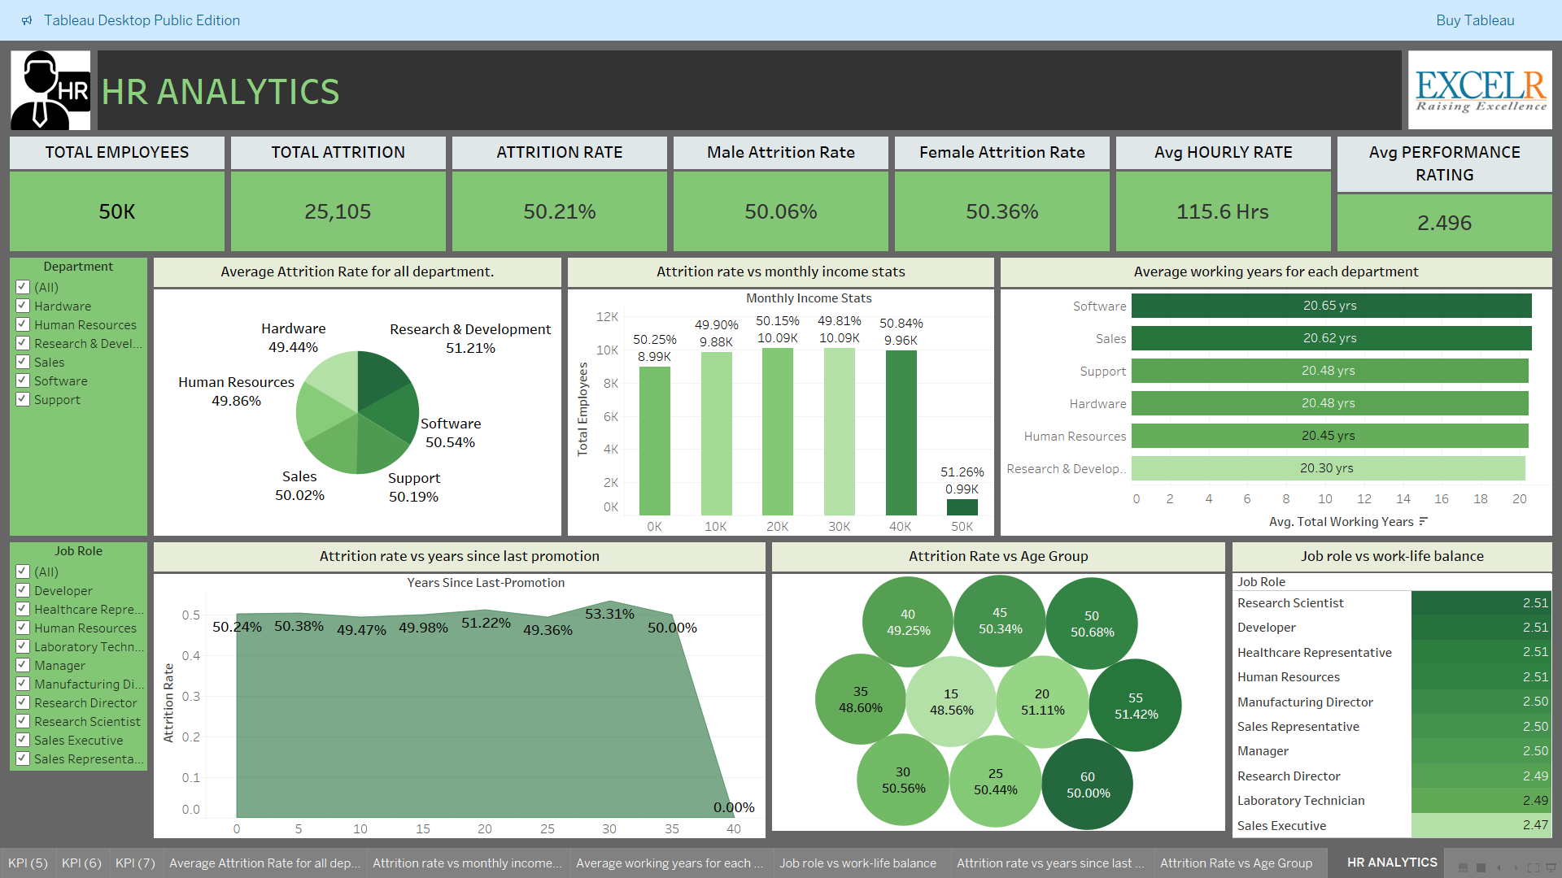
Tableau Dashboard

Slide 15
Power BI Dashboard - Attrition

Slide 16
Power BI Dashboard - Performance

Slide 17
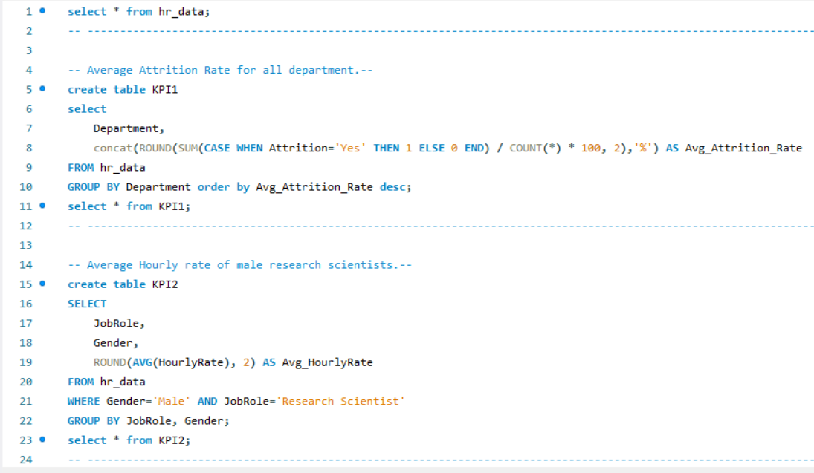
SQL Queries

Slide 18
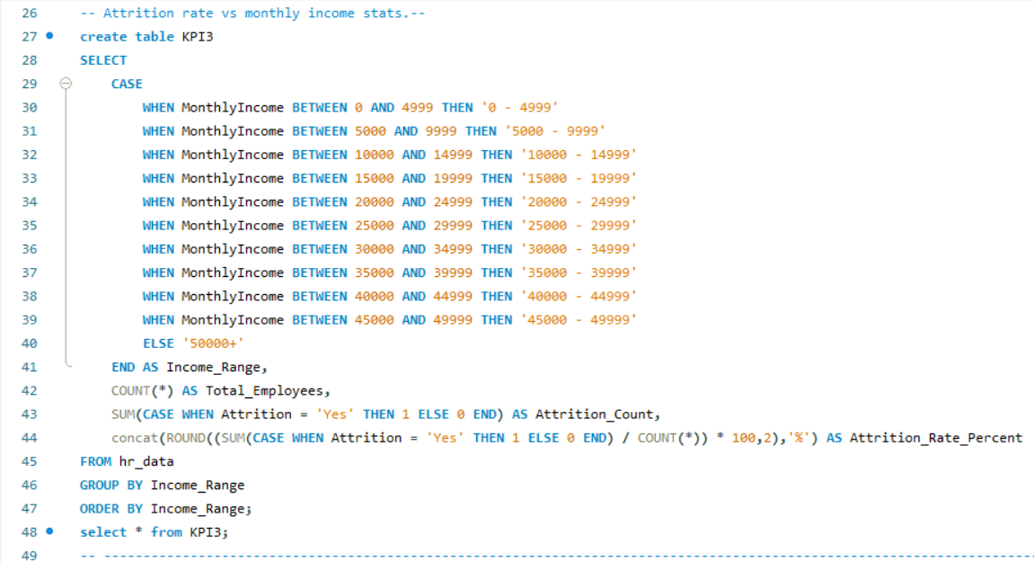
SQL Queries

Slide 19
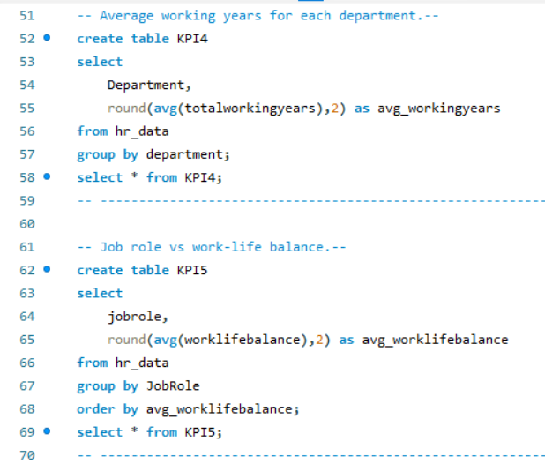
SQL Queries

Slide 20
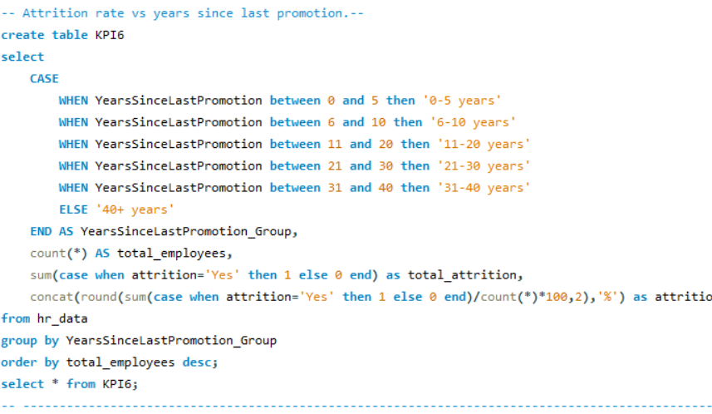
SQL Queries

Slide 21
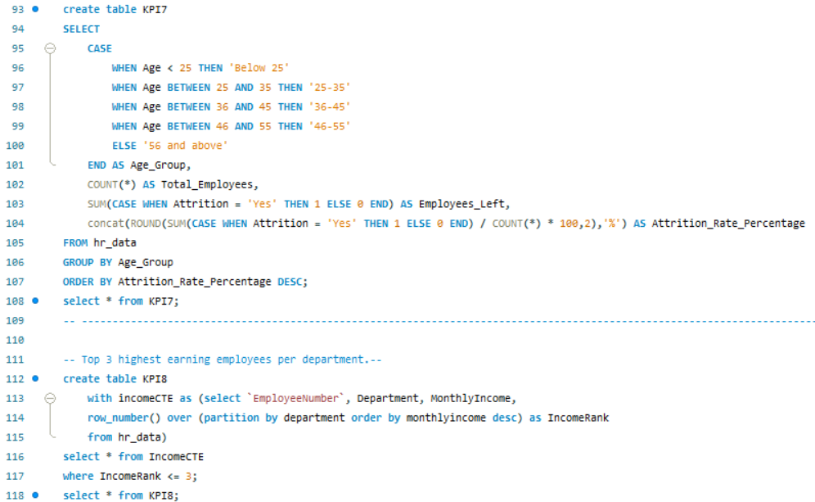
SQL Queries

Slide 22
Summary & Strategic Action Plan
Key Findings & Conclusion
Actionable Recommendations &Feedback
Attrition Risk is Structural : Overall attrition rate is high (50%), indicating a systemic issue, not just isolated department problems.
Promotion Lag Drives Loss : Waiting 6-30 years for a promotion is strongly correlated with high attrition rates.
High-Value Flight : The 50,000+ income bracket has the highest attrition rate (51.97%),indicating poor retention of senior/highly-paid staff.
Manager Burnout : The Manager role reports the lowest Work-Life Balance (2.47), making it a high-risk role for dissatisfaction.:
R&D Stability Risk : Research & Development has the highest overall department attrition rate(51.21%) and one of the lowest average tenures (20.34years).
Re-evaluate Promotion Cadence : Implement mandatory review points for promotion every 5 years to break the high-risk 6-30 year waiting window.
Targeted Retention for 50k+ : Conduct stay interviews with high-income employees to understand non-monetary retention factors (e.g., impact, autonomy).
Fix Manager WLB : Deploy support staff or adjust span of control for Managers to immediately improve their Work-Life Balance score (2.47).
Prioritize R&D & Sales : Focus retention efforts on R&D (highest rate) and Sales (shortest tenure)to stabilize core creative and revenue functions.

Slide 23
Challenges and Solutions
Challenge 1: Combining HR1 and HR2 datasets with no common column
Solution: Added a index column on both files (from 1) and with the merge queries used the index columns from both HR1 and HR2 as common column.
Challenge 2: Loading CSV files into MySQL (LOCAL INFILE error)
Solution: Enabled local_infile in MySQL configuration and reloaded using proper permissions
Challenge 3: struggling to Load MySQL tables into Power BI for visualization
Solution: With the Help of ChatGPTs instruction, we Connected Power BI to MySQL via the MySQL Connector, imported cleaned HR tables, and built interactive dashboards directly from the database.

Slide 24

THANK YOU

