Slide 1
Towards stock price analysis on time series data using LSTM
The project "Stock Prediction using Machine Learning" takes us through the basic process of predicting the trends of stock prices using machine learning architecture of LSTM while also making use of prominent Python Libraries such as TensorFlow, Kera’s.
-A Project by KAMIL ILHAQ, IT SEC B , 3RD YEAR
ROLL NO- 1802913073

Slide 2
OBJECTIVE
The objective of this project is to correctly predict the stock prices of a company’s shares in the financial market.

Slide 3
FLOW PROCESS
Selection of Dataset.
Understanding LSTM Architecture.
Data Pre-processing.
Feature Extraction.
Implementing the Adam Optimiser.
Regularisation.
Fitting the RNN to the Training set.
Training Neural Network.
Output generation.
Data Visualization.

Slide 4
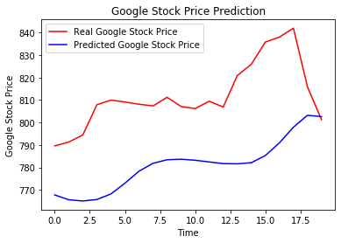
EXPERIMENTAL RESULTS
Red line in the graph indicates the real Google stock price.
Blue line shows the predicted stock price of Google.
We can see that almost at every point of the graph the predicted value holds true.

Slide 5
CONCLUSION
The whole concept of this project was to correctly predict the trends in stock prices of a company in the future.
Using machine learning and LSTM, I was able to achieve my desired goal at the end by correctly predicting the trends observed in stock prices of Google in the future.
On comparing the predicted stock prices and the real stock prices, we see that at almost every point of the graph, our predicted trend holds true thereby fulfilling the whole purpose of the project.

Slide 6
BY KAMIL ILHAQ , IT SECTION B, 3RD YEAR, ROLL NO-1802913073
THANK YOU

