Slide 1
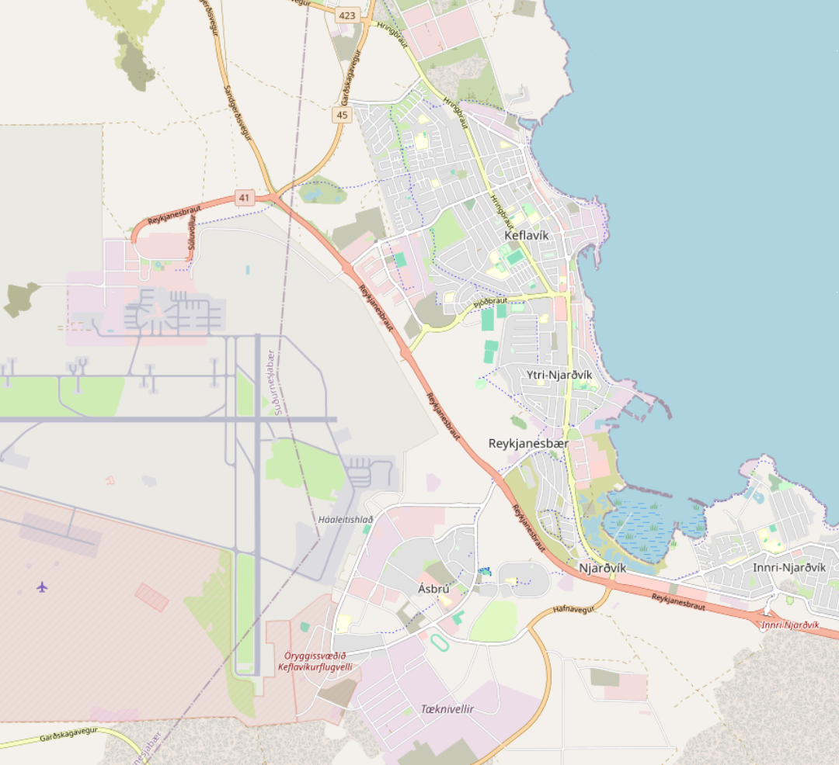
where can I leave my car while I'm away?
YOU'VE EARNED IT
KEF AIRPORT
Mountain Car
Mountain Car Garage
Njarðarbraut 3i, Njarðvík
Open · Mon–Sat 15:00–21:00
map © OpenStreetMap contributors
LEAVE YOUR CAR WITH US —
GO ENJOY YOUR TIME OFF
Heading out of Iceland? Drop the car off at the garage
and pick it up when you're back.
MOUNTAIN CAR GARAGE · NJARÐVÍK · WhatsApp +354 888 8005

