Slide 1










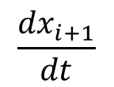


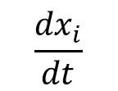
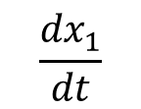
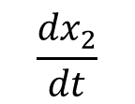

$$x_{0}$$
$$x_{1}$$
$$x_{2}$$
$$…$$
$$x_{i}$$
$$x_{i+1}$$
$$…$$
Decoder
Predictions
$$\frac{{dx}_{1}}{dt}$$
$$\frac{{dx}_{2}}{dt}$$
$$\frac{{dx}_{i}}{dt}$$
$$\frac{{dx}_{i+1}}{dt}$$
Time
$$t_{0}$$
$$t_{1}$$
$$t_{2}$$
$$…$$
$$t_{i}$$
$$t_{i+1}$$

Slide 2
$$x_{0}$$
$$x_{1}$$
$$x_{2}$$
$$…$$
$$x_{i}$$
$$x_{i+1}$$
$$…$$
Decoder
Predictions
$$\frac{{dx}_{1}}{dt}$$
$$\frac{{dx}_{2}}{dt}$$
$$\frac{{dx}_{i}}{dt}$$
$$\frac{{dx}_{i+1}}{dt}$$
Time
$$t_{0}$$
$$t_{1}$$
$$t_{2}$$
$$…$$
$$t_{i}$$
$$t_{i+1}$$

Slide 3
Hidden Layers
Input
Output
ReLU
ReLU
ReLU
ReLU
ReLU
ReLU
ReLU
ReLU
Layer 1
Layer 2

Slide 4
Hidden Layers
Input
ReLU
ReLU
Output
ReLU
ReLU
ReLU
ReLU
ReLU
ReLU
Layer 1
Layer 2

Slide 5

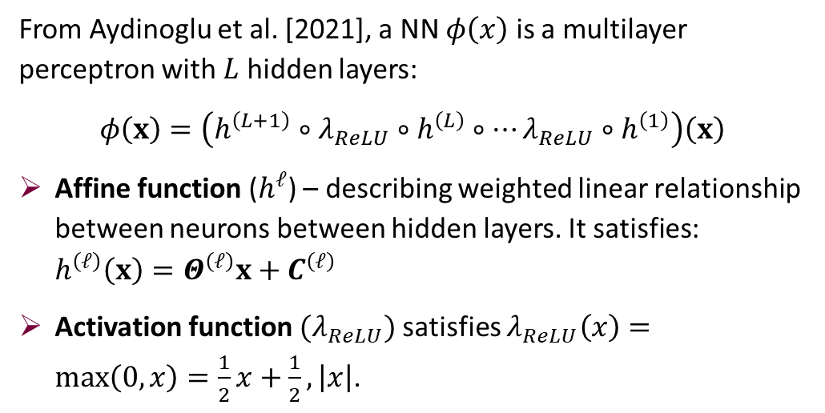
Root Finding for Embedded ReLU Neural Networks
Goal: Given a fitted ReLU neural network $ϕ$ applied to state variable $x$, solve:
$$g(x,ϕ(x))=0$$
Where residual function $g:R^{n}→R^{n}$ is defined as:
$$g\left(x,y\right)=Px+Qy+r$$
Neural Network Architecture
From Aydinoglu et al. [2021], a NN $φ\left(x\right)$ is a multilayer perceptron with $L$ hidden layers:
$$φ\left(x\right)=\left(h^{\left(L+1\right)}∘λ_{ReLU}∘h^{\left(L\right)}∘…λ_{ReLU}∘h^{\left(1\right)}\right)\left(x\right)$$
Affine function ($h^{ℓ}$) – describing weighted linear relationship between neurons between hidden layers. It satisfies: $h^{\left(ℓ\right)}\left(x\right)=Θ^{\left(ℓ\right)}x+C^{\left(ℓ\right)}$
Activation function $(λ_{ReLU})$satisfies $λ_{ReLU}\left(x\right)=\max\left(0,x\right)=\frac{1}{2}x+\frac{1}{2},\left|x\right|$.
Hidden Layers
Input
Output
Layer 1
Layer 2

Slide 6







Hidden Layers
Input
Output
Each Neuron
inputs
weights
$$a_{1}$$
$$w_{1}$$
$$a_{2}$$
$$w_{2}$$
$$Σ$$
$$w_{3}$$
ReLU
$$a_{3}$$

Slide 7
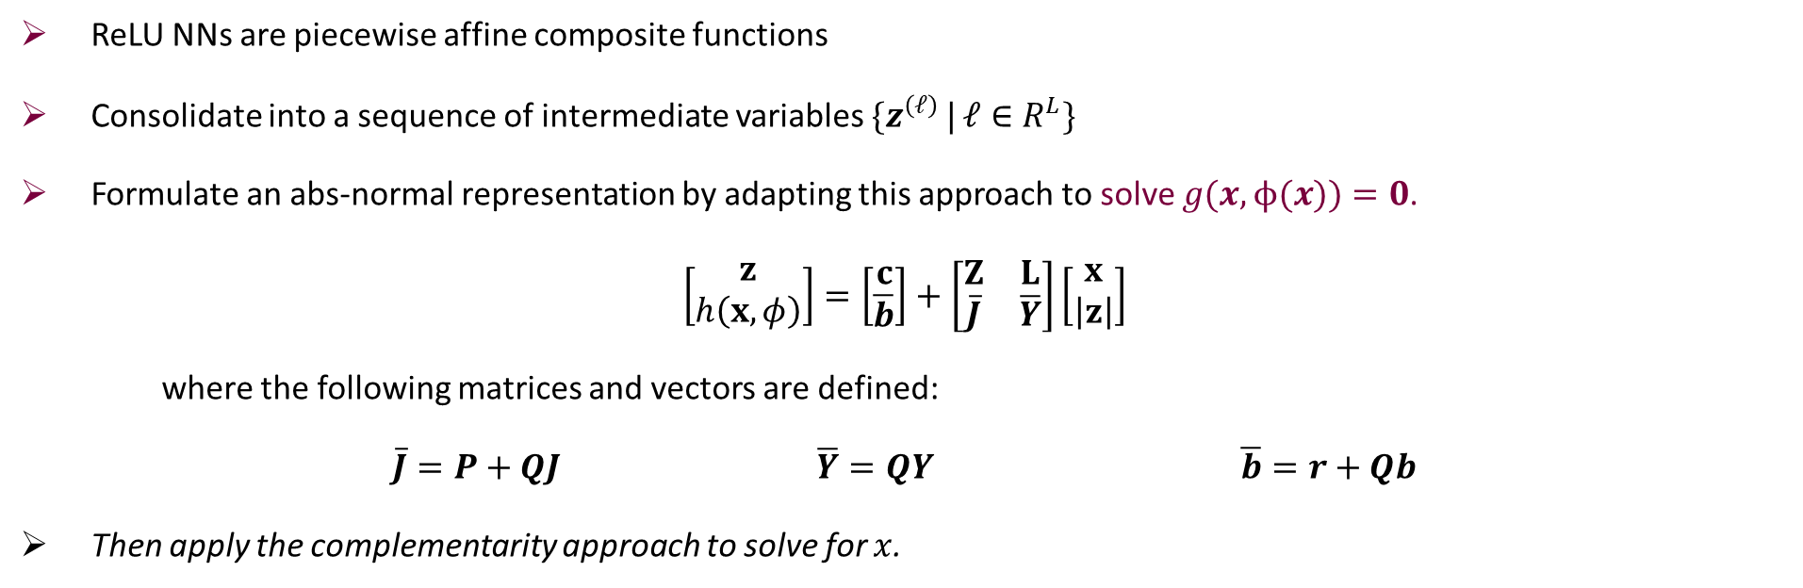
Root Finding for Embedded ReLU Neural Networks
Goal: Given a fitted ReLU neural network $ϕ$ applied to state variable $x$, solve:
$$g(x,ϕ(x))=0$$
Where residual function $g:R^{n}→R^{n}$ is defined as:
$$g\left(x,y\right)=Px+Qy+r$$
Adapted abs-normal solver
ReLU NNs are piecewise affine composite functions
Consolidate into a sequence of intermediate variables $\{z^{\left(ℓ\right)} | ℓ∈R^{L}\}$
Formulate an abs-normal representation by adapting this approach to solve $g(x,ϕ(x))=0$.
$$\left[\begin{matrix}z \\ h\left(x,φ\right)\end{matrix}\right]=\left[\begin{matrix}c \\ \overline{b}\end{matrix}\right]+\left[\begin{matrix}Z & L \\ \overline{J} & \overline{Y}\end{matrix}\right]\left[\begin{matrix}x \\ \left|z\right|\end{matrix}\right]$$
where the following matrices and vectors are defined:
$\overline{J}=P+QJ$ $\overline{Y}=QY$ $\overline{b}=r+Qb$
Then apply the complementarity approach to solve for $x$.

Slide 8
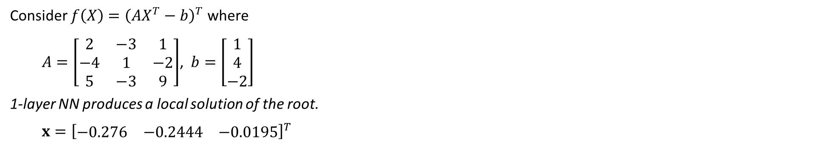
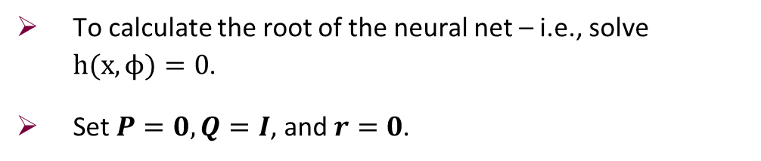
Root Finding for Embedded ReLU Neural Networks
To calculate the root of the neural net – i.e., solve $h(x,ϕ)=0$.
Set $P=0,Q=I$, and $r=0$.
Consider $f\left(X\right)={\left(AX^{T}−b\right)}^{T}$ where
  $A=\left[\begin{matrix}2 & −3 & 1 \\ −4 & 1 & −2 \\ 5 & −3 & 9\end{matrix}\right]$, $b=\left[\begin{matrix}1 \\ 4 \\ −2\end{matrix}\right]$
1-layer NN produces a local solution of the root.
  $$x={\left[\begin{matrix}−0.276 & −0.2444 & −0.0195\end{matrix}\right]}^{T}$$

Slide 9
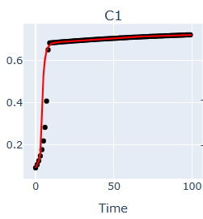




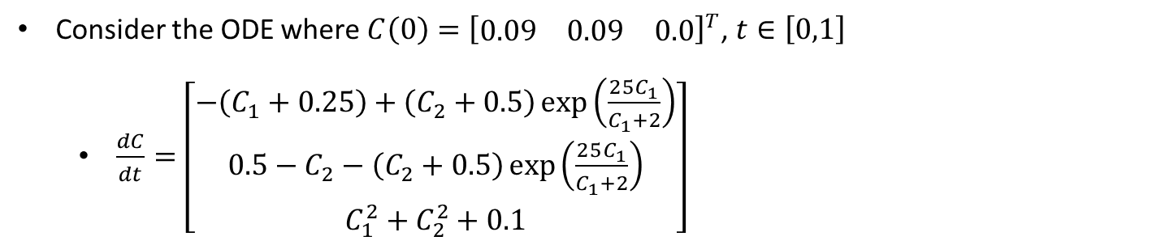





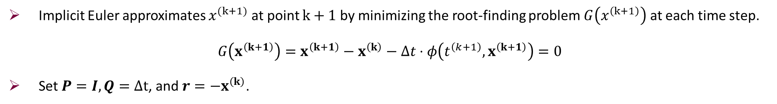





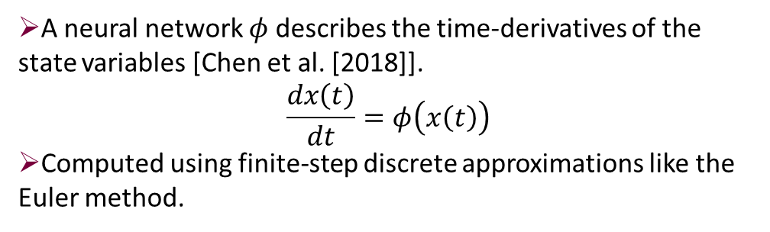



Neural ODE Definition
A neural network $φ$ describes the time-derivatives of the state variables [Chen et al. [2018]].
$$\frac{dx\left(t\right)}{dt}=φ\left(x\left(t\right)\right)$$
Computed using finite-step discrete approximations like the Euler method.
$$x_{0}$$
$$x_{1}$$
$$x_{2}$$
$$…$$
$$x_{i}$$
$$x_{i+1}$$
Decoder
$$…$$
Predictions
$$\frac{{dx}_{1}}{dt}$$
$$\frac{{dx}_{2}}{dt}$$
$$\frac{{dx}_{i}}{dt}$$
$$\frac{{dx}_{i+1}}{dt}$$
Time
$$t_{0}$$
$$t_{1}$$
$$t_{2}$$
$$…$$
$$t_{i}$$
$$t_{i+1}$$
Solving first-order Neural ODEs
Implicit Euler approximates $x^{(k+1)}$ at point $k+1$ by minimizing the root-finding problem $G\left(x^{\left(k+1\right)}\right)$ at each time step.
$$G\left(x^{\left(k+1\right)}\right)=x^{\left(k+1\right)}−x^{\left(k\right)}−Δt⋅φ\left(t^{\left(k+1\right)},x^{\left(k+1\right)}\right)=0$$
Set $P=I,Q=∆t$, and $r=−x^{\left(k\right)}$.
Consider the ODE where $C\left(0\right)={\left[\begin{matrix}0.09 & 0.09 & 0.0\end{matrix}\right]}^{T}$, $t∈\left[0,1\right]$
  $\frac{dC}{dt}=\left[\begin{aligned}−\left(C_{1}+0.25\right)+\left(C_{2}+0.5\right)\exp\left(\frac{25C_{1}}{C_{1}+2}\right) \\ 0.5−C_{2}−\left(C_{2}+0.5\right)\exp\left(\frac{25C_{1}}{C_{1}+2}\right) \\ C_{1}^{2}+C_{2}^{2}+0.1\end{aligned}\right]$

Slide 10
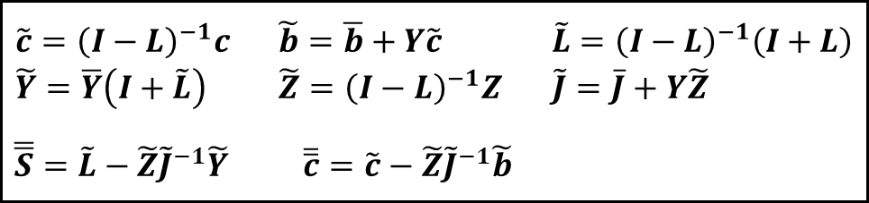
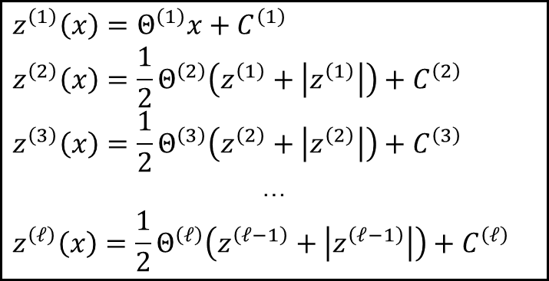

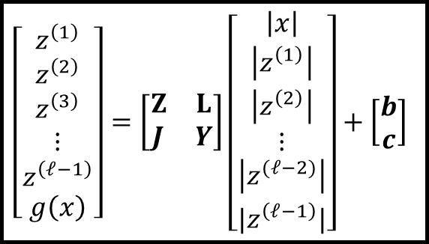

Summary of Construction
ReLU NN
Abs-normal matrix set-up
$$z^{\left(1\right)}\left(x\right)=Θ^{\left(1\right)}x+C^{\left(1\right)}$$
$$z^{\left(2\right)}\left(x\right)=\frac{1}{2}Θ^{\left(2\right)}\left(z^{\left(1\right)}+\left|z^{\left(1\right)}\right|\right)+C^{\left(2\right)}$$
$$z^{\left(3\right)}\left(x\right)=\frac{1}{2}Θ^{\left(3\right)}\left(z^{\left(2\right)}+\left|z^{\left(2\right)}\right|\right)+C^{\left(3\right)}$$
…
$$z^{\left(ℓ\right)}\left(x\right)=\frac{1}{2}Θ^{\left(ℓ\right)}\left(z^{\left(ℓ−1\right)}+\left|z^{\left(ℓ−1\right)}\right|\right)+C^{\left(ℓ\right)}$$
$$\left[\begin{matrix}z^{\left(1\right)} \\ \begin{aligned}z^{\left(2\right)} \\ z^{\left(3\right)} \\ ⋮ \\ z^{\left(ℓ−1\right)}\end{aligned} \\ g\left(x\right)\end{matrix}\right]=\left[\begin{matrix}Z & L \\ J & Y\end{matrix}\right]\left[\begin{matrix}\begin{aligned}\begin{aligned}\left|x\right| \\ \left|z^{\left(1\right)}\right|\end{aligned} \\ \left|z^{\left(2\right)}\right|\end{aligned} \\ \begin{aligned}⋮ \\ \left|z^{(ℓ−2)}\right|\end{aligned} \\ {|z}^{\left(ℓ−1\right)}|\end{matrix}\right]+\left[\begin{aligned}b \\ c\end{aligned}\right]$$
Partition NN parameters into abs-normal form
Neural ODE: Solve Euler Equation for x
$$g\left(x\right)=Px+Qz^{\left(ℓ\right)}\left(x\right)+r$$
$\overline{J}=P+QJ \overline{Y}=QY$ $\overline{b}=r+Qb$
Complementary Solver
Construction of new coefficients
$$\tilde{J}x=−\tilde{b}−\tilde{Y}w$$
where $w$ solves LCP:
$0≤w⊥\check{c}+\check{S}w≥0$
$$\begin{matrix}\tilde{c}={\left(I−L\right)}^{−1}c & \tilde{b}=\overline{b}+Y\tilde{c} & \tilde{L}={\left(I−L\right)}^{−1}\left(I+L\right) \\ \tilde{Y}=\overline{Y}\left(I+\tilde{L}\right) & \tilde{Z}={\left(I−L\right)}^{−1}Z & \tilde{J}=\overline{J}+Y\tilde{Z} \end{matrix}$$
$\overline{\overline{S}}=\tilde{L}−\tilde{Z}{\tilde{J}}^{−1}\tilde{Y}$ $\overline{\overline{c}}=\tilde{c}−\tilde{Z}{\tilde{J}}^{−1}\tilde{b}$

Slide 11
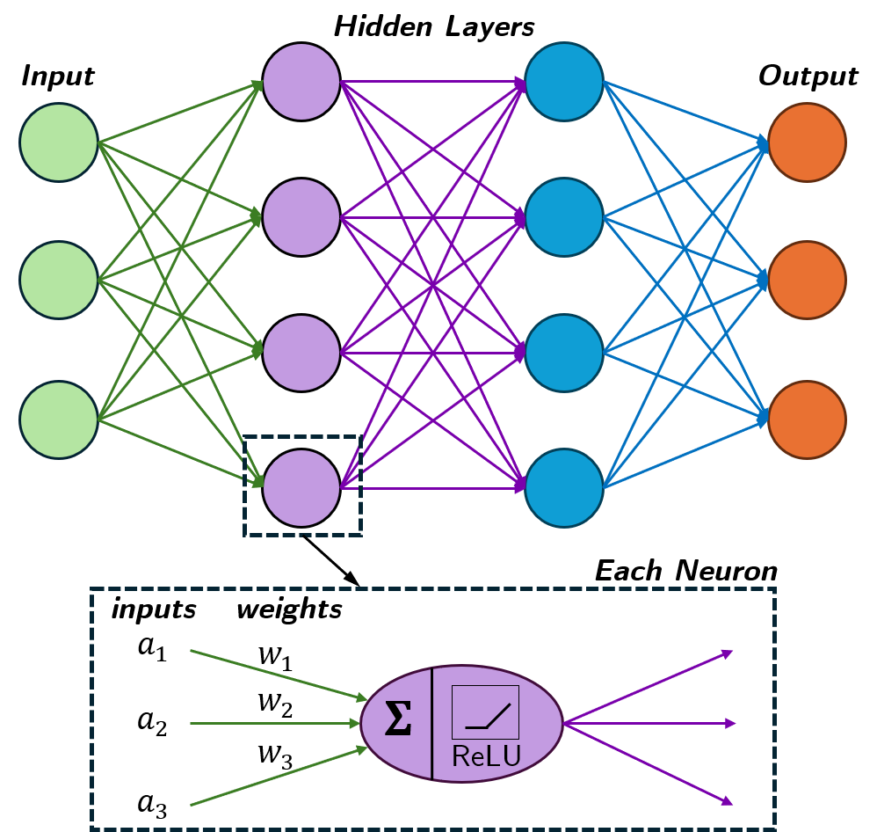

Piecewise affine mapping of neural ODE
Abs-normal form
Construct LCP coefficients
Solve LCP
Neural Network Architecture
From Aydinoglu et al. [2021], a NN $φ\left(x\right)$ is a multilayer perceptron with $L$ hidden layers:
$$φ\left(x\right)=\left(h^{\left(L+1\right)}∘λ_{ReLU}∘h^{\left(L\right)}∘…λ_{ReLU}∘h^{\left(1\right)}\right)\left(x\right)$$
Affine function ($h^{ℓ}$) – describing weighted linear relationship between neurons between hidden layers. It satisfies: $h^{\left(ℓ\right)}\left(x\right)=Θ^{\left(ℓ\right)}x+C^{\left(ℓ\right)}$
Activation function $(λ_{ReLU})$satisfies $λ_{ReLU}\left(x\right)=\max\left(0,x\right)=\frac{1}{2}x+\frac{1}{2},\left|x\right|$.

Slide 12
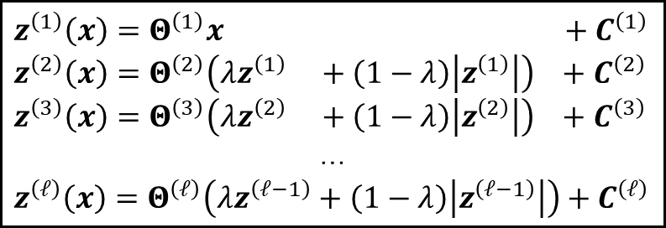
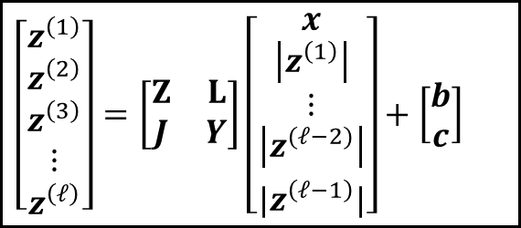
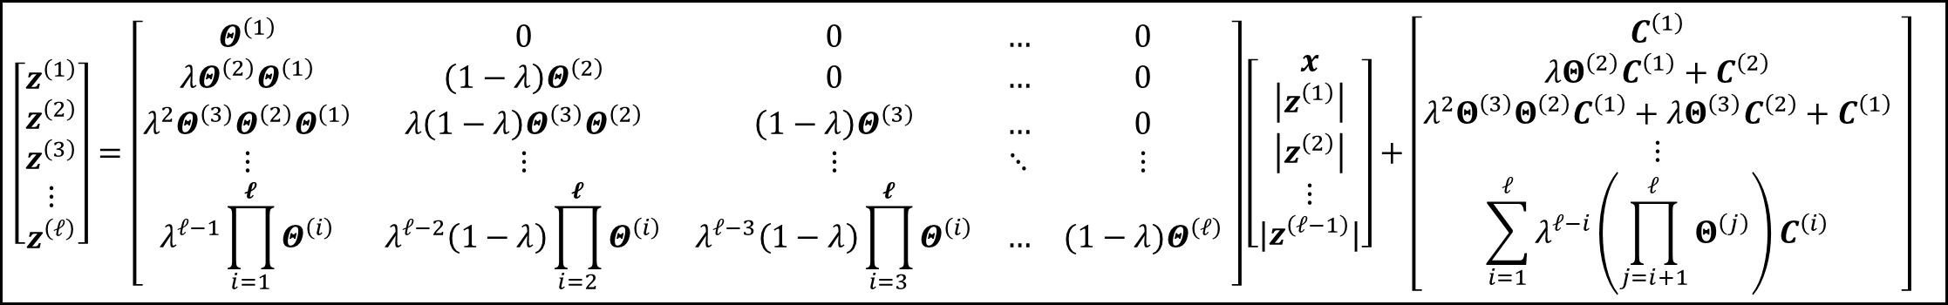
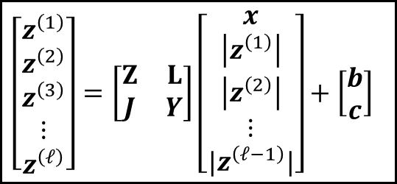
Piecewise affine mapping of neural ODE
Partition into abs-normal form
Construct coefficients for LCP problem
Solve LCP using complementary solver
Neural Network Architecture
Partition NN parameters into abs-normal form
ReLU NN
Abs-normal matrix set-up
$$z^{\left(1\right)}\left(x\right)=Θ^{\left(1\right)}x\left(z^{\left(1\right)}+ \left|z^{\left(1\right)}\right| \right) +C^{\left(1\right)}$$
$$z^{\left(2\right)}\left(x\right)=Θ^{\left(2\right)}\left(λz^{\left(1\right)} +\left(1−λ\right)\left|z^{\left(1\right)}\right|\right) +C^{\left(2\right)}$$
$$z^{\left(3\right)}\left(x\right)=Θ^{\left(3\right)}\left(λz^{\left(2\right)} +\left(1−λ\right)\left|z^{\left(2\right)}\right|\right) +C^{\left(3\right)}$$
…
$$z^{\left(ℓ\right)}\left(x\right)=Θ^{\left(ℓ\right)}\left(λz^{\left(ℓ−1\right)}+\left(1−λ\right)\left|z^{\left(ℓ−1\right)}\right|\right)+C^{\left(ℓ\right)}$$
$$\left[\begin{aligned}z^{\left(1\right)} \\ \begin{aligned}z^{\left(2\right)} \\ z^{\left(3\right)} \\ ⋮ \\ z^{\left(ℓ\right)}\end{aligned}\end{aligned}\right]=\left[\begin{matrix}Z & L \\ J & Y\end{matrix}\right]\left[\begin{matrix}\begin{aligned}x \\ \left|z^{\left(1\right)}\right|\end{aligned} \\ \begin{aligned}⋮ \\ \left|z^{(ℓ−2)}\right|\end{aligned} \\ {|z}^{\left(ℓ−1\right)}|\end{matrix}\right]+\left[\begin{aligned}b \\ c\end{aligned}\right]$$
$$\left[\begin{aligned}z^{\left(1\right)} \\ \begin{aligned}z^{\left(2\right)} \\ z^{\left(3\right)} \\ ⋮ \\ z^{\left(ℓ\right)}\end{aligned}\end{aligned}\right]=\left[\begin{matrix}Z & L \\ J & Y\end{matrix}\right]\left[\begin{matrix}\begin{aligned}x \\ \left|z^{\left(1\right)}\right| \\ \left|z^{\left(2\right)}\right|\end{aligned} \\ ⋮ \\ {|z}^{\left(ℓ−1\right)}|\end{matrix}\right]+\left[\begin{aligned}b \\ c\end{aligned}\right]$$
$$\left[\begin{aligned}z^{\left(1\right)} \\ \begin{aligned}z^{\left(2\right)} \\ z^{\left(3\right)} \\ ⋮ \\ z^{\left(ℓ\right)}\end{aligned}\end{aligned}\right]=\left[\begin{matrix}Θ^{\left(1\right)} & 0 & 0 & … & 0 \\ λΘ^{\left(2\right)}Θ^{\left(1\right)} & \left(1−λ\right)Θ^{\left(2\right)} & 0 & … & 0 \\ λ^{2}Θ^{\left(3\right)}Θ^{\left(2\right)}Θ^{\left(1\right)} & λ\left(1−λ\right)Θ^{\left(3\right)}Θ^{\left(2\right)} & \left(1−λ\right)Θ^{\left(3\right)} & … & 0 \\ ⋮ & ⋮ & ⋮ & ⋱ & ⋮ \\ λ^{𝓁−1}\prod_{i=1}^{𝓵}{Θ^{\left(i\right)}} & λ^{𝓁−2}\left(1−λ\right)\prod_{i=2}^{𝓵}{Θ^{\left(i\right)}} & λ^{𝓁−3}\left(1−λ\right)\prod_{i=3}^{𝓵}{Θ^{\left(i\right)}} & … & (1−λ)Θ^{\left(𝓁\right)}\end{matrix} \right]\left[\begin{matrix}\begin{aligned}x \\ \left|z^{\left(1\right)}\right| \\ \left|z^{\left(2\right)}\right|\end{aligned} \\ ⋮ \\ {|z}^{\left(ℓ−1\right)}|\end{matrix}\right]+\left[\begin{matrix}C^{\left(1\right)} \\ λΘ^{\left(2\right)}C^{\left(1\right)}+C^{\left(2\right)} \\ λ^{2}Θ^{\left(3\right)}Θ^{\left(2\right)}C^{\left(1\right)}+λΘ^{\left(3\right)}C^{\left(2\right)}+C^{\left(1\right)} \\ ⋮ \\ \sum_{i=1}^{𝓁}{λ^{𝓁−i}\left(\prod_{j=i+1}^{𝓁}{Θ^{\left(j\right)}}\right)C^{\left(i\right)}}\end{matrix} \right]$$

Slide 13
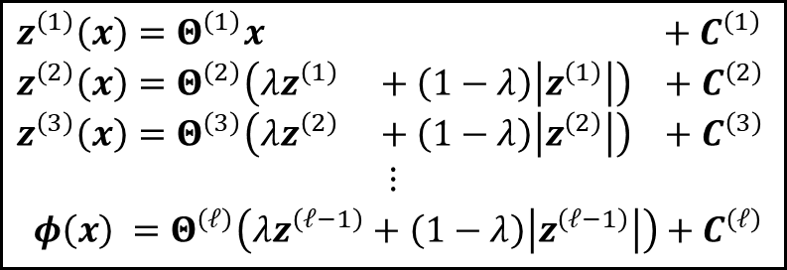
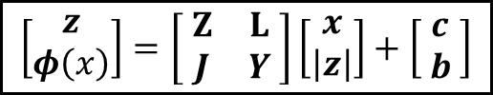
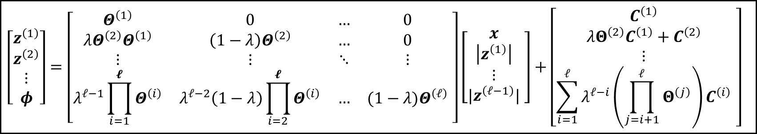
Piecewise affine mapping of neural ODE
Partition into abs-normal form
Construct coefficients for LCP problem
Solve LCP using complementary solver
ReLU NN
$z^{\left(1\right)}\left(x\right)=Θ^{\left(1\right)}x$ $+ C^{\left(1\right)}$
$$z^{\left(2\right)}\left(x\right)=Θ^{\left(2\right)}\left(λz^{\left(1\right)} +\left(1−λ\right)\left|z^{\left(1\right)}\right|\right) +C^{\left(2\right)}$$
$$z^{\left(3\right)}\left(x\right)=Θ^{\left(3\right)}\left(λz^{\left(2\right)} +\left(1−λ\right)\left|z^{\left(2\right)}\right|\right) +C^{\left(3\right)}$$
$$⋮$$
$$φ\left(x\right) =Θ^{\left(ℓ\right)}\left(λz^{\left(ℓ−1\right)}+\left(1−λ\right)\left|z^{\left(ℓ−1\right)}\right|\right)+C^{\left(ℓ\right)}$$
$$\left[\begin{aligned}z \\ φ\left(x\right)\end{aligned}\right]=\left[ \begin{matrix}Z & L \\ J & Y\end{matrix} \right]\left[\begin{aligned}x \\ \left|z\right|\end{aligned}\right]+\left[ \begin{aligned}c \\ b\end{aligned} \right]$$
Goal: Abs-normal form
Partition NN parameters into abs-normal form
Abs-normal matrix set-up
$$\left[\begin{aligned}z^{\left(1\right)} \\ z^{\left(2\right)} \\ ⋮ \\ φ\end{aligned}\right]=\left[\begin{matrix}Θ^{\left(1\right)} & 0 & … & 0 \\ λΘ^{\left(2\right)}Θ^{\left(1\right)} & \left(1−λ\right)Θ^{\left(2\right)} & … & 0 \\ ⋮ & ⋮ & ⋱ & ⋮ \\ λ^{𝓁−1}\prod_{i=1}^{𝓵}{Θ^{\left(i\right)}} & λ^{𝓁−2}\left(1−λ\right)\prod_{i=2}^{𝓵}{Θ^{\left(i\right)}} & … & (1−λ)Θ^{\left(𝓁\right)}\end{matrix} \right]\left[\begin{matrix}\begin{aligned}x \\ \left|z^{\left(1\right)}\right|\end{aligned} \\ ⋮ \\ {|z}^{\left(𝓁−1\right)}|\end{matrix} \right]+\left[\begin{matrix}C^{\left(1\right)} \\ λΘ^{\left(2\right)}C^{\left(1\right)}+C^{\left(2\right)} \\ ⋮ \\ \sum_{i=1}^{𝓁}{λ^{𝓁−i}\left(\prod_{j=i+1}^{𝓁}{Θ^{\left(j\right)}}\right)C^{\left(i\right)}}\end{matrix} \right]$$
Notes:
\begin{figure}[htbp]
\makeflowchart{mcmasterred}{darkgrey}{darkgrey}{darkgrey}
\vspace{-2.5mm}
\noindent
\hspace*{-0.027\linewidth}{\color{darkgrey}\rule{1.061\linewidth}{1pt}}
\end{figure}

Slide 14
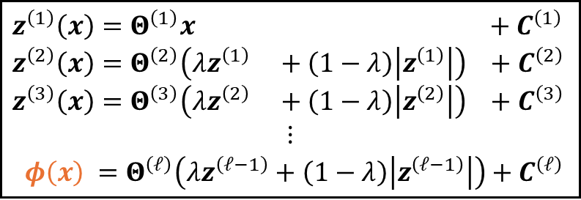

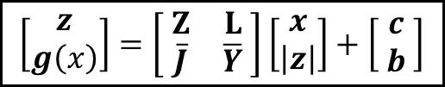
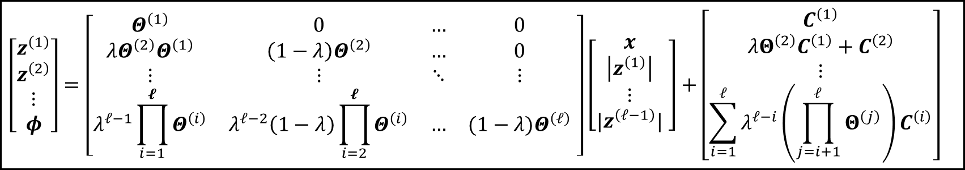
Piecewise affine mapping of neural ODE
Partition into abs-normal form
Construct coefficients for LCP problem
Solve LCP using complementary solver
ReLU NN
$z^{\left(1\right)}\left(x\right)=Θ^{\left(1\right)}x$ $+ C^{\left(1\right)}$
$$z^{\left(2\right)}\left(x\right)=Θ^{\left(2\right)}\left(λz^{\left(1\right)} +\left(1−λ\right)\left|z^{\left(1\right)}\right|\right) +C^{\left(2\right)}$$
$$z^{\left(3\right)}\left(x\right)=Θ^{\left(3\right)}\left(λz^{\left(2\right)} +\left(1−λ\right)\left|z^{\left(2\right)}\right|\right) +C^{\left(3\right)}$$
$$⋮$$
$$φ\left(x\right) =Θ^{\left(ℓ\right)}\left(λz^{\left(ℓ−1\right)}+\left(1−λ\right)\left|z^{\left(ℓ−1\right)}\right|\right)+C^{\left(ℓ\right)}$$
$$\left[\begin{aligned}z \\ g\left(x\right)\end{aligned}\right]=\left[ \begin{matrix}Z & L \\ \overline{J} & \overline{Y}\end{matrix} \right]\left[\begin{aligned}x \\ \left|z\right|\end{aligned}\right]+\left[ \begin{aligned}c \\ b\end{aligned} \right]$$
Goal: Abs-normal form
Transformation of NN: Solve Equation for x
Partition NN parameters into abs-normal form
$$g\left(x\right) =Px+Qφ\left(x\right)+r$$
Abs-normal matrix set-up
$$\left[\begin{aligned}z^{\left(1\right)} \\ z^{\left(2\right)} \\ ⋮ \\ φ\end{aligned}\right]=\left[\begin{matrix}Θ^{\left(1\right)} & 0 & … & 0 \\ λΘ^{\left(2\right)}Θ^{\left(1\right)} & \left(1−λ\right)Θ^{\left(2\right)} & … & 0 \\ ⋮ & ⋮ & ⋱ & ⋮ \\ λ^{𝓁−1}\prod_{i=1}^{𝓵}{Θ^{\left(i\right)}} & λ^{𝓁−2}\left(1−λ\right)\prod_{i=2}^{𝓵}{Θ^{\left(i\right)}} & … & (1−λ)Θ^{\left(𝓁\right)}\end{matrix} \right]\left[\begin{matrix}\begin{aligned}x \\ \left|z^{\left(1\right)}\right|\end{aligned} \\ ⋮ \\ {|z}^{\left(𝓁−1\right)}|\end{matrix} \right]+\left[\begin{matrix}C^{\left(1\right)} \\ λΘ^{\left(2\right)}C^{\left(1\right)}+C^{\left(2\right)} \\ ⋮ \\ \sum_{i=1}^{𝓁}{λ^{𝓁−i}\left(\prod_{j=i+1}^{𝓁}{Θ^{\left(j\right)}}\right)C^{\left(i\right)}}\end{matrix}\right]$$
$\overline{J}=P+QJ \overline{Y}=QY$ $\overline{b}=r+Qb$
Adjust coefficients
Notes:
\begin{figure}[htbp]
\makeflowchart{mcmasterred}{darkgrey}{darkgrey}{darkgrey}
\vspace{-2.5mm}
\noindent
\hspace*{-0.027\linewidth}{\color{darkgrey}\rule{1.061\linewidth}{1pt}}
\end{figure}

Slide 15
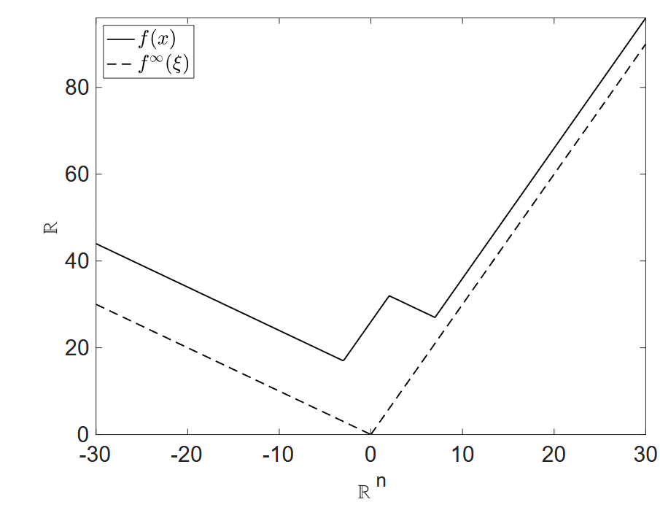
y
x

Slide 16
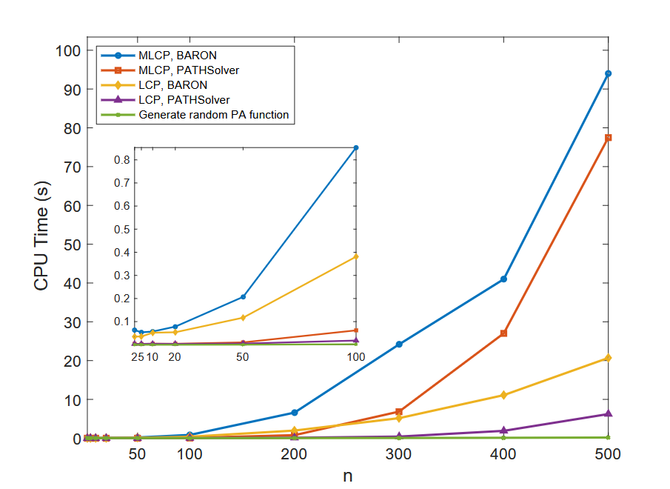
Problem Size

Slide 17
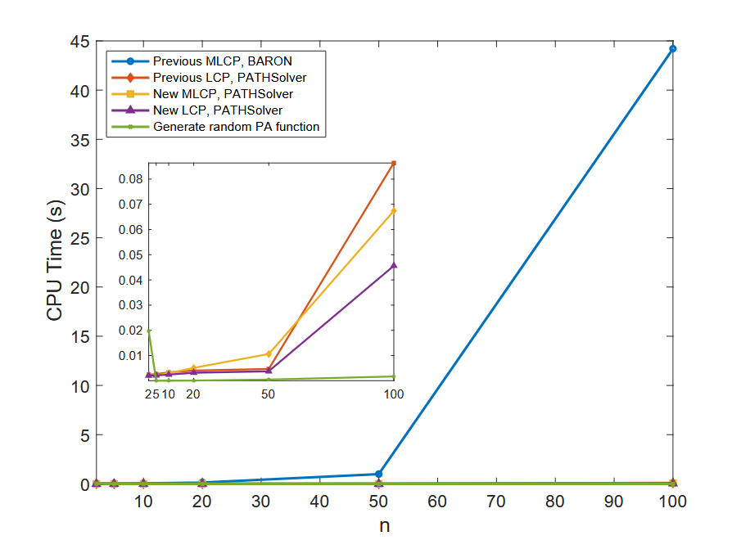
Problem Size

Slide 18
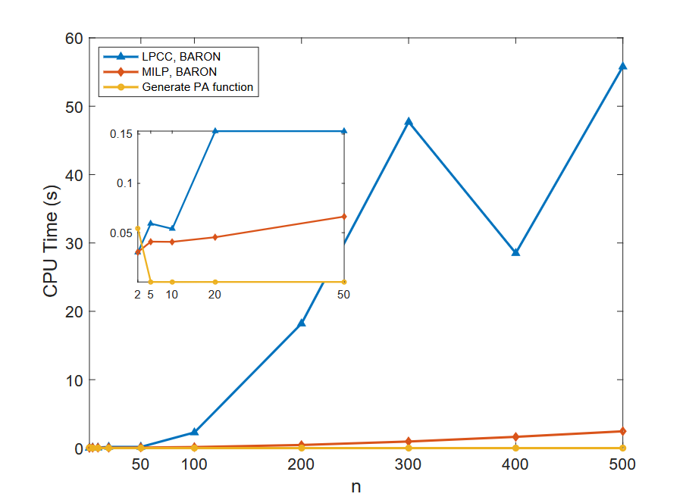
Problem Size

